Slide 1
Garden Sheds

Slide 2
Agenda
Overview
Next level – good example to teach construction skills
Includes layout skills – transferable to other projects
Orientation to plans
Tools
Learning Outcomes
Cutting Lists
Bills of Materials
Construction Tips
Customize the Shed
Resources

Slide 3
Quiz Key
What is a sinker? A vinyl cement coated nail.
A roof slope is described as 4/12 meaning it rises 4” for every 12” of run .
The actual size of 2” x 4” surfaced lumber is: 1 ½” x 3 ½”.
A rafter supports the roof of the building.
A 2”x6”x12’ board contains 12 board feet.
Lumber used for framing commonly comes from fir, hemlock, or spruce trees.
The horizontal framing member at the top of a wall is called a plate.
Galvanized coating on nails is used to prevent rusting.
The material used under composition shingles is called roofing felt or tar paper.
OSB or plywood is commonly used as sheeting to cover walls or the roof framing.

Slide 4
Activity #1 - What Tools Are Required? Make your list – required/optional
Required
Optional
Steel Tape
Framing Square
Circular Saw
Hammer
Utility Knife
Screwdriver
Power Miter Saw
Hammer Tacker
Cat’s Paw
Power screw driver
Level
And ….

Slide 5
Building Process
Plans & drawings
Cutting Lists
And
Bill of Materials
Knowledge
Of Materials
Layout
Plan reading
Measuring
Construction
Tool selection & use
Construction Methods

Slide 6
Activity #2 Student Learning Outcomes
Review the plan. What SLOs will students learn by completing the project?
10 min & share

Slide 7
Student Learning Outcomes
Students will:
Read and interpret plans common to wood framed buildings
Identify common parts of a building by name (e.g.; header, cripple)
Create a cut list using the plans
Create a bill of materials and estimate the cost of the building
Identify common fasteners and materials used in wood frame construction
Identify common tools used in wood frame construction
Cut lumber based on a cut list
Layout floor joists
Build a framed floor with joists and sheeting
Square a framed floor or wall section

Slide 8
Student Learning Outcomes
Layout wall plates
Assemble a wall with window and door openings
Cut and apply siding to a wall
Install windows
Determine the roof angle and layout with a square
Cut a rafter
Layout rafter locations
Frame a roof
Cut and apply roof sheeting
Install a roofing system such as composition roofing of steel.
Cut and install trim

Slide 9
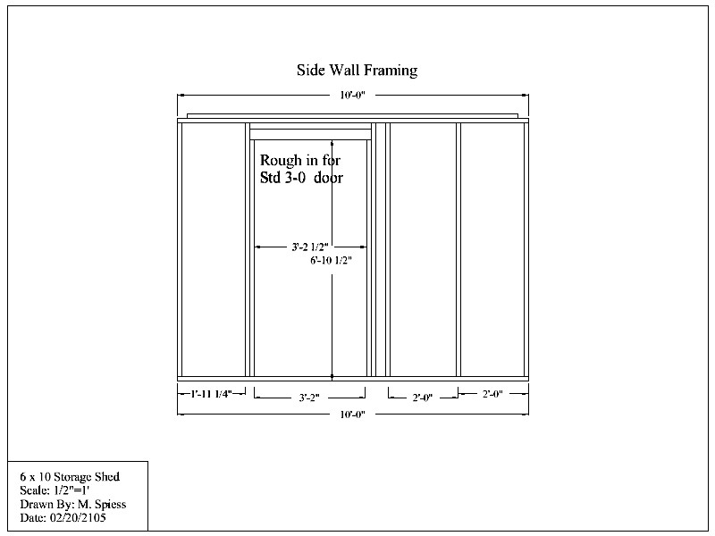

Slide 10
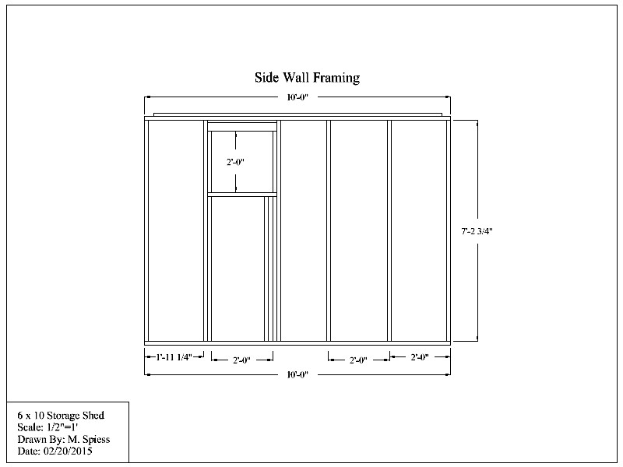
Plate
Header
Cripple
Stud
Trimmer

Slide 11
Activity #2
Create a cutting list for the walls using the plan
15 minutes
Common lumber sizes: 2x4x8’, 2x4x10’, 2x4x12’, 2x4x14’, 2x4x16’
No siding or window. Framing Only

Slide 12
Review cut list and process
Qty | Material | Dimension(s) | Notes
12 | #2 or BTR S4S Fir | 2x4x86 3/4" | Studs
4 | #2 or BTR S4S Fir | 2x4x120" | Plate
2 | #2 or BTR S4S Fir | 2x4x113" | Plate
1 | #2 or BTR S4S Fir | 4x4x27" | Window Header
1 | #2 or BTR S4S Fir | 4x4x41 1/2" | Door Header
1 | #2 or BTR S4S Fir | 2x4x27" | Sill
1 | #2 or BTR S4S Fir | 2x4x56 3/4" | Cripple
2 | #2 or BTR S4S Fir | 2x4x56 3/4" | Window Trimmer
2 | #2 or BTR S4S Fir | 2x4x81" | Door Trimmer
2 | #2 or BTR S4S Fir | 2x4x24" | Window Trimmer

Slide 13
Review the Process for Bill of Materials
Layout is important
Utilization
Standard sizes
Combine similar materials
Use published prices

Slide 14
Activity #3
Create a bill of materials based on the cut list.
20 minutes
(need handout form and pricelist)
(Make a key)

Slide 15
BOM Key
How close did you get?
Material | Units | Qty | Price | Total |  | Notes
2x4x8 | ea | 17 | 2.75 | 46.75 |  | Studs, door trimmers, cripple
2x4x10 | ea | 6 | 3.64 | 21.84 |  | Plates, window trimmer
4x4x8 | ea | 1 | 8.55 | 8.55 |  | Window trimmer, sill
 |  |  | TOTAL | 77.14 |  | Header

Slide 16
Uses/Materials
SAE – student or a small team can build and sell
Class project – Custom build
Team building activity
Lumber yards vs. Home Improvement Stores
Contractor's discounts

Slide 17
Team building activity
Pre-cut lumber
Bundle by use (floors, walls)
Mark layout

Slide 18
Tips
Use jigs when possible
Check square multiple times
Install siding flat
On some designs you can build roof on the ground. Think ahead on the attachment.
Look for ways to conserve materials.
Layout plates/joists in pairs. Check before assembly

Slide 19
Transportation
Build complete or in flat sections
Use “peelers” as rollers
Tiltbed trailers are useful

Slide 20
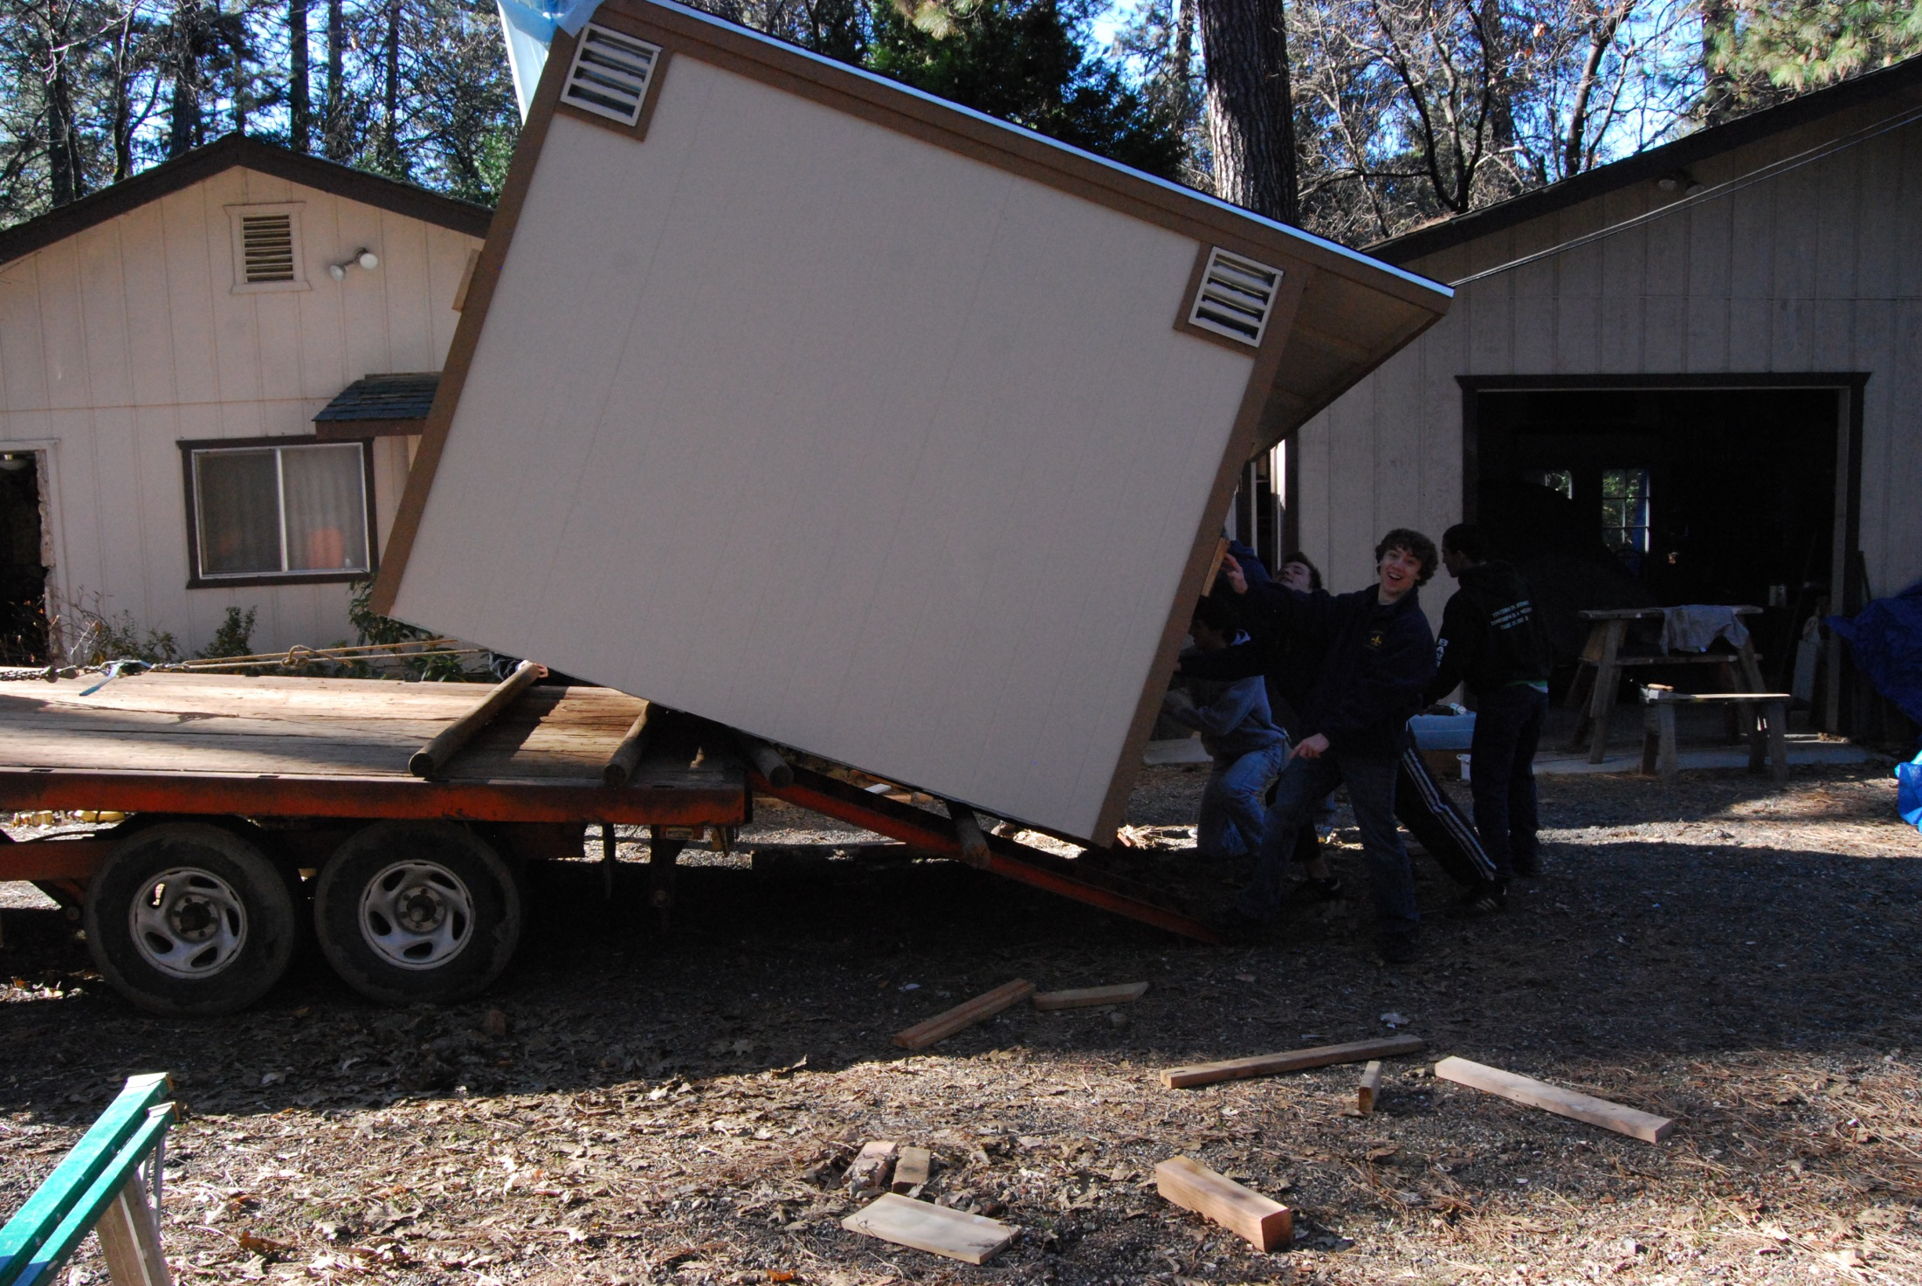
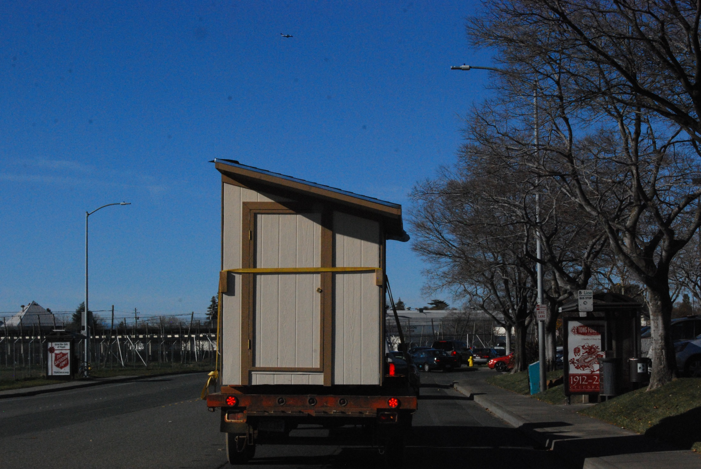
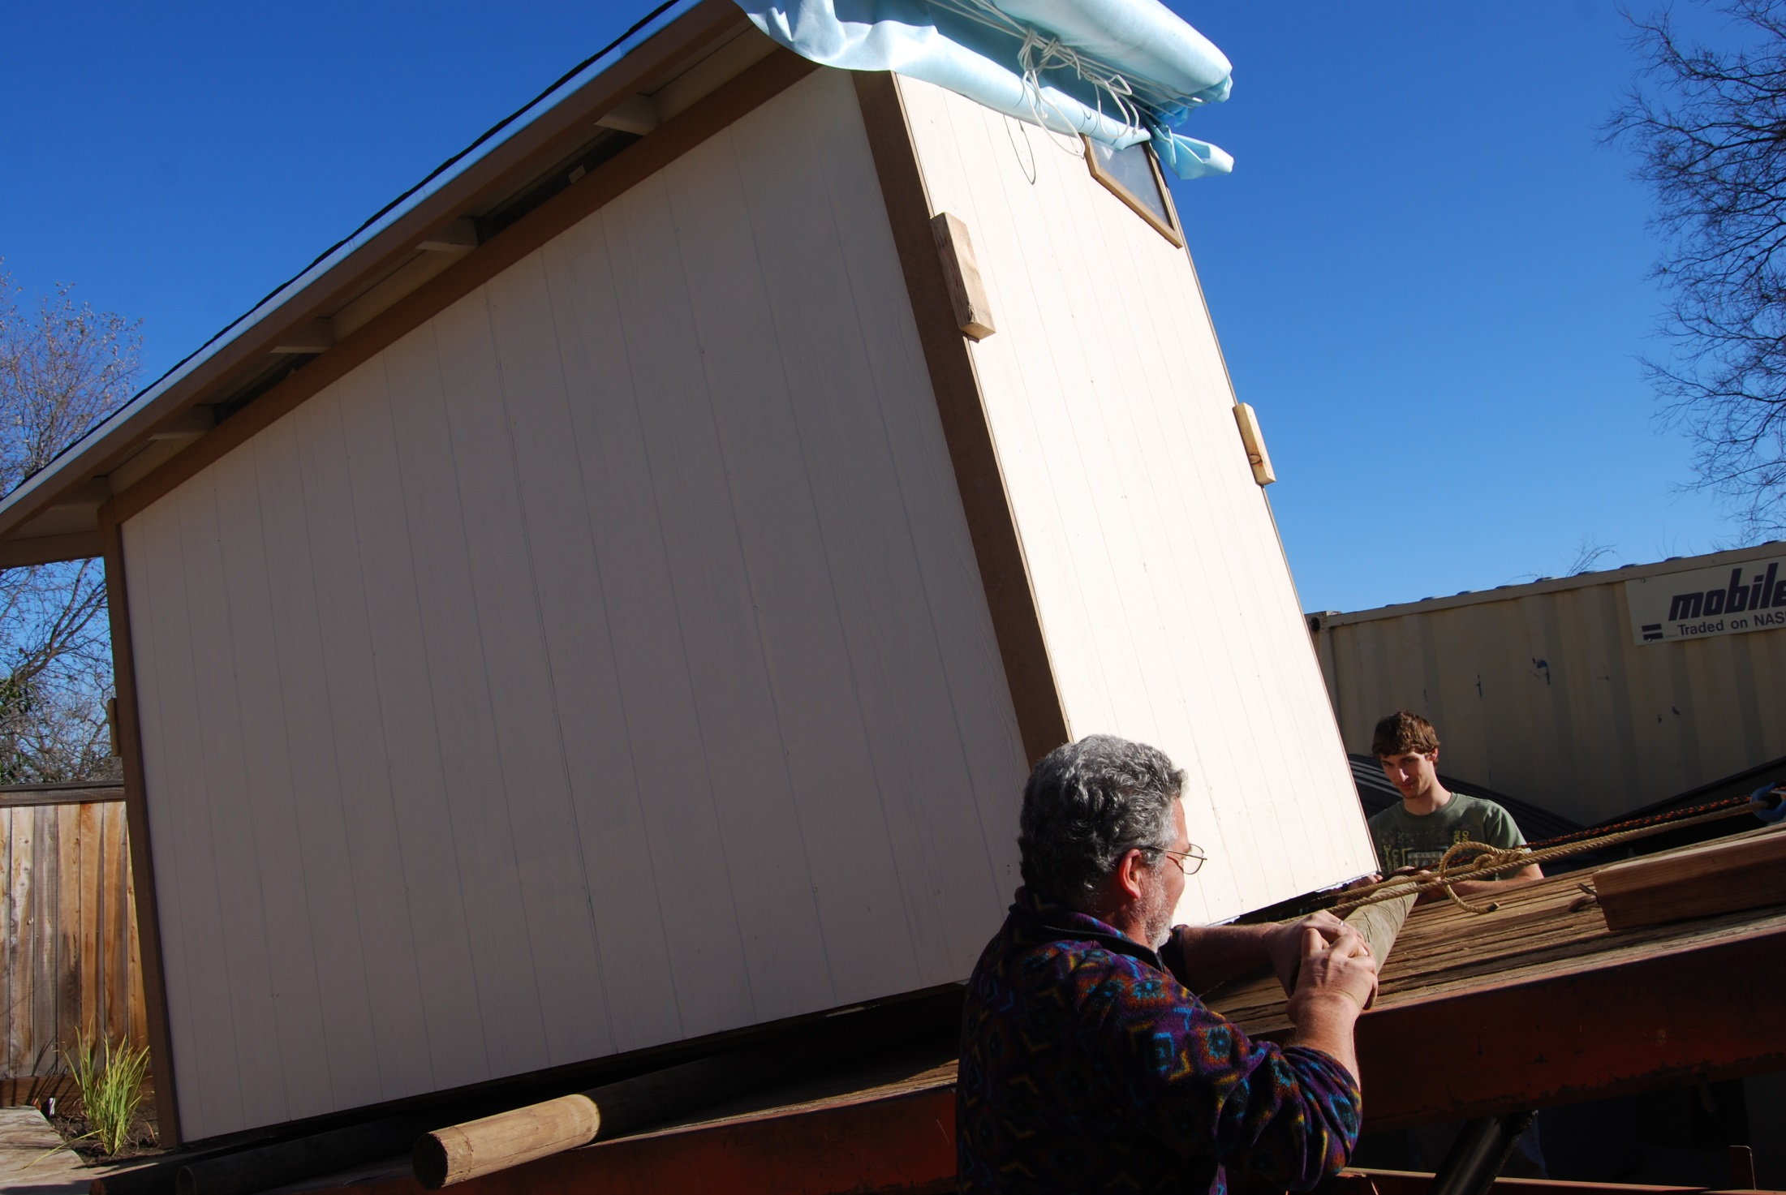
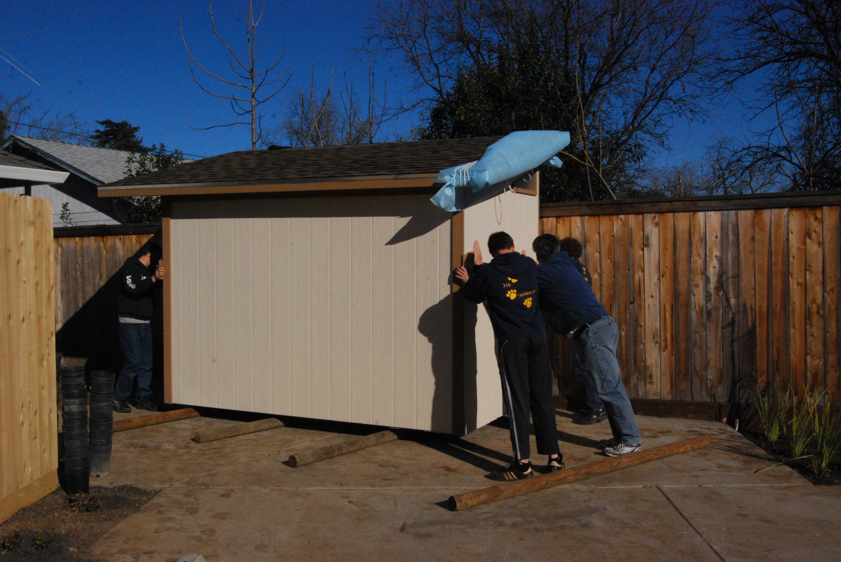
Transportation
Build complete or in flat sections

Slide 21
Customizations
Changing the design
Trim options
Roof – metal or comp
Shelves
Workbench
Wiring – note likely a code violation use caution

Slide 22
Resources
www.agedweb.org/sheds
Books
CAD
AutoCAD educational version
Free 2D programs

