Slide 1
6 x 10 Shed Construction Photos
California Agricultural Education

Slide 2
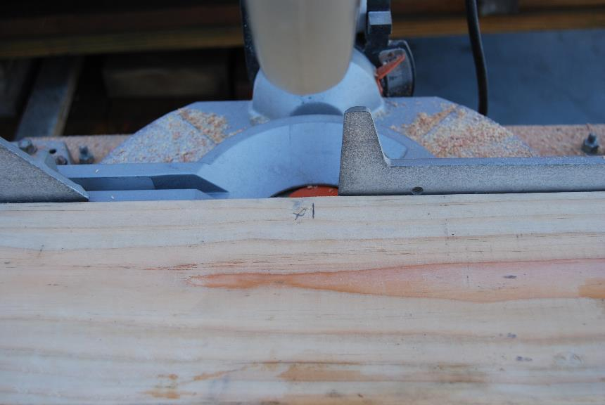
Mark cut line with an “X” on the kerf side of the line

Slide 3
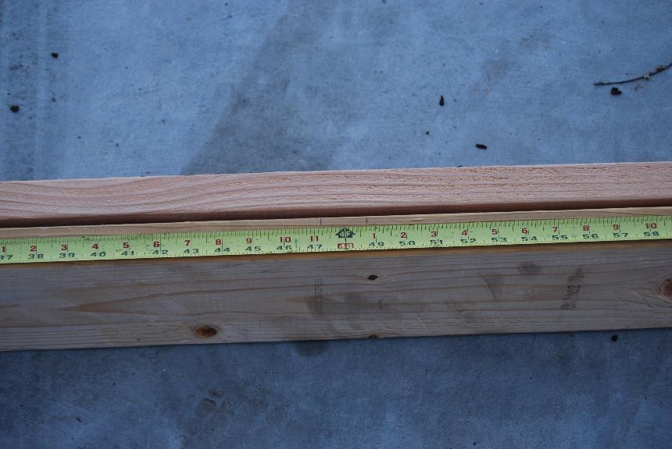
Pair plates and joists, mark stud and joist locations

Slide 4
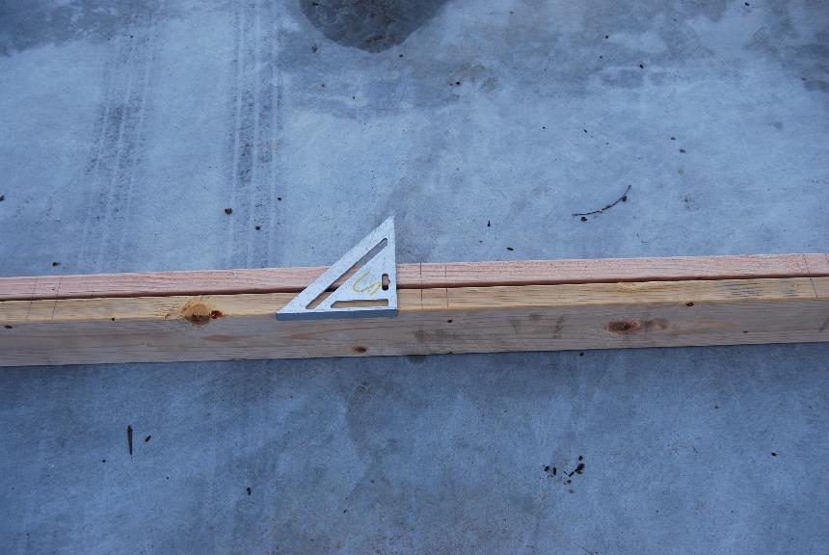
Use a square to mark both plates so they will match

Slide 5
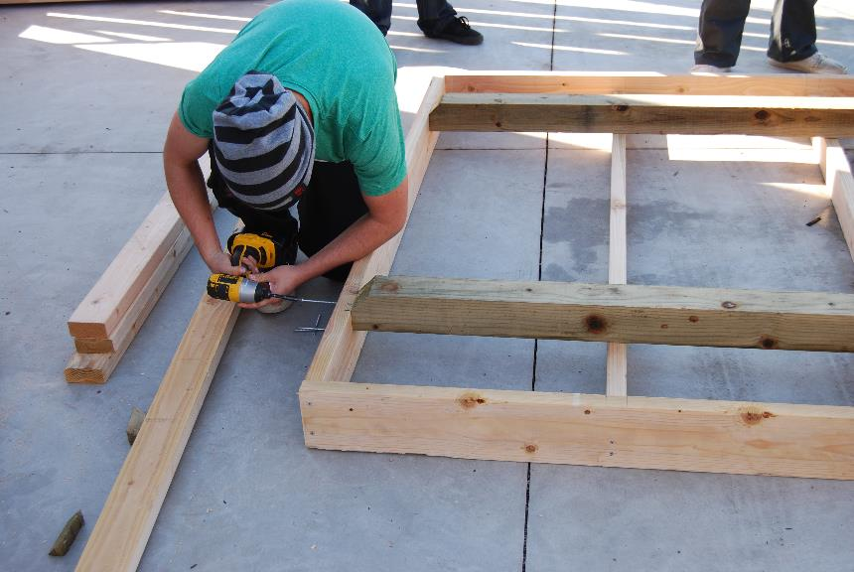
Installing floor sleepers with screws

Slide 6
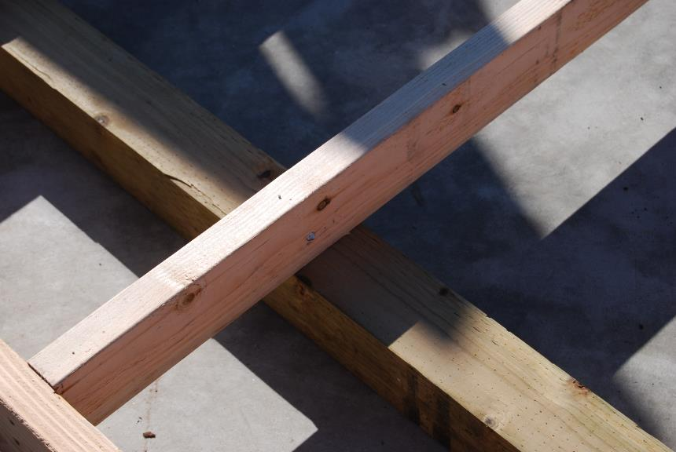
Floor joist installation

Slide 7
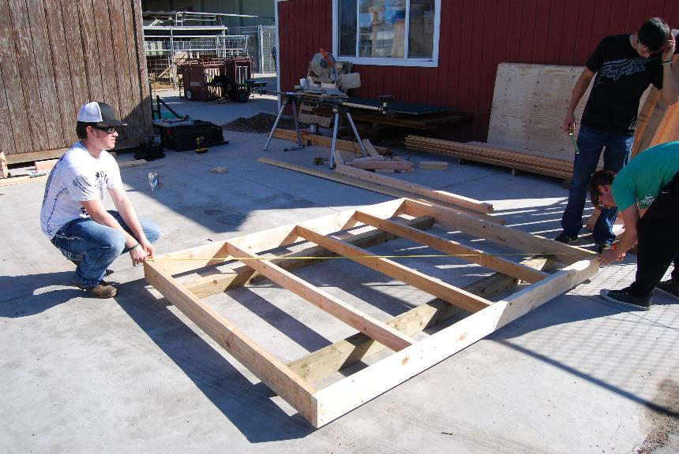
Check square by measuring diagonals

Slide 8
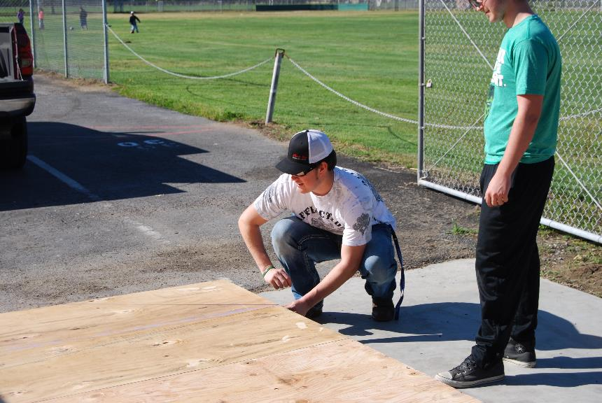
Tacking plywood sub floor

Slide 9
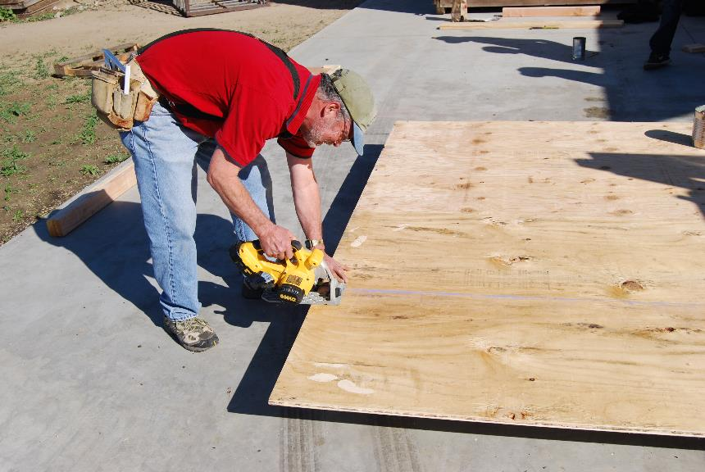
Trimming sub floor in place

Slide 10
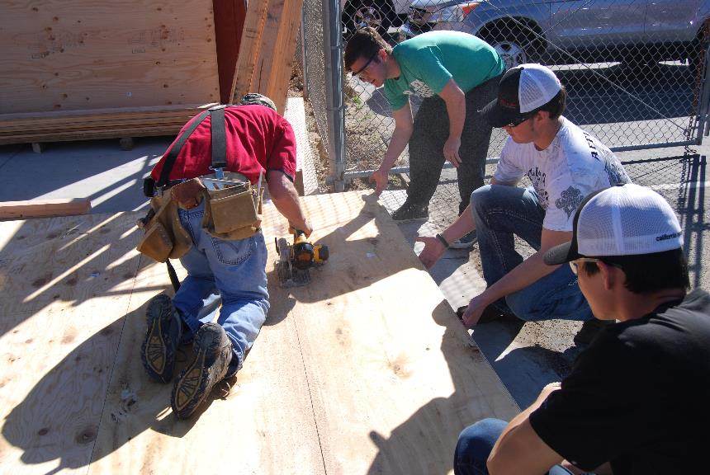
DSC_0513

Slide 11
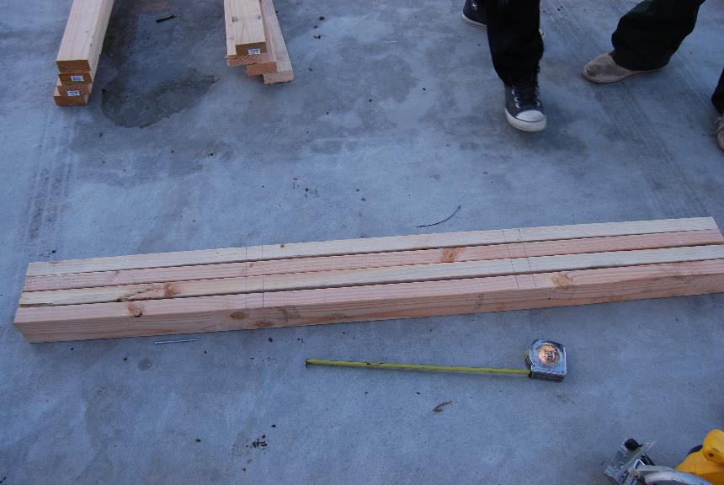
Plates marled before assembly

Slide 12
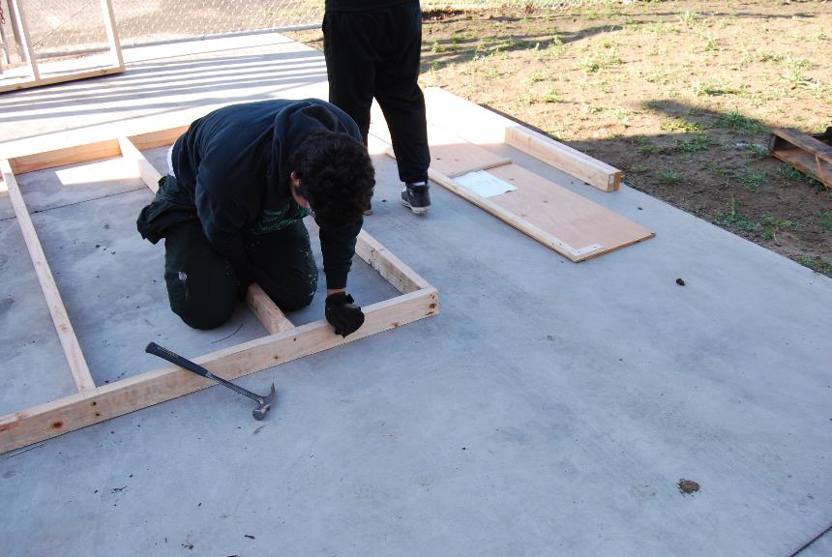
2x4 should be nailed with two nails per stud.

Slide 13
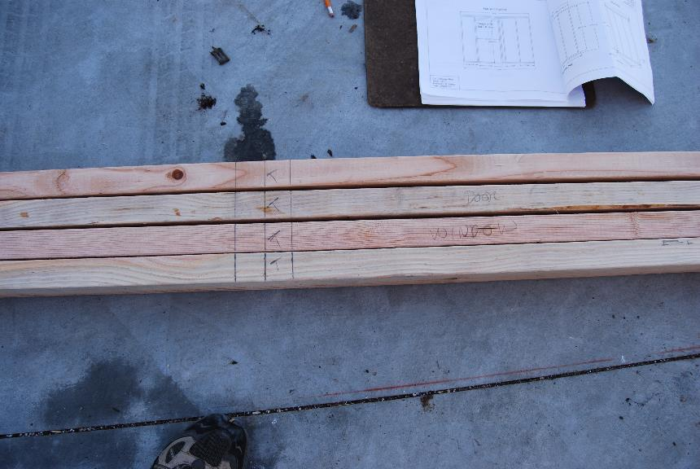
Mark trimmers and cripples

Slide 14
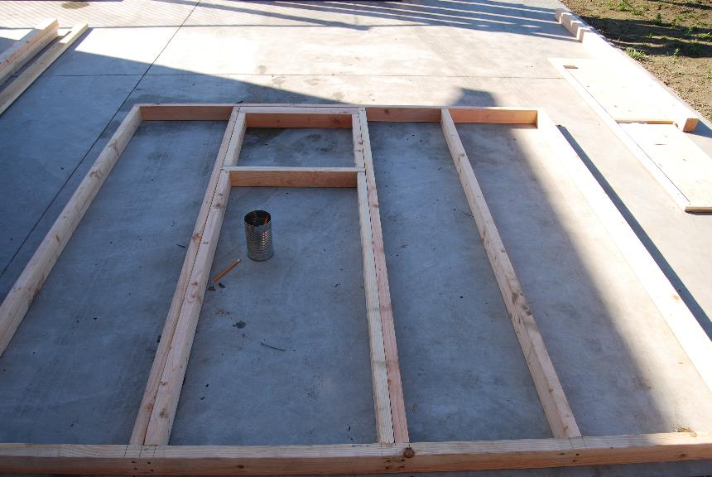
Window framing

Slide 15
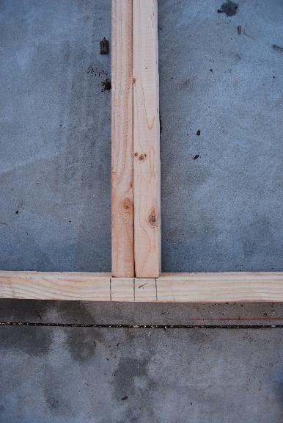
Trimmer installation

Slide 16
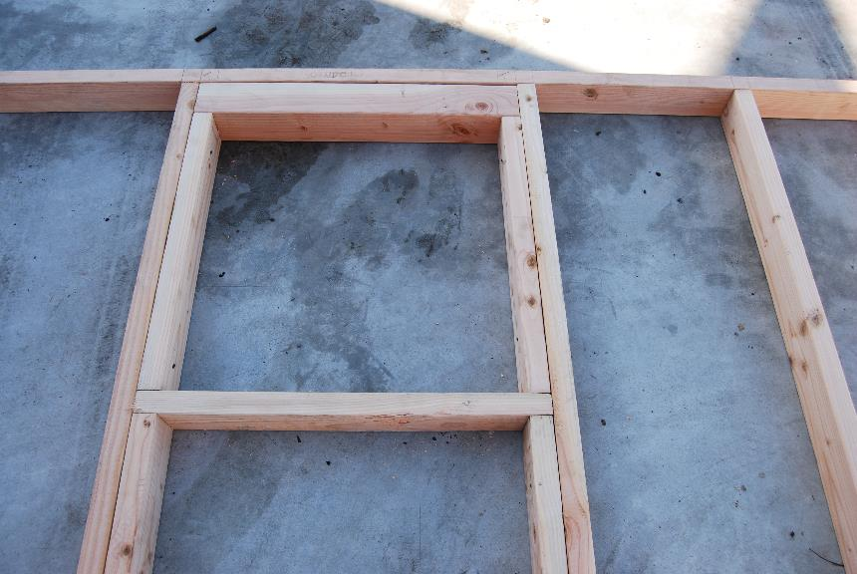
Trimmer and header installation

Slide 17
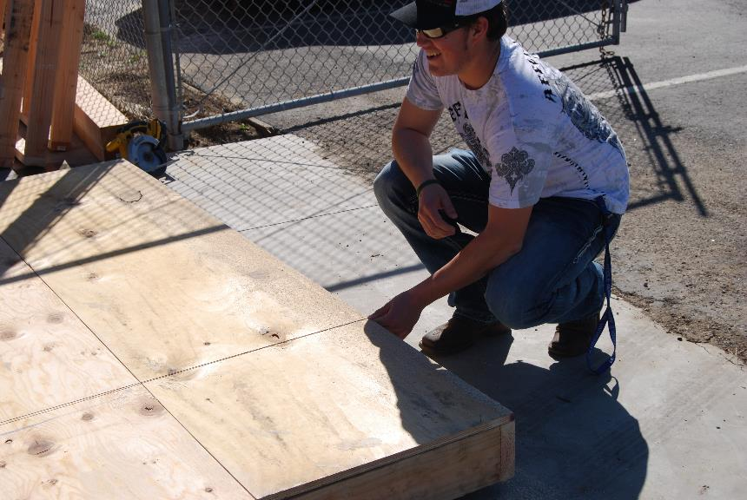
Marking joist nailing locations with a chalk line

Slide 18
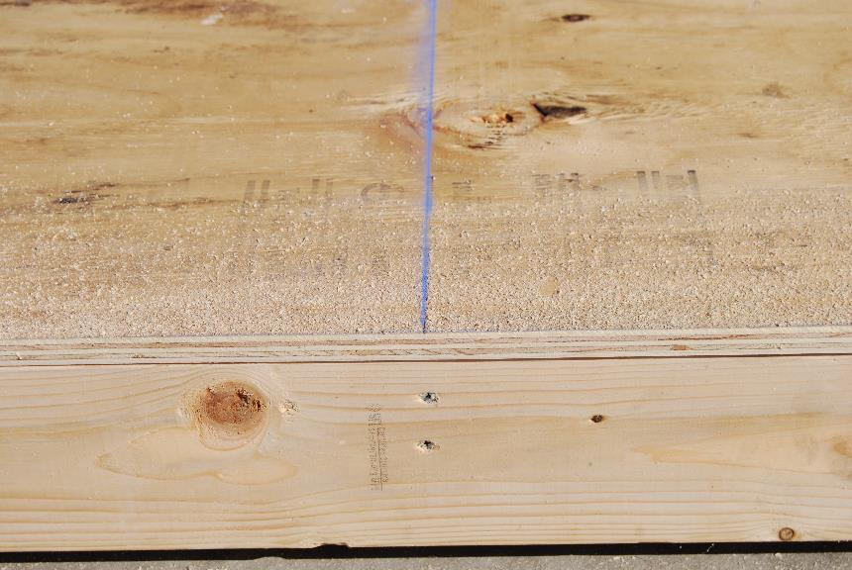
DSC_0518

Slide 19
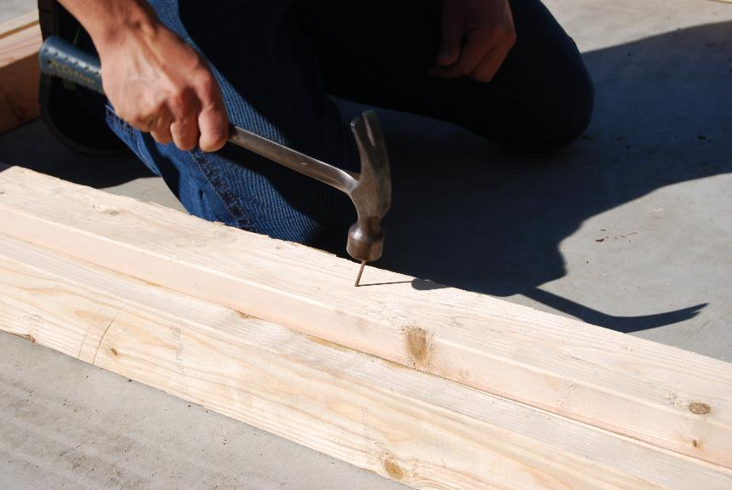
Nailing trimmers to studs at an angle so nails will not poke through

Slide 20
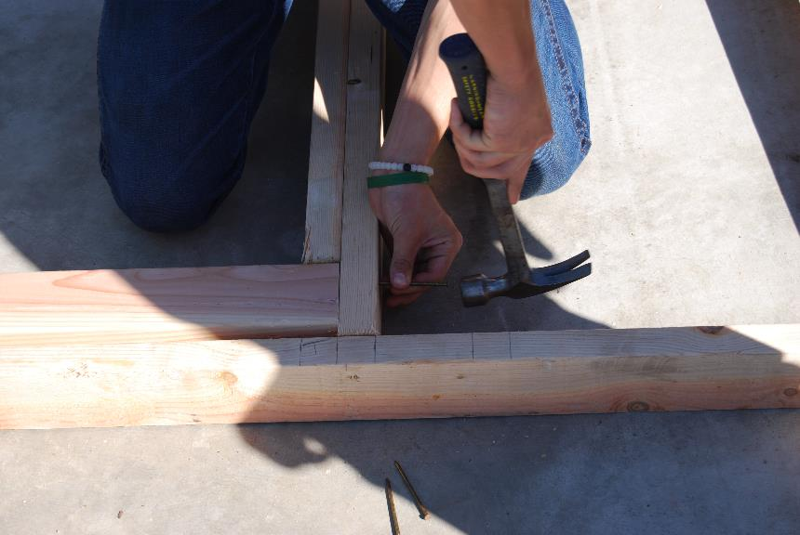
Nailing 4x4 header

Slide 21
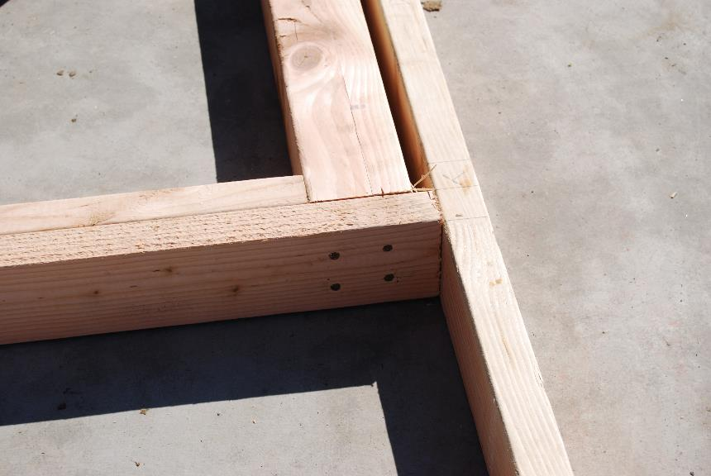
DSC_0527

Slide 22
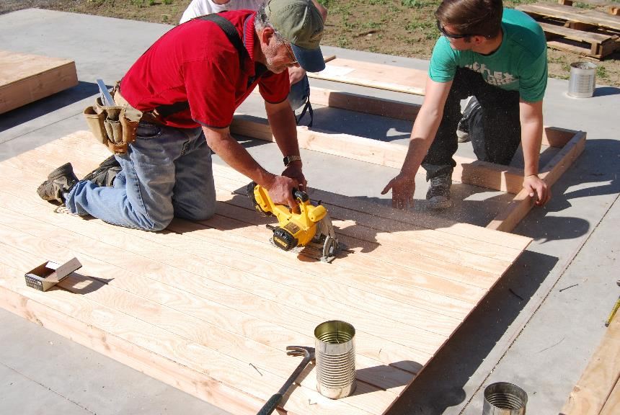
Cutting door opening (used to make door)

Slide 23
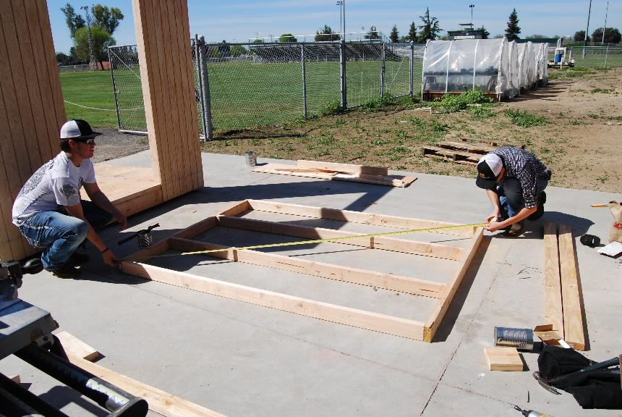
Checking wall framing for square

Slide 24
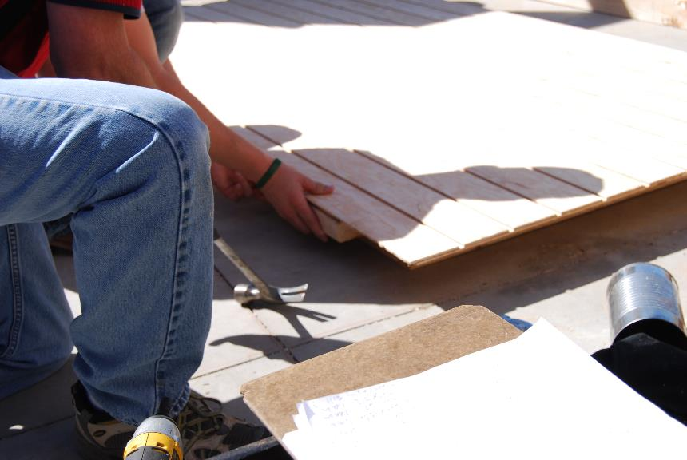
DSC_0531

Slide 25
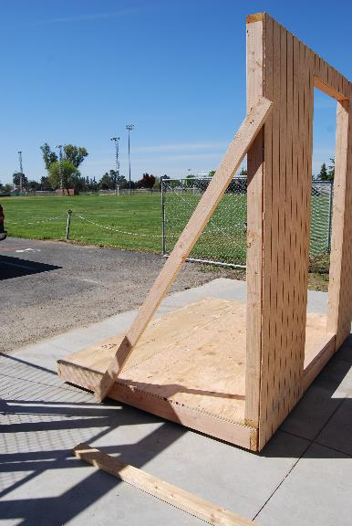
Setting a wall with a temporary brace

Slide 26
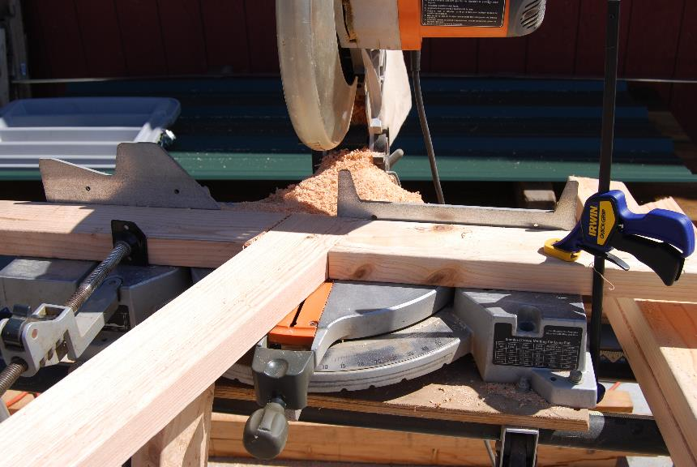
Using a jig on the miter saw to cut rafter tails

Slide 27
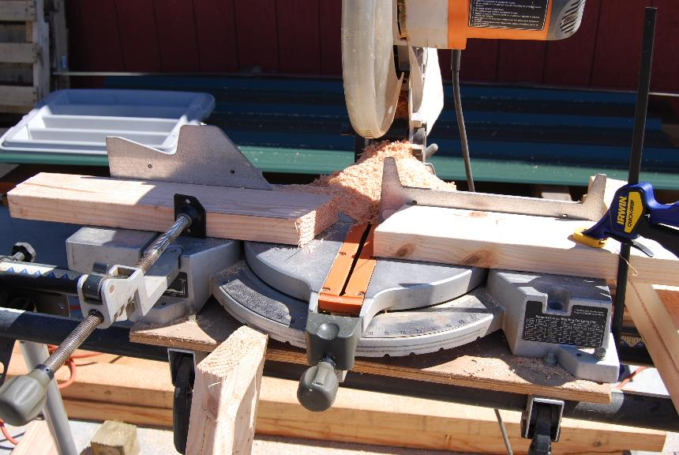
Jig

Slide 28
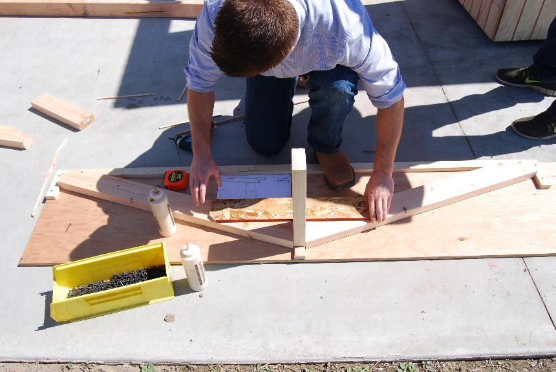
Using the jig to create truss

Slide 29
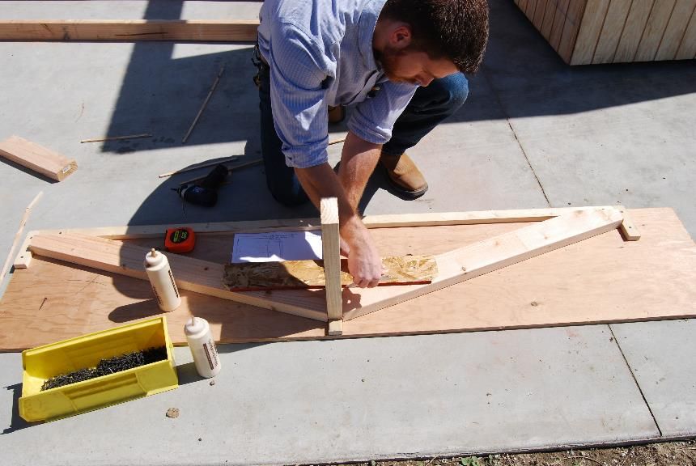
OSB collar tie is installed with glue and screws, mark glue location

Slide 30
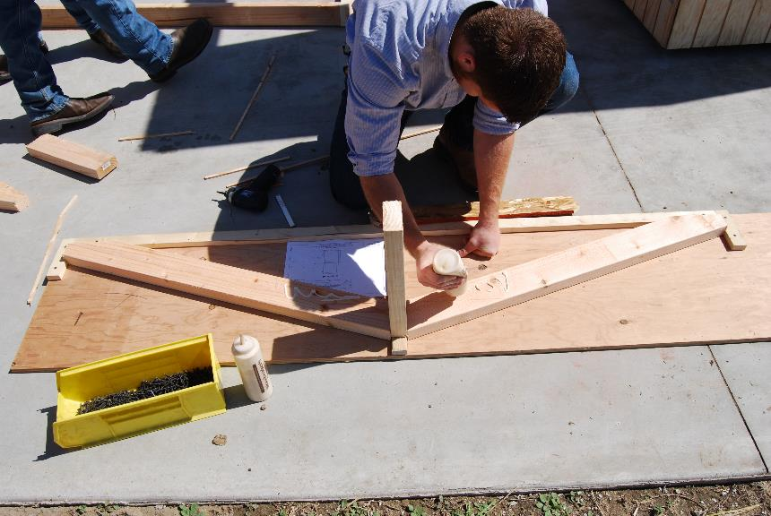
Add glue

Slide 31
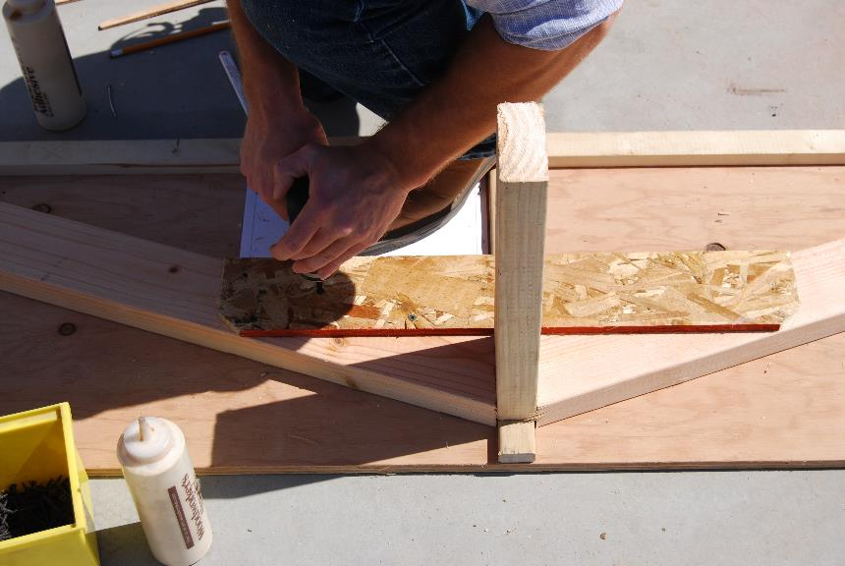
Screw in collar tie

Slide 32
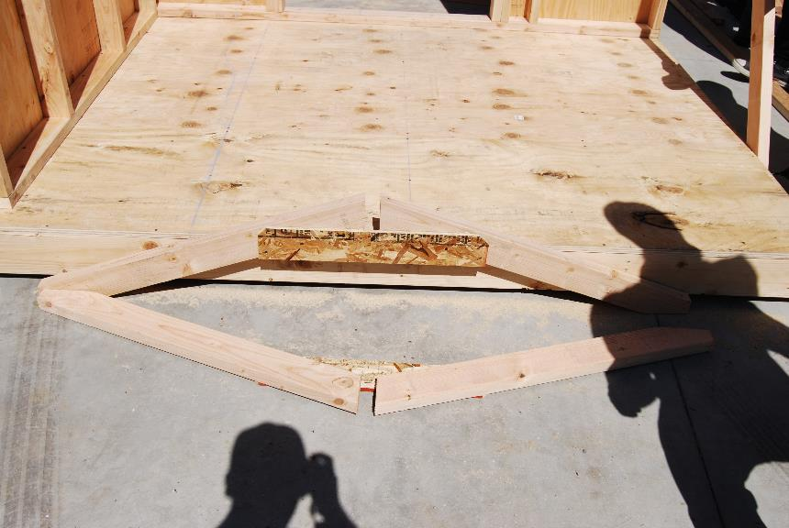
Finished truss

Slide 33
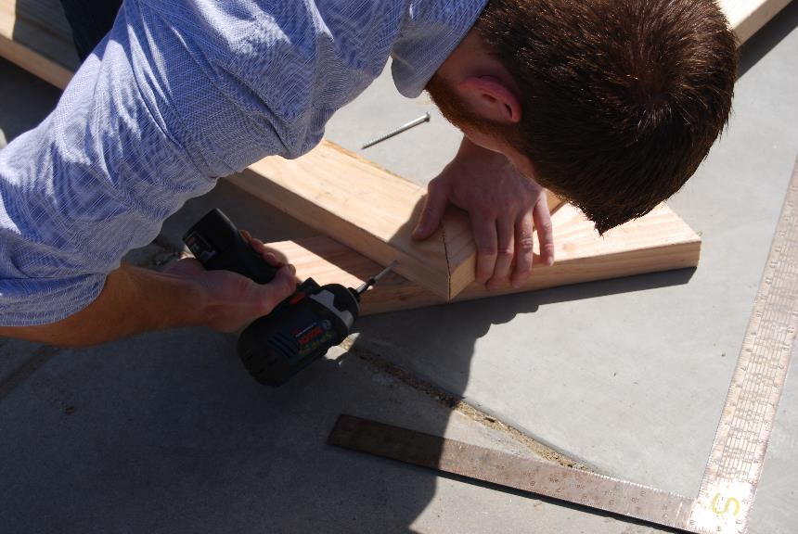
Door assembled with glue and screws

Slide 34
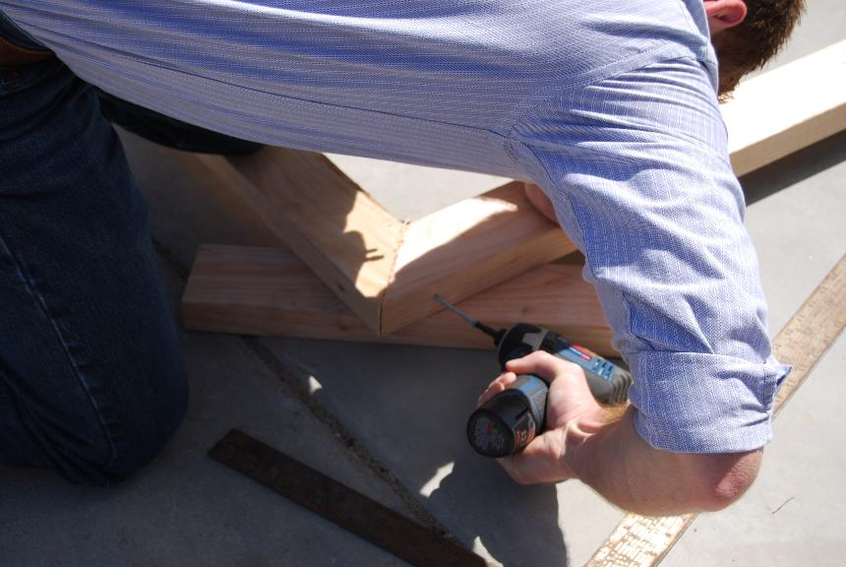
One screw from each side

Slide 35
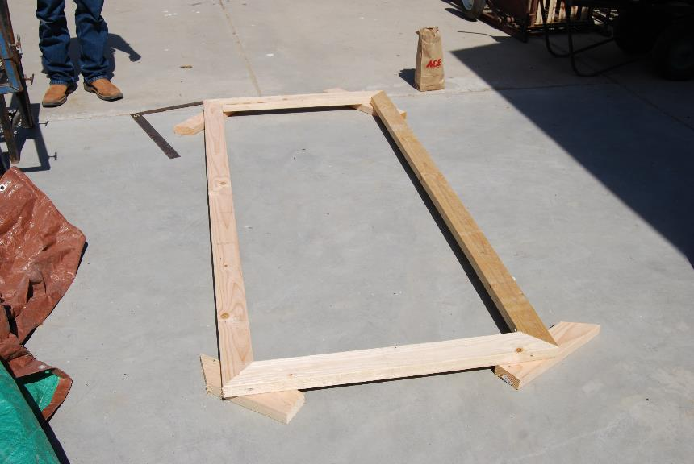
Finished exterior frame

Slide 36
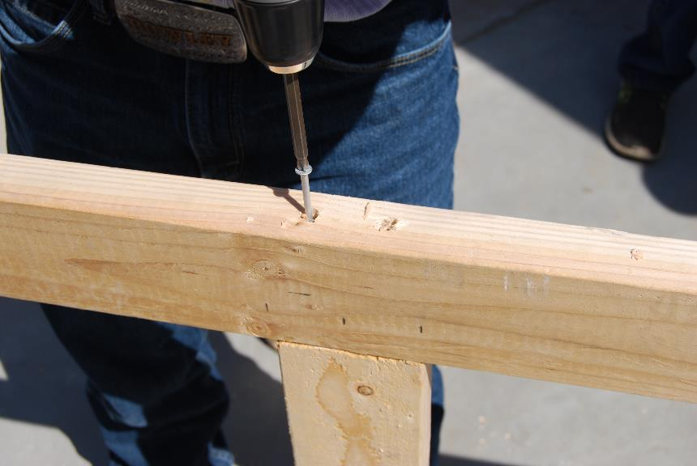
Installation of interior framing

Slide 37
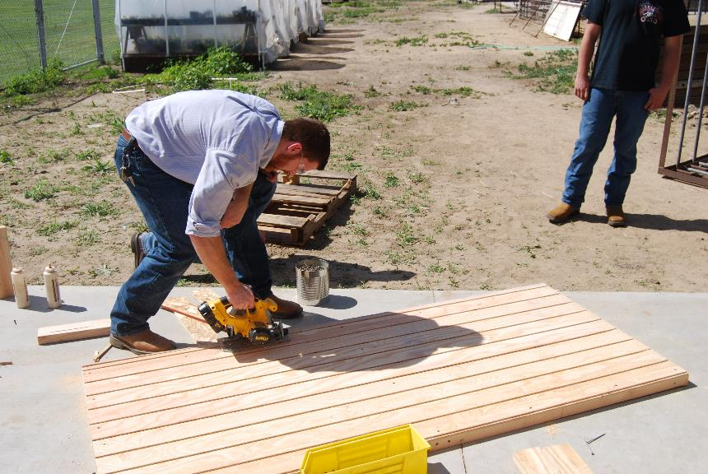
Trim plywood edge flush

Slide 38
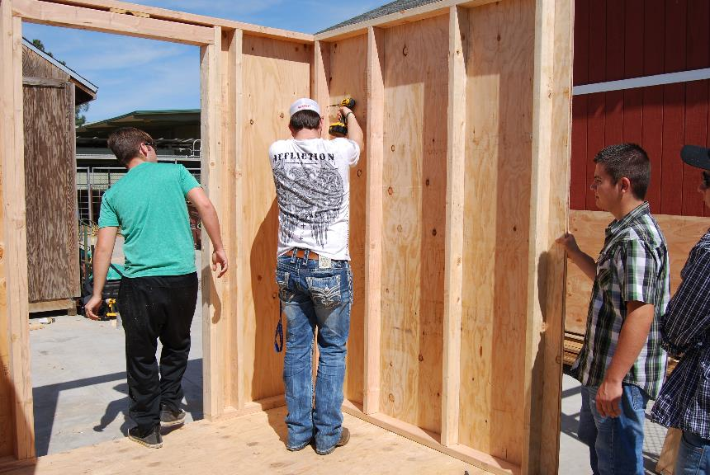
Install walls with screws or nails

Slide 39
Mark truss locations on top plate

Slide 40
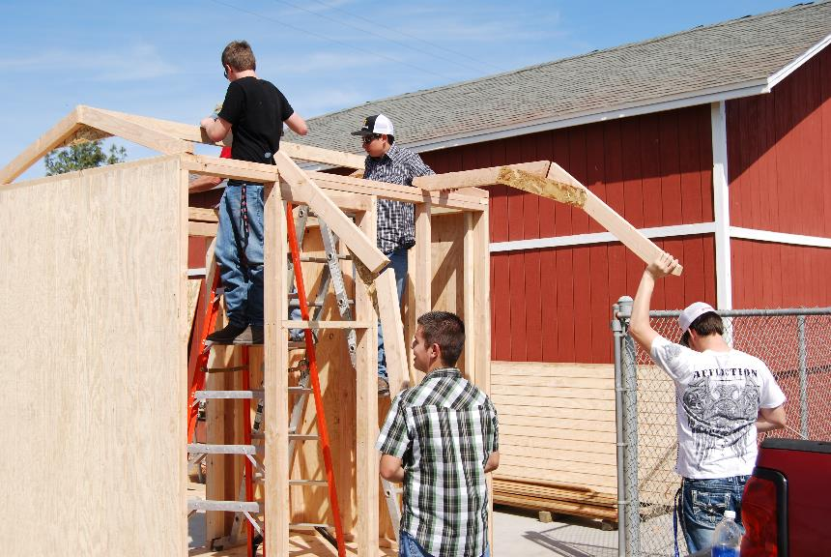
Install gable end trusses with ridge board, then add interior trusses

Slide 41
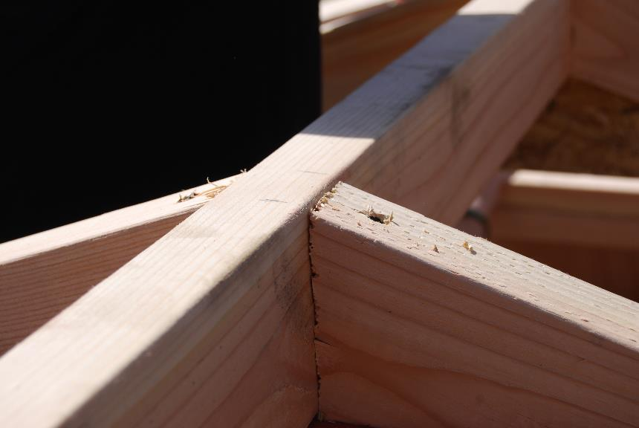
Connection to ridge board

Slide 42
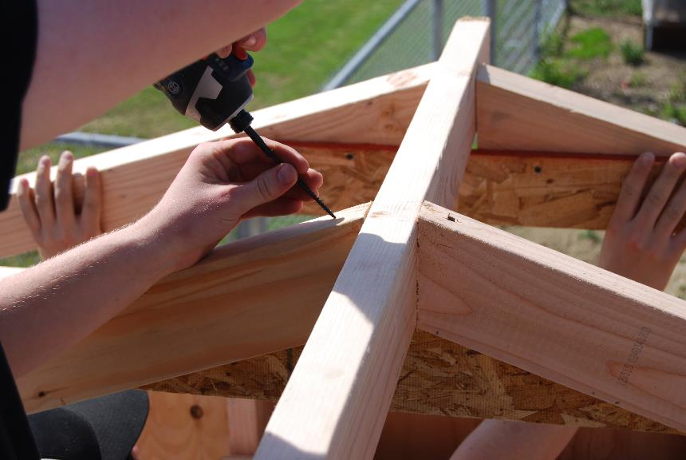
Use screws or nails

Slide 43
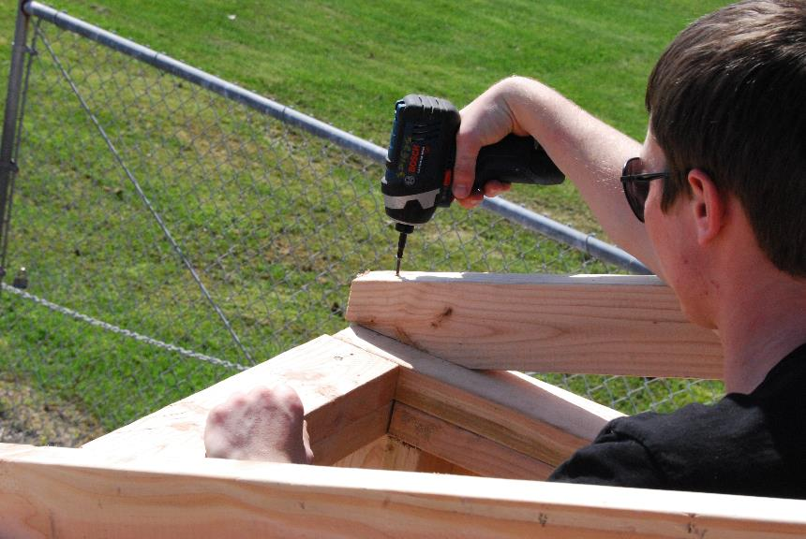
Install heel cut end with screws or nails

Slide 44
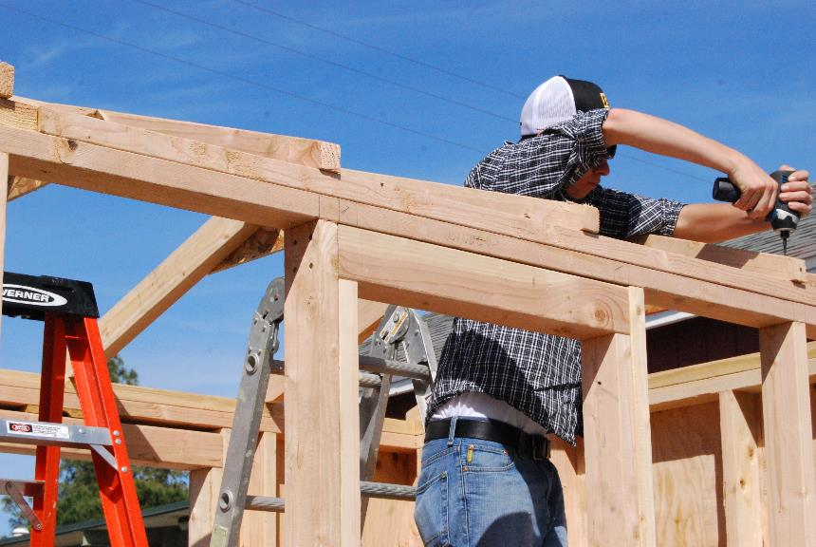
Installing trusses

Slide 45
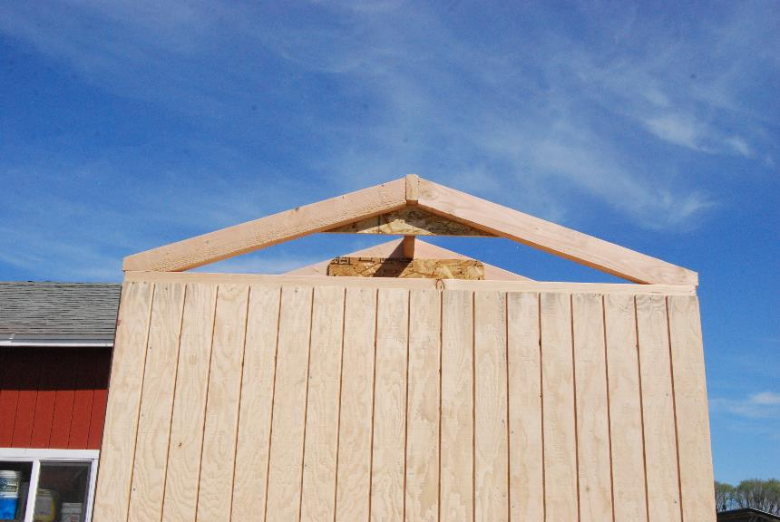
Installed trusses

Slide 46
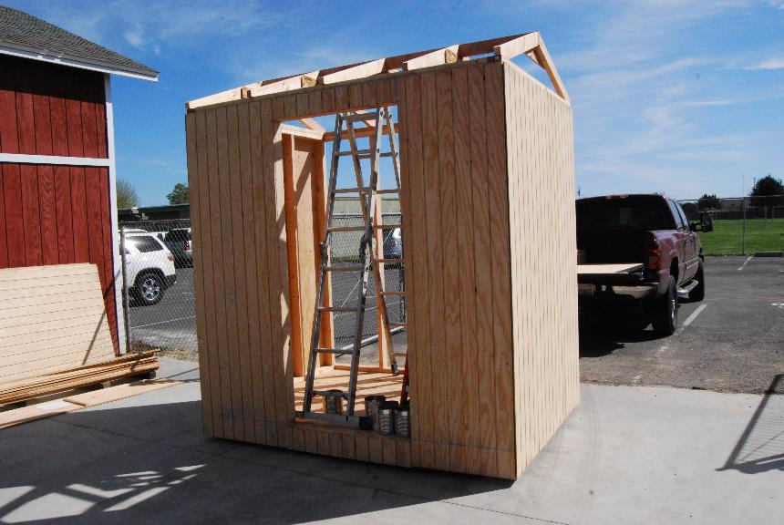
Walls and trusses installed

Slide 47
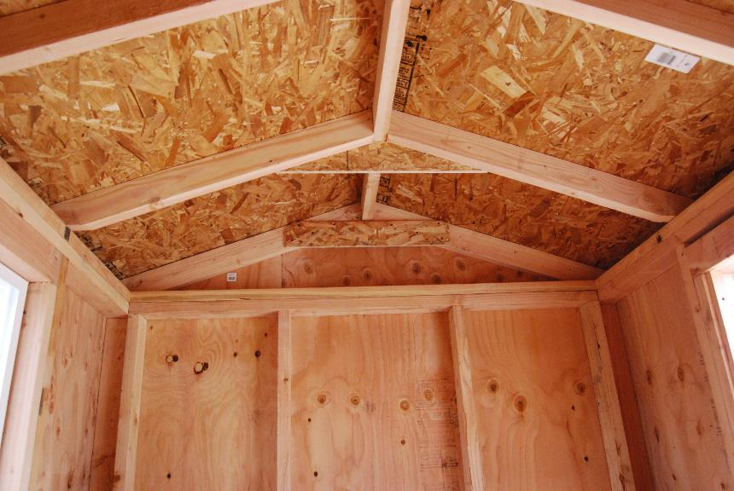
Trusses

Slide 48
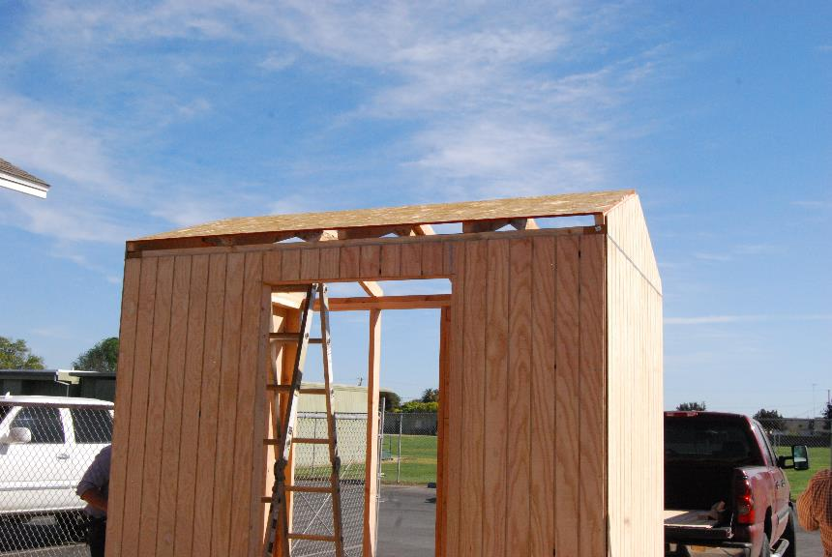
Osb installed on trusses, gable end siding installed

Slide 49
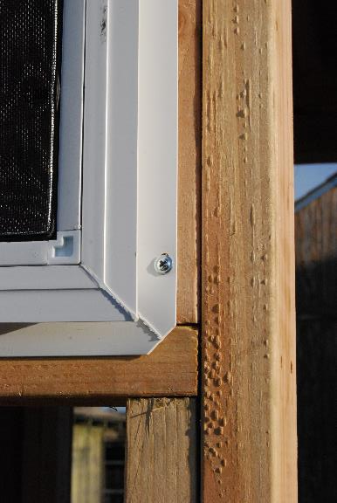
Window installation with screws

Slide 50
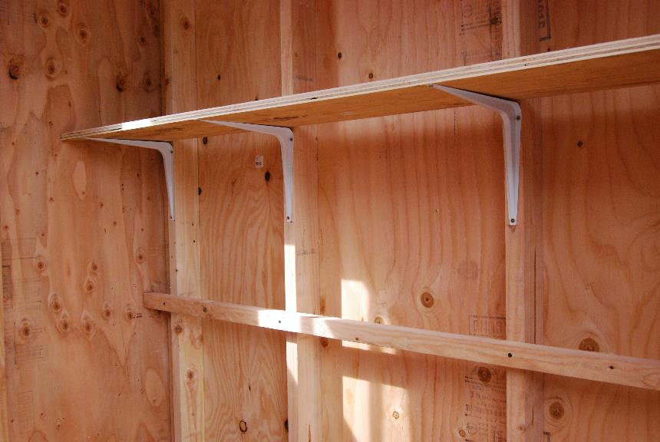
Two methods of installing shelves

Slide 51
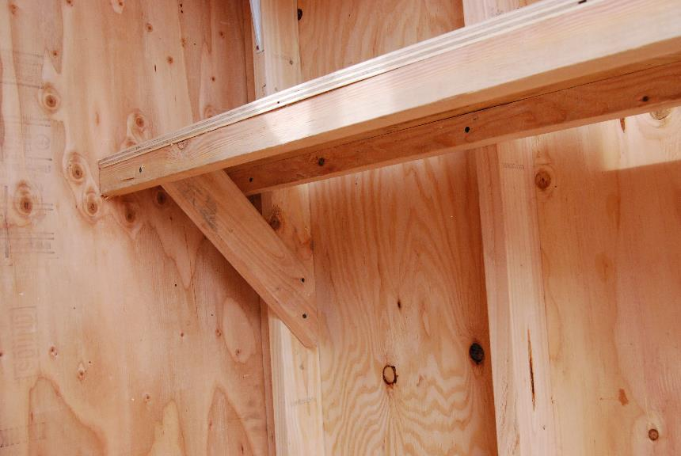
Wood shelf brace

Slide 52
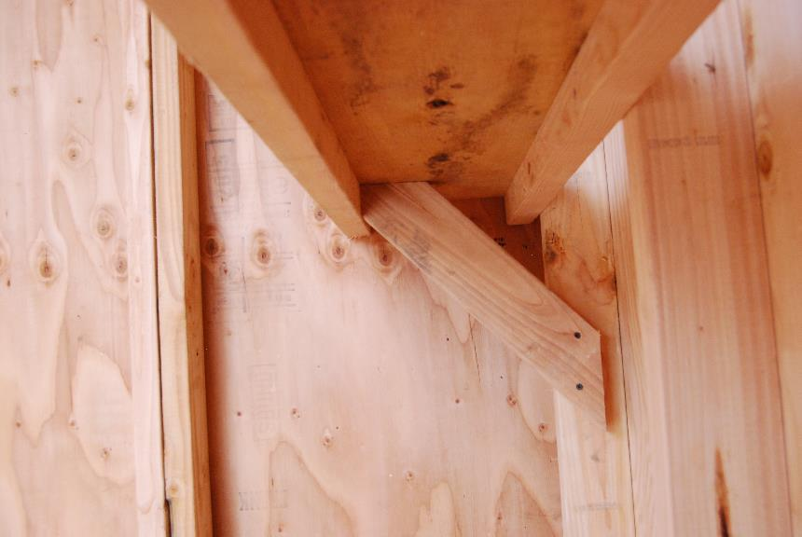
Shelf support

Slide 53
Installed shelves

Slide 54
Corner trim

Slide 55
DSC_0573

Slide 56
Window trim

Slide 57
Door Trim

Slide 58
Scrap trim for door stop

Slide 59
Finished door

Slide 60
Trimmed rear side

Slide 61
Trimmed front side

Slide 62
Trimmed end

Slide 63
Never leave tools on a ladder!

Slide 64
Minimal waste

