Slide 1
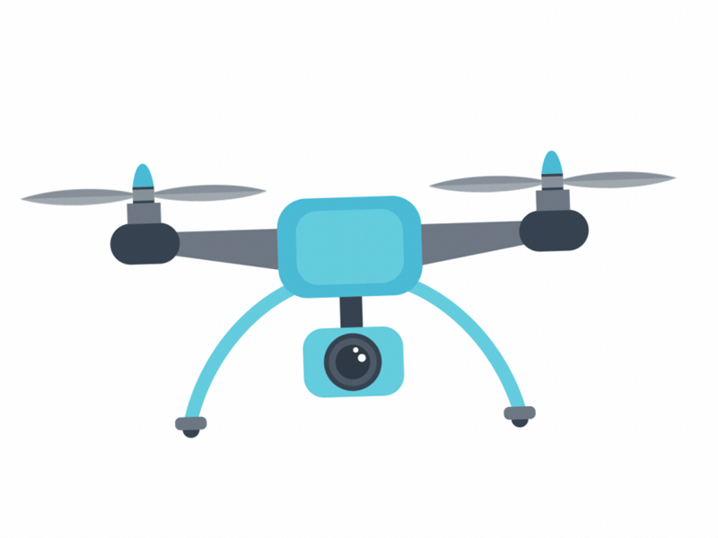

Slide 2
Adding Agricultural Drones to Your Curriculum
Mike Spiess

Slide 3
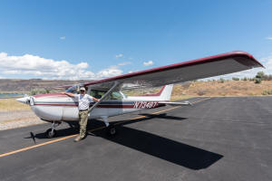
About Mike
Instrument Rated Private Pilot – 30 years (Own C-172)
Part 107 Drone Pilot – 6 years
Experience flying DJI Inspire, P3, P4, Mavic Air drones
Used RGB, Near-IR, and Thermal Sensors
Used Drone Deploy, Dronelink, WebODM, and ArcGIS

Slide 4
Why Drones?
Drones are being used for many industries
Ag
Solar
Building Maintenance
Law Enforcement
Fire Fighting
Utilities
Drones are cost effective for remote sensing
Gee Whiz factor!
A lot of science can be introduced

Slide 5
Mapping with Drones
Used in lieu of satellites or fixed wing aircraft
The most common use in Ag
Three basic operations:
Missing planning
Data capture
Stitching and analysis

Slide 6
Overview
Time | Topic
1:00 | Welcome / Overview
1:10 | Drone operator regulations (including education exception)
1:30 | Drone operation regulations
1:50 | Preparing for missions (Checklists for drone and flight area)
2:10 | B4Ufly and airhub Apps, LAANC
2:20 | Mission planning with Drone link
2:40 | Actual Mapping Flight (Irrigation Field). Practice pre-flight.
3:40 | Processing Images WebODM
4:00 | Curriculum Examples (activities)
4:30 | Wrap up, Review, Evaluation

Slide 7
Drone Regulations
Title 14 Code of Federal Regulations (CFR) Part 107
Regulates most drone operations
There is an exception (49 U.S.C. § 44809) that allows flying drones for recreational purposes (under certain conditions) without complying with Part 107. In order to fly under the statutory exception, you must comply with all portions of Section 44809, including flying your drone for recreational purposes..

Slide 8
Pilot Requirements

Slide 9
Pilot Requirements
Unmanned Aircraft Systems (UAS) remote pilot
Certificate Test (Part 61 + Part 107) $150 at testing center
Online test (for holders of Part 61 license)
Recreational Pilot
TRUST (about 30 minute training)
The Exception for Limited Operation of Unmanned Aircraft (USC 44809) is the law that describes how, when, and where you can fly drones for recreational purposes. Following these rules will keep people, your drone and our airspace safe.
Educational Uses

Slide 10
Part 107 UAS License
Online test for Part 61 pilots
Renew every 2 years
Many study guides available.
Covers:
Applicable regulations relating to small unmanned aircraft system rating privileges, limitations, and flight operation
Airspace classification and operating requirements, and flight restrictions affecting small unmanned aircraft operation
Aviation weather sources and effects of weather on small unmanned aircraft performance
Small unmanned aircraft loading and performance

Slide 11
Part 107 UAS License
Emergency procedures
Crew resource management
Radio communication procedures
Determining the performance of small unmanned aircraft
Physiological effects of drugs and alcohol
Aeronautical decision-making and judgment
Airport operations
Maintenance and preflight inspection procedures
Operation at night

Slide 12
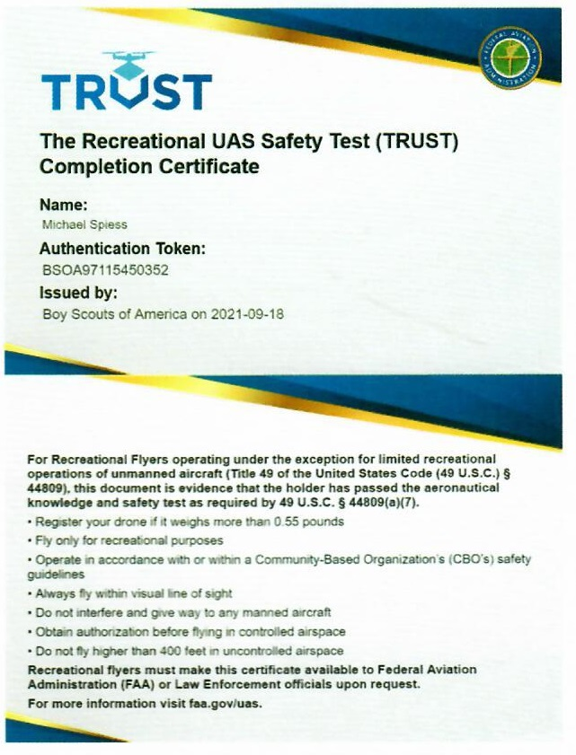
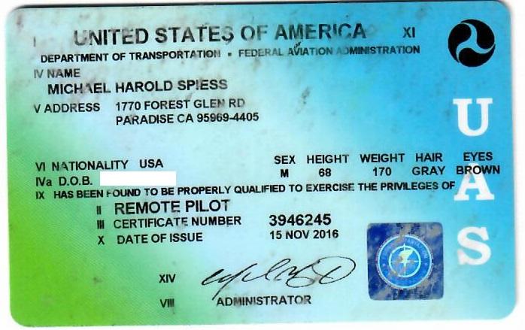
Certificates (carry when flying)
OR

Slide 13
Part 107 vs Recreational Flyers
Recreational Flyers
Part 107 Flyers
Take The Recreational UAS Safety Test (TRUST) and carry proof of test passage. About 30 minutes online.
No Minimum Age
Fly only for recreational purposes (enjoyment).
Have a current registration, mark your drones on the outside with the registration number and carry proof of registration with you.
Follow the safety guidelines of an FAA-recognized Community Based Organization (CBO). Note: The FAA has not yet begun officially recognizing CBOs. See Advisory Circular 91-57B.
Pass an exam (107.73)
Minimum age 16
Required to fly for hire or business
Have a current registration, mark your drones on the outside with the registration number and carry proof of registration with you.
Supervise another person manipulating the controls (ex. students)
Can apply for airspace authorization or rule waivers (ex. night flight)

Slide 14
The Educational Exception
There is also a statutory provision (P.L. 115-254, Section 350, as amended by P.L. 116-283, Section 10002) that clarifies that education and research uses of drones for educational (and research) purposes can be operated under the rules for recreational flyers.
Comply with recreational pilot (TRUST) and drone requirements.

Slide 15
A Case for Part 107
Greater knowledge is required
Background is useful for instruction
Options exist to operate in more airspace and ask for waivers
Could also perform commercial activity

Slide 16
Drone Requirements

Slide 17
Part 107 General Requirements
Drones under 55 pounds
Must have Remote Pilot Certificate (107.12) (or meet education exception)
Drone is registered (107.13)
Drone in safe condition to operate (107.15)
Remote Pilot, Visual Observer in medical condition to operate (107.17)
Cannot operate under the influence. < .04 and 8hours. (107.25)
Remote Pilot in Command (rPIC) is responsible (107.19)

Slide 18
Part 107 General Requirements
Cannot operate at night (with some exceptions) (107.29)
Must maintain Visual Line of Sight (VLOS) (107.31)
Yield to manned aircraft (107.37)
May not fly over people (107.39)
May not operate in Class B,C, or D airspace or Surface of Class E. (107.41)
May not operate in the area of airports as to interfere with normal operations (107.43)
May not operate in restricted airspace (107.45 and 107.47)
Preflight check required (107.49)

Slide 19
Waivers (for UAS pilots)
Some restrictions may be waived
§107.25* Operation from a moving vehicle or aircraft
§107.29 Operation at Night
§107.31* Visual line of sight aircraft operation
§107.33 Visual observer
§107.35 Operation of multiple small unmanned aircraft systems
§107.37(a) Yielding the right of way
§107.39 Operation over human beings
§107.41 Operation in certain airspace
§107.51 Operating limitations for small unmanned aircraft
§107.145 Operations Over Moving Vehicles

Slide 20
Drone Requirements
Weight Classes
Under .55 pounds
.55 to 55 pounds
Registration
All drones must be registered, except those that weigh 0.55 pounds or less (less than 250 grams) and are flown exclusively under the Exception for Recreational Flyers.
Drones registered under part 107 may be flown for recreational purposes as well as under part 107.
Drones registered under the Exception for Recreational Flyers cannot be flown for Part 107 operations.
Information Needed to Register
Physical address and mailing address (if different from physical address)
Email address
Phone number
Make and model of your drone
Specific Remote ID serial number provided by the manufacturer (if applicable)
Credit or debit card ($5/3 years)

Slide 21
Drone Requirements
Label Your Drone
The FAA requires that you mark all drones with your registration number before you fly them.
Must be maintained in a condition that is legible.
Must be affixed to the small unmanned aircraft by any means necessary to ensure that it will remain affixed for the duration of each operation.
Must be legibly displayed on an external surface of the small unmanned aircraft.
Remote Identification and Your Drone
Remote ID is the ability of a drone in flight to provide identification and location information that can be received by other parties. (Similar to aircraft transponder or ADS-B.)
Beginning September 16, 2023, all drone pilots required to register their drone must operate their aircraft in accordance with the remote ID rule for pilots, which gives drone owners sufficient time to upgrade their aircraft.
Drone manufacturers have until September 16, 2022 to produce drones with built-in standard remote ID.

Slide 22
Flight Restrictions
Basics
400 AGL (above ground level)
Line of sight
No Night Flight
Recreational vs. Part 107 License
Waivers (of Part 107 regulations)
Airspace authorization
Temporary Flight Restrictions (TFR)
Fires
Special Events

Slide 23
Preparing for Missions

Slide 24
Sensors
Video and Still Photos
RGB (Red, Green, Blue)
Color camera
Analysis:
Visual
VARI (red/green ratio)
Near IR (Infra-red)
NDVI – Normalized Difference Vegetation Index is a ration of red/near IR
Sensitive to Chlorophyll levels.
Thermal (heat)
Using with your drone
Drones typically come with RGB, but some may be ordered with other sensors
Replacement sensors are designed to replace the OEM camera.
External sensors may be attached to the drone (alters the flight characteristics)
Altering the drone may void the warranty.
The speed of image capture affect the maximum ground speed

Slide 25
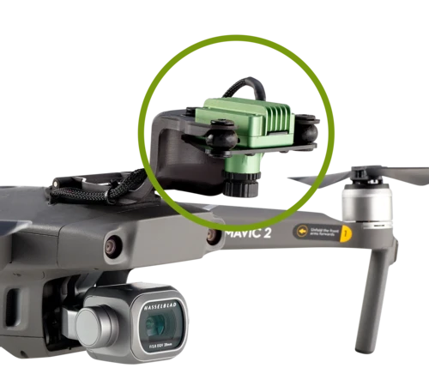
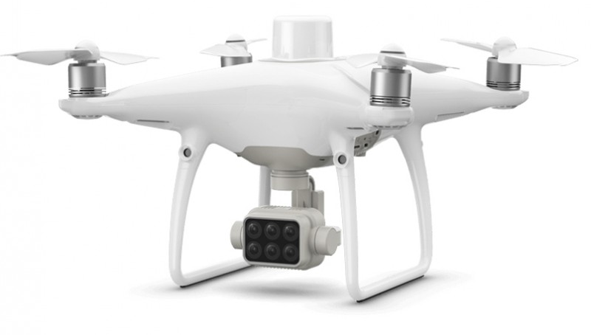
Sensor Configurations

Slide 26
Image Area
Affected by:
Focal Length (angle)
Height
Sensor size (Megapixels)
Distortion
Longer focal lengths reduce distortion
Fewer images are easier to stitch
Larger sensors will need fewer images
Ground Sampling Distance (GSD) - inches/pixel

Slide 27
Comparison
Images courtesy of DroneDeploy

Slide 28
Mission Planning
Determine the study area
Locate hazards and obstacles
Check the airspace
Layout the flight lines
Determine altitude and overlap (commonly 70-80%) – This determines the number of images.
Determine time (for battery life)

Slide 29
Online Tools
Airspace: https://vfrmap.com/
B4UFly https://b4ufly.aloft.ai/?lat=35.307047435737786&long=-120.66568068204839
OK to Fly: https://oktofly.com/loc/35.282752,-120.659616
LAANC (Low Altitude Authorization and Notification Capability)
General Hazards: https://www.google.com/maps/@35.3051917,-120.6614847,165m/data=!3m1!1e3

Slide 30
So What Do You Think of our Mission?
Regulatorily Restrictions?
Environmental Restrictions?

Slide 31
Mission Planning with DroneLink

Slide 32
Mission Parameters
Altitude 100’
Area: Irrigation Field
https://app.dronelink.com/mike-spiess
Mission Estimate
Time (battery)
Photos:
Mission Preview

Slide 33
Let’s Go Fly the Mission!
(Field Trip)

Slide 34
Advisory Circular 107-2 Checklist
1. Visual condition inspection of the UAS components;
2. Airframe structure (including undercarriage), all flight control surfaces, and linkages;
3. Registration markings, for proper display and legibility;
4. Moveable control surface(s), including airframe attachment point(s);
5. Servo motor(s), including attachment point(s);
6. Propulsion system, including powerplant(s), propeller(s), rotor(s), ducted fan(s), etc.;
7. Verify all systems (e.g., aircraft and control unit) have an adequate energy supply for the intended operation and are functioning properly;
8. Avionics, including control link transceiver, communication/navigation equipment, and antenna(s);
9. Calibrate UAS compass prior to any flight;
10. Control link transceiver, communication/navigation data link transceiver, and antenna(s);
11. Display panel, if used, is functioning properly;
12. Check ground support equipment, including takeoff and landing systems, for proper operation;
13. Check that control link correct functionality is established between the aircraft and the CS;
14. Check for correct movement of control surfaces using the CS;
15. Check onboard navigation and communication data links;
16. Check flight termination system, if installed;
17. Check fuel for correct type and quantity;
18. Check battery levels for the aircraft and CS;
19. Check that any equipment, such as a camera, is securely attached;
20. Verify communication with UAS and that the UAS has acquired GPS location from at least four satellites;
21. Start the UAS propellers to inspect for any imbalance or irregular operation;
22. Verify all controller operation for heading and altitude;
23. If required by flight path walk through, verify any noted obstructions that may interfere with the UAS; and
24. At a controlled low altitude, fly within range of any interference and recheck all controls and stability.

Slide 35
Sample Checklist Items
Build your own! Every drone is different. Common items might include:
Battery charge
Prop condition
Camera free (and uncovered)
Memory installed
No obvious damage to airframe

Slide 36
Data Capture (control software)
Check flying conditions (ex. wind, clouds)
Pre-flight the drone
Execute the mission
Download the images

Slide 37
Processing the Images

Slide 38
Sensors
Video and Still Photos
RGB (Red, Green, Blue)
Color camera
Analysis:
Visual
VARI (red/green ratio)
Near IR (Infra-red)
NDVI – Normalized Difference Vegetation Index
Sensitive to Chlorophyll levels.
Using with your drone
Drones typically come with RGB, but some may be ordered with other sensors
Replacement sensors are designed to replace the OEM camera.
External sensors may be attached to the drone (alters the flight characteristics)
Altering the drone may void the warranty.
The speed of image capture affect the maximum ground speed

Slide 39
Sensors
Least expensive is RGB (Red-Green-Blue)
3 bands
Can be process as VARI
Near-IR

Slide 40
Stitching and Analysis (software)
Stitching will combine individual images into one.
Analysis
Visual (color image)
VARI – A ratio of red and green bands. Simple RGB sensor
NDVI – the most common in Ag
Requires Near Infrared sensor
Ratio of red to Near IR

Slide 41
WebODM
Stitching
Analysis VARI

Slide 42
Curriculum

Slide 43
Developing a Curriculum
SLO’s – What are your goals
Time – How much time do you have?
Hardware and Flying Restrictions may be limiting
Options may be:
Classroom activities with existing data
Simple drone flight demos
Training for Part 107 license (a certification)
Fly with an RGB drone
Fly with a Near-IR drone (NDVI analysis)
A complete course to be come certified and skills to fly missions
GIS / PA components

Slide 44
Ideas for Activities
Have student take the TRUST test. (then laminate their cards ;-)
Plan a general mission using Google Maps.
Pick a spot, scout the area for hazards (make a checklist).
Do a pre-flight check on a drone.
Field check data previously collected. Look for causes. This works well with recreation fields (lawn).
Take single images and analyze.
Plan missions using software like DroneDeploy or Dronelink.
Fly planned missions
Stitch images and analyze using software like DroneDeploy or WebODM

Slide 45
Draft Activities
1. Drone Pre-flight Activity
2. Mission Planning – Ground Sampling Distance Activity
3. Mission Planning – Airspace Activity
4. Mission Planning – Area Inspection Activity
5. Mission Planning – Flight Planning Activity
6. Fly the Mission Activity
7. Download Images Activity
8. Photo Stitching Activity
9. VARI / NDVI Processing of Images Activity
10. Area Measurement Activity
11. Interpretation Activity
12. Field Checking Activity
13. GIS Layer Activity

Slide 46
Wrap Up

Slide 47
GIS
Geographical Information Systems (GIS) are the next logical step.
Stores the data
Complex image and spatial analysis
A component of Precision Ag
ArcGIS – Most commonly used by government agencies
QGIS – Free
Many Others
Access via Phone App

Slide 48
Costs (very general idea)
Drone – a good quadcopter $400-$1500
Drone with Near IR sensor - $2500+
Mapping Software: $50 up. Subscriptions $1000/year (likely will stitch too)
Stitching Software Free to $$$

Slide 49
General Planning
Initial Purchase $
Ongoing Subscription Costs
Maintenance (yes they do break and crash)
Establish a “practice area” for activities.

Slide 50
Resources & Questions
http://agedweb.org/drone

