Slide 1
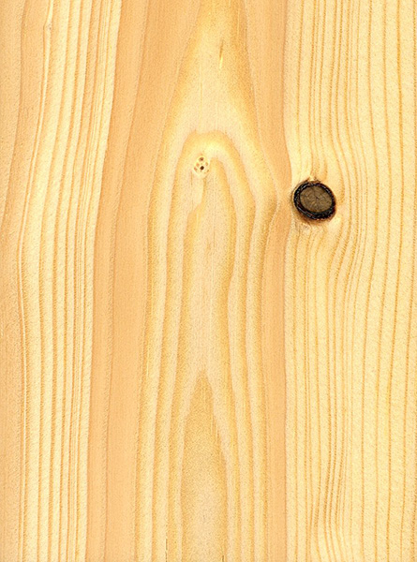
Pine
A softwood used for small projects and mouldings.
Notes:
Woodworking-Wood Image: pine.jpg Height: 144 Width: 106.8

Slide 2
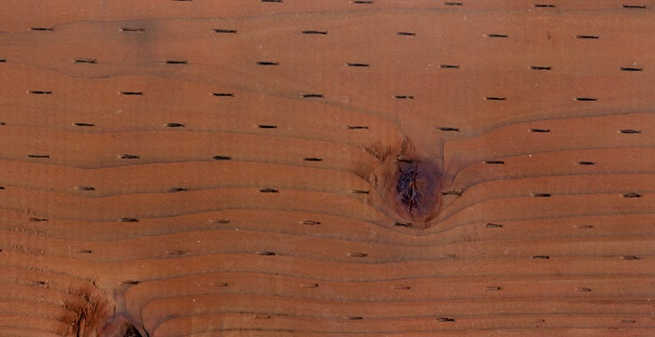
Pressure Treated Lumber
Generally fir species that is treated to resist decay. Green in color.
Notes:
Woodworking-Wood Image: PressureTreated.jpg Height: 361 Width: 701

Slide 3
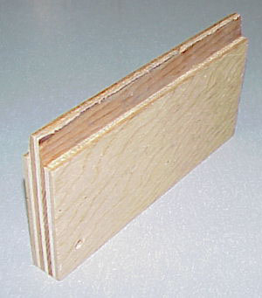
Plywood
Composed of layers of wood sheets with the grain of each sheet glued at right angles. Very strong. Used for flooring, roof sheeting, and shear walls. Comes in various grades denoted by letters. A=best, D=worst. For example AC would be A on one side and C on the other. Plywood can be designated as interior or exterior depending on the type of glue used in its manufacture.
Notes:
Woodworking-Wood Image: Plywood.jpg Height: 341 Width: 300

Slide 4
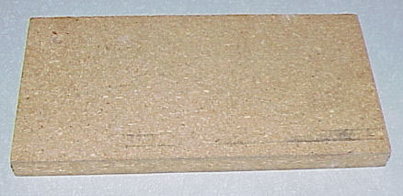
Particle Board
Primarily made from sawdust. Used for subfloor where shear strength is not needed.
Notes:
Woodworking-Wood Image: Particle.jpg Height: 213 Width: 438

Slide 5
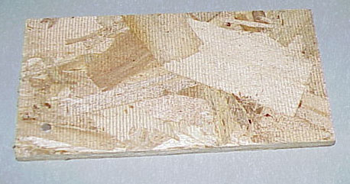
Oriented Strand Board (OSB)
Primarily made from wood chips. Used for shear walls and roof sheeting
Notes:
Woodworking-Wood Image: wood11.jpg Height: 241 Width: 458

Slide 6
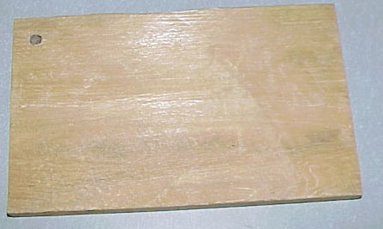
Cedar
Known for its resistance to decay. Used for fencing.
Notes:
Woodworking-Wood Image: Cedar.jpg Height: 267 Width: 447

Slide 7
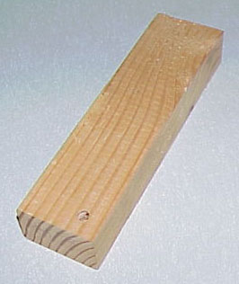
Douglass Fir
Used primarily for structural framing. Very strong.
Notes:
Woodworking-Wood Image: DougFir.jpg Height: 316 Width: 266

Slide 8
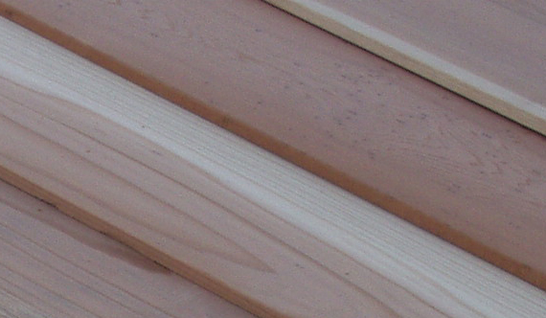
Redwood
Known for its resistance to decay. Used for landscaping, decking, etc.
Notes:
Woodworking-Wood Image: Redwood.jpg Height: 332 Width: 570

Slide 9
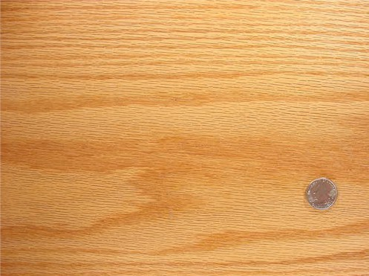
Oak
A hardwood used for cabinets and similar applications. The grain is very distinctive. May be used as a solid wood or as a veneer on plywood or particle board.
Notes:
Woodworking-Wood Image: Oak.jpg Height: 222.6 Width: 298.2

Slide 10
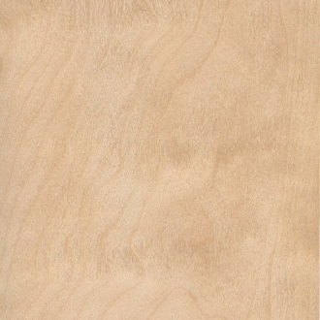
Birch
A hardwood used for cabinets, door veneer, and similar applications. May be used as a solid wood or as a veneer on plywood or particle board.
Notes:
Woodworking-Wood Image: Birch.jpg Height: 72 Width: 72

Slide 11
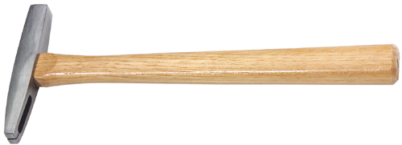
Tack Hammer
One side of the head is magnetic and used for starting short tacks.
Notes:
Woodworking-Hammers (Wood) Image: Tack hammer.jpg Height: 86.88 Width: 240

Slide 12
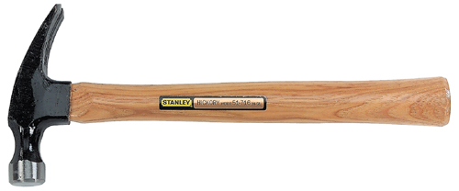
Straight Claw Hammer
The hammer head is the same as a curved claw hammer, but the claw is nearly straight. Weight 16-28 oz. Head may be smooth or serrated. Also called a Ripping hammer.
Notes:
Woodworking-Hammers (Wood) Image: Straight Claw Hammer.jpg Height: 99.84 Width: 240

Slide 13
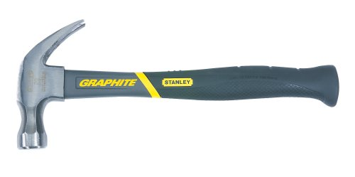
Curved Claw Hammer
Used for driving and puling nails. Face is commonly rounded for finish work. Weight 13-16 oz.
Notes:
Woodworking-Hammers (Wood) Image: CurvedClawHammer1.jpg Height: 119.52 Width: 240

Slide 14
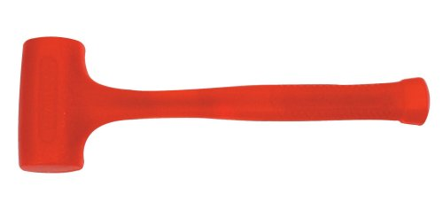
Mallet
Heads are made of wood, plastic, rawhide and rubber. Also called a Soft Headed Hammer.
Notes:
Woodworking-Hammers (Wood) Image: Mallet.jpg Height: 117.6 Width: 240

Slide 15
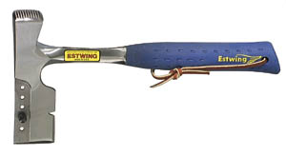
Shingler’s Hatchet
It has a gauge that can be adjusted for the desired shingle exposure and has a nail pulling slot in the back and above the cutting edge.
Notes:
Woodworking-Hammers (Wood) Image: SingleHatchet.jpg Height: 39.12 Width: 72

Slide 16
Back Saw
This saw should be used in a horizontal position.
Notes:
Woodworking-Saws And Accessories Image: back saw.jpg Height: 68.64 Width: 240

Slide 17
Hand Cross Cut Saw
The standard length is 26 inches. Typically 8-12 teeth/inch.
Notes:
Woodworking-Saws And Accessories Image: hand saw.jpg Height: 63.84 Width: 240

Slide 18
Hand Rip Saw
The edges of the teeth are not beveled, but are shaped like chisels. Typically 4-7 teeth/inch.
Notes:
Woodworking-Saws And Accessories Image: hand saw.jpg Height: 63.84 Width: 240

Slide 19
Keyhole or Compass Saw
Used for sawing curves, especially where the cut must be started from a hole bored with an auger bit.
Notes:
Woodworking-Saws And Accessories Image: compass saw.jpg Height: 65.28 Width: 240

Slide 20
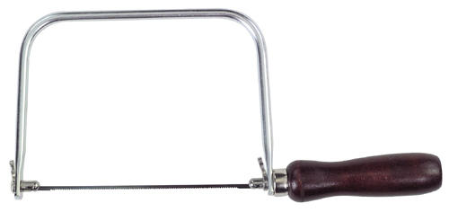
Coping Saw
The blade is installed to cut on the pull stroke.
Notes:
Woodworking-Saws And Accessories Image: coping saw.jpg Height: 113.28 Width: 240

Slide 21
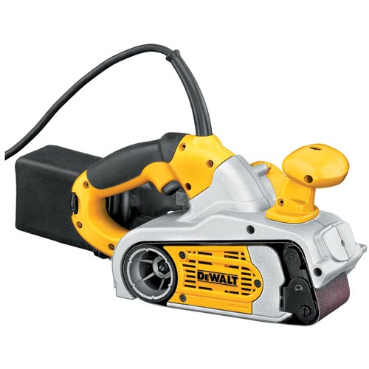
Belt Sander
Sands or cuts using a sanding belt. Used for course sanding of large surfaces.
Notes:
Woodworking-Power Tools Image: Belt Sander.jpg Height: 300 Width: 300

Slide 22
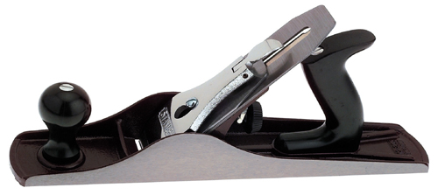
Jack Plane
Planing should be done with the grain of the wood. Note tail behind the handle.
Notes:
Woodworking-Planes And Similar Tools Image: Jack plane.jpg Height: 107.04 Width: 240

Slide 23
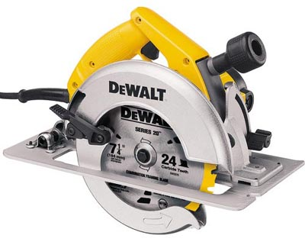
Circular Saw
Primarily used for cutting wood, however many blades types are available for cutting sheet metal, metal, stone, and various other products. Available as a direct drive or worm drive.
Notes:
Woodworking-Power Tools Image: power7.jpg Height: 321 Width: 400

Slide 24
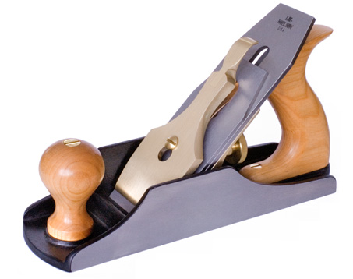
Smooth Plane
Sizes range from 5 1/2 to 10 inches long and 1 1/4 to 2 3/8 inches wide.
Notes:
Woodworking-Planes And Similar Tools Image: Smoothing Plane.jpg Height: 214.8 Width: 271.8

Slide 25
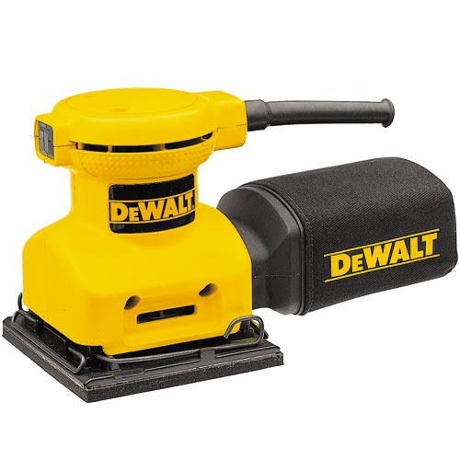
Finishing Sander
Sands by a vibrating action.
Notes:
Woodworking-Power Tools Image: Palm Sander.jpg Height: 300 Width: 300

Slide 26
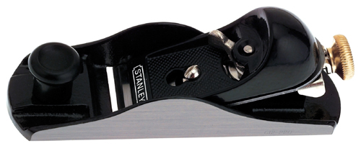
Block Plane
Sizes range form 5 1/2 to 7 inches long and 1 3/8 to 1 5/8 inches wide. Used to plane the end of a board.
Notes:
Woodworking-Planes And Similar Tools Image: block plane.jpg Height: 97.44 Width: 240

Slide 27
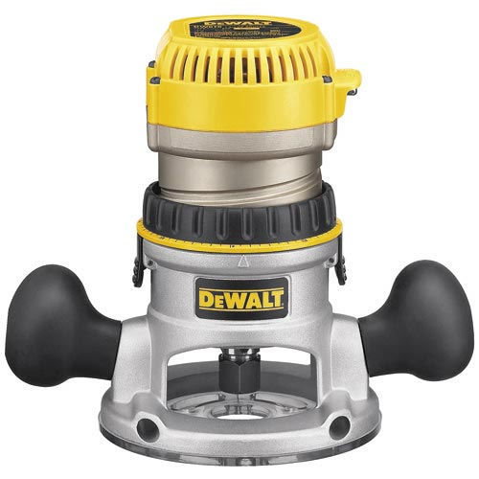
Router
Depth of cut is adjustable. Used to shape wood (ex. round the edge of a board).
Notes:
Woodworking-Power Tools Image: Router.jpg Height: 300 Width: 300

Slide 28
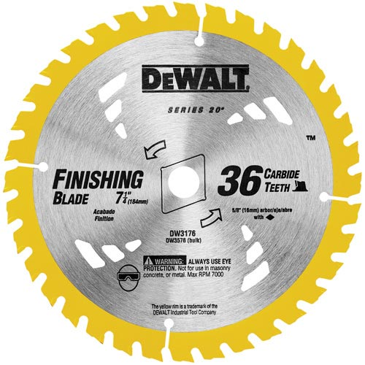
Circular Saw Blade
The size is determined by the diameter of the blade.
Notes:
Woodworking-Power Tools Image: Circular Saw Blade.jpg Height: 300 Width: 300

Slide 29
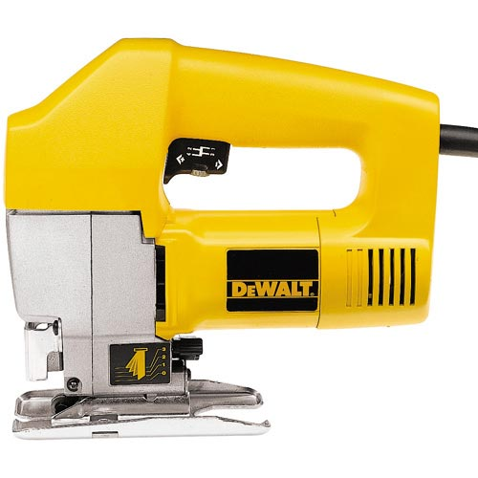
Jig Saw
Many variations of blades are available for cutting wood, plastics, and other soft materials. Also called a Saber Saw
Notes:
Woodworking-Power Tools Image: Jig Saw.jpg Height: 300 Width: 300

Slide 30
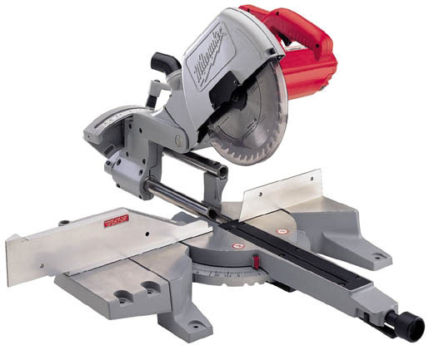
Power Miter Saw
The saw pivots on the miter box for various angles.
Notes:
Woodworking-Power Tools Image: spower3.jpg Height: 252.6 Width: 309

Slide 31
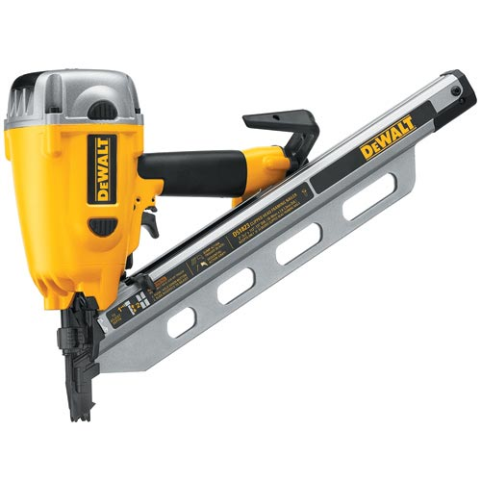
Nail Gun
Nails are fed automatically from a loading chamber and are dispensed by pulling the trigger.
Notes:
Woodworking-Power Tools Image: Nailer.jpg Height: 500 Width: 500

Slide 32
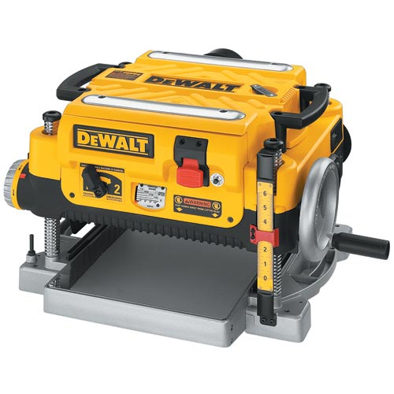
Planer
Used for planing wood surfaces. A portable power version of a hand plane.
Notes:
Woodworking-Power Tools Image: Planer.jpg Height: 300 Width: 300

Slide 33
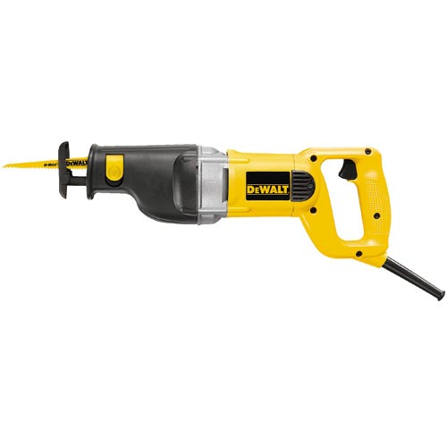
Reciprocating Saw
Similar to the jig saw but much larger and used for heavy duty work.
Notes:
Woodworking-Power Tools Image: RecipSaw.jpg Height: 300 Width: 300

Slide 34
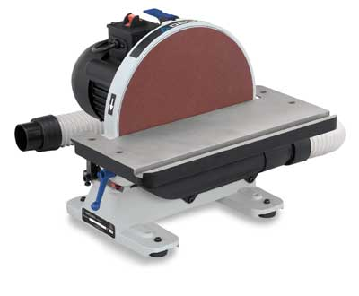
Disc Sander
A stationary power tool with a 6-12 inch sanding disc.
Notes:
Woodworking-Power Tools Image: DiscSander.jpg Height: 198 Width: 240

Slide 35
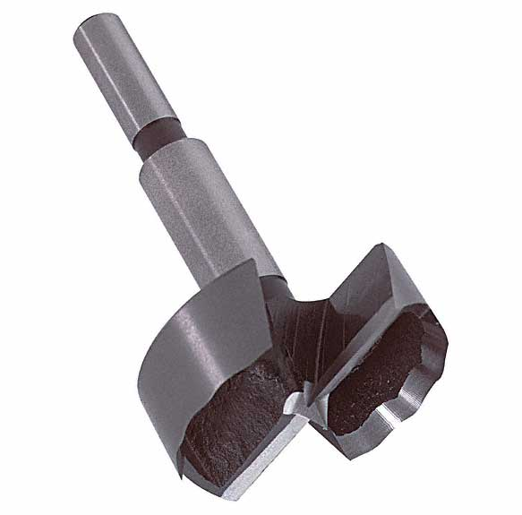
Forstner Bit
A power bit for drilling flat bottomed holes in wood. Commonly found in sizes 3/8-2 inch.
Notes:
Woodworking-Boring Tools (Wood) Image: Forstner.jpg Height: 345 Width: 349.8

Slide 36
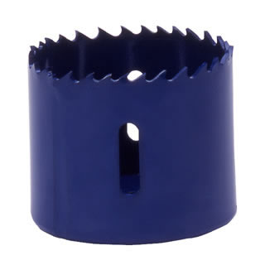
Hole Saw
Hole saws come in sizes from ¾ to 2 1/2 inches and one mandrel fits all.
Notes:
Woodworking-Boring Tools (Wood) Image: HoleSaw.jpg Height: 320 Width: 320

Slide 37
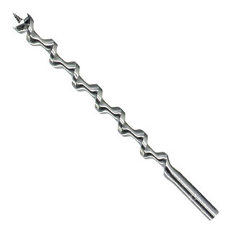
Auger Bit
The straight round shank adapted for power drills.
Notes:
Woodworking-Boring Tools (Wood) Image: AugerBit.jpg Height: 192 Width: 192

Slide 38
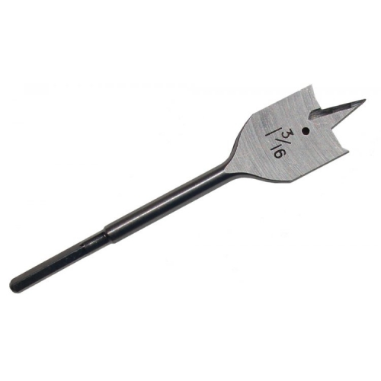
Spade Bit
A wood boring bit with a hex shaft to be used in a power hand drill or drill press.
Notes:
Woodworking-Boring Tools (Wood) Image: SpadeBit.jpg Height: 300 Width: 300

Slide 39
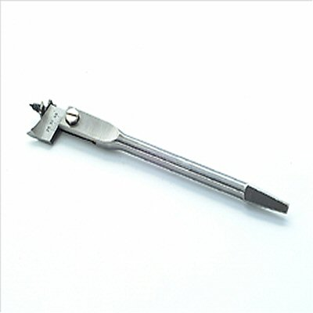
Expansive Bit
The shank is a square taper, adapted for the bit brace.
Notes:
Woodworking-Boring Tools (Wood) Image: ExpansiveBit.jpg Height: 96 Width: 96

Slide 40
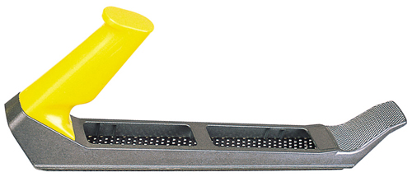
Surform Tool
A tool like a wood rasp with a replaceable cutter. Available in flat, round, and half round shapes.
Notes:
Woodworking-Woodworking Tools Image: surform tool.jpg Height: 103.2 Width: 240

Slide 41
Nail Set
The point has a slight hollow at the end.
Notes:
Woodworking-Woodworking Tools Image: NailSet.jpg Height: 41.76 Width: 240

Slide 42
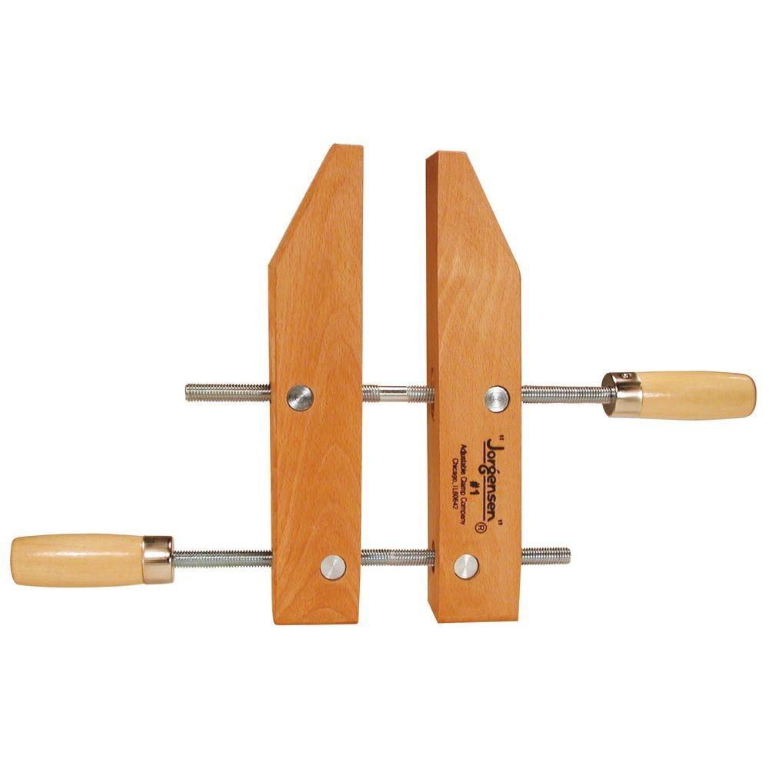
Hand Screw Clamp
The wooden handles are mounted on opposite sides of the jaws.
Notes:
Woodworking-Woodworking Tools Image: clamp6.jpg Height: 1000 Width: 1000

Slide 43
Cat's Paw
A tool used to pull nails
Notes:
Woodworking-Woodworking Tools Image: CatsPaw.jpg Height: 172.2 Width: 579

Slide 44
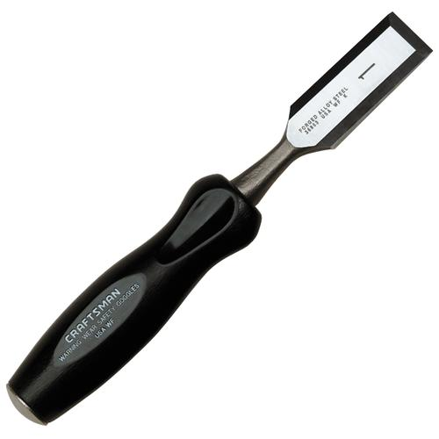
Wood Chisel
It is sharpened only on one side to a 25 or 30 degree angle and may be used with or across the grain.
Notes:
Woodworking-Woodworking Tools Image: Wood Chisel.bmp Height: 300 Width: 300

Slide 45
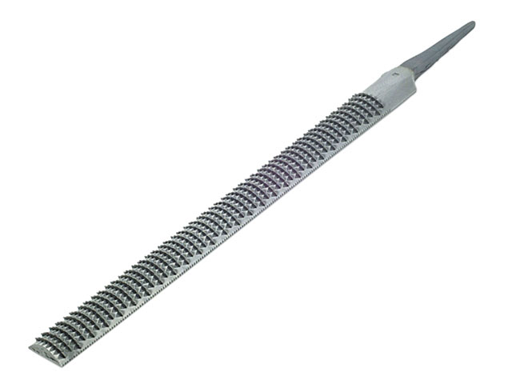
Wood Rasp
Other rasps are 4-in-hand and horse rasps.
Notes:
Woodworking-Woodworking Tools Image: WoodRasp.jpg Height: 288 Width: 384

Slide 46
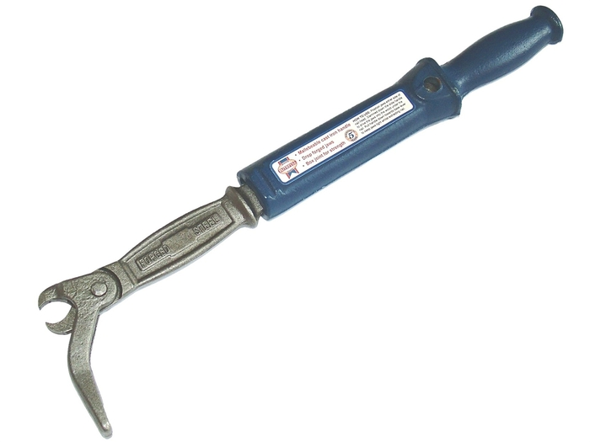
Nail Puller
A pair of jaws is driven into the wood below the nail head by impact action of the handle.
Notes:
Woodworking-Woodworking Tools Image: NailPuller.jpg Height: 393.75 Width: 525

Slide 47
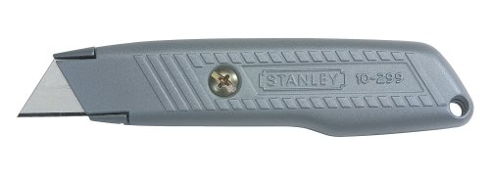
Utility Knife
A sharp knife for cutting drywall, roofing felt, etc.
Notes:
Woodworking-Construction Image: UtilityKnife.jpg Height: 86.88 Width: 240

Slide 48
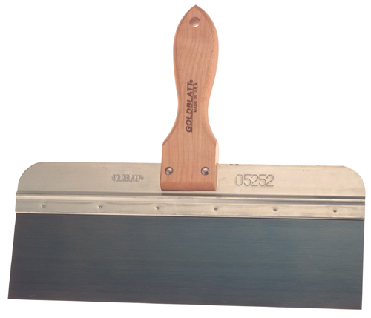
Drywall Trowel
A flexible trowel for applying drywall compound and tapping.
Notes:
Woodworking-Construction Image: Drywall taping knife.jpg Height: 205.92 Width: 240

Slide 49
Drywall Saw
A tapered hand saw for cutting drywall.
Notes:
Woodworking-Construction Image: drywall saw.jpg Height: 35.52 Width: 240

Slide 50
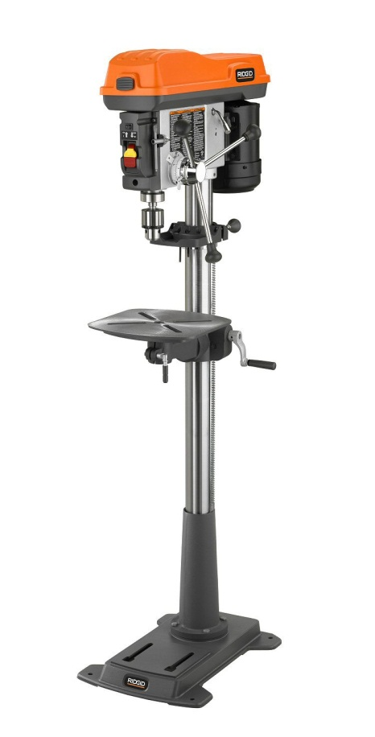
Drill Press
A stationary drill.
Notes:
Woodworking-Stationary Power Tools Image: Drill Press.jpg Height: 353.76 Width: 180

Slide 51
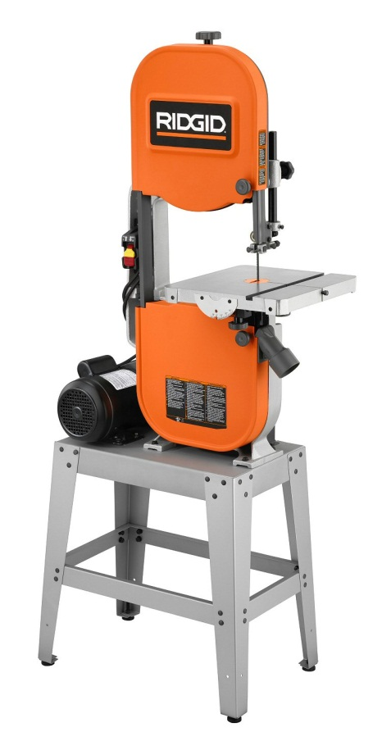
Band Saw
Used for making curved cuts in wood or metal.
Notes:
Woodworking-Stationary Power Tools Image: Bandsaw.jpg Height: 353.52 Width: 180

Slide 52
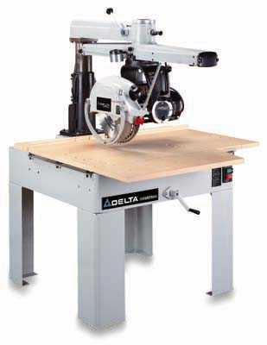
Radial Arm Saw
A saw designed to cross cut and rip with the ability to cut compound angles.
Notes:
Woodworking-Stationary Power Tools Image: radialArm.jpg Height: 400 Width: 309

Slide 53
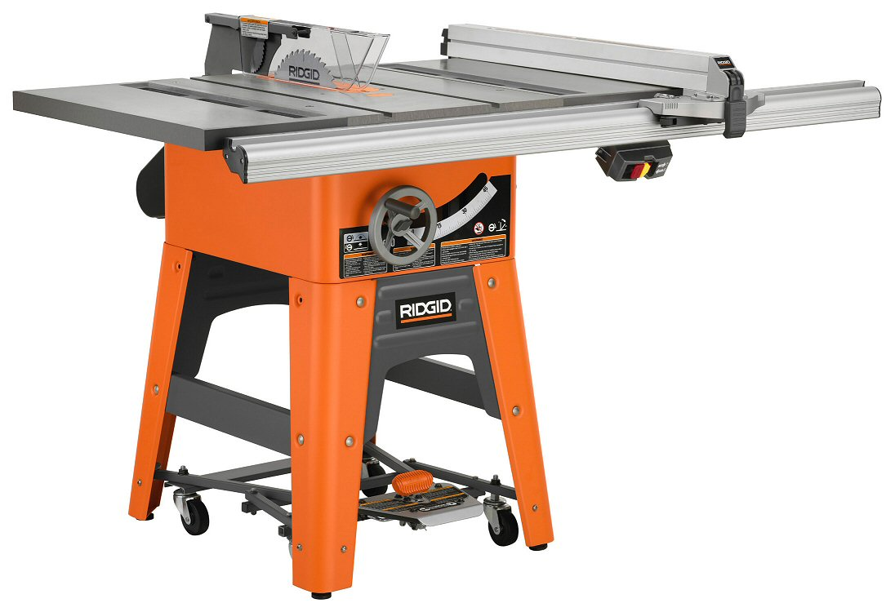
Table Saw
A stationary saw used primarily for ripping lumber and sheet materials.
Notes:
Woodworking-Stationary Power Tools Image: Table Saw.jpg Height: 180 Width: 263.04

