Slide 1

Proof Coil Chain
A welded link chain. Chain size is designated by the diameter of the steel used in making the links (e.g.. 3/16"-3/4"). Made from low carbon steel, proof coil is a general utility chain for such uses as tie-down, log chain and assembly tow and switch chain. Available in plain, hot galvanized, and bright zinc finishes.
Notes:
Rope and Chain-Chains, Lashing Straps, and Accessories Image: ChainProofCoil.jpg Height: 46.2 Width: 120

Slide 2

Sash Chain
Sash Chain is sold by the foot. Used to hang light fixtures, etc.
Notes:
Rope and Chain-Chains, Lashing Straps, and Accessories Image: ChainSashLink.jpg Height: 40.2 Width: 150

Slide 3

Twist Link Chain
Used where the chain must travel easily over something (links don’t get caught).
Notes:
Rope and Chain-Chains, Lashing Straps, and Accessories Image: ChainTwistedLink.jpg Height: 45 Width: 120

Slide 4

Double Loop Chain
Used for tether chains, swings and hammocks and wherever a light inexpensive chain is needed.
Notes:
Rope and Chain-Chains, Lashing Straps, and Accessories Image: Chaindbleloop.jpg Height: 49.2 Width: 120

Slide 5
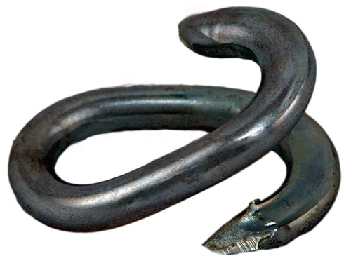
Repair Link
Used to repair a broken chain and for attaching rings and hooks. Also called a Lap Link
Notes:
Rope and Chain-Chains, Lashing Straps, and Accessories Image: ChainRepairLink.jpg Height: 90 Width: 120

Slide 6
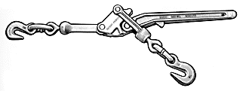
Load or Chain Binder
This devise consists of a handle, two offset links and grab hooks which, when connected to a section of the load-binding chain and the handle pulled, tightens the chain.
Notes:
Rope and Chain-Chains, Lashing Straps, and Accessories Image: ChainBinder.gif Height: 72.6 Width: 195.6

Slide 7
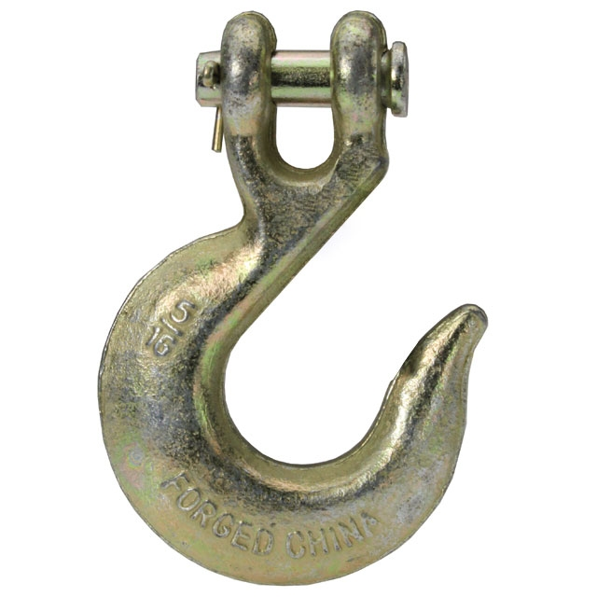
Slip Hook
A round hook used on one end of a log chain to permit it to slip along the chain.
Notes:
Rope and Chain-Chains, Lashing Straps, and Accessories Image: ChainSlipHook.jpg Height: 640 Width: 640

Slide 8
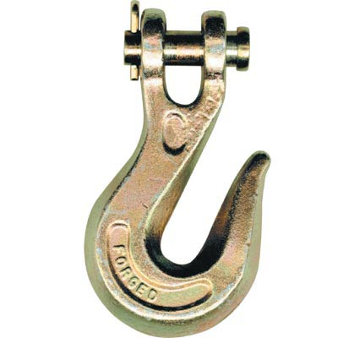
Grab Hook
Grab hooks are designed to hook over a chain link and will hold fast when the chain is tightened.
Notes:
Rope and Chain-Chains, Lashing Straps, and Accessories Image: chainGrabHook.jpg Height: 240 Width: 240

Slide 9
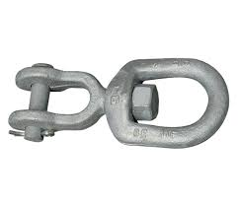
Swivel
It consists of two chain links connected by a riveted pin.
Notes:
Rope and Chain-Chains, Lashing Straps, and Accessories Image: swivel.jpg Height: 124.2 Width: 145.8

Slide 10
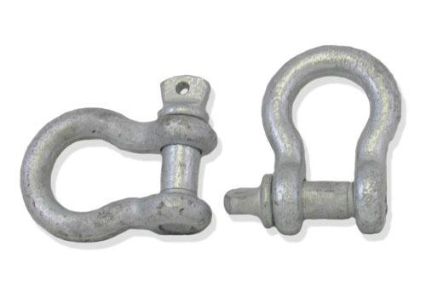
Clevis or Shackle
Used for fastening an implement to a draw bar for pulling, fastening a tow cable, and for purposes requiring the fastening or securing of machines or materials.
Notes:
Rope and Chain-Chains, Lashing Straps, and Accessories Image: ChainClevis.jpg Height: 210 Width: 300

Slide 11
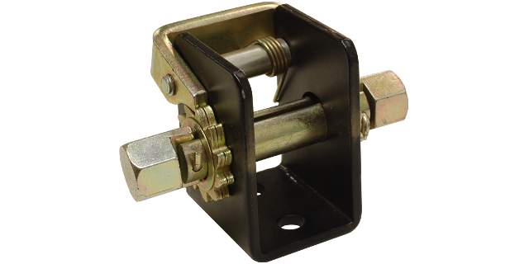
Winch
A ratcheting device used to tighten a rope or lashing strap.
Notes:
Rope and Chain-Chains, Lashing Straps, and Accessories Image: winch.jpg Height: 320 Width: 640

Slide 12
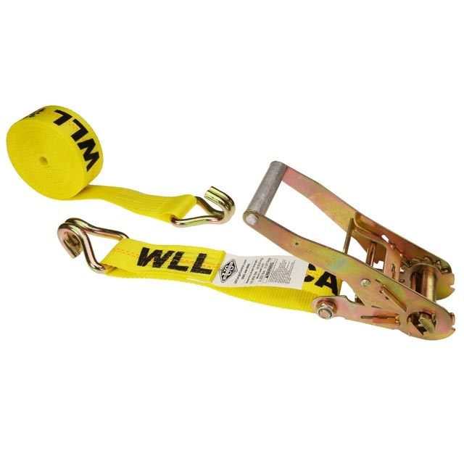
Lashing Strap
Used for securing loads. Not used for securing heavy equipment. Typical polyester or nylon strap strength is 10,000-20,000 pounds. Smaller straps are available with a built-in winch. Larger straps are designed to be used with winches mounted on the truck bed.
Notes:
Rope and Chain-Chains, Lashing Straps, and Accessories Image: TieDownStrap.jpg Height: 640 Width: 640

Slide 13
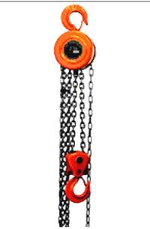
Chain Hoist
Sizes are available from 1/2 to 5 ton capacity.
Notes:
Rope and Chain-Chains, Lashing Straps, and Accessories Image: ChainHoist.jpg Height: 183.6 Width: 120

Slide 14
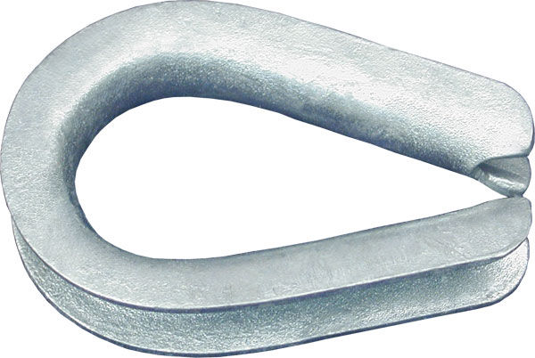
Rope Thimble
Used to protect the eye in a rope or cable.
Notes:
Rope and Chain-Rope Image: RopeThimble.jpg Height: 289.44 Width: 432

Slide 15
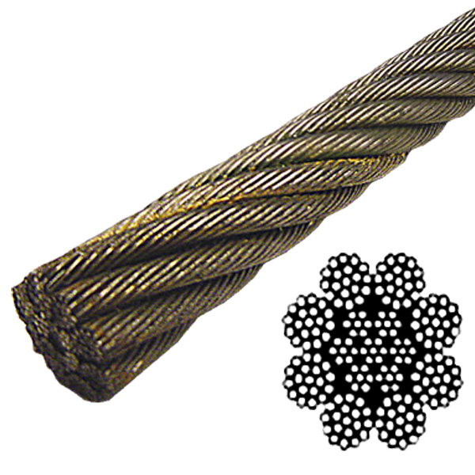
Wire Rope
To coil or uncoil, roll the rope like a steel hoop.
Notes:
Rope and Chain-Rope Image: wireRope.jpg Height: 360 Width: 360

Slide 16
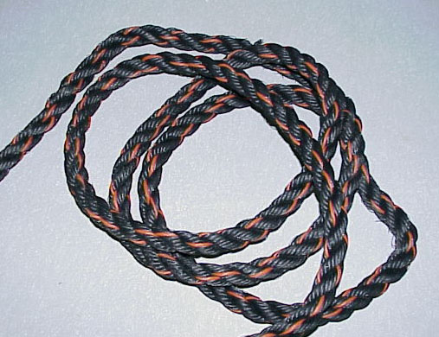
Twisted Polypropylene Rope
Keep away from flames and hot metal, it will melt or solidify and break easily. Also called trucker's rope which is generally black with an orange stripe.
Notes:
Rope and Chain-Rope Image: rope5.jpg Height: 390 Width: 507

Slide 17
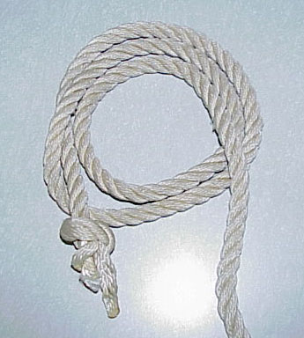
Nylon Rope
Maybe manufactured as a laid (twisted) rope or a braided rope. Stronger and more expensive then poly rope. Braided rope does not have individual strands therefore it is not suited for hand braiding.
Notes:
Rope and Chain-Rope Image: rope4.jpg Height: 384 Width: 345

Slide 18
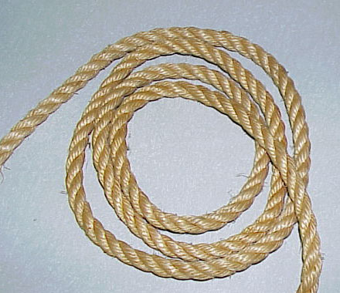
Manila Rope
This is a laid (twisted) and comes in three and four strands. A natural fiber, manila is stronger than cotton, but weaker than the synthetic ropes.
Notes:
Rope and Chain-Rope Image: rope2.jpg Height: 380 Width: 440

Slide 19
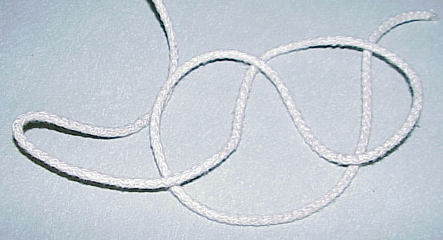
Cotton Rope
Cotton ropes are soft but the weakest of the natural fiber ropes.
Notes:
Rope and Chain-Rope Image: Cotton.jpg Height: 306 Width: 564

Slide 20
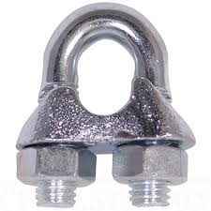
Wire Rope Clamps
There are two types, the "U" bolt with cleat and the bolt clamp.
Notes:
Rope and Chain-Rope Image: WireRopeClamp.jpg Height: 135 Width: 135

Slide 21
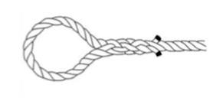
Eye Splice
Used to make a permanent loop in a laid (twisted) rope.
Notes:
Rope and Chain-Knots, Hitches, and Splices Image: Eye Splice.jpg Height: 99 Width: 208.5

Slide 22
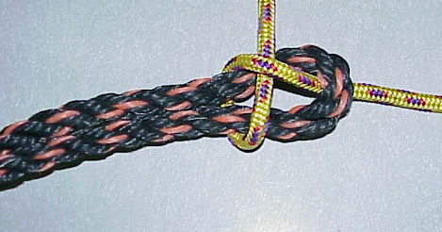
Sheet Bend
A knot for joining ropes of different diameters
Notes:
Rope and Chain-Knots, Hitches, and Splices Image: knot4.jpg Height: 246 Width: 469

Slide 23
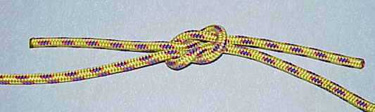
Square Knot
A common knot for joining two ropes
Notes:
Rope and Chain-Knots, Hitches, and Splices Image: knot5.jpg Height: 160 Width: 533

Slide 24
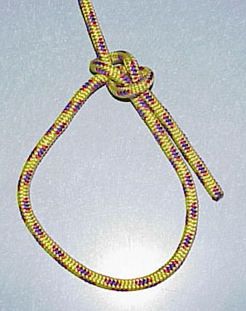
Bowline
A knot for making a loop
Notes:
Rope and Chain-Knots, Hitches, and Splices Image: knot6.jpg Height: 375 Width: 297

Slide 25
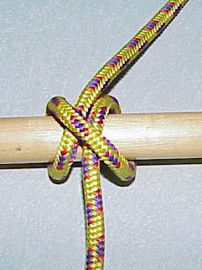
Clove Hitch
A hitch used to secure a rope to a hook.
Notes:
Rope and Chain-Knots, Hitches, and Splices Image: knot3.jpg Height: 321 Width: 241

Slide 26
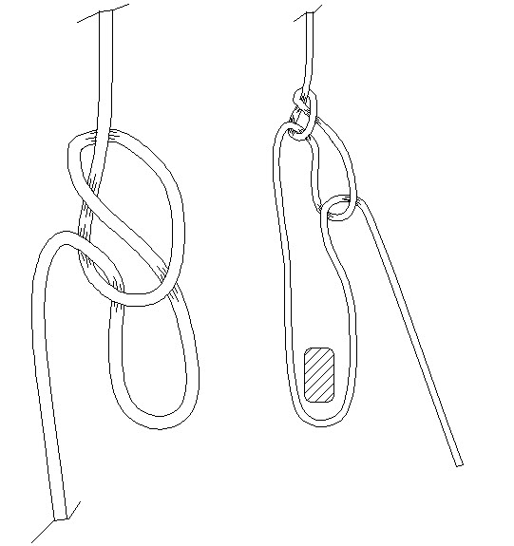
Trucker's Hitch
A hitch used for securing a load
Notes:
Rope and Chain-Knots, Hitches, and Splices Image: TruckersHitch.jpg Height: 345 Width: 324.6

