Slide 1
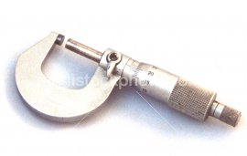
Micrometer
Sizes range from 0 to 1 inch up to 12 inches.
Notes:
Measuring, Layout, and Surveying-Measuring And Marking Tools Image: Micrometer.jpg Height: 102.6 Width: 162

Slide 2

Fractional Vernier Caliper
Direct reading of 16ths and 32nds of an inch on the handle, and vernier readings of 1/128 inch.
Notes:
Measuring, Layout, and Surveying-Measuring And Marking Tools Image: VernierCaliper.jpg Height: 46.56 Width: 144

Slide 3
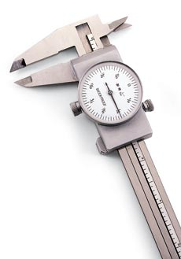
Dial Caliper
Capacity is from 0 to 6 inches.
Notes:
Measuring, Layout, and Surveying-Measuring And Marking Tools Image: DialCaliper.jpg Height: 197.4 Width: 138

Slide 4
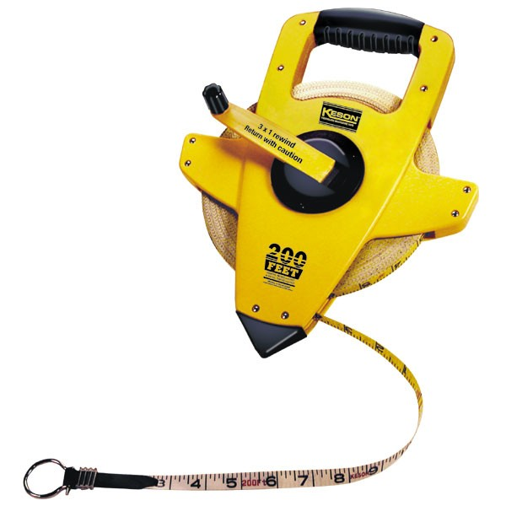
Fiberglass Tape
Lengths of 50', 100', 200, and 300' common. Tape maybe graduated in feet and inches, feet and 1/100', or metric.
Notes:
Measuring, Layout, and Surveying-Measuring And Marking Tools Image: OpenReelFiberglassTape.jpg Height: 360 Width: 360

Slide 5
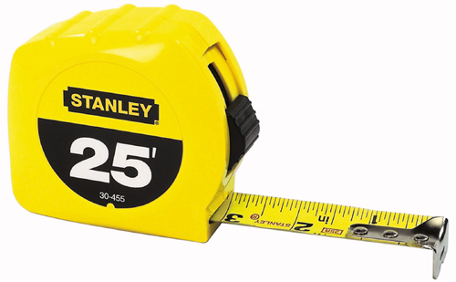
Steel Tape
It should be cleaned after using and kept free from rust.
Notes:
Measuring, Layout, and Surveying-Measuring And Marking Tools Image: Steel Tape.jpg Height: 148.32 Width: 240

Slide 6
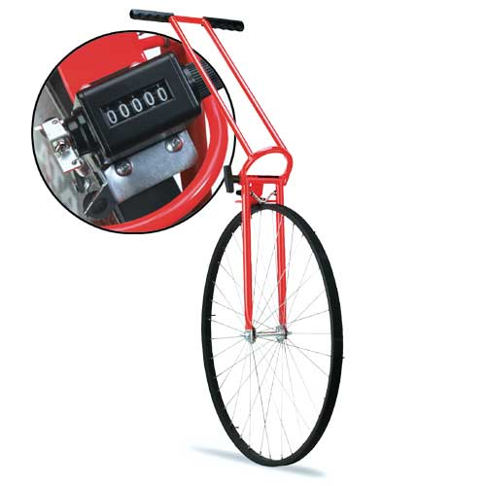
Measuring Wheel
Used to measure long distances such as field boundaries or road length where high accuracy is not required.
Notes:
Measuring, Layout, and Surveying-Measuring And Marking Tools Image: measuringWheel.jpg Height: 300 Width: 300

Slide 7
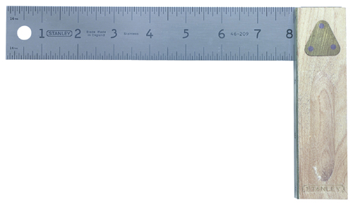
Try Square
It is marked in 8ths and 16ths of an inch.
Notes:
Measuring, Layout, and Surveying-Measuring And Marking Tools Image: Try Square.jpg Height: 139.68 Width: 240

Slide 8
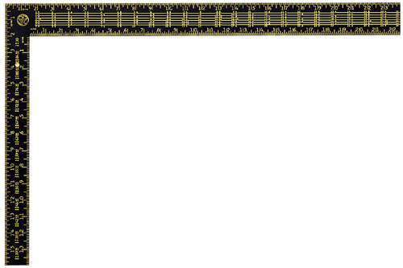
Framing Square
Rafter framing squares are marked in 12ths of an inch on the back side. Also called a Carpenter’s or steel square. Many of these squares are inscribed with rafter tables.
Notes:
Measuring, Layout, and Surveying-Measuring And Marking Tools Image: Framing Square.jpg Height: 159.84 Width: 240

Slide 9
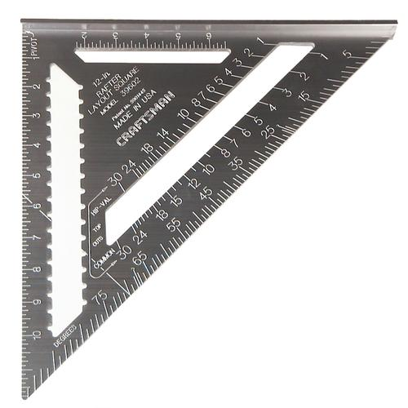
Rafter Square
An aluminum square marked for cutting rafters and angles. Also can be used as a guide for cross cutting with a circular saw. Small size will fit in a nail pouch.
Notes:
Measuring, Layout, and Surveying-Measuring And Marking Tools Image: Rafter Square.bmp Height: 300 Width: 300

Slide 10
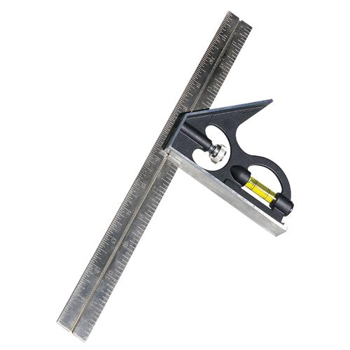
Combination Square
A level and a scribe are contained in the beam.
Notes:
Measuring, Layout, and Surveying-Measuring And Marking Tools Image: Combo Square.bmp Height: 300 Width: 300

Slide 11
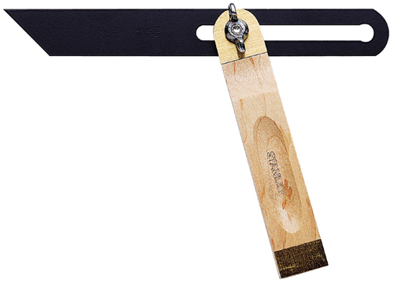
Sliding "T" Bevel
After it is set at the correct angle, it is much the same as a square.
Notes:
Measuring, Layout, and Surveying-Measuring And Marking Tools Image: T bevel.jpg Height: 172.32 Width: 240

Slide 12
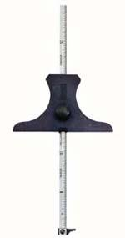
Depth Gauge
Usually graduated in 32nds and 64ths.
Notes:
Measuring, Layout, and Surveying-Measuring And Marking Tools Image: depth gage.jpg Height: 285 Width: 150

Slide 13
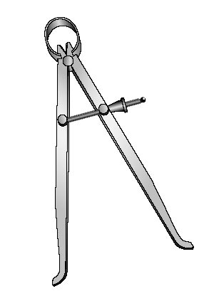
Inside Calipers
The calipers are adjusted to the diameter of the object and then laid on a rule where the reading is taken.
Notes:
Measuring, Layout, and Surveying-Measuring And Marking Tools Image: inside-caliper.jpg Height: 245.4 Width: 180

Slide 14
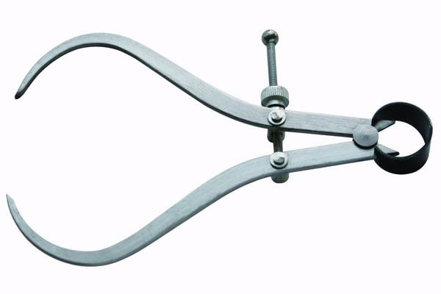
Outside Calipers
The calipers are adjusted to the outside diameter of the object and then laid on a rule where the reading is taken.
Notes:
Measuring, Layout, and Surveying-Measuring And Marking Tools Image: OutsideCalipers.jpg Height: 240 Width: 360

Slide 15
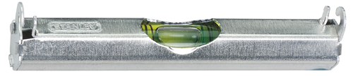
Line Level
It consists of a bubble tube housed in a metal or plastic case which has hooks for attaching to the line.
Notes:
Measuring, Layout, and Surveying-Measuring And Marking Tools Image: line level.jpg Height: 52.32 Width: 240

Slide 16

Carpenter’s Level
Used for marking level lines and for checking surfaces for level and plumb. Typical length 24-48 inches. Longer levels are often called masonry levels since they are commonly used to lay brick.
Notes:
Measuring, Layout, and Surveying-Measuring And Marking Tools Image: level.jpg Height: 26.88 Width: 240

Slide 17
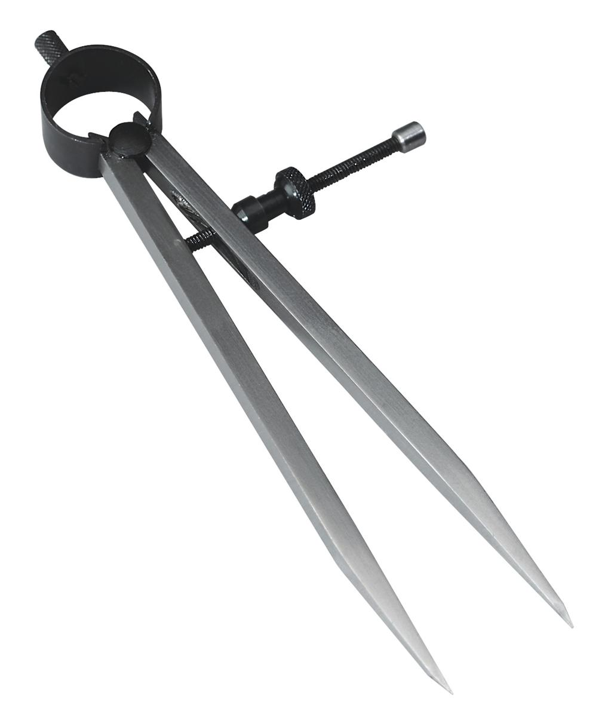
Dividers
Used for marking out circles or parts of circles, for transferring or duplicating short measurements, and for dividing distances into a number of equal parts.
Notes:
Measuring, Layout, and Surveying-Measuring And Marking Tools Image: dividers.jpg Height: 288 Width: 245.52

Slide 18
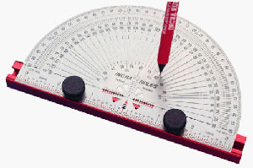
Protractor
It is graduated from 0 to 180 degrees.
Notes:
Measuring, Layout, and Surveying-Measuring And Marking Tools Image: Protractor.jpg Height: 119.4 Width: 180

Slide 19
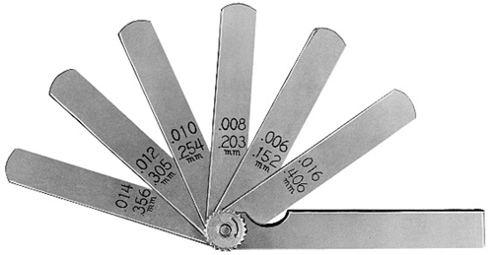
Feeler Gauge
Used for gauging the clearance or spacing of valve tappets and other jobs where accurate measurements of .001 to .032 may be desired.
Notes:
Measuring, Layout, and Surveying-Measuring And Marking Tools Image: FeelerGauge.jpg Height: 124.32 Width: 240

Slide 20
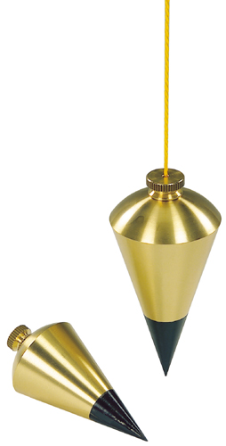
Plumb Bob
It can also be used to establish a plumb line in laying brick or concrete blocks. Also used to establish a survey instrument (like a transit) above a specific point.
Notes:
Measuring, Layout, and Surveying-Measuring And Marking Tools Image: plumb bob.jpg Height: 240 Width: 121.92

Slide 21
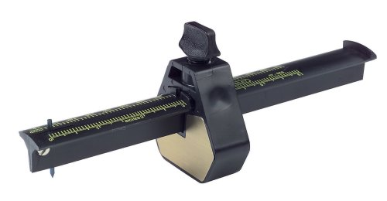
Marking Gauge
It is marked in 8ths and 16ths of an inch and is 8 inches long.
Notes:
Measuring, Layout, and Surveying-Measuring And Marking Tools Image: Marking Gauge.jpg Height: 124.8 Width: 240

Slide 22
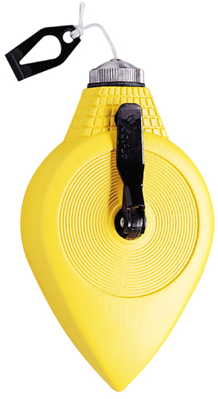
Chalk Line
A special container contains the chalk powder and line which is on a winding spool.
Notes:
Measuring, Layout, and Surveying-Measuring And Marking Tools Image: Chalk Line.jpg Height: 240 Width: 131.52

Slide 23
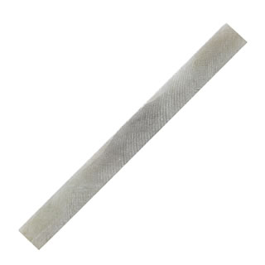
Soapstone
Unlike chalk, it is hard enough not to mark hands or clothing and can be used in holders that resemble pencils.
Notes:
Measuring, Layout, and Surveying-Measuring And Marking Tools Image: SoapStone.jpg Height: 320 Width: 320

Slide 24
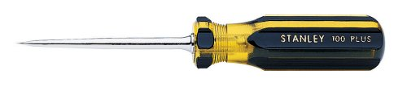
Scratch Awl
Also used as a punch for making small holes in light gauge sheet metal for the insertion of sheet metal screws.
Notes:
Measuring, Layout, and Surveying-Measuring And Marking Tools Image: ScratchAwl.jpg Height: 51.84 Width: 240

Slide 25
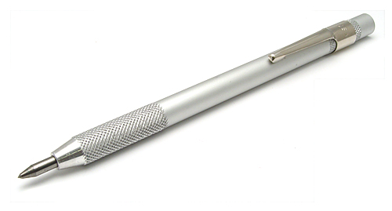
Scribe
The tip is brittle and will snap off if dropped on the point or used as center punch.
Notes:
Measuring, Layout, and Surveying-Measuring And Marking Tools Image: Scribe.jpg Height: 161.4 Width: 300

Slide 26
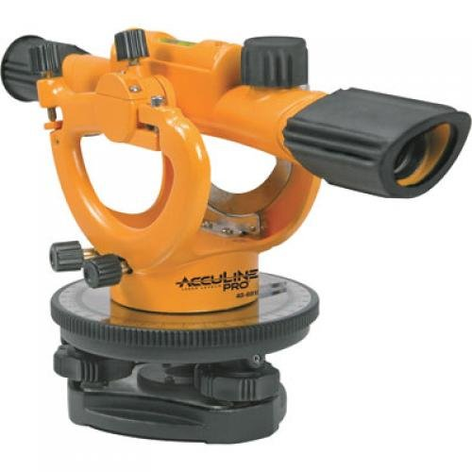
Builder's Level
A telescope instrument used to check level of forms or field grades. Builders' levels are designed to be used for short distances. Farm or dumpy levels are similar to builder's levels, but have more powerful telescopes. Farm levels are used for longer distances. Both instruments are leveled manually using adjusting screws. An "auto" level requires less manual leveling and has only three leveling screws.
Notes:
Measuring, Layout, and Surveying-Surveying Tools Image: BuildersLevel.jpg Height: 500 Width: 500

Slide 27
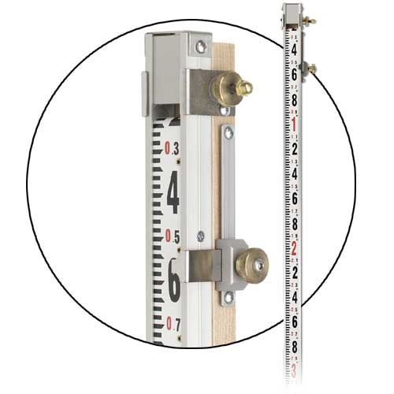
Direct Elevation Rod
Rod reads elevations directly (without subtraction from the HI) by used a sliding tape. Some rods have a cut/fill scale for use in grading.
Notes:
Measuring, Layout, and Surveying-Surveying Tools Image: DirectElevRod.jpg Height: 300 Width: 300

Slide 28
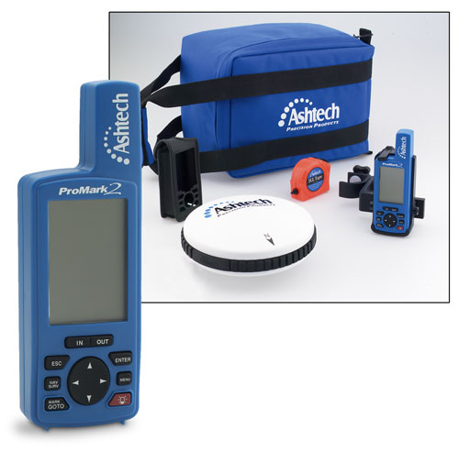
Global Position System Receiver
Commonly called GPS receivers, they used satellites to establish the user’s position (e.g., latitude and longitude). Recreational receivers have an accuracy of 13 m and survey grade receivers have an accuracy of 2 cm. Differential GPS receivers (accuracy 2cm – 1 m) are commonly used in agriculture to map field boundaries, scout fields, and provide tractor guidance.
Notes:
Measuring, Layout, and Surveying-Surveying Tools Image: GPS.jpg Height: 295.2 Width: 300

Slide 29
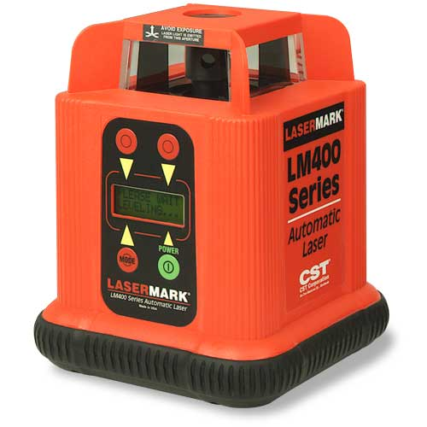
Laser Level
A level that used a rotating laser beam to establish a level plane. Leveling can be done with a single person.
Notes:
Measuring, Layout, and Surveying-Surveying Tools Image: LaserLevel.jpg Height: 300 Width: 300

Slide 30
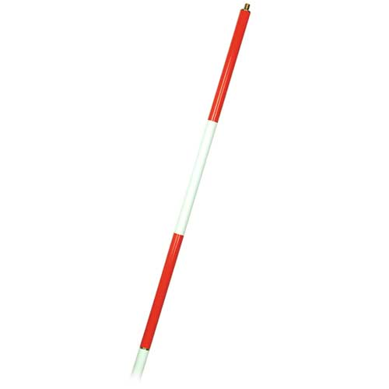
Range pole
A simple pole used in lieu of a rod where elevation measurement is not needed.
Notes:
Measuring, Layout, and Surveying-Surveying Tools Image: RangePole.jpg Height: 300 Width: 300

Slide 31
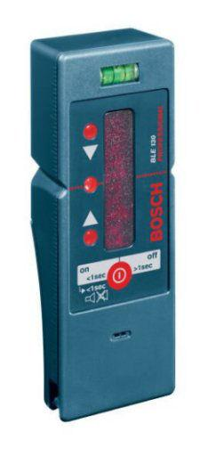
Laser Level Receiver
The receiver that detects the laser beam of the laser level. Can be fitted to a Philadelphia or Direct Elevation rod.
Notes:
Measuring, Layout, and Surveying-Surveying Tools Image: LaserLevelReceiver.jpg Height: 390.75 Width: 168.75

Slide 32
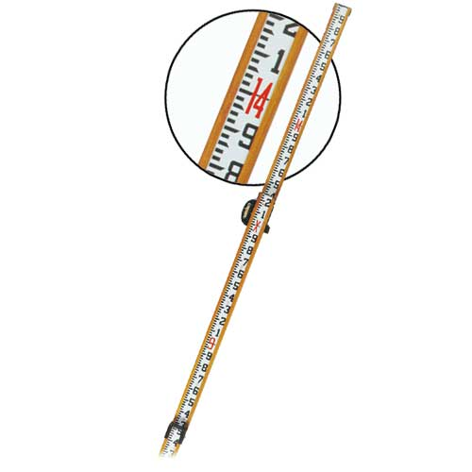
Philadelphia Rod
Reads like a tape measure. An adjustable target is available to allow readings up to 700 feet in distance.
Notes:
Measuring, Layout, and Surveying-Surveying Tools Image: PhiliRod.jpg Height: 300 Width: 300

Slide 33
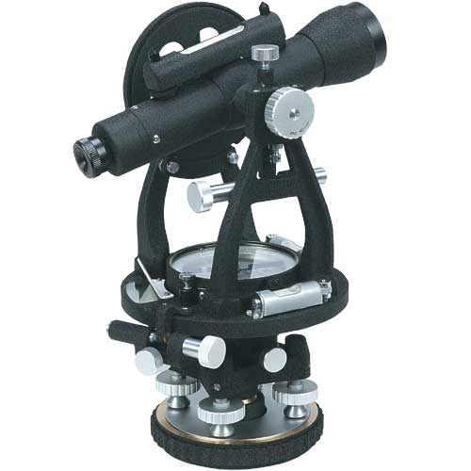
Transit
Similar to a level, but a transit telescope can be tilted vertically to measure vertical angles. Surveyor’s have generally replaced these with "Total Stations", but transits are still used to measure vertical angles in construction.
Notes:
Measuring, Layout, and Surveying-Surveying Tools Image: Transit.jpg Height: 300 Width: 300

Slide 34
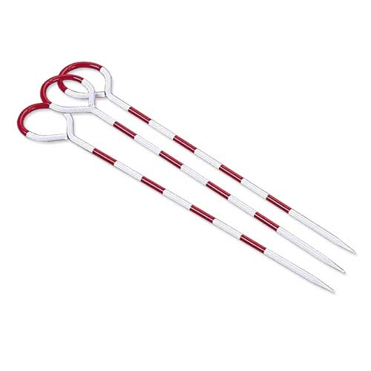
Surveyor's Arrows
Sizes range from 10 to 14 inches in length. Used to mark distances when "chaining" or measuring distance.
Notes:
Measuring, Layout, and Surveying-Surveying Tools Image: SurveyArrow.jpg Height: 300 Width: 300

Slide 35
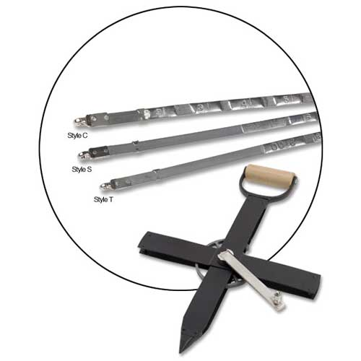
Surveyor’s Steel Tape
Quite often called a "chain". These may be stored on a reel or coiled.
Notes:
Measuring, Layout, and Surveying-Surveying Tools Image: SurveySteelTape.jpg Height: 300 Width: 300

Slide 36
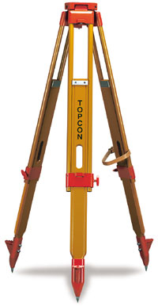
Surveying Tripod
Used to hold a level or other survey instrument. To protect threads, keep cap on when not in use.
Notes:
Measuring, Layout, and Surveying-Surveying Tools Image: tripod.jpg Height: 231.6 Width: 120

Slide 37
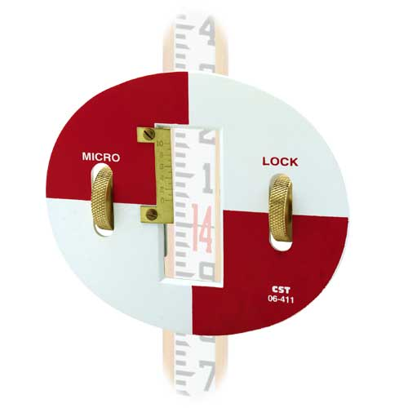
Rod Target
Used with the surveyor’s rod to allow readings at a greater distance.
Notes:
Measuring, Layout, and Surveying-Surveying Tools Image: Target.jpg Height: 300 Width: 300

Slide 38
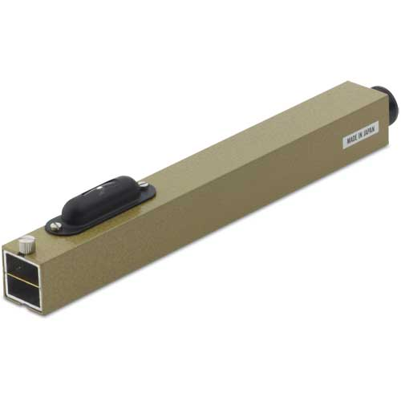
Hand Level
The hand level is held in the hand thus providing little accuracy.
Notes:
Measuring, Layout, and Surveying-Surveying Tools Image: HandLevel.jpg Height: 300 Width: 300

