Slide 1
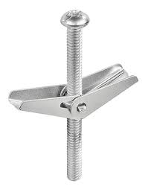
Toggle Bolt
When the screw is tightened a firm anchorage is made.
Notes:
Fasteners-Bolts Image: bolt8.jpg Height: 152.4 Width: 119.4

Slide 2
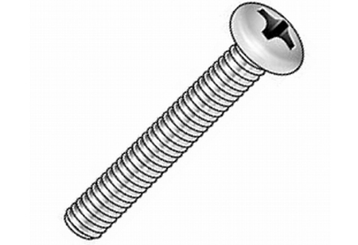
Machine Screw
The head is slotted for a screwdriver and may be either round of flat. Typical sizes 4-12.
Notes:
Fasteners-Bolts Image: Pan Head Machine Screw.jpg Height: 309 Width: 450

Slide 3
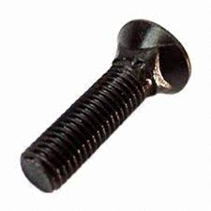
Plow Bolt
No wrench is necessary to hold the bolt head.
Notes:
Fasteners-Bolts Image: bolt6.jpg Height: 135 Width: 135

Slide 4
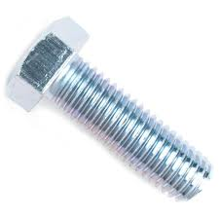
Machine Bolt
The head and nut may be square or hexagon shaped.
Notes:
Fasteners-Bolts Image: MachineBolt.jpg Height: 135 Width: 135

Slide 5
Lag Bolt
The bolt has a square or hex head with a tapered wood screw on the other end. Common sizes 1/4 to 1/2 in diameter, 2" to 12" long. Also called a Lag Screw.
Notes:
Fasteners-Bolts Image: bolt4.jpg Height: 69.12 Width: 176.4

Slide 6
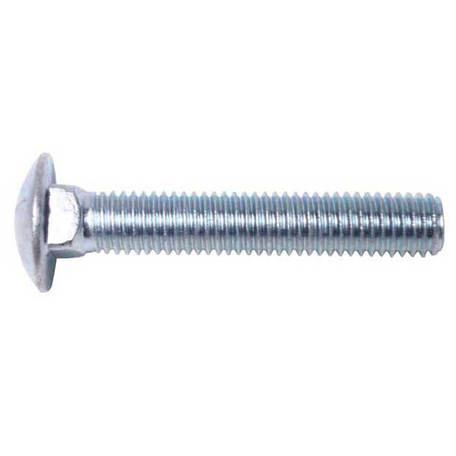
Carriage Bolt
Never use a washer under the head. Use to bolt wood.
Notes:
Fasteners-Bolts Image: Carriage Bolt.jpg Height: 360 Width: 360

Slide 7
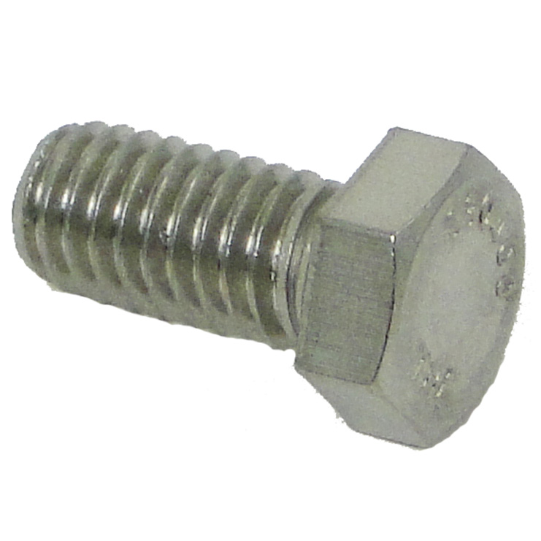
Cap Screw
It resembles a short bolt with a hexagon head with either coarse, fine, or metric thread. Term describes machine bolts and machine screws.
Notes:
Fasteners-Bolts Image: Cap_Screw.jpg Height: 444.6 Width: 444.6

Slide 8
Eye Bolt
It has an eye on one end and coarse or fine threads on the other.
Notes:
Fasteners-Bolts Image: Eye Bolt.jpg Height: 240 Width: 77.76

Slide 9
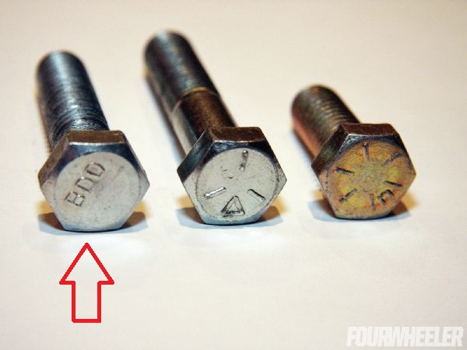
Grade 2 Bolt
Soft bolt commonly used for landscape applications and other applications where strength is not important.
Notes:
Fasteners-Bolts Image: Grade 2 bolt.jpg Height: 337.5 Width: 450

Slide 10
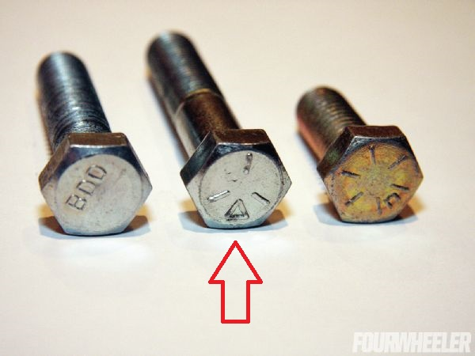
Grade 5 Bolt
Mildly hardened bolt used commonly in machinery and equipment applications. Three markings on the head.
Notes:
Fasteners-Bolts Image: Grade 5 Bolt.jpg Height: 337.5 Width: 450

Slide 11
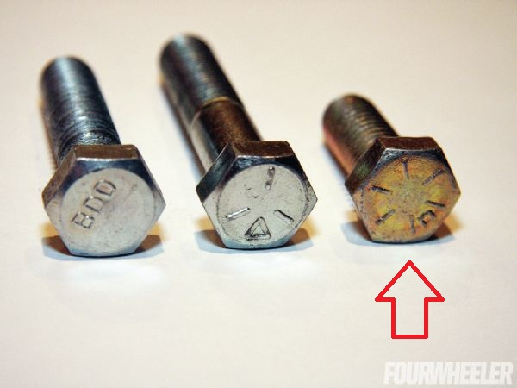
Grade 8 Bolt
Hardened bolt used where high tensile strength is required. 6 markings on the head.
Notes:
Fasteners-Bolts Image: Grade 8 Bolt.jpg Height: 337.5 Width: 450

Slide 12
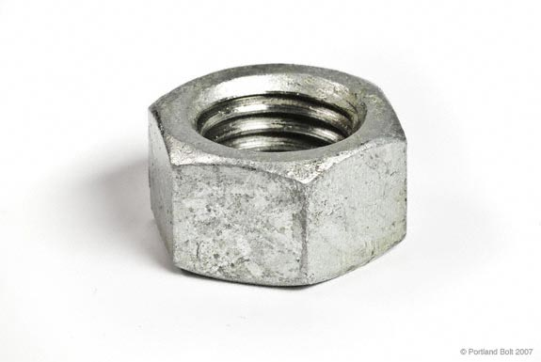
Hex Nut
It may have NC, NF, or metric threads.
Notes:
Fasteners-Nuts Image: Hex nut1.jpg Height: 231 Width: 345

Slide 13
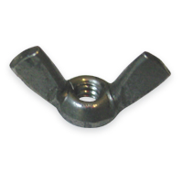
Wing Nut
Used where hand tightening (no wrench) is desired such as inspection covers.
Notes:
Fasteners-Nuts Image: wingNut.jpg Height: 200 Width: 200

Slide 14
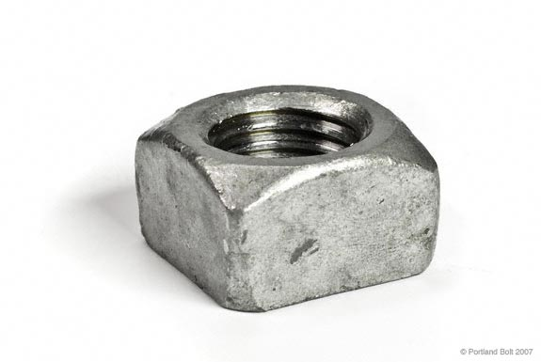
Square Nut
Used on farm implements with carriage bolts, machine bolts, stoves bolts and plow bolts.
Notes:
Fasteners-Nuts Image: SquareNut.jpg Height: 231 Width: 345

Slide 15
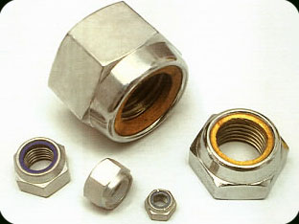
Self-Locking Nut
When tightened on a bolt the scored threads bite into the threads of the bolt preventing it from backing off.
Notes:
Fasteners-Nuts Image: LockNut.jpg Height: 140.4 Width: 187.2

Slide 16
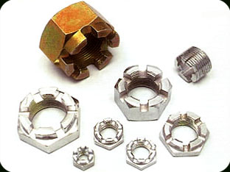
Castellated Hex Nut
Used with a cotter pin to prevent loosening or tightening. Top of the nut is smaller in diameter than the base.
Notes:
Fasteners-Nuts Image: CastleNut.jpg Height: 140.4 Width: 187.2

Slide 17
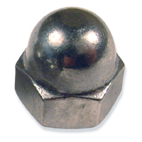
Cap Nut
A nut closed on one side to cover an exposed bolt.
Notes:
Fasteners-Nuts Image: capNut.jpg Height: 200 Width: 200

Slide 18
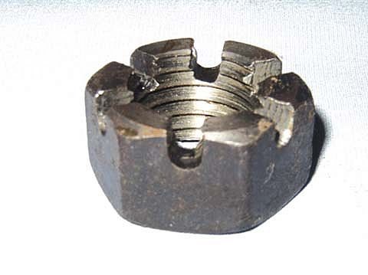
Slotted Hex Nut
It differs from the castellated nut in that there is no stepped-in castle-like top.
Notes:
Fasteners-Nuts Image: slottedHexNut.jpg Height: 359 Width: 480

Slide 19
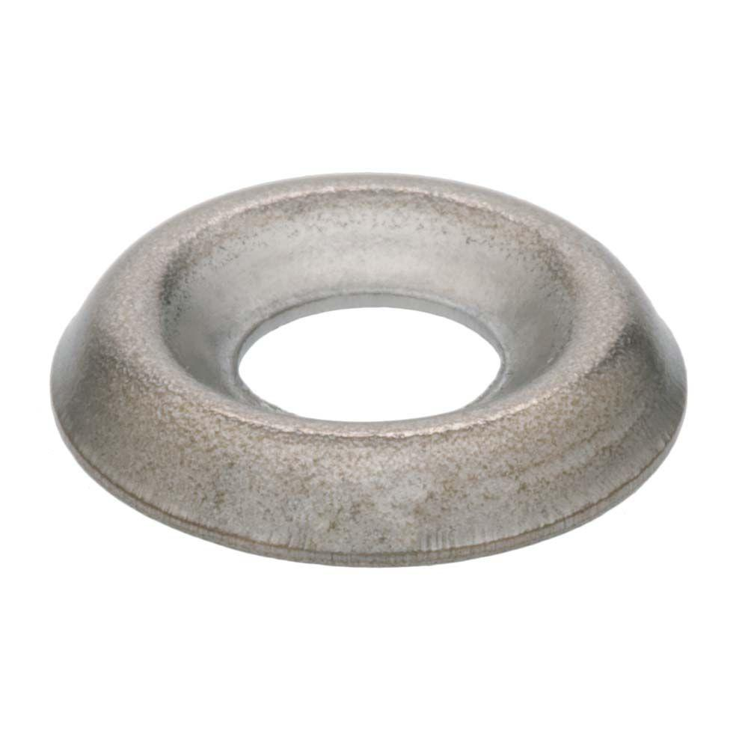
Finishing Washer
This is a chrome plated countersunk washer used with oval head wood or metal screws.
Notes:
Fasteners-Washers Image: FinishingWasher.jpg Height: 1000 Width: 1000

Slide 20
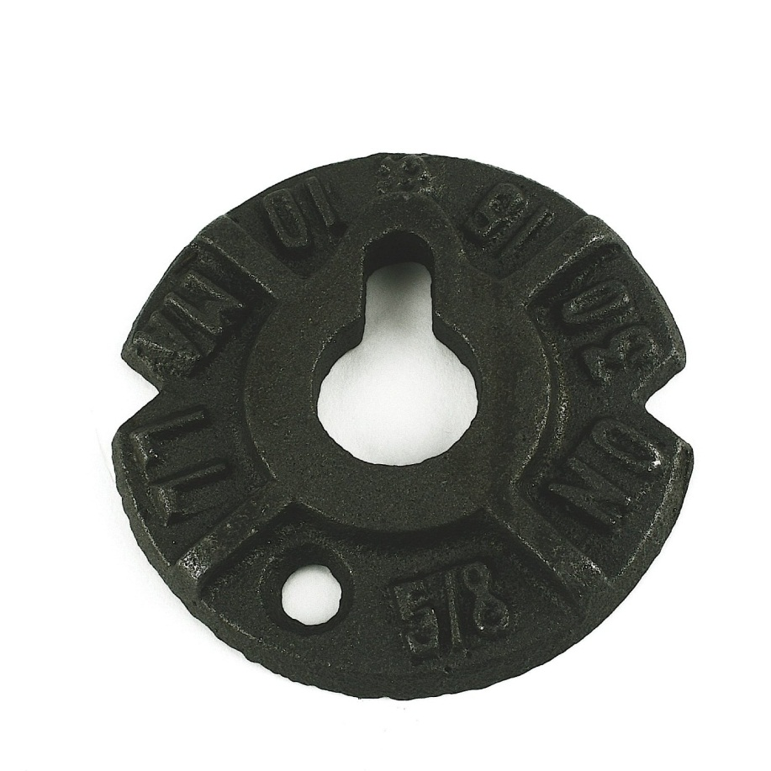
Malleable Iron Washer
Used where excess pressure or stress is exerted on wooden structures.
Notes:
Fasteners-Washers Image: MalleableIronWasher.jpg Height: 900 Width: 900

Slide 21
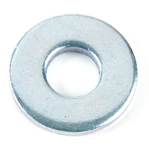
Flat Washer
Used to prevent the nut from rubbing and becoming imbedded in the bolted material. Also called a Cut Washer.
Notes:
Fasteners-Washers Image: FlatWasher.jpg Height: 200 Width: 200

Slide 22
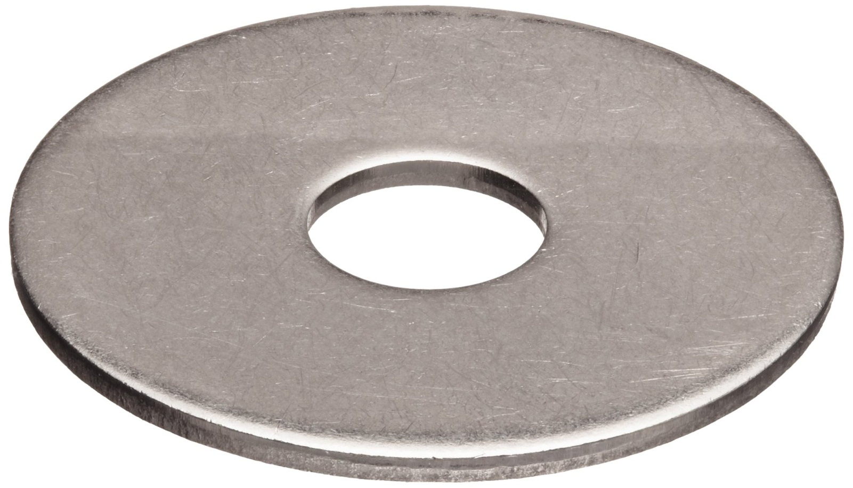
Fender Washers
The large holes are used for aligning or adjusting for proper fit.
Notes:
Fasteners-Washers Image: FenderWasher.jpg Height: 710.4 Width: 1240.2

Slide 23
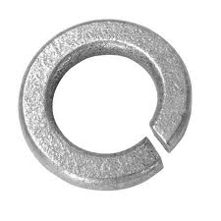
Lock Washer
It should not be used on wood.
Notes:
Fasteners-Washers Image: LockWasher.jpg Height: 135 Width: 135

Slide 24
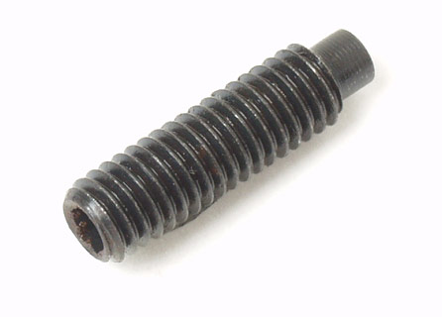
Set Screw
When screwed into a set collar the cup point makes an indentation in the shaft preventing the collar from vibrating loose.
Notes:
Fasteners-Screws Image: SetScrew.jpg Height: 192 Width: 267.6

Slide 25
Sheet Metal Screws
Head types are flat, round, pan, oval and binding.
Notes:
Fasteners-Screws Image: SheetMetal.gif Height: 41.4 Width: 100.2

Slide 26
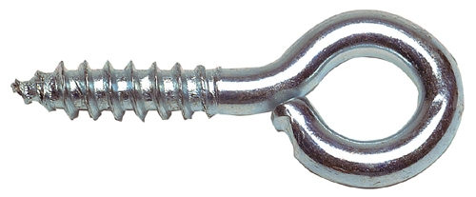
Screw Eye
It may be described as a screw with an eye or ring head.
Notes:
Fasteners-Screws Image: Screw Eye.jpg Height: 99.36 Width: 240

Slide 27
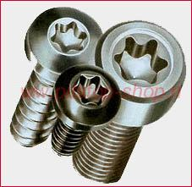
Torx Head Screws
The head is similar to the Phillips but having a six point star shaped opening in the center of the head rather than a four point star.
Notes:
Fasteners-Screws Image: TorxScrew.jpg Height: 221 Width: 227

Slide 28
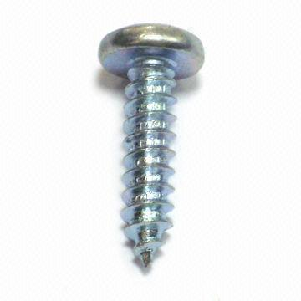
Self Tapping Screws
Screw has a sharp point with coarse threads that make their own threads when screwed into a pre-drilled hole that is smaller than the diameter of the screw.
Notes:
Fasteners-Screws Image: screw6.jpg Height: 360 Width: 360

Slide 29
Self Drilling Screws
No pre-drilling is necessary when using a self drilling screw.
Notes:
Fasteners-Screws Image: SelfDrilling.gif Height: 48 Width: 119.4

Slide 30
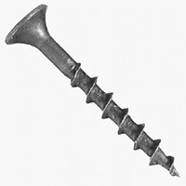
Drywall Screws
All Are Phillips Except the Hex Wafer Head. Used to fasten drywall. Bugle shaped flat head.
Notes:
Fasteners-Screws Image: DrywallScrew.jpg Height: 200 Width: 200

Slide 31
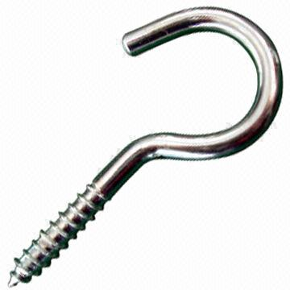
Screw Hook
Can be screw into wood walls or concrete or masonry when pre-drilled and a plastic or lead anchor is used.
Notes:
Fasteners-Screws Image: Screw hook.jpg Height: 360 Width: 360

Slide 32
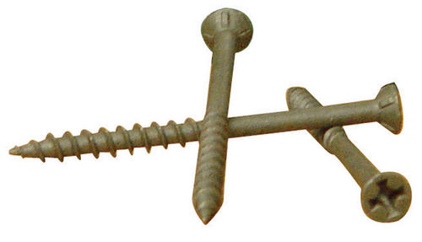
Deck Screws
A straight shank wood screw with a bugle head. Commonly made with a Phillips or square drive 2 1/2" of longer. Coated to prevent rusting.
Notes:
Fasteners-Screws Image: DeckScrew.jpg Height: 206.64 Width: 360

Slide 33
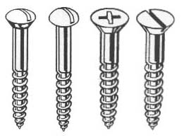
Wood Screws
A tapered screw with a round, oval, or flat head. The threaded portion of the screw is tapered with a very coarse thread and cuts its own thread as it is turned into the wood. Shown L-R oval head, round head, flat head Phillips, and flat head slotted.
Notes:
Fasteners-Screws Image: WoodScrews.jpg Height: 198 Width: 261

Slide 34
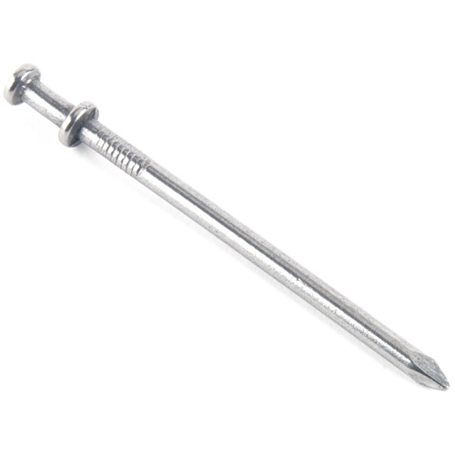
Duplex-Head Nail
The point is sharp, and there are two heads, one above the other, to make removal easy. Common sizes 6d, 8d, 16d.
Notes:
Fasteners-Nails Image: DUPLEX.jpg Height: 500 Width: 500

Slide 35
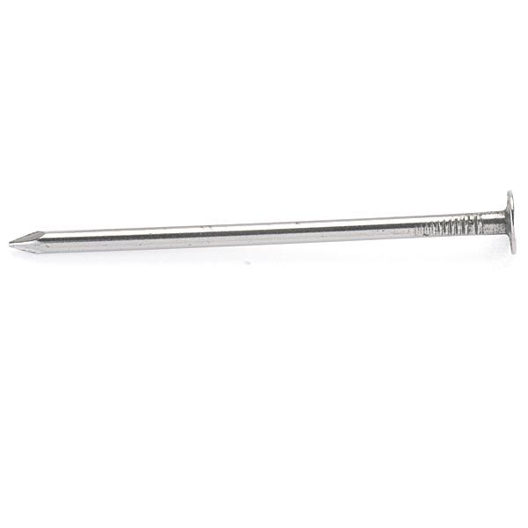
Box Nail
Roughly speaking, d equals 1/4 inch in length, but this is not constant. The shank is smaller in diameter than the common nail to prevent splitting of the wood. Common sizes 2d to 16d
Notes:
Fasteners-Nails Image: BOXNAIL2.jpg Height: 450 Width: 450

Slide 36
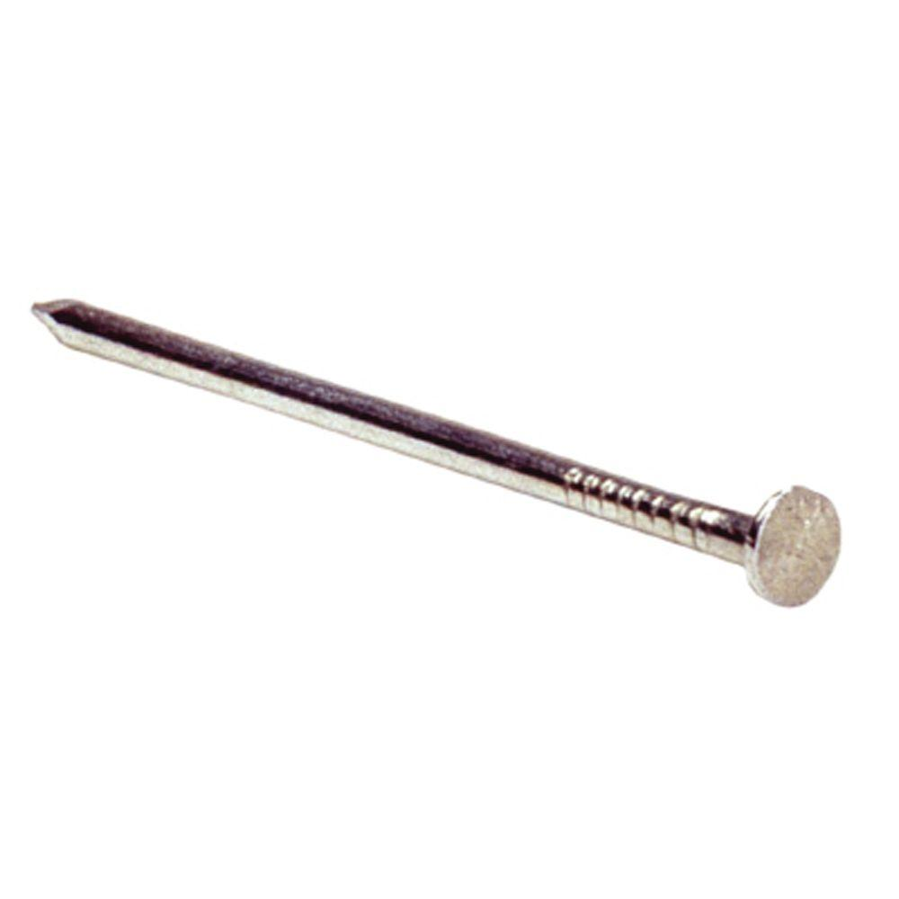
Common Nail
Roughly speaking, d equals 1/4 inch in length, but this is not constant. The shank is larger in diameter than the box nail making the nail less likely to bend. Common sizes 2d – 20d. Sizes larger then 20d are often called spikes.
Notes:
Fasteners-Nails Image: commonsmooth.jpg Height: 1000 Width: 1000

Slide 37
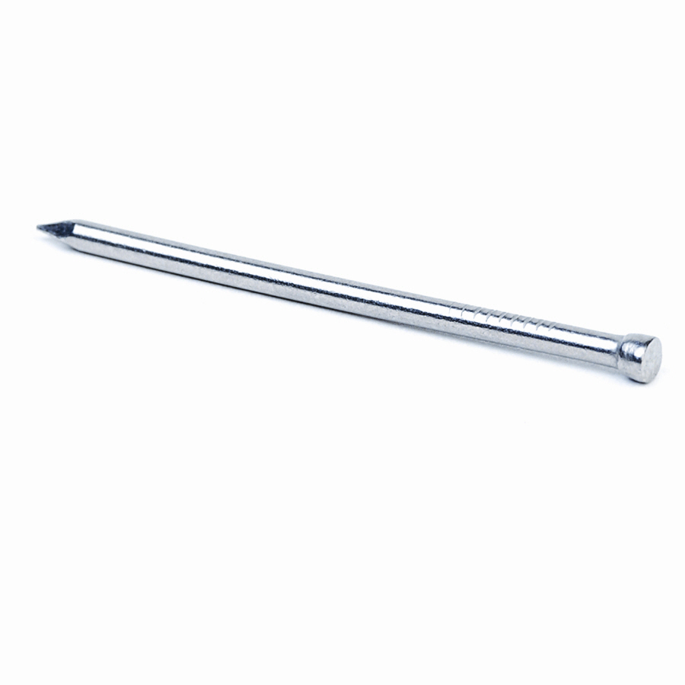
Finish Nail
The sizes range from 2d to 20d. The nail is designed to be counter sunk and the hole filled.
Notes:
Fasteners-Nails Image: finish.jpg Height: 900 Width: 900

Slide 38
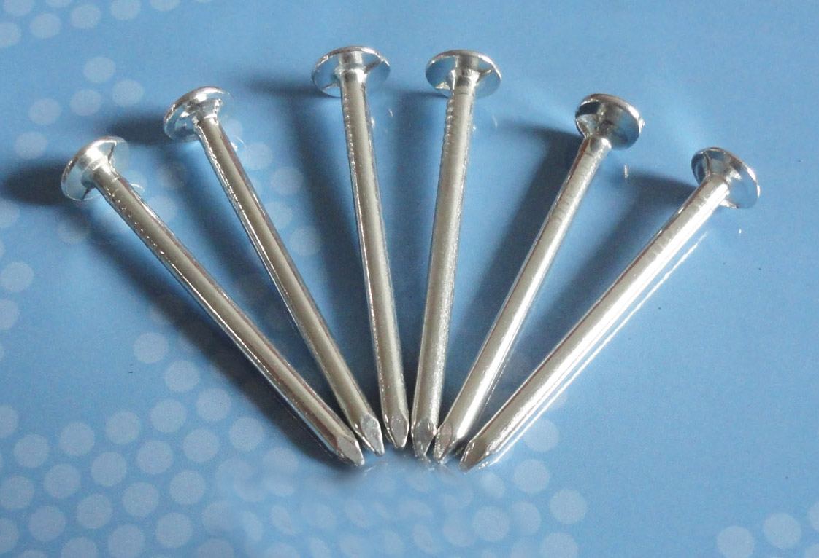
Galvanized Nail
Common, box, and finish nails are available for exterior use with a galvanized coating. The coating may be hot dipped (thicker) or electro-plated (EG).
Notes:
Fasteners-Nails Image: GalvNail.jpg Height: 766 Width: 1122

Slide 39
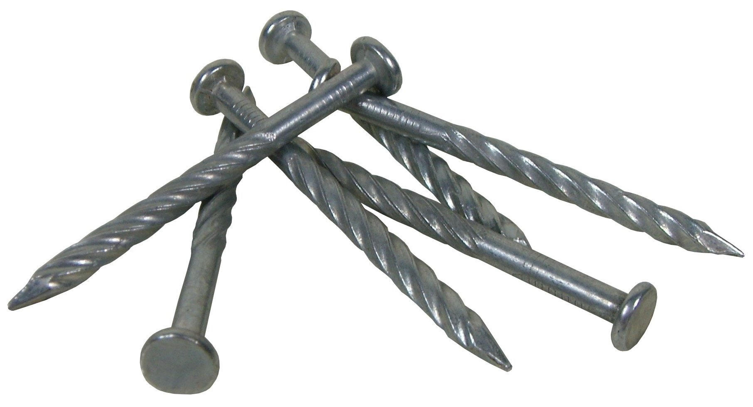
Spiral Shank Nails
Designed for the construction and repair of wood pallets. These spiral shank nails are also good for re-nailing wagon beds, trailers.
Notes:
Fasteners-Nails Image: SprialShankNail.jpg Height: 235.44 Width: 434.88

Slide 40
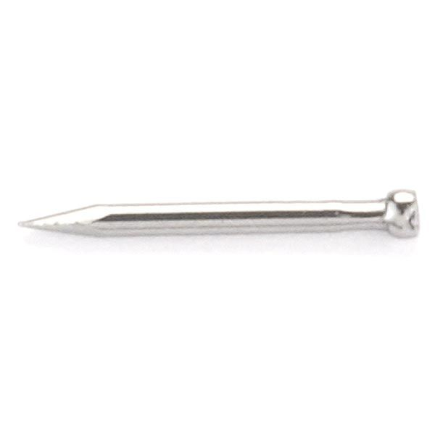
Wire Brad
The size is expressed in wire gauge and ranges from 1/4 to 1 1/2 inches long.
Notes:
Fasteners-Nails Image: WireBrad.jpg Height: 450 Width: 450

Slide 41
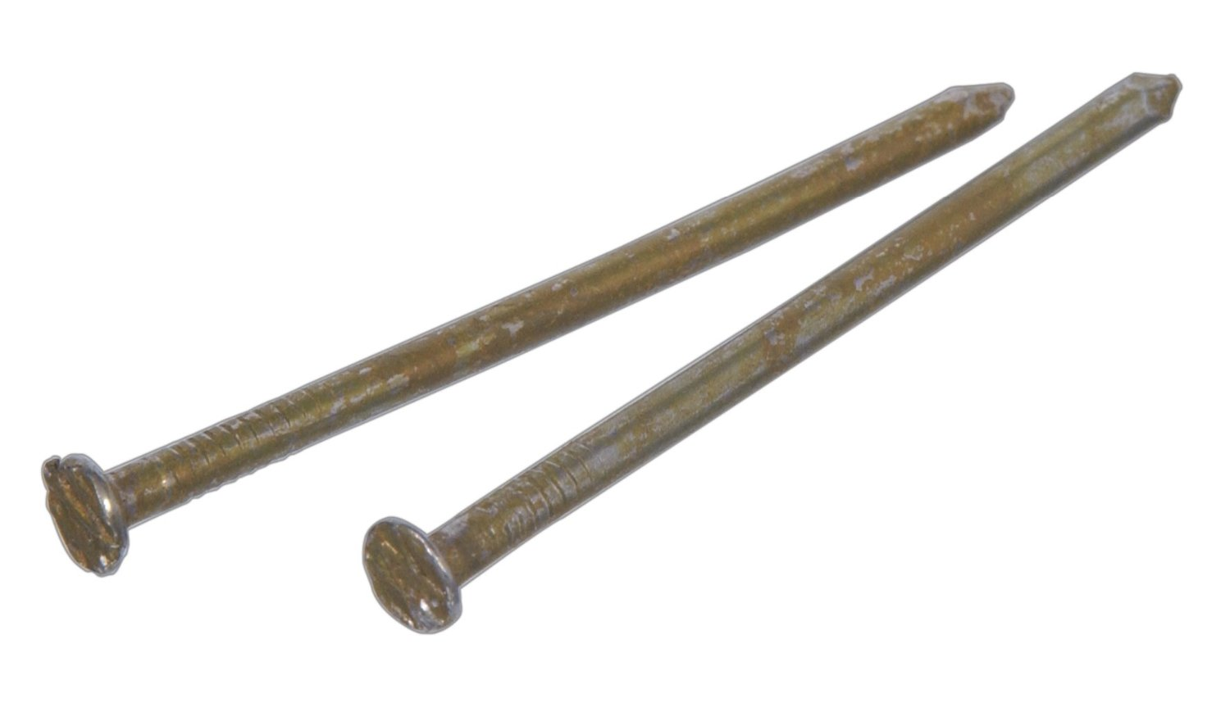
Cement Coated Nails
Sizes range from 2d to 16d. Commonly found in a green coating in 8d and 16d ("sinkers").
Notes:
Fasteners-Nails Image: CoatedNail.jpg Height: 531.6 Width: 900

Slide 42
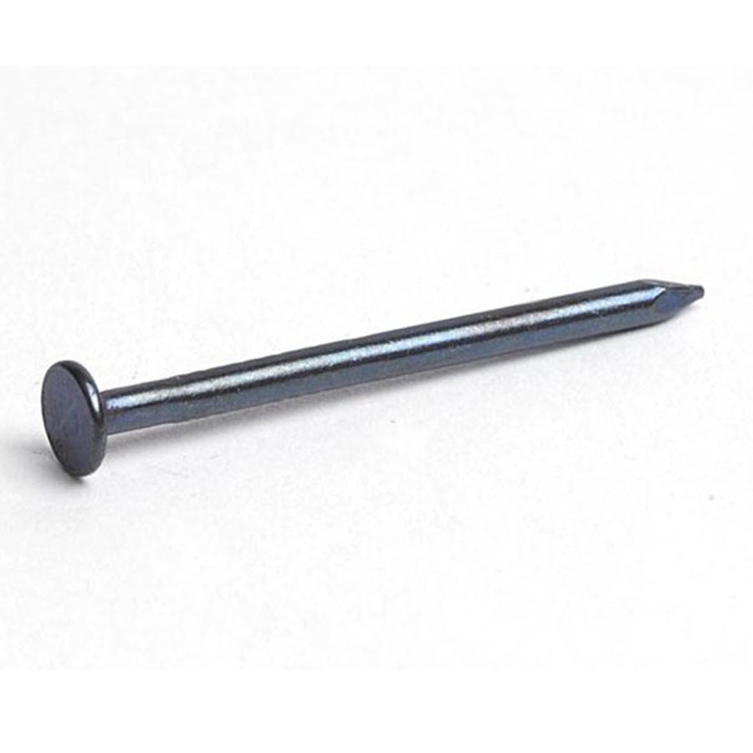
Blue Plaster Board Nail
The range in size is 1 to 1 1/2 inches.
Notes:
Fasteners-Nails Image: BluedLathNail.jpg Height: 900 Width: 900

Slide 43
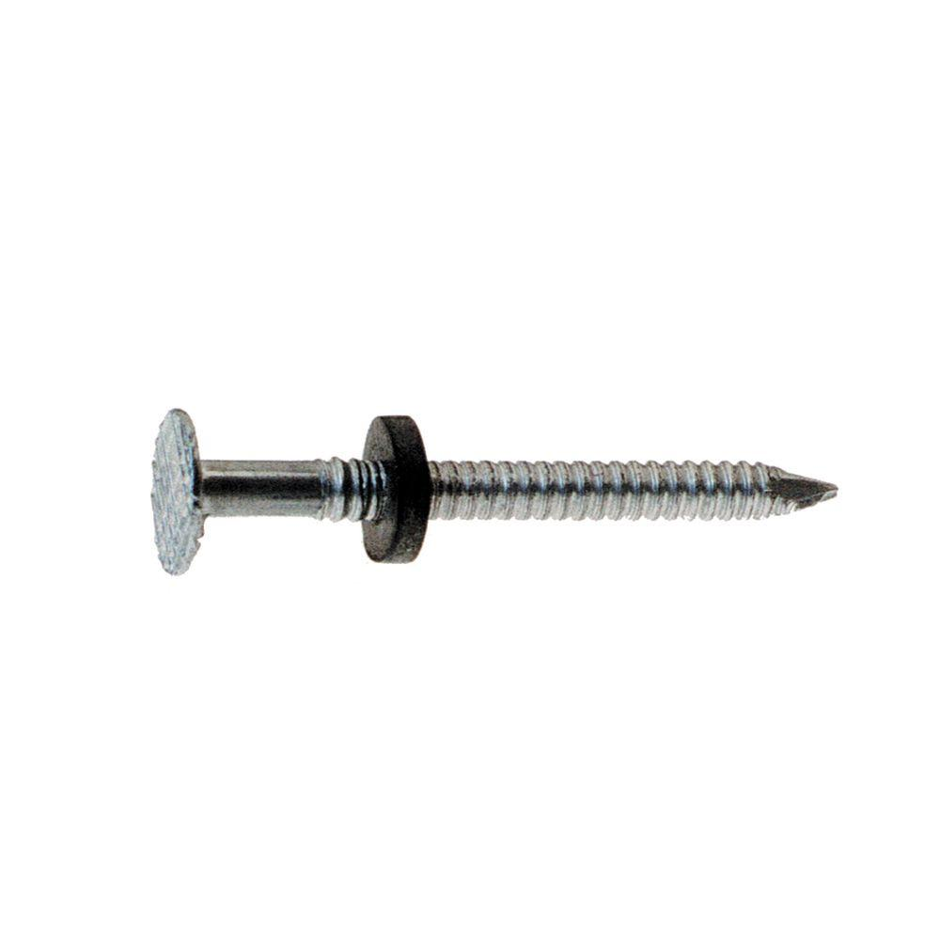
Aluminum Roofing Nails
Sizes range from 1 to 1 1/2 inches long. Used to apply aluminum roofing.
Notes:
Fasteners-Nails Image: AlRoofingNail.jpg Height: 1000 Width: 1000

Slide 44
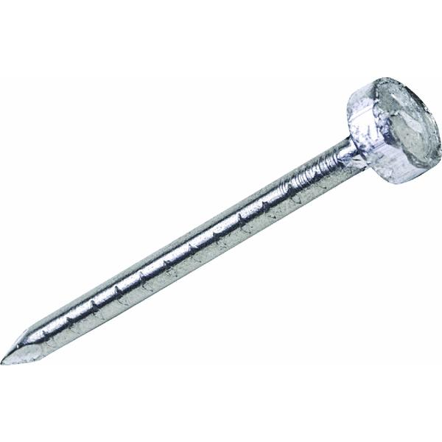
Lead-Head Nails
Lead washer is to prevent oxidation between the head of the nail and the galvanized roofing and also prevents leakage.
Notes:
Fasteners-Nails Image: LeadHeadNail.jpg Height: 450 Width: 450

Slide 45
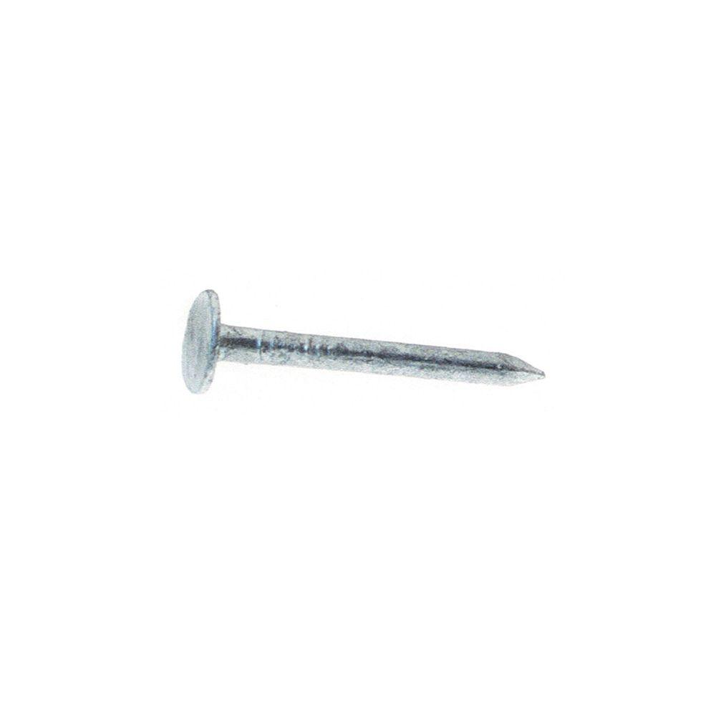
Galvanized Shingle Nail
The 3d is generally used for shingling.
Notes:
Fasteners-Nails Image: ShingleNail.jpg Height: 1000 Width: 1000

Slide 46
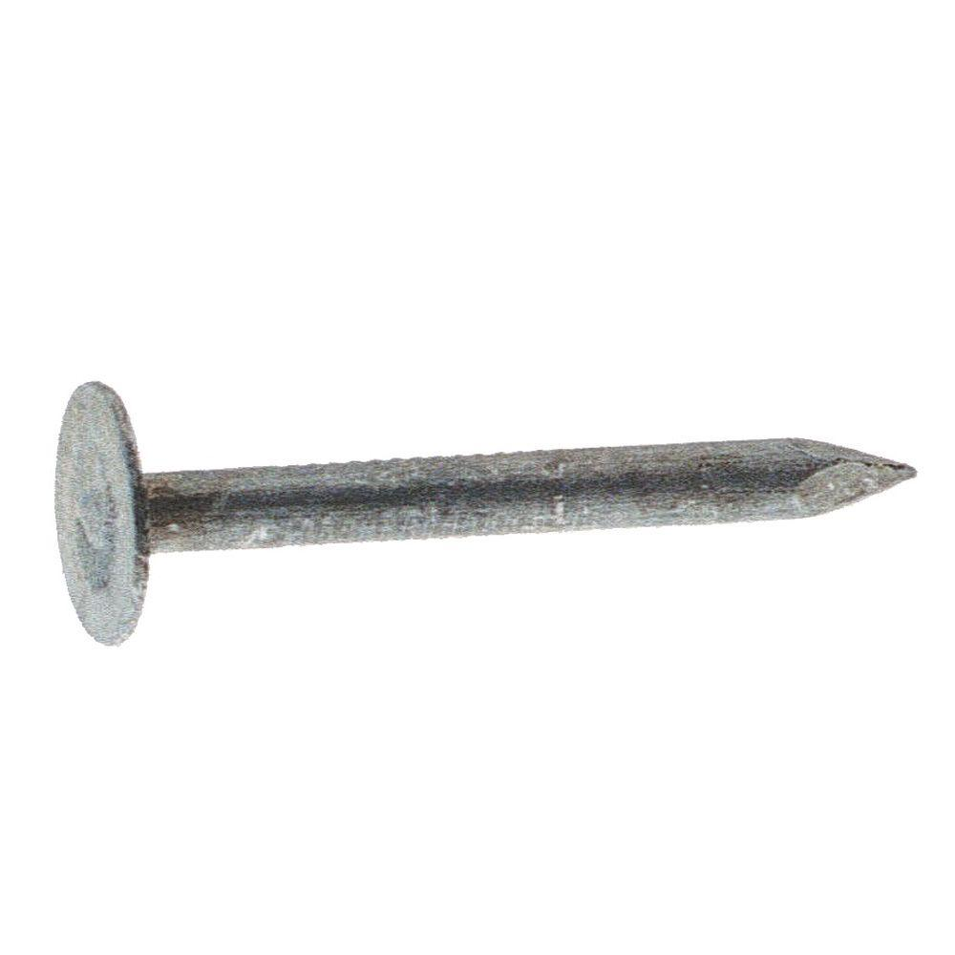
Galvanized Roofing Nail
The head is about 1/2 inch in diameter, and the length ranges from ¾ to 2 inches.
Notes:
Fasteners-Nails Image: RoofingNail.jpg Height: 1000 Width: 1000

Slide 47
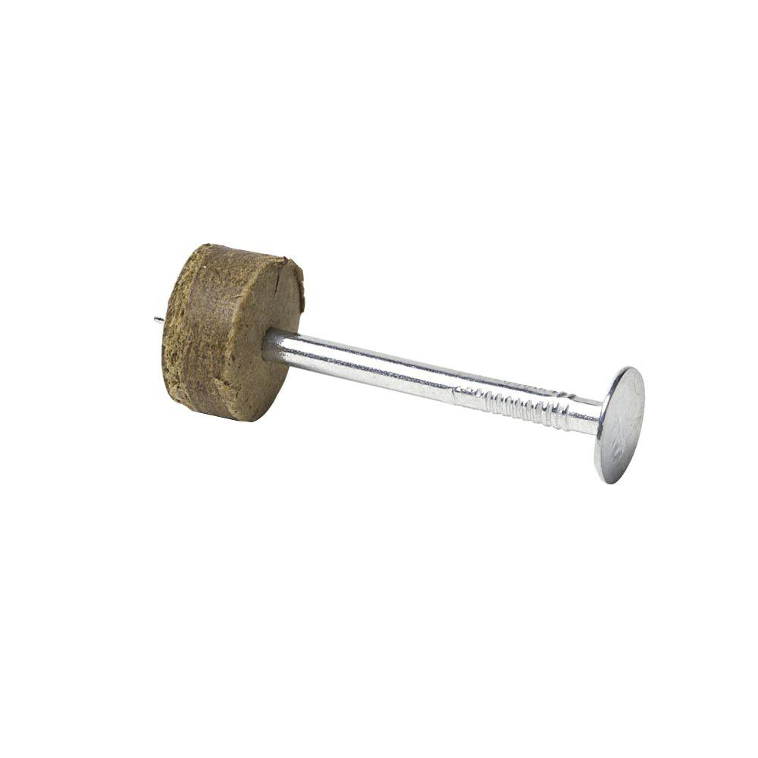
Furring Nail
This allows the wire to become a reinforcing agent and the nails hold the plaster to the wall.
Notes:
Fasteners-Nails Image: FurringNail.jpg Height: 1000 Width: 1000

Slide 48
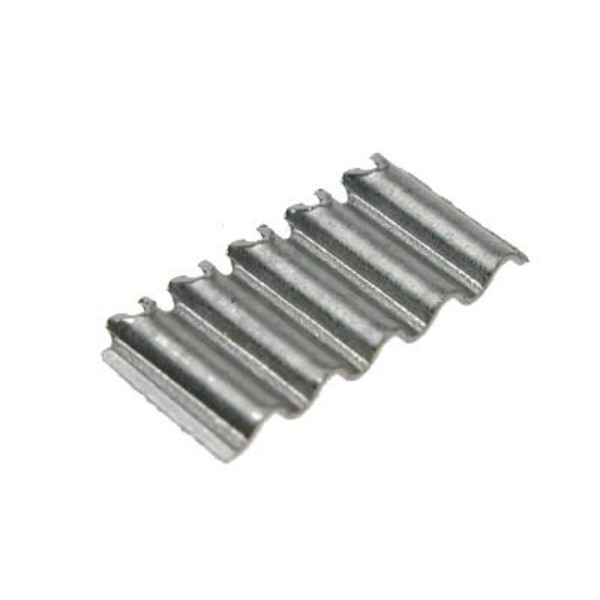
Corrugated Fastener
The size is 1/4 to 1 inch in depth and 2 to 7 corrugations. Used to fasten wood.
Notes:
Fasteners-Miscellaneous Fasteners Image: CorrigatedFastener.jpg Height: 800 Width: 800

Slide 49
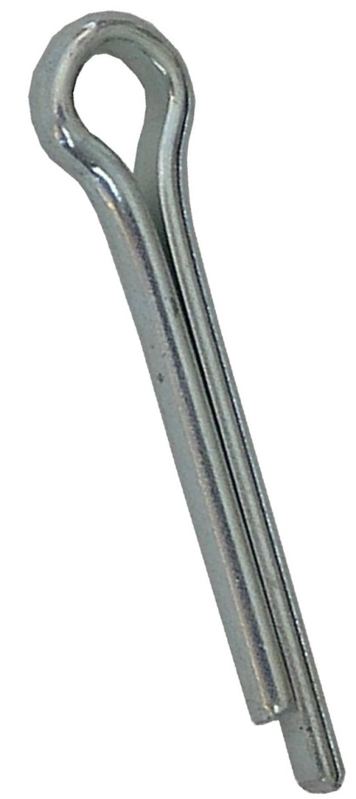
Cotter Pin
This prevents the nut from working loose. Also called a Cotter Key.
Notes:
Fasteners-Miscellaneous Fasteners Image: cotterPin.jpg Height: 287.76 Width: 128.64

Slide 50
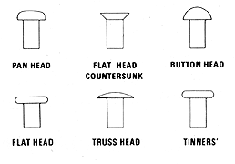
Soft Iron Rivet
The size is based on length and diameter.
Notes:
Fasteners-Rivets Image: rivet.gif Height: 108 Width: 154.8

Slide 51
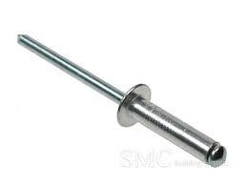
Pop Rivet
A pop rivet tool is required to set the rivet.
Notes:
Fasteners-Rivets Image: PopRivet.jpg Height: 116.4 Width: 155.4

Slide 52
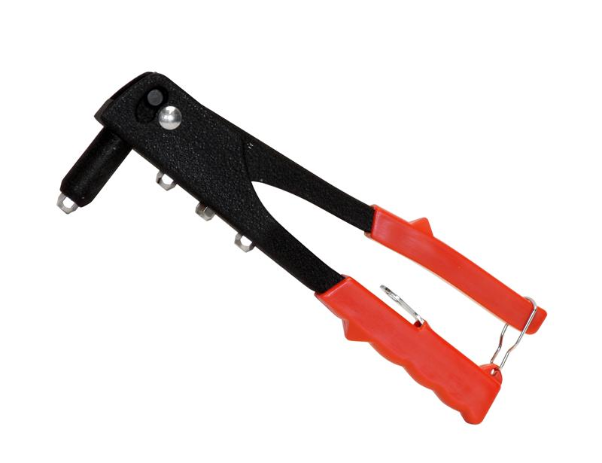
Pop Rivet Tool
Tool is adjustable to use the various sizes (diameter) of rivets available.
Notes:
Fasteners-Rivets Image: PopRivetTool.jpg Height: 461.25 Width: 600

Slide 53
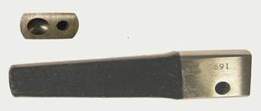
Rivet Set
A rivet set is a small bar of steel with a hole drilled in the end to receive the rivet, and with a cup-like depression for forming a round head on the rivet.
Notes:
Fasteners-Rivets Image: RivetSet.jpg Height: 35.04 Width: 81.84

