Slide 1
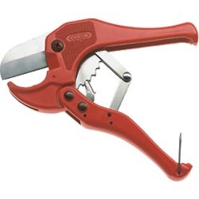
PVC Pipe Cutter
This cutter makes smooth clean cuts on small diameter PVC pipe. Also used with polyethylene (PEX) tubing.
Notes:
Plumbing Tools And Supplies-Plumbing Tools and Supplies Image: PVC_Cutter.jpg Height: 250 Width: 250

Slide 2
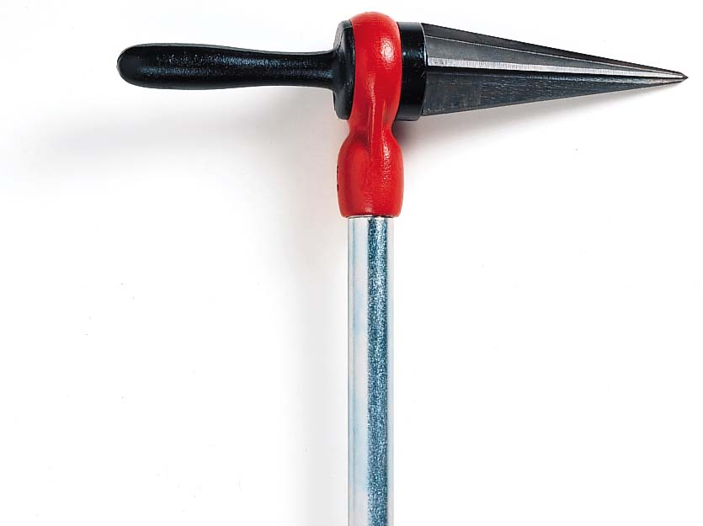
Pipe or Burring Reamer
This type of reamer is made with bit brace shank, round shank, or “T” handle.
Notes:
Plumbing Tools And Supplies-Plumbing Tools and Supplies Image: Pipe Reamer.jpg Height: 147.5409 Width: 197.1147

Slide 3
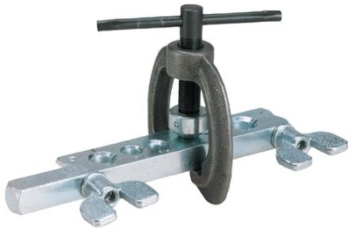
Flaring Tool
Used to make flared ends for soft tempered tubing.
Notes:
Plumbing Tools And Supplies-Plumbing Tools and Supplies Image: Flaring Tool.jpg Height: 290 Width: 450

Slide 4
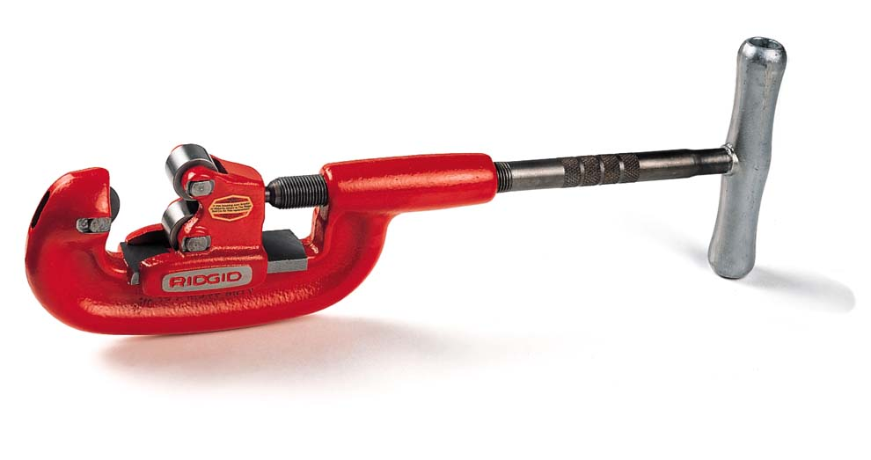
Pipe Cutter
Too much pressure on the handle may cause the cutting wheel to break.
Notes:
Plumbing Tools And Supplies-Plumbing Tools and Supplies Image: pipe cutter.jpg Height: 123.4623 Width: 233.7049

Slide 5
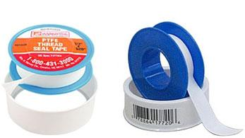
Teflon Tape
Used for sealing threads on metal and PVC pipe and on valves.
Notes:
Plumbing Tools And Supplies-Plumbing Tools and Supplies Image: TeflonTape.jpg Height: 146.25 Width: 260.25

Slide 6
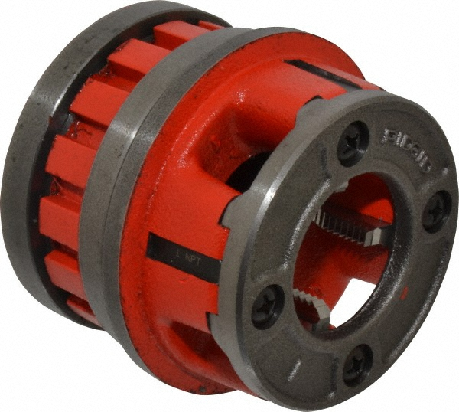
Pipe Die
Pipe dies should not be used for bolt threading as they are tapered.
Notes:
Plumbing Tools And Supplies-Plumbing Tools and Supplies Image: Pipe die.jpg Height: 538 Width: 600

Slide 7
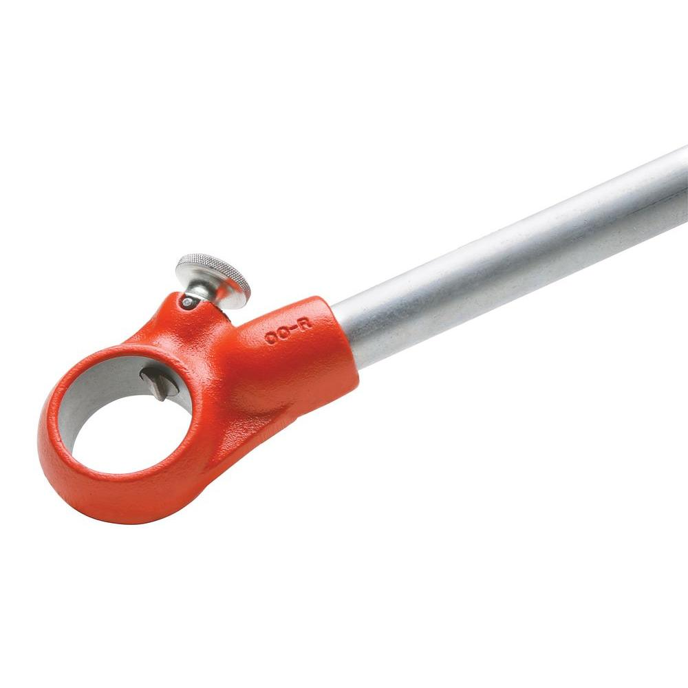
Pipe Die Stock
Operates as a ratchet in both directions. Hold the pipe die.
Notes:
Plumbing Tools And Supplies-Plumbing Tools and Supplies Image: Pipe Die Stock.jpg Height: 1000 Width: 1000

Slide 8
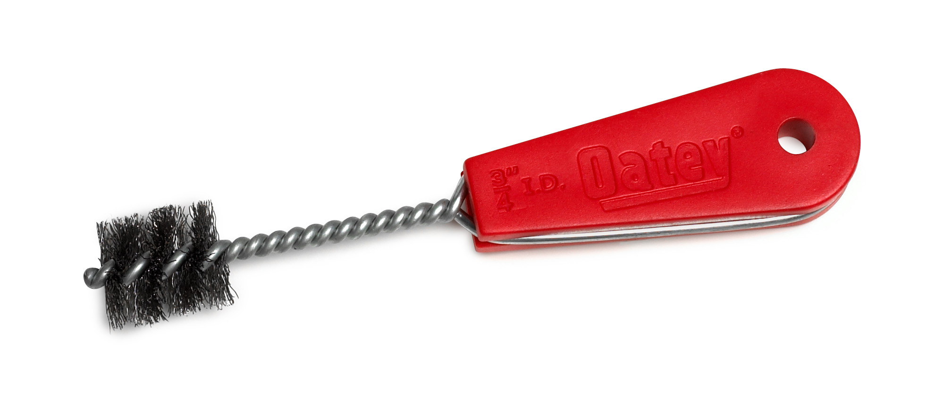
Copper Fitting Brush
Used to clean metal parts to be soldered or welded and for cleaning pipe threads.
Notes:
Plumbing Tools And Supplies-Plumbing Tools and Supplies Image: CopperFittingBrush.jpg Height: 203.76 Width: 475.92

Slide 9
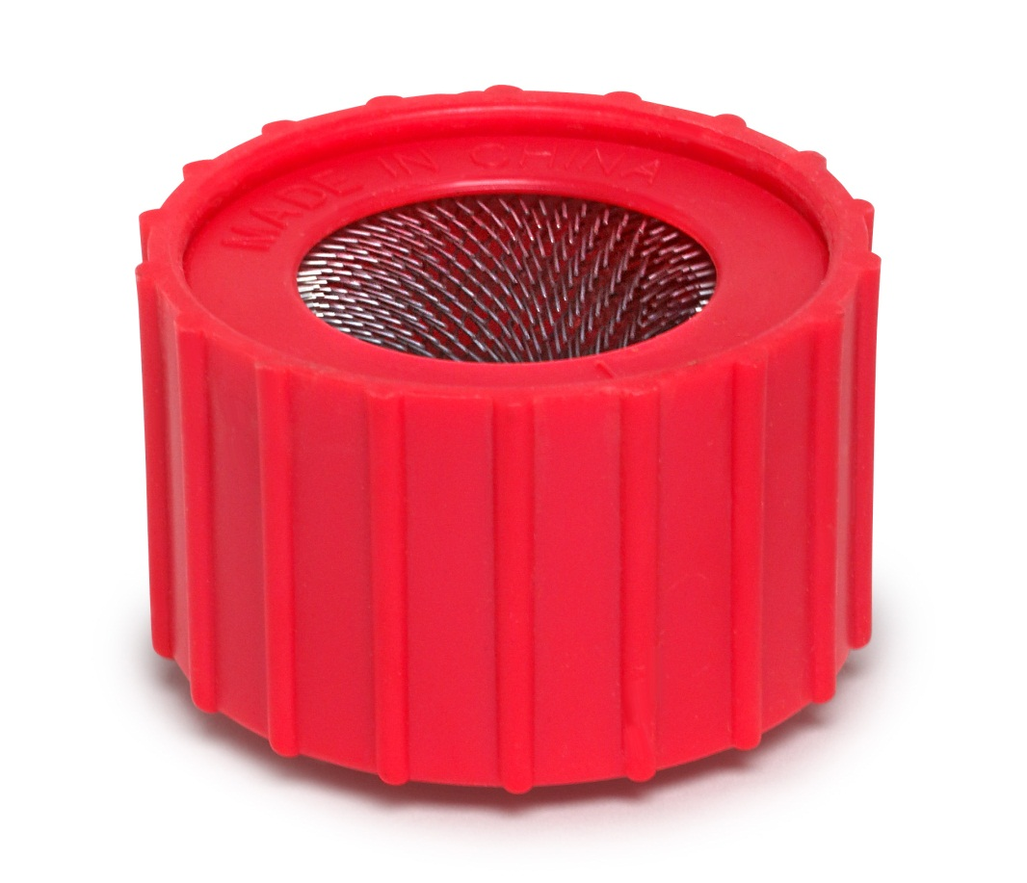
Copper Tube Cleaning Brush
A wire brush used to clean copper pipe or tubing for soldering. Comes in sizes 1/2" to 1".
Notes:
Plumbing Tools And Supplies-Plumbing Tools and Supplies Image: O.D. Tubing Brush.jpg Height: 392.16 Width: 455.76

Slide 10
Pipe Tap
Used to cut internal threads in pipe fittings.
Notes:
Plumbing Tools And Supplies-Plumbing Tools and Supplies Image: Pipe Tap2.jpg Height: 20.1 Width: 75

Slide 11
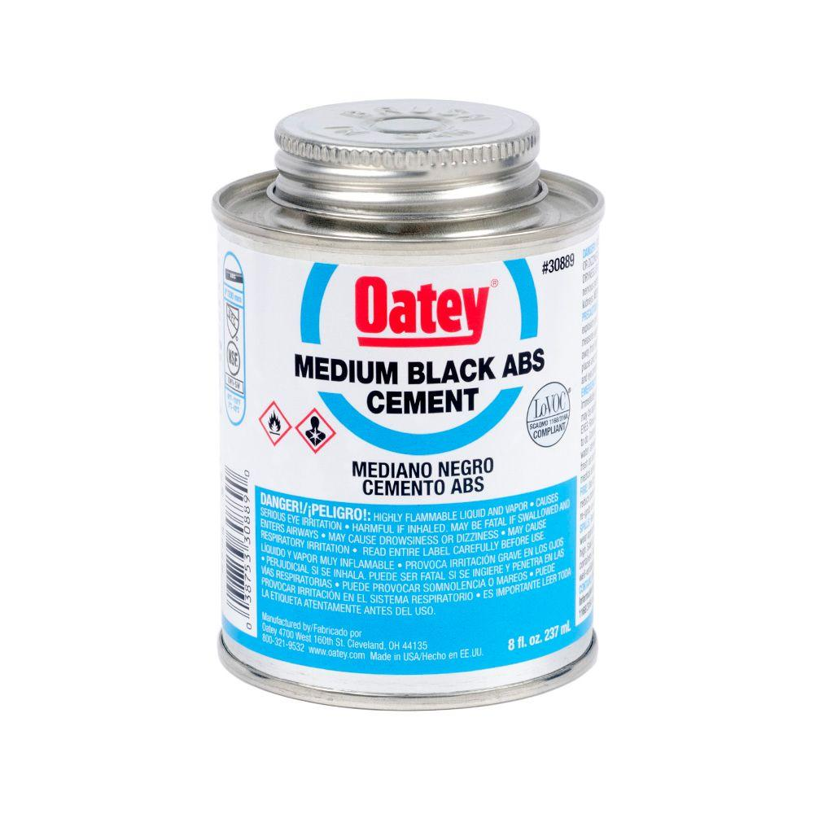
ABS Cement
Used to connect ABS Plastic pipe and fitting. Black in color. Not compatable with PVC Pipe.
Notes:
Plumbing Tools And Supplies-Plumbing Tools and Supplies Image: ABS_Cement.jpg Height: 1000 Width: 1000

Slide 12
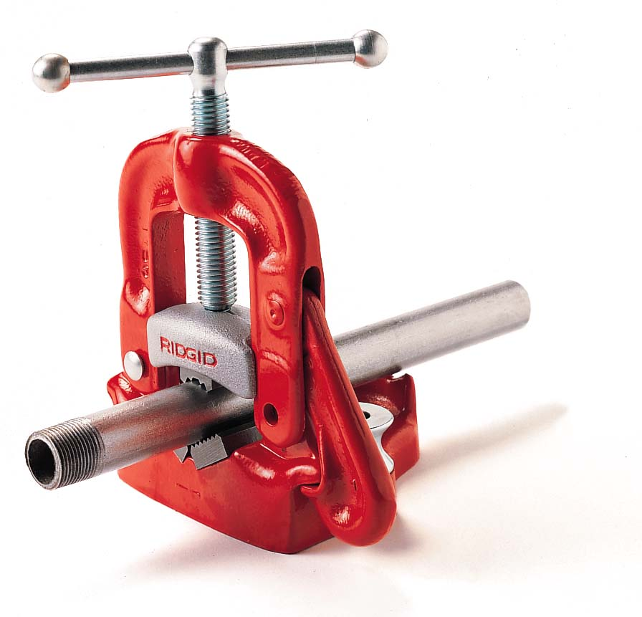
Pipe Vise
Used for holding pipe while cutting and threading.
Notes:
Plumbing Tools And Supplies-Plumbing Tools and Supplies Image: pipe vise.jpg Height: 203.2524 Width: 211.5147

Slide 13
Pipe Wrench
Adjustable and is used to turn pipe or conduit or round stock. Sizes 6" -18" in length are common, but can be much larger.
Notes:
Plumbing Tools And Supplies-Plumbing Tools and Supplies Image: Pipe Wrench.jpg Height: 64.44591 Width: 215.7639

Slide 14
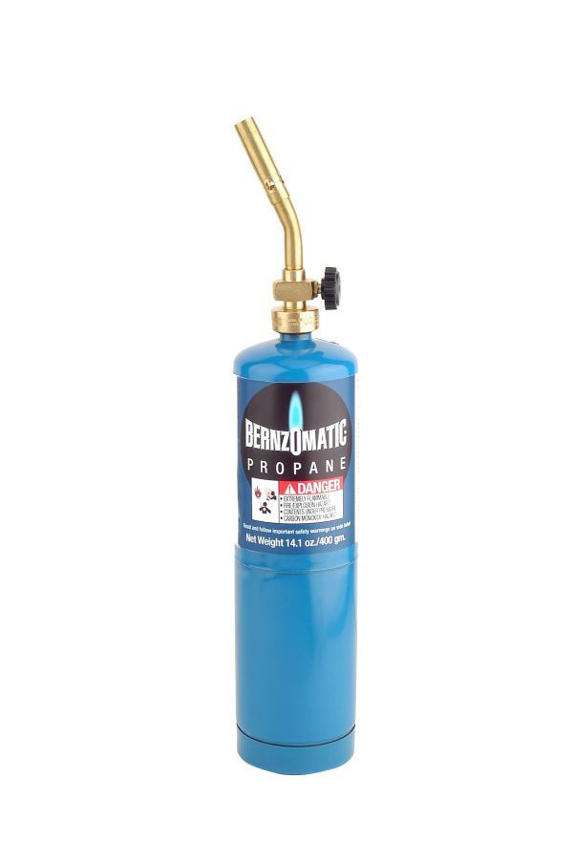
Propane Torch
A propane/air torch that develops temperatures suitable for soldering.
Notes:
Plumbing Tools And Supplies-Plumbing Tools and Supplies Image: PropaneTorch.jpg Height: 216.48 Width: 144

Slide 15
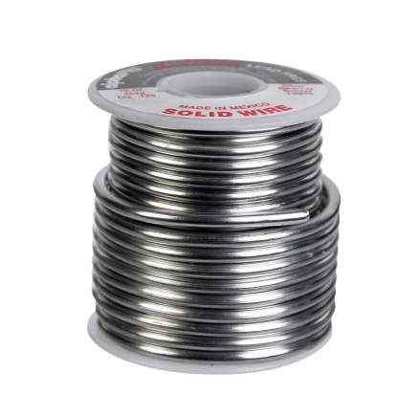
Solid Solder
It is available in I or 5 pound spools. Lead free solder is used for plumbing of domestic copper pipe.
Notes:
Plumbing Tools And Supplies-Plumbing Tools and Supplies Image: Plumbing_Solder.jpg Height: 435 Width: 435

Slide 16
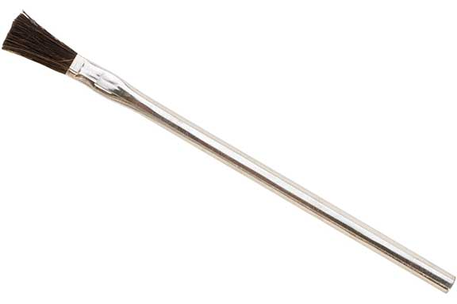
Acid Brush
Used for applying pipe joint compound on threaded pipe and thinner's fluid (acid) or flux on copper pipe for soldering. The handle is tubular sheet metal 3/8 inch in diameter and 6 inches long.
Notes:
Plumbing Tools And Supplies-Plumbing Tools and Supplies Image: AcidBrush.jpg Height: 230.4 Width: 345.6

Slide 17
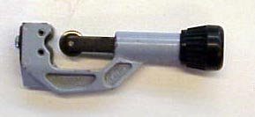
Tubing Cutter
Used to cut copper and aluminum tubing.
Notes:
Plumbing Tools And Supplies-Plumbing Tools and Supplies Image: cutter5.jpg Height: 133 Width: 289

Slide 18
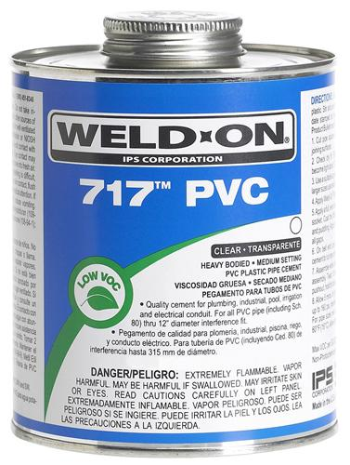
PVC Glue
When gluing, apply glue to both the fitting and the pipe, slide the two pieces together and rotate 1/4 turn for good adhesion. Glue comes in a variety of thicknesses, set times, and colors.
Notes:
Plumbing Tools And Supplies-Plumbing Tools and Supplies Image: PVC_Cement.jpg Height: 375 Width: 282.75

Slide 19
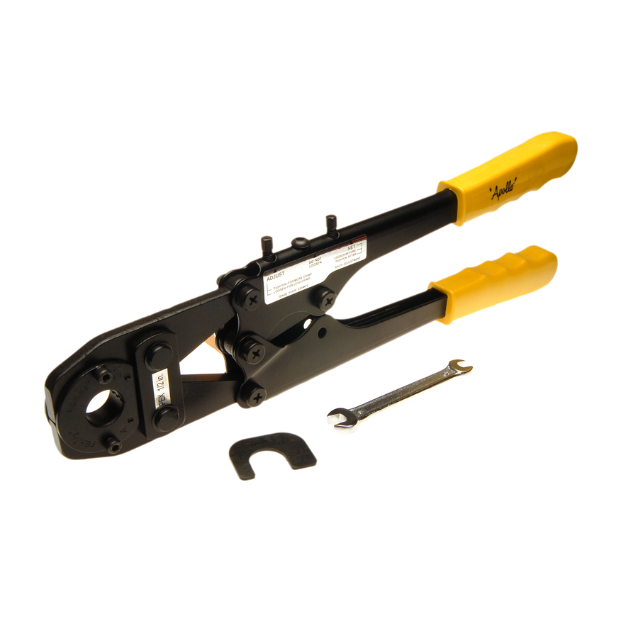
PEX Crimp Tool
Use to close the crimp fasteners that hold PEX pipe to fittings. There are a number of other systems in use.
Notes:
Plumbing Tools And Supplies-Plumbing Tools and Supplies Image: PEX Crimp Tool.jpg Height: 900 Width: 900

Slide 20
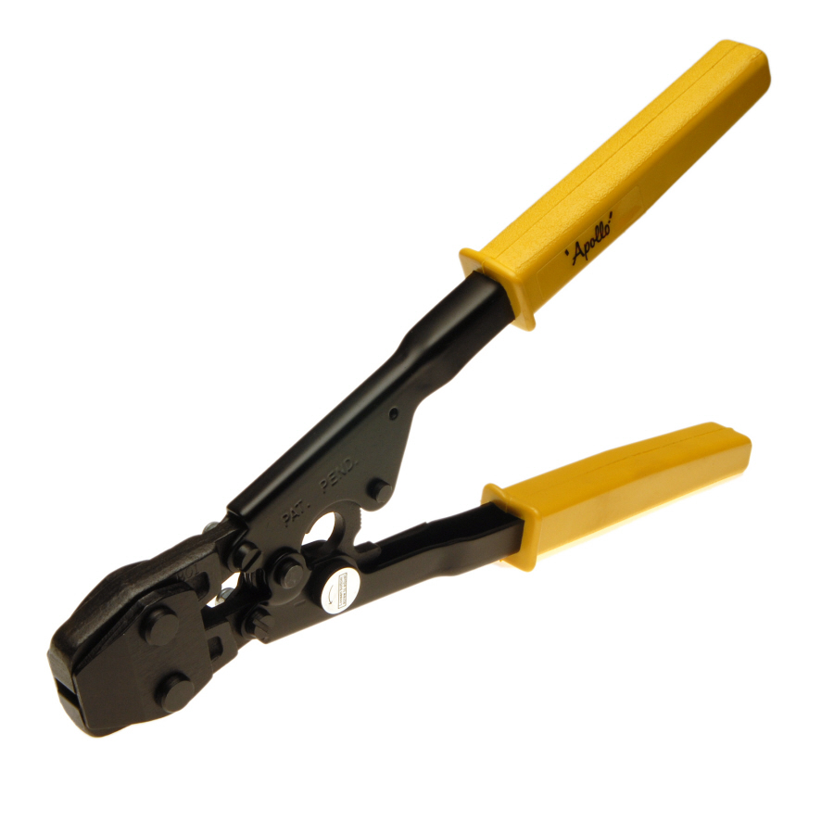
PEX Cinch Tool
Use to close the cinch fasteners that hold PEX pipe to fittings. There are a number of other systems in use.
Notes:
Plumbing Tools And Supplies-Plumbing Tools and Supplies Image: PEX Cinch Tool.jpg Height: 900 Width: 900

Slide 21
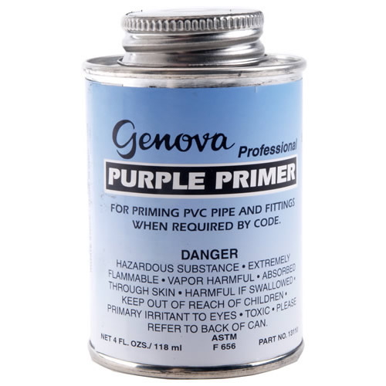
PVC Primer
User to clean and soften PVC pipe before applying cement. Generally recommended for pipe 1" and larger.
Notes:
Plumbing Tools And Supplies-PVC Pipe And Fittings Image: PVC_Primer.jpg Height: 500 Width: 500

Slide 22
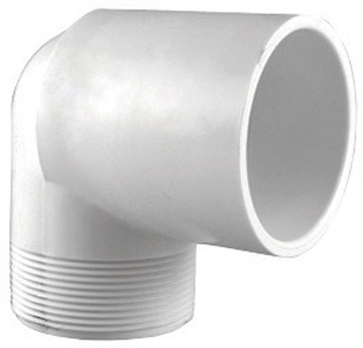
SxT Street Ell.
Used to connect PVC pipe to threaded pipe at an angle. May be threaded on both ends, slip on both ends, or slip-thread.
Notes:
Plumbing Tools And Supplies-PVC Pipe And Fittings Image: PVC_90ST_StreetEll.jpg Height: 368 Width: 384

Slide 23
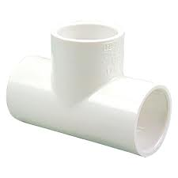
SxSxS Tee
Used to connect three pieces of PVC pipe together. Outlet is commonly smaller than the ends. A typical designation is 1" x 1" x 1/2 SSS Tee. If the outlet is threaded then the designation would be SST.
Notes:
Plumbing Tools And Supplies-PVC Pipe And Fittings Image: PVCTee.jpg Height: 135 Width: 135

Slide 24
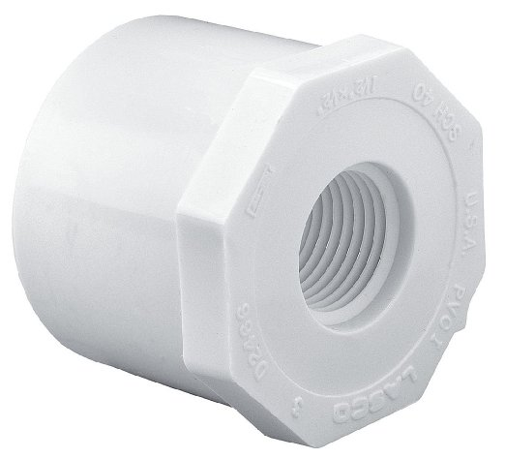
SxT Reducer Bushing
Used to connect PVC pipe to a smaller diameter threaded pipe.
Notes:
Plumbing Tools And Supplies-PVC Pipe And Fittings Image: PVCBushing.jpg Height: 283.8 Width: 313.2

Slide 25
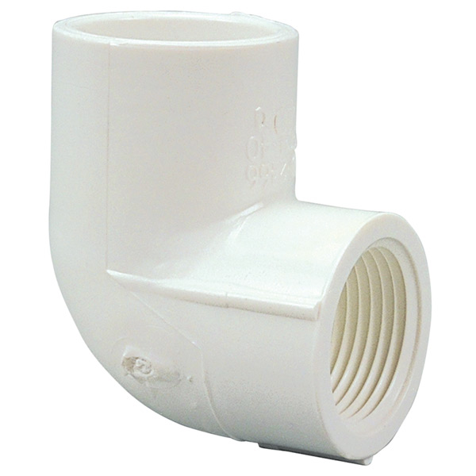
SxT Elbow
Used to connect PVC pipe to threaded pipe at a 45 or 90 degree angle. May change sizes. Such as 3/4" x 1/2" ST Elbow.
Notes:
Plumbing Tools And Supplies-PVC Pipe And Fittings Image: PVC_90ST_Ell.jpg Height: 360 Width: 360

Slide 26
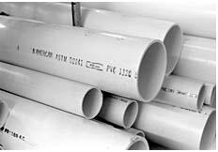
PVC Pipe
Used for cold water purposes, sizes range from 1/2 to 2 inch and it comes in 20 foot lengths.
Notes:
Plumbing Tools And Supplies-PVC Pipe And Fittings Image: PVC_Pipe.jpg Height: 162 Width: 232

Slide 27
SxS Reducer Bushing
Used to connect PVC pipes of different diameters.
Notes:
Plumbing Tools And Supplies-PVC Pipe And Fittings Image: PVCBushing.jpg Height: 283.8 Width: 313.2

Slide 28
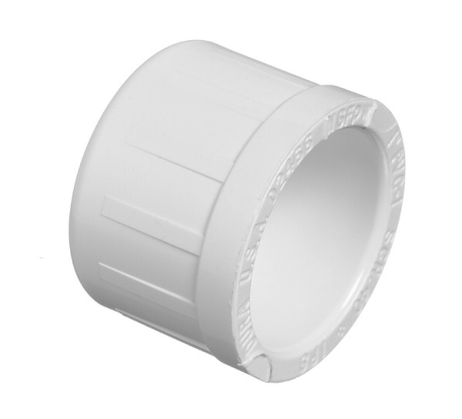
S Cap
Used to stop the flow on PVC pipe. Slip cap is shown, but can be threaded.
Notes:
Plumbing Tools And Supplies-PVC Pipe And Fittings Image: PVCCap.jpg Height: 326.4 Width: 360

Slide 29
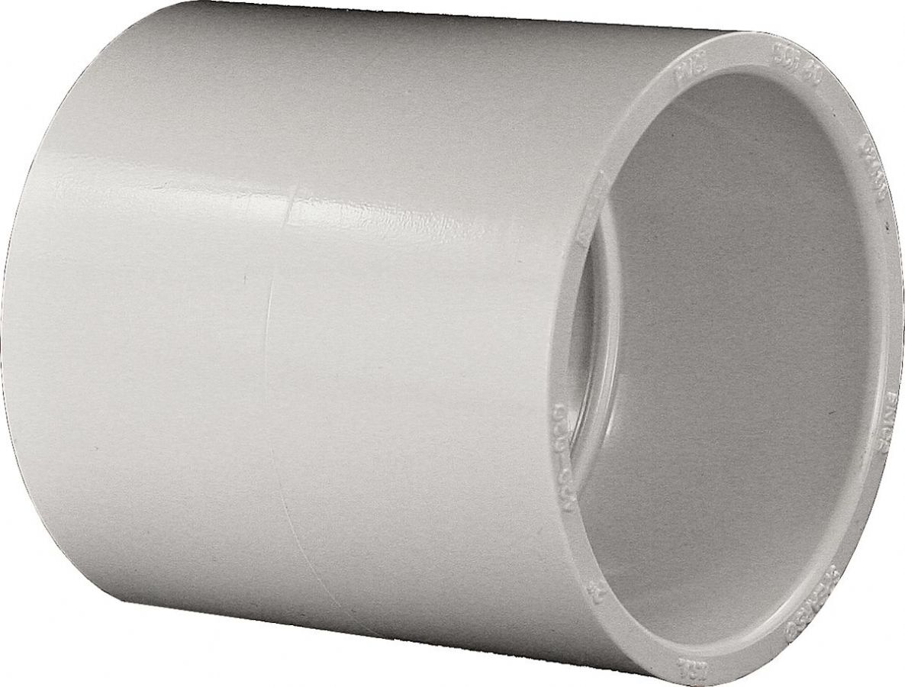
SxS Coupling
Used to connect two pieces of pipe together in a straight line.
Notes:
Plumbing Tools And Supplies-PVC Pipe And Fittings Image: PVCCoupling.jpg Height: 540 Width: 711.6

Slide 30
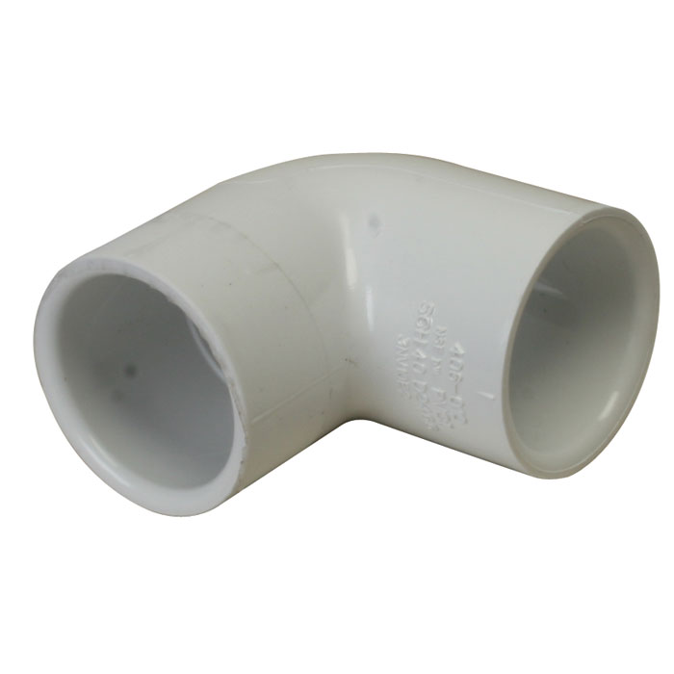
SxS Elbow
Comes in 45 and 90 degree angles.
Notes:
Plumbing Tools And Supplies-PVC Pipe And Fittings Image: PVC_90_Ell.jpg Height: 420 Width: 420

Slide 31
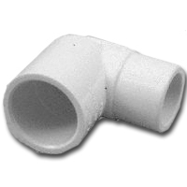
SxS Street Ell
Used to connect two pieces of PVC pipe at an 90 degree angle. One end is male and other is female.
Notes:
Plumbing Tools And Supplies-PVC Pipe And Fittings Image: PVC_StreetEll.jpg Height: 200 Width: 200

Slide 32
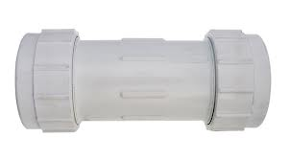
Compression Coupling
Can be used on steel or PVC pipe. Usually used for repair or temporary connections. Seals with a neoprene gasket.
Notes:
Plumbing Tools And Supplies-PVC Pipe And Fittings Image: PVCCompCoupling.jpg Height: 100.2 Width: 181.2

Slide 33
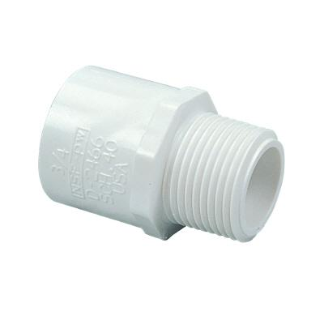
Male Adaptor
The PVC slip end is female and the threaded end is male thread.
Notes:
Plumbing Tools And Supplies-PVC Pipe And Fittings Image: PVCMA.jpg Height: 192 Width: 192

Slide 34
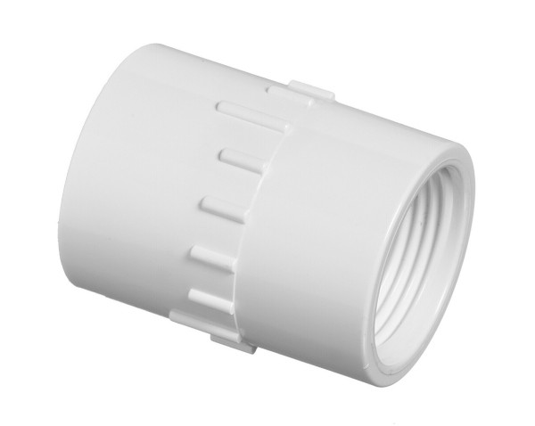
Female Adaptor
Used to connect PVC pipe to threaded pipe, has female ends.
Notes:
Plumbing Tools And Supplies-PVC Pipe And Fittings Image: PVCFA.jpg Height: 286.8 Width: 360

Slide 35
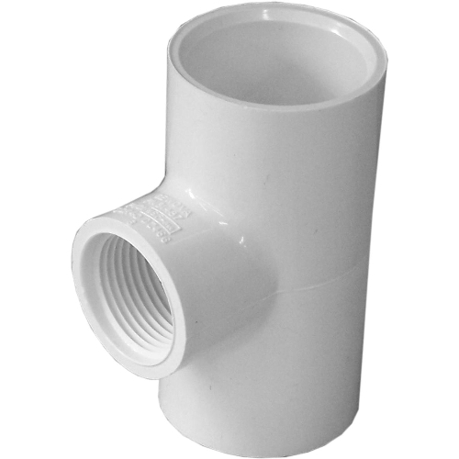
SxSxT Tee
Used to connect a straight length of PVC pipe to a threaded pipe at an intersection. Sizes are given as end, end, middle such as 3/4" x 3/4" x 1/2" SST.
Notes:
Plumbing Tools And Supplies-PVC Pipe And Fittings Image: PVCST_Tee.jpg Height: 375 Width: 375

Slide 36
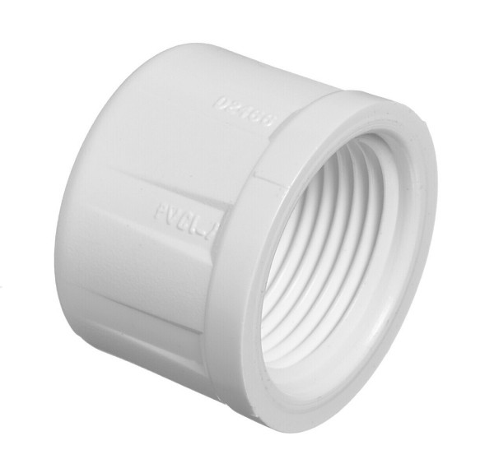
Threaded Cap
Used to stop the flow on threaded pipe.
Notes:
Plumbing Tools And Supplies-PVC Pipe And Fittings Image: PVC threaded-cap.jpg Height: 345 Width: 360

Slide 37
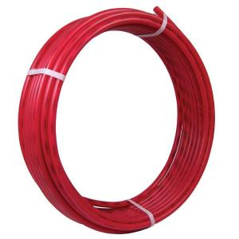
PEX Pipe
Cross-linked polyethylene plastic pipe (tubing) is used for hot and cold water. It is easily worked and used with barbed fittings.
Notes:
Plumbing Tools And Supplies-PEX Pipe And Fittings Image: PEX Pipe.jpg Height: 300 Width: 300

Slide 38
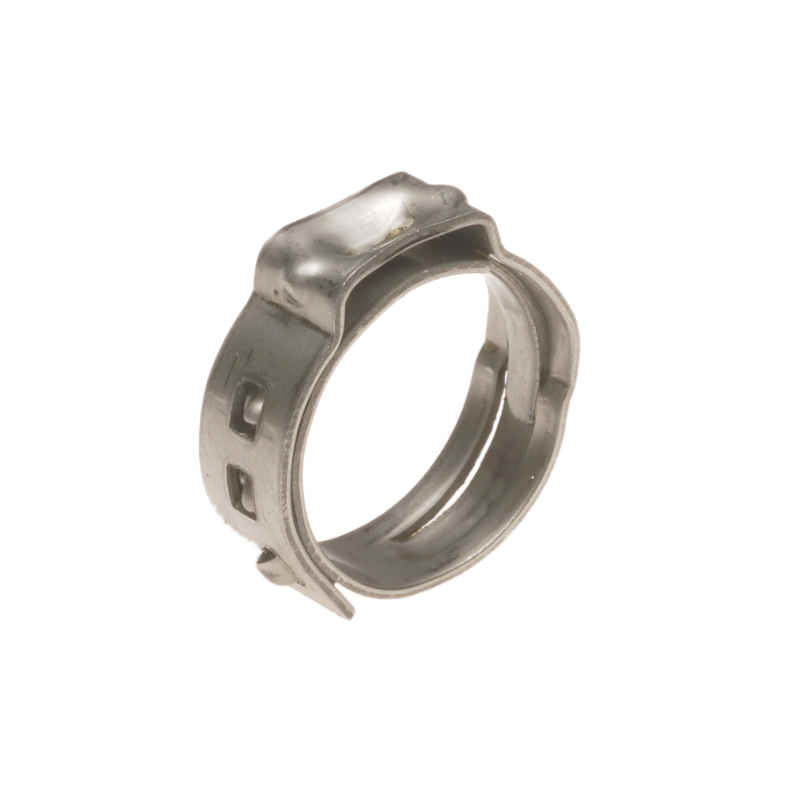
PEX Pinch Clamp
Use to fasten PEX pipe to barbed fittings. Used with a cinch tool. Made of stainless steel.
Notes:
Plumbing Tools And Supplies-PEX Pipe And Fittings Image: PEX Pinch Clamp.jpg Height: 900 Width: 900

Slide 39
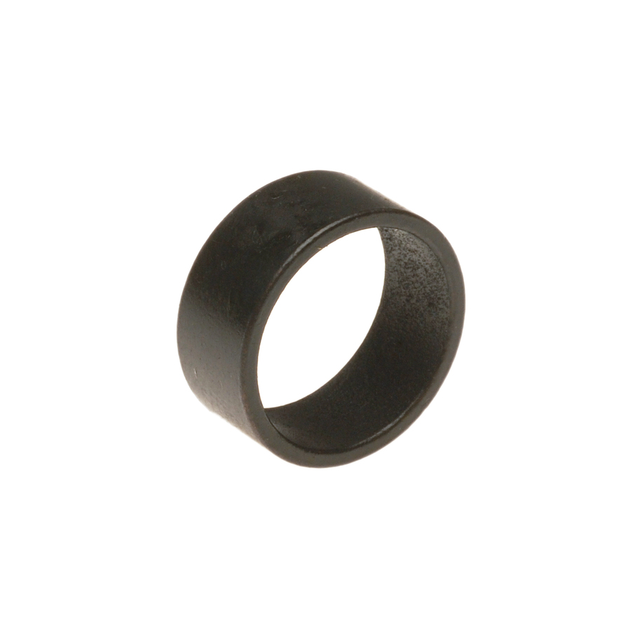
PEX Crimp Ring
Used to hold the PEX pipe on the barbed fitting. Used with a crimp tool. Commonly made of copper.
Notes:
Plumbing Tools And Supplies-PEX Pipe And Fittings Image: PEX Crimp Ring.jpg Height: 900 Width: 900

Slide 40
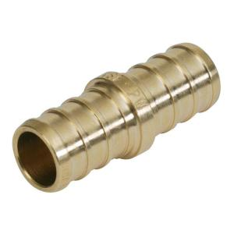
PEX Coupling
Couples PEX pipe.
Notes:
Plumbing Tools And Supplies-PEX Pipe And Fittings Image: PEX Coupling.jpg Height: 300 Width: 300

Slide 41
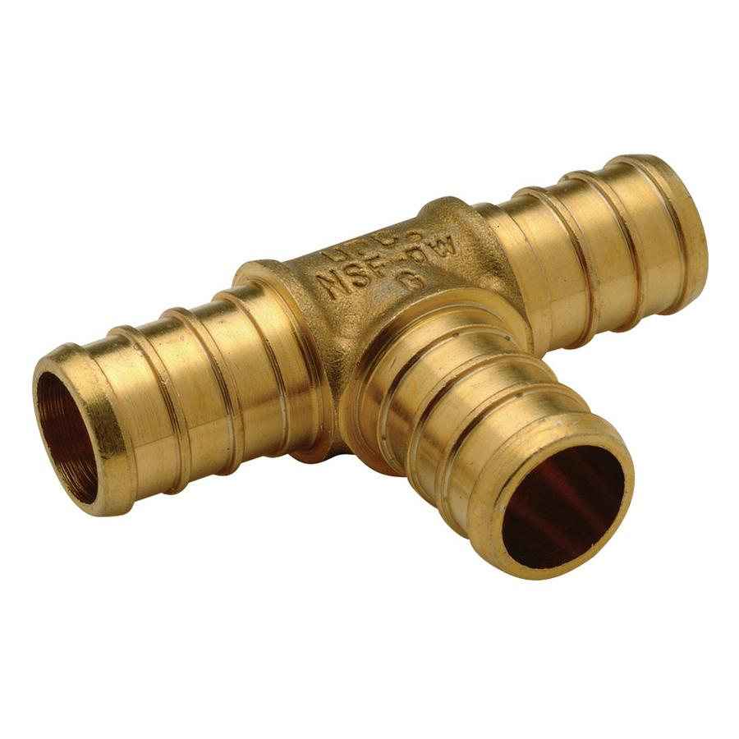
PEX Tee
A barbed tee fitting used with PEX pipe systems. Commonly described by the size or each opening such as 1/2" x 1/2" x 3/4" (end, end, middle).
Notes:
Plumbing Tools And Supplies-PEX Pipe And Fittings Image: PEX Tee.jpg Height: 540 Width: 540

Slide 42
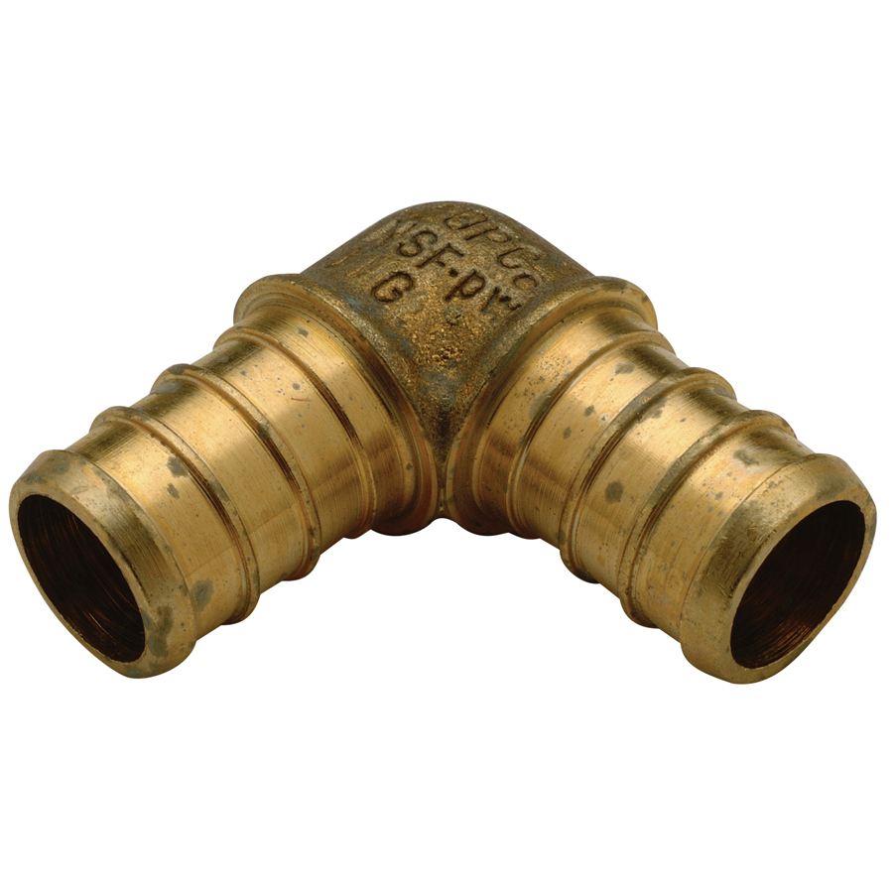
PEX Elbow
A 90 degree barbed elbow used with PEX systems
Notes:
Plumbing Tools And Supplies-PEX Pipe And Fittings Image: PEX Ell.jpg Height: 900 Width: 900

Slide 43
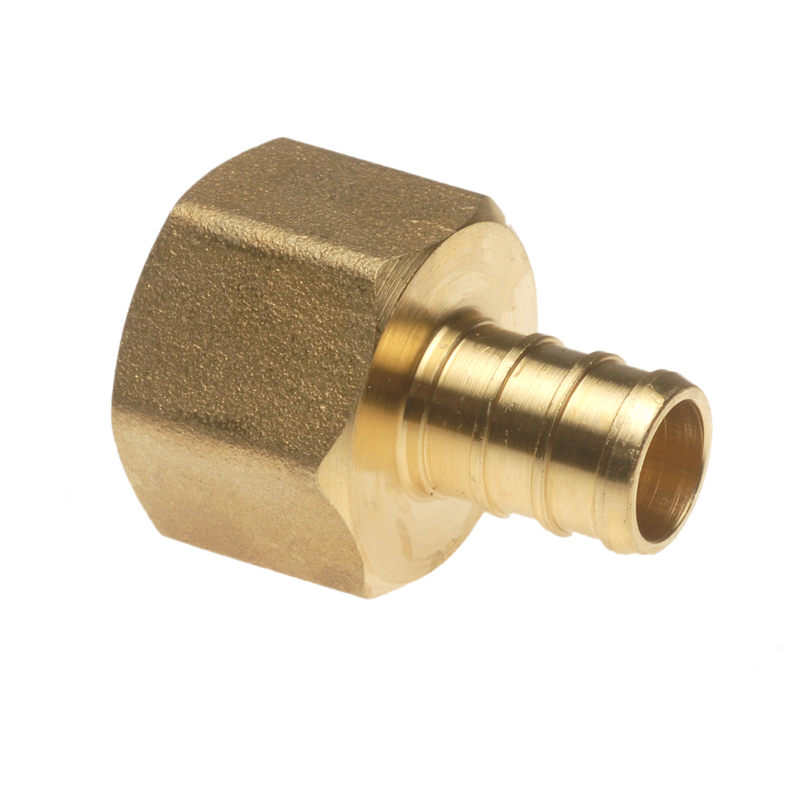
PEX Female Adapter
An adapter from the PEX barbed system to female iron pipe threads.
Notes:
Plumbing Tools And Supplies-PEX Pipe And Fittings Image: PEX FA.jpg Height: 900 Width: 900

Slide 44
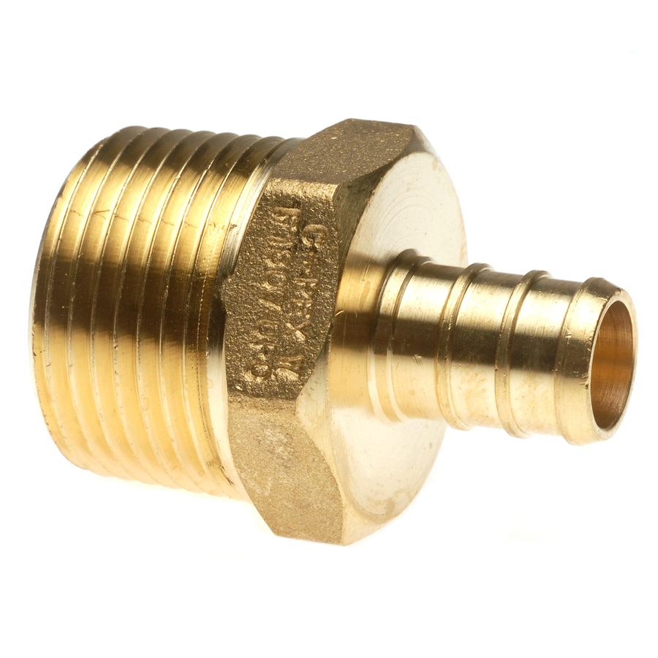
PEX Male Adapter
An adapter from the PEX barbed system to male iron pipe threads.
Notes:
Plumbing Tools And Supplies-PEX Pipe And Fittings Image: PEX MA.jpg Height: 900 Width: 900

Slide 45
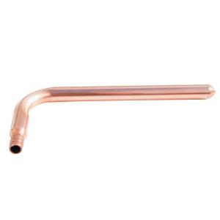
PEX Stubout
An adapter to copper pipe. Commonly used to with shutoff valves with compression fittings for water supply lines.
Notes:
Plumbing Tools And Supplies-PEX Pipe And Fittings Image: PEX Stubout.jpg Height: 300 Width: 300

Slide 46
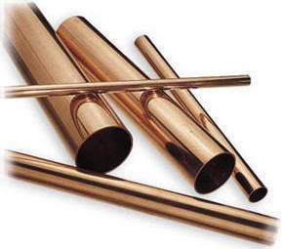
Copper Pipe
Rigid pipe used for water supply plumbing. Sizes commonly 1/2" - 2". Connections are soldered. Copper pipe is available in three basic types: Type M is thin-walled, Type L is medium-walled and Type K is thick-walled.
Notes:
Plumbing Tools And Supplies-Copper Pipe and Fittings Image: copperPipe.jpg Height: 255 Width: 289

Slide 47
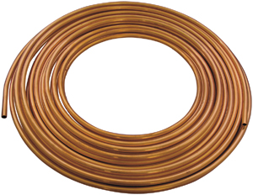
Copper Tubing
Flexible tubing used for water applications. Sizes commonly 1/4"-2" O.D. Connections are soldered, flared, or compression type.
Notes:
Plumbing Tools And Supplies-Copper Pipe and Fittings Image: CopperTubing.jpg Height: 232 Width: 300

Slide 48
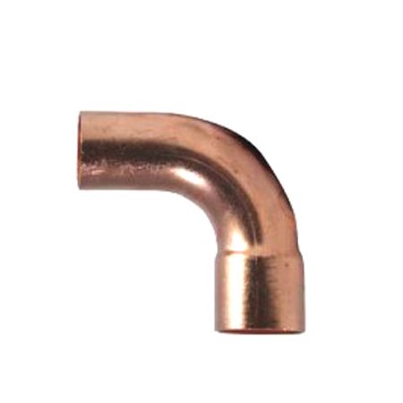
CxC Street Ell
A street elbow for use the copper fittings. Often used with a C x C Ell to make a odd angle.
Notes:
Plumbing Tools And Supplies-Copper Pipe and Fittings Image: CopperStEll.jpg Height: 450 Width: 450

Slide 49
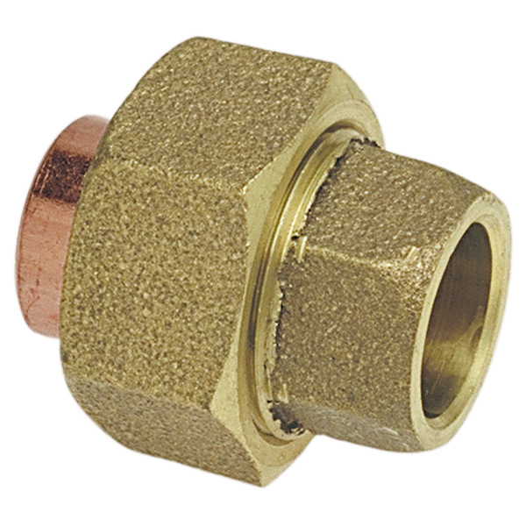
CxC Union
Used to connect two copper pipes together when neither can be moved.
Notes:
Plumbing Tools And Supplies-Copper Pipe and Fittings Image: CopperUnion.jpg Height: 360 Width: 360

Slide 50
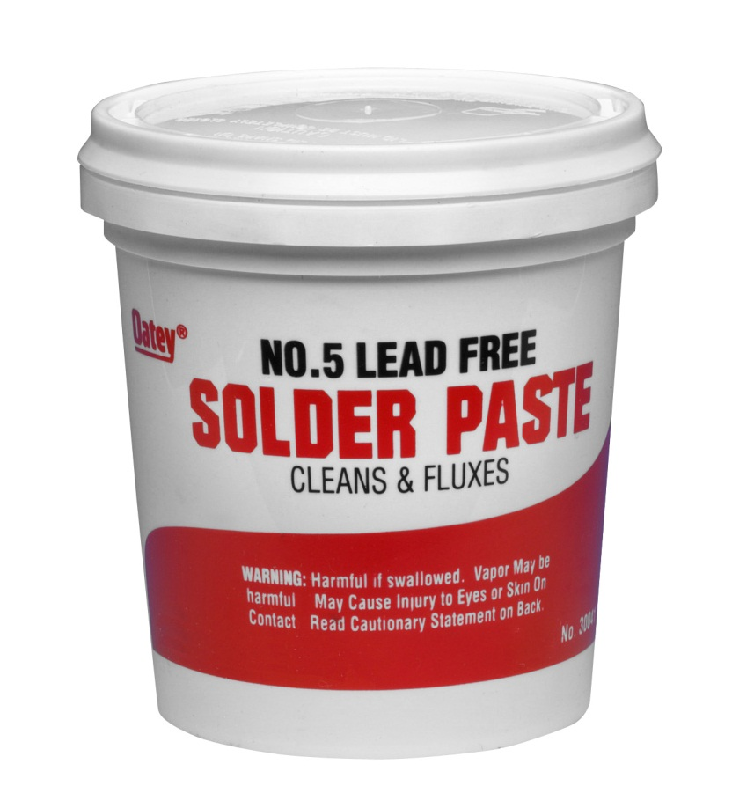
Paste Flux
Flux is used in soldering to clean pipe allowing solder to flow easily.
Notes:
Plumbing Tools And Supplies-Copper Pipe and Fittings Image: paste_flux.jpg Height: 334.32 Width: 303.12

Slide 51
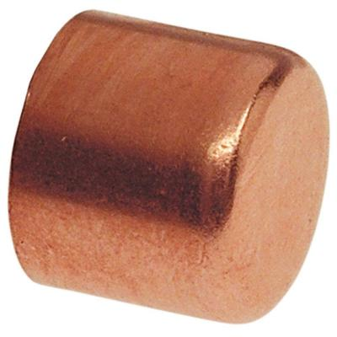
C Cap
Used to stop the flow of liquid or gas in a copper pipe.
Notes:
Plumbing Tools And Supplies-Copper Pipe and Fittings Image: CopperCap.jpg Height: 400 Width: 400

Slide 52
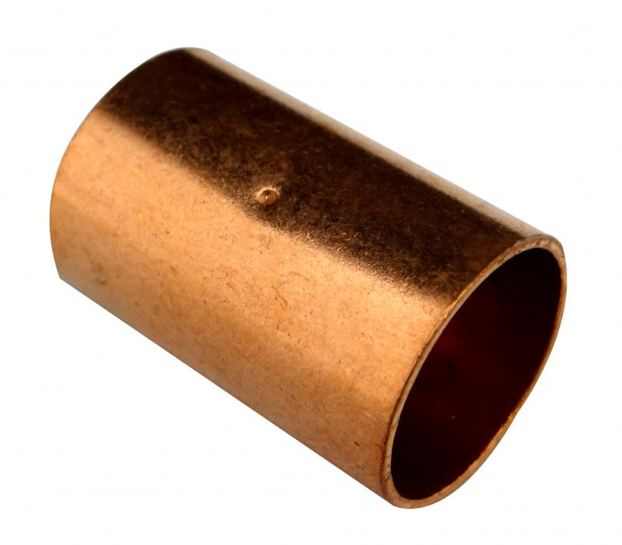
CxC Coupling
Used to connect two copper pipes together.
Notes:
Plumbing Tools And Supplies-Copper Pipe and Fittings Image: CopperCoupling.jpg Height: 420.6 Width: 480

Slide 53
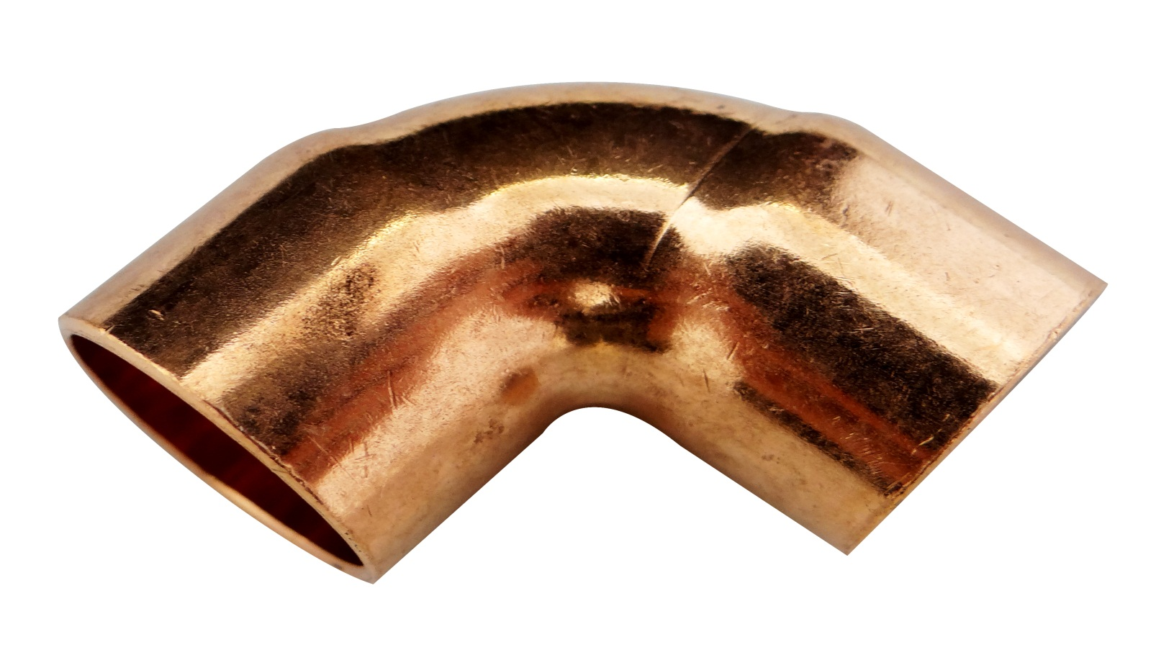
CxC Elbow
Comes in 45 and 90 degree angles.
Notes:
Plumbing Tools And Supplies-Copper Pipe and Fittings Image: CopperEll.jpg Height: 399.6 Width: 700.6909

Slide 54
CxT Adaptor or Male Adapter
Used to connect copper pipe to threaded pipe.
Notes:
Plumbing Tools And Supplies-Copper Pipe and Fittings Image: CopperMA.jpg Height: 1000 Width: 1000

Slide 55
CxC Reducing Coupling
Used to connect copper pipes of different diameters.
Notes:
Plumbing Tools And Supplies-Copper Pipe and Fittings Image: CopperRedCoupling.jpg Height: 360 Width: 360

Slide 56
CxCxC Tee
Used to connect three pieces of copper pipe together.
Notes:
Plumbing Tools And Supplies-Copper Pipe and Fittings Image: CopperTee.jpg Height: 450 Width: 450

Slide 57
CxCxT Tee
Used to connect two copper pipes to a threaded pipe.
Notes:
Plumbing Tools And Supplies-Copper Pipe and Fittings Image: CopperCxCxTTee.jpg Height: 117 Width: 154.8

Slide 58
CxT Female Adapter
Used to adapt to female threads
Notes:
Plumbing Tools And Supplies-Copper Pipe and Fittings Image: CopperFA.jpg Height: 559 Width: 600

Slide 59
90 Degree Elbow
A elbow that changes direction by 90 degrees. Both ends are female threads.
Notes:
Plumbing Tools And Supplies-Steel Pipe and Fittings Image: Galv90Ell.jpg Height: 132 Width: 132

Slide 60
Floor Flange
It is a steel flange with female threads in the center and holes drilled on the edge of the flange for bolts or screws.
Notes:
Plumbing Tools And Supplies-Steel Pipe and Fittings Image: GalvFloorFlange.jpg Height: 200 Width: 200

Slide 61
Galvanized Pipe
Steel pipe with a galvanized coating to prevent corrosion. It Should Not Be Used In Hydraulic Systems.
Notes:
Plumbing Tools And Supplies-Steel Pipe and Fittings Image: GalvPipe.jpg Height: 300 Width: 300

Slide 62
Union
A three piece fitting. The center piece is hex shaped to accommodate a wrench and tighten the two outer pieces. Used to join two pipes so they can be easily disconnected or join threaded pipe in the middle of a piping run.
Notes:
Plumbing Tools And Supplies-Steel Pipe and Fittings Image: Union.jpg Height: 232 Width: 217

Slide 63
Coupling
It is used to connect two pieces of pipe in a straight line.
Notes:
Plumbing Tools And Supplies-Steel Pipe and Fittings Image: GalvCoupling.jpg Height: 500 Width: 500

Slide 64
45 Degree Elbow
A elbow that changes direction by 45 degrees. Both ends are female threads.
Notes:
Plumbing Tools And Supplies-Steel Pipe and Fittings Image: Galv45Ell.jpg Height: 135 Width: 135

Slide 65
Nipple
Short pieces of threaded pipe, nipples are classified as close, short and medium, or are measured in inches of length.
Notes:
Plumbing Tools And Supplies-Steel Pipe and Fittings Image: GalvNipple.jpg Height: 1000 Width: 1000

Slide 66
Bushing
Used to reduce pipe size. One end is hex shaped to receive a wrench.
Notes:
Plumbing Tools And Supplies-Steel Pipe and Fittings Image: GalvBushing.jpg Height: 129.6 Width: 139.8

Slide 67
Black Pipe
Pipe lines may be constructed with threaded fittings or may be welded. Used for natural gas not water.
Notes:
Plumbing Tools And Supplies-Steel Pipe and Fittings Image: Black Pipe.jpg Height: 1000 Width: 1000

Slide 68
Cross
It is shaped like a cross and is threaded inside at the four ends.
Notes:
Plumbing Tools And Supplies-Steel Pipe and Fittings Image: GalvCross.jpg Height: 126 Width: 144

Slide 69
Pipe Plug
The end is square to accommodate a wrench.
Notes:
Plumbing Tools And Supplies-Steel Pipe and Fittings Image: GalvPlug.jpg Height: 147 Width: 123

Slide 70
Bell Reducer
Similar to a coupling, but changes pipe sizes.
Notes:
Plumbing Tools And Supplies-Steel Pipe and Fittings Image: Bell Reducer.jpg Height: 202 Width: 223

Slide 71
Street Ell
An elbow with male thread on one end and female threads on the other. Available in 90 and 45 degree angles.
Notes:
Plumbing Tools And Supplies-Steel Pipe and Fittings Image: Street Ell.jpg Height: 278 Width: 394

Slide 72
Tee
Used to connect lateral branches of a pipe.
Notes:
Plumbing Tools And Supplies-Steel Pipe and Fittings Image: GalvTee.jpg Height: 288 Width: 288

Slide 73
Close Nipple
A nipple that is as short as possible (threads touch).
Notes:
Plumbing Tools And Supplies-Steel Pipe and Fittings Image: GalvCloseNipple.jpg Height: 300 Width: 300

Slide 74
Cap
Used to screw over the threaded end of a pipe to seal the opening.
Notes:
Plumbing Tools And Supplies-Steel Pipe and Fittings Image: GalvCap.jpg Height: 450 Width: 443

Slide 75
Pipe Clamp
For 1/2 to 2 inch pipe. Used for repairing small leaks in steel pipe.
Notes:
Plumbing Tools And Supplies-Steel Pipe and Fittings Image: PipeClamp.jpg Height: 1000 Width: 1000

Slide 76
ABS Pipe
Acrylonitrile-Butadiene-Styrene (ABS) pipe used for sewer applications. Pipe is black plastic. ABS fittings are glued like other plastic pipe systems. Male and female ends are designated as "spigot" and "hub" respectively. Elbows are not designated by degrees, but rather by the part of the circle (ex. 1/4 bend = 90 degrees). Pipe commonly is found in sizes from 1 1/4" to 6" and 20 foot lengths.
Notes:
Plumbing Tools And Supplies-ABS Pipe and Fittings Image: ABSpipe.jpg Height: 208 Width: 592

Slide 77
Long Sweep 1/4 Bend Hub
Used to connect ABS pipe at a 90 degree angle and allows for easy clean out when using a drain auger or plumbers snake to clean out lines.
Notes:
Plumbing Tools And Supplies-ABS Pipe and Fittings Image: ABSQtrBend.jpg Height: 500 Width: 500

Slide 78
Double Wye Hub
Used for connecting two lines at a 45 degree angle to a straight ABS pipe.
Notes:
Plumbing Tools And Supplies-ABS Pipe and Fittings Image: ABSDoubleWye.jpg Height: 415 Width: 450

Slide 79
Wye Hub
Used for attaching a line at a 45 degree angle to a straight line.
Notes:
Plumbing Tools And Supplies-ABS Pipe and Fittings Image: ABS_Wye.jpg Height: 500 Width: 500

Slide 80
Male Adaptor-Hub X Male Pipe
Used to connect ABS pipe to female pipe threads.
Notes:
Plumbing Tools And Supplies-ABS Pipe and Fittings Image: ABS_MA.jpg Height: 500 Width: 500

Slide 81
Female Adaptor-Hub X Female
Used to connect ABS pipe to threaded pipe.
Notes:
Plumbing Tools And Supplies-ABS Pipe and Fittings Image: ABS_FA.jpg Height: 500 Width: 500

Slide 82
Adaptor-Spigot X Female Pipe
Used to connect female ABS pipe fitting to male pipe thread. Often used for cleanouts.
Notes:
Plumbing Tools And Supplies-ABS Pipe and Fittings Image: sABSSpigotXFemale.jpg Height: 500 Width: 500

Slide 83
P Trap Hub With Union
Liquid is held in the base of the P Trap to prevent the passage of air or gasses.
Notes:
Plumbing Tools And Supplies-ABS Pipe and Fittings Image: ABS_PTrap.jpg Height: 500 Width: 500

Slide 84
Hose Bib
It has standard pipe threads on one end and hose coupling threads on the other.
Notes:
Plumbing Tools And Supplies-Valves Image: hose_bib.JPG Height: 290.25 Width: 375

Slide 85
Globe Valve
The flow is stopped when the handle is screwed in, forcing the disk over the vent.
Notes:
Plumbing Tools And Supplies-Valves Image: GlobeValve.gif Height: 162 Width: 107.4

Slide 86
Gate Valve
The flow is stopped when the wedge or gate is lowered into the seat.
Notes:
Plumbing Tools And Supplies-Valves Image: Gate Valve.jpg Height: 135 Width: 135

Slide 87
Check Valve
Once liquid has passed through the valve it cannot flow back.
Notes:
Plumbing Tools And Supplies-Valves Image: CheckValve.jpg Height: 135 Width: 135

Slide 88
Ball Valve
By rotating the ball with the handle the valve closes or opens.
Notes:
Plumbing Tools And Supplies-Valves Image: BallValve.jpg Height: 600 Width: 649

Slide 89
Cock Valve
Used to stop the flow of liquid or gas through a pipe. Also called a Stop Cock
Notes:
Plumbing Tools And Supplies-Valves Image: GasCock.jpg Height: 243 Width: 360

Slide 90
Drain Auger
By rotating the auger while feeding it into the line the auger bit tip cuts away the obstruction in the line.
Notes:
Plumbing Tools And Supplies-Misc Plumbing Image: DrainAugar.jpg Height: 400 Width: 400

Slide 91
Pipe Joint Compound
Used to seal threaded fittings. May be formulated for use with plastic pipe or steel pipe only.
Notes:
Plumbing Tools And Supplies-Misc Plumbing Image: PipeJointCompound2.jpg Height: 500 Width: 500

Slide 92
Plumbers Tape
A galvanized flexible steel tape with holes for screws or nails used to secure plumbing. It is cut to length on the job, wrapped around the pipe and secured with a nail or screw.
Notes:
Plumbing Tools And Supplies-Misc Plumbing Image: PlumbersTape.jpg Height: 103 Width: 250

Slide 93
Hose Clamp
Used with rubber hose and polyethylene pipe. It consists of a circular steel collar with a tightening screw to secure the hose in place on a barbed fitting.
Notes:
Plumbing Tools And Supplies-Misc Plumbing Image: hose-clamp.gif Height: 132 Width: 132

