Slide 1
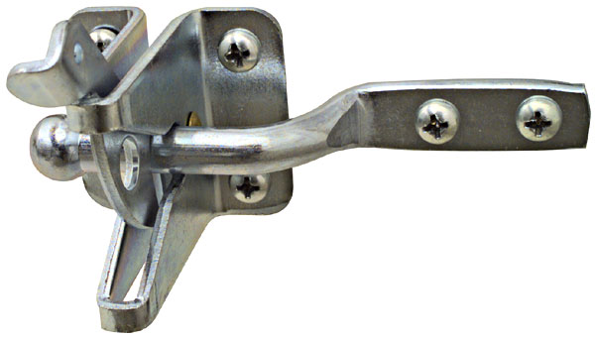
Gate Latch
The hook is inserted into the eye screw to latch.
Notes:
Hardware-Hinges Image: GateLatch.jpg Height: 81.84 Width: 144

Slide 2
Strap Hinge
The size is measured from the hinge pin to the end of one strap.
Notes:
Hardware-Hinges Image: strap hinge.jpg Height: 55.68 Width: 240

Slide 3
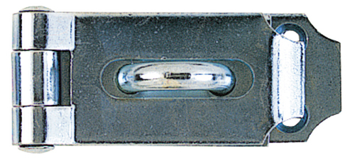
Hinge Hasp
One end is like a strap hinge with a slot which folds over an eye or staple to accommodate a padlock.
Notes:
Hardware-Hinges Image: hasp.jpg Height: 107.04 Width: 240

Slide 4
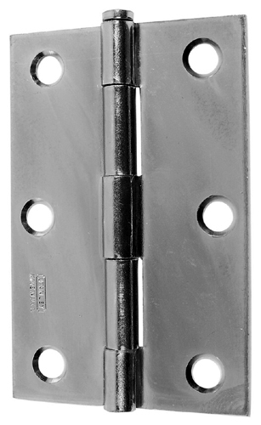
Butt Hinge
This hinge is available with fast pin or loose pin and is plain brass or steel or primed with paint.
Notes:
Hardware-Hinges Image: butt hinge.jpg Height: 240 Width: 147.36

Slide 5
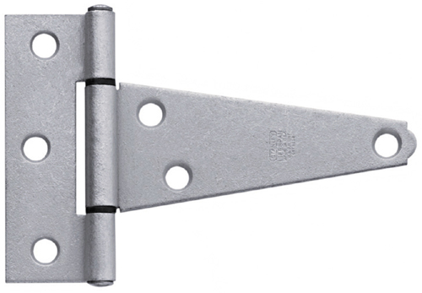
"T" Hinge
Size is measured from hinge pin to the end of the strap. Commonly use for gates ("T" fastens to post).
Notes:
Hardware-Hinges Image: T Hinge.jpg Height: 166.56 Width: 240

Slide 6
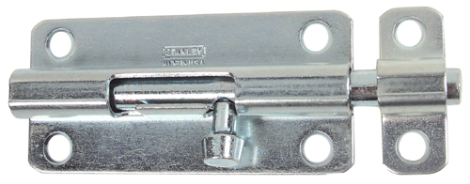
Barrel Bolt
The other end, a separate piece is an eye which the bolt slides into when locking.
Notes:
Hardware-Hinges Image: Barrel Bolt.jpg Height: 94.08 Width: 240

Slide 7
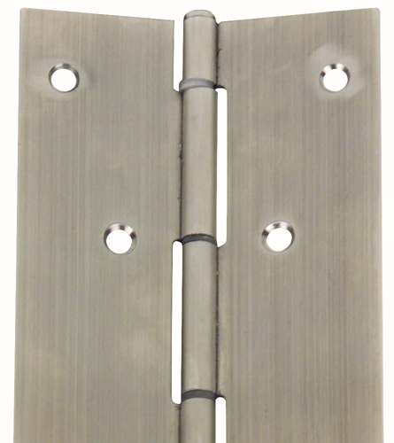
Continuous Hinge
Same as the butt hinge except it comes in 8" to 8' lengths and is cut to length with a hacksaw. Also called a Piano hinge
Notes:
Hardware-Hinges Image: Continous hinge.jpg Height: 240 Width: 213.6

Slide 8
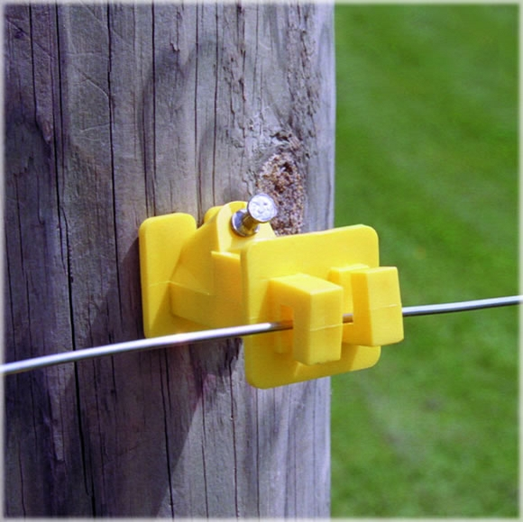
Nail On Electric Fence Insulator
Commonly a plastic insulator that nails to a wood post. Insulators hold electric fence conductors about 1" from the post.
Notes:
Hardware-Fencing And Supplies Image: NailOnInsulator.jpg Height: 579 Width: 580

Slide 9
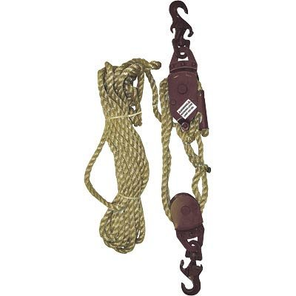
Wire Stretcher
It consists of two double sheave blocks specifically designed with hooks, holding lock, wire clamp and a rope.
Notes:
Hardware-Fencing And Supplies Image: FenceStretcher.jpg Height: 240 Width: 240

Slide 10
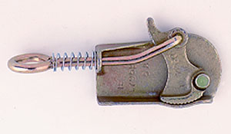
Wire Grip
Made of steel or malleable iron. Used to grip fencing wire when tightening
Notes:
Hardware-Fencing And Supplies Image: wire_grip.jpg Height: 175 Width: 300

Slide 11
Welded Wire Fence
Consists of 16 gauge galvanized wire spot welded rather than woven, and has 2 inch by 3 inch mesh.
Notes:
Hardware-Fencing And Supplies Image: WeldedWire.jpg Height: 107.25 Width: 210

Slide 12
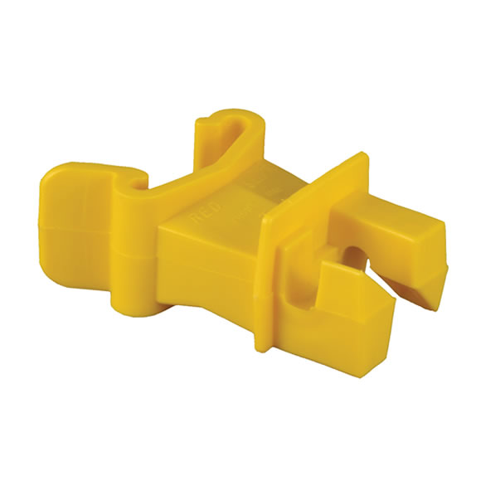
T-Post Insulator
The insulator is clipped to the steel post and the wire inserted into the plastic clip, thus preventing grounding of the electrical system.
Notes:
Hardware-Fencing And Supplies Image: TpostIns.jpg Height: 379.6364 Width: 379.6364

Slide 13
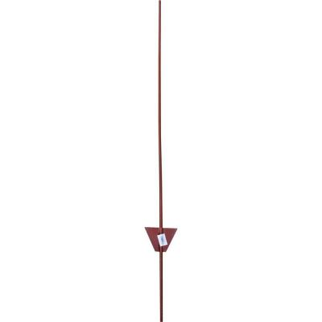
Steel Fence Posts
Round steel post with an anchor plate 12 inches from the bottom and comes in 3 to 6 foot lengths.
Notes:
Hardware-Fencing And Supplies Image: SteelFencePost.jpg Height: 400 Width: 400

Slide 14
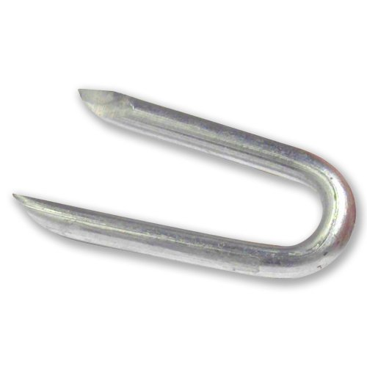
Fence Staple
The length is stated in inches and fractions.
Notes:
Hardware-Fencing And Supplies Image: FenceStaple.jpg Height: 300 Width: 300

Slide 15
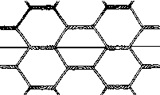
Poultry Wire Netting
The rolls are 50 to 150 feet long and from 1 1/4 to 4 feet wide.
Notes:
Hardware-Fencing And Supplies Image: PoultryNetting.gif Height: 72 Width: 120.6

Slide 16
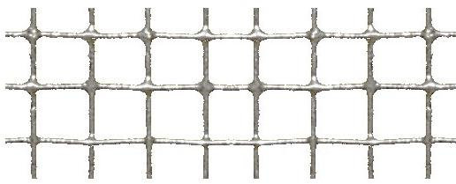
Woven Wire Fencing
The roll contains 20 rods of wire ranging from 32 to 47 inches wide.
Notes:
Hardware-Fencing And Supplies Image: WovenWire.jpg Height: 209 Width: 516

Slide 17
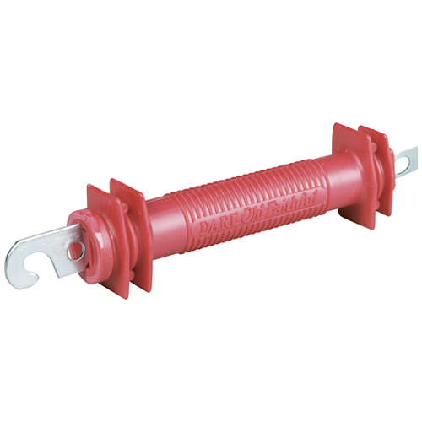
Electric Fence Gate Handle
By pulling on the handle, tension can be released on the fence and it can be disconnected allowing entry.
Notes:
Hardware-Fencing And Supplies Image: ElectricFenceGate.jpg Height: 300 Width: 300

Slide 18
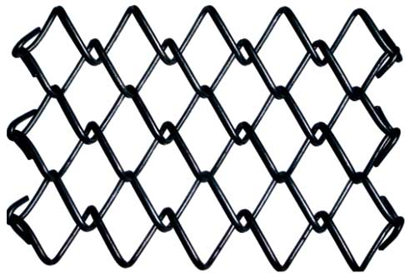
Chain Link Fencing
Comes in 36 to 60 inch widths and 50 to 100 foot lengths. Also called Diamond Mesh.
Notes:
Hardware-Fencing And Supplies Image: ChainLinkFence.jpg Height: 200.4 Width: 291.6

Slide 19
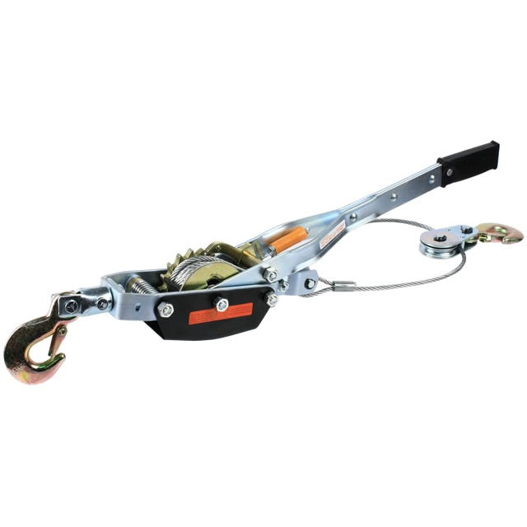
Come-A-Long
By working the ratchet handle the cable is tightened and moves the sheave block closer to the ratchet spool.
Notes:
Hardware-Fencing And Supplies Image: Come-a-long.jpg Height: 640 Width: 640

Slide 20
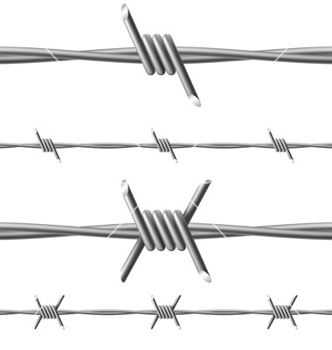
Barbed Wire
A spool of wire is 80 rods long.
Notes:
Hardware-Fencing And Supplies Image: BarbedWire.jpg Height: 22.67717 Width: 21.54331

Slide 21
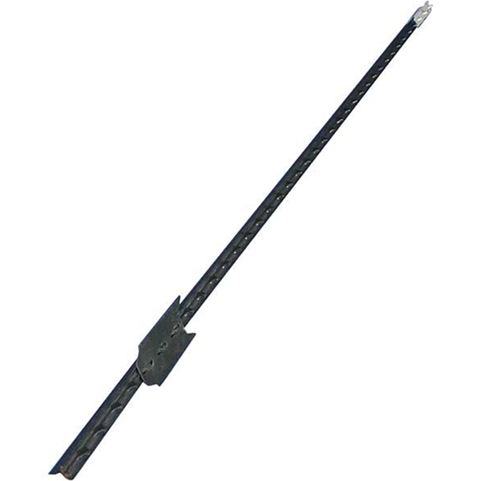
T Post
A steel post with an attached plate to help anchor the post. Commonly 5'-8' long.
Notes:
Hardware-Fencing And Supplies Image: Tpost.jpg Height: 450 Width: 450

Slide 22
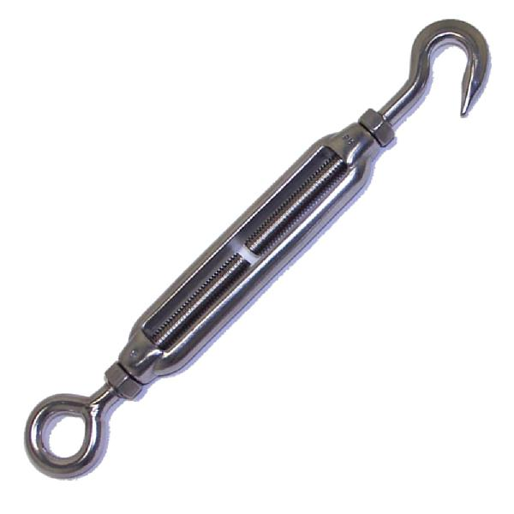
Turn Buckle
Turning the body tightens or loosens both at the same time.
Notes:
Hardware-Fencing And Supplies Image: TurnBuckle.jpg Height: 360 Width: 360

Slide 23
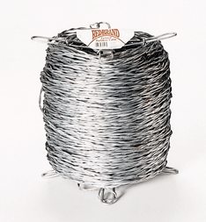
Smooth Galvanized Wire
It is made of smooth galvanized steel and is available in a variety of gauges.
Notes:
Hardware-Fencing And Supplies Image: smoothFenceWire.gif Height: 151.8 Width: 140.4

Slide 24
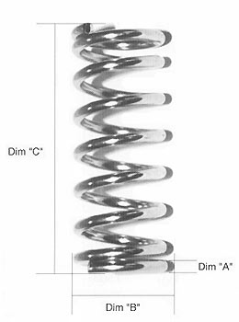
Compression Spring
A compression spring is one that exerts pressure when it is compressed.
Notes:
Hardware-Springs Image: compressionSpring.jpg Height: 210 Width: 156

Slide 25
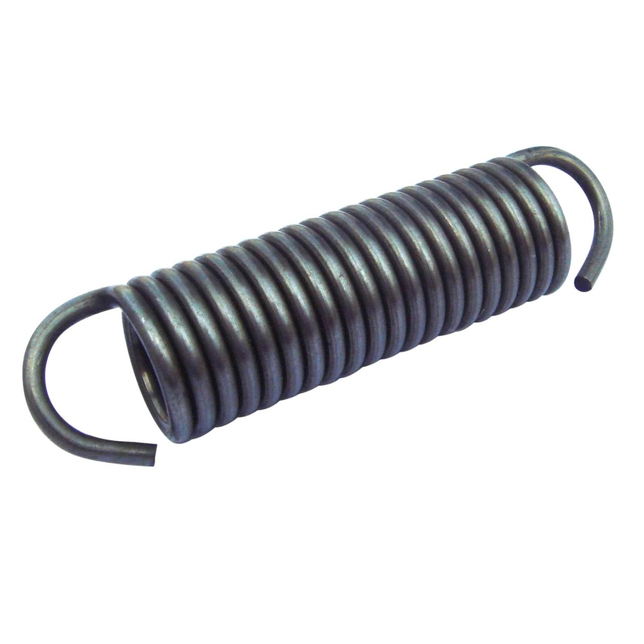
Tension Spring
This spring can be extended, but exerts force by extending to pull back to its original length.
Notes:
Hardware-Springs Image: TensionSpring.jpg Height: 1254 Width: 1254

Slide 26
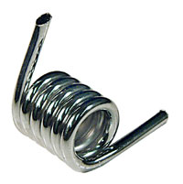
Torsion Spring
When the spring is wound up it exerts a twisting force.
Notes:
Hardware-Springs Image: TorsionSpring.jpg Height: 120.6 Width: 120

