Slide 1
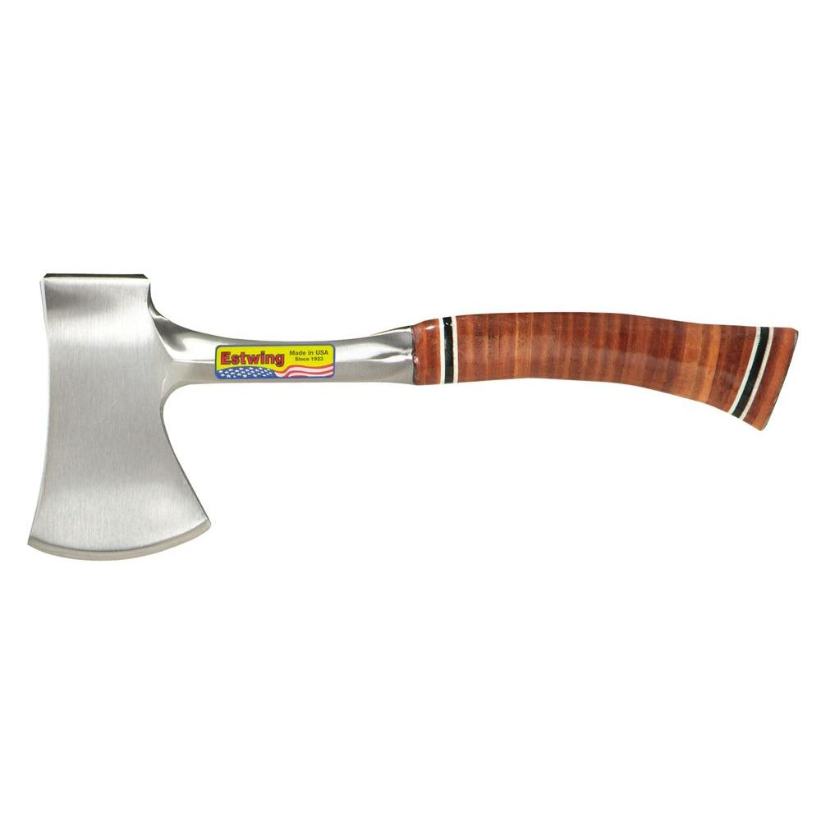
Hand Axe
Used for sharpening stakes, cutting small limbs or brush. Also used to drive in small stakes, grade stakes, and corner stakes. The hand axe is similar to the single bit axe but smaller. The handle is 16 to 18 inches long.
Notes:
Common Tools-Axes Image: handAx.jpg Height: 1000 Width: 1000

Slide 2
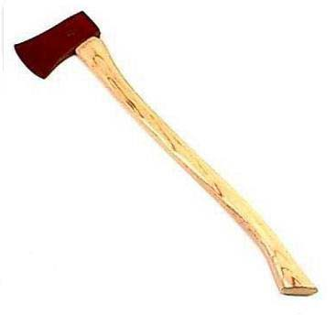
Single Bit Axe
Used for building fences, cutting small trees and construction work. This very versatile tool should not be used as a sledge hammer on wedges or iron stakes. Handles are usually of hickory, 36 inches long, oval in cross section and shaped for good balance.
Notes:
Common Tools-Axes Image: Singlebitax.jpg Height: 258.75 Width: 275.25

Slide 3
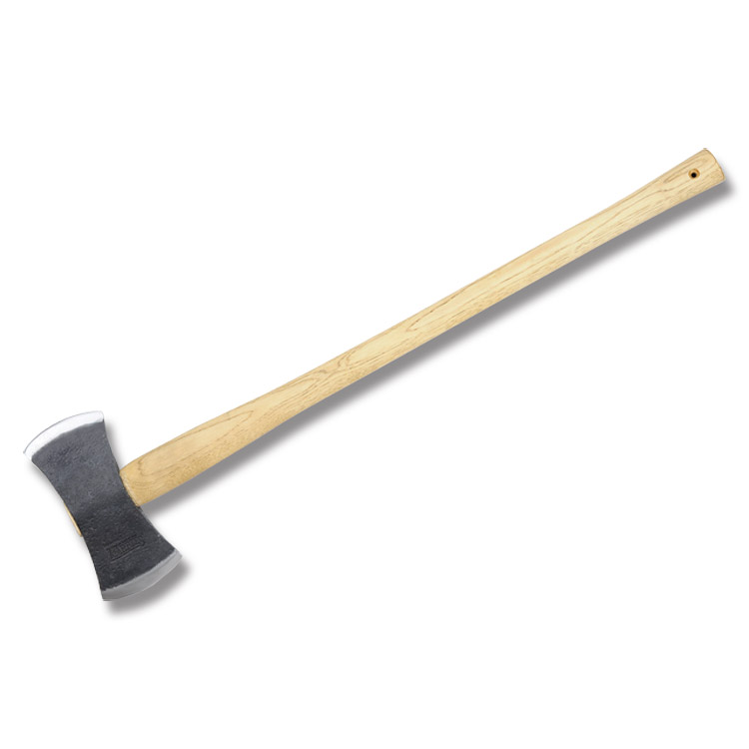
Double Bit Axe
Used to cut small trees, trim logs and tops. Its two cutting edges should not be left in a vertical position because of the safety hazard. The 36 inch handle is oval and straight.
Notes:
Common Tools-Axes Image: DoublebitAx.jpg Height: 450 Width: 450

Slide 4
Water Pump Pliers
The jaws are adjustable to 2 inches.
Notes:
Common Tools-Pliers Image: water pump pliers.jpg Height: 65.28 Width: 228.72

Slide 5
Slip Joint Combination Pliers
Used for general purpose work, for holding flat or round stock, and for cutting soft wires.
Notes:
Common Tools-Pliers Image: Slip Joint Pliers.jpg Height: 67.2 Width: 240

Slide 6
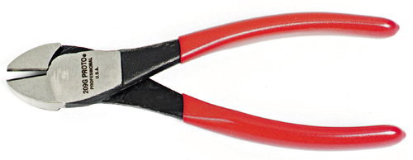
Diagonal Cutting Pliers
It has curved handles, lap joined; and diagonal cutting jaws.
Notes:
Common Tools-Pliers Image: DiagCutter.jpg Height: 93.12 Width: 240

Slide 7
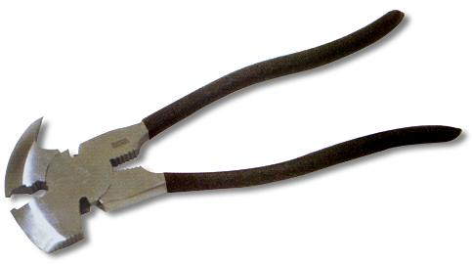
Fence Pliers
Grips between the handles hold the wire tightly while leverage is exerted against the fence post to stretch the wire fairly tight.
Notes:
Common Tools-Pliers Image: fence pliers.jpg Height: 65.04 Width: 115.92

Slide 8
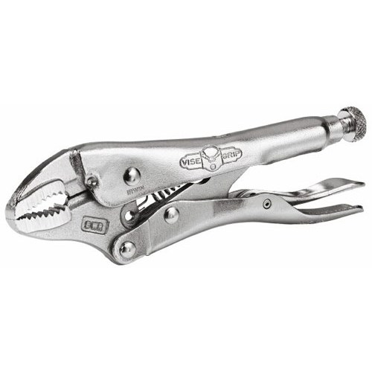
Locking Pliers
Locks with a toggle action that holds until the lever is opened. Commonly called Vise-Grip pliers.
Notes:
Common Tools-Pliers Image: LockingPliers.jpg Height: 375 Width: 375

Slide 9
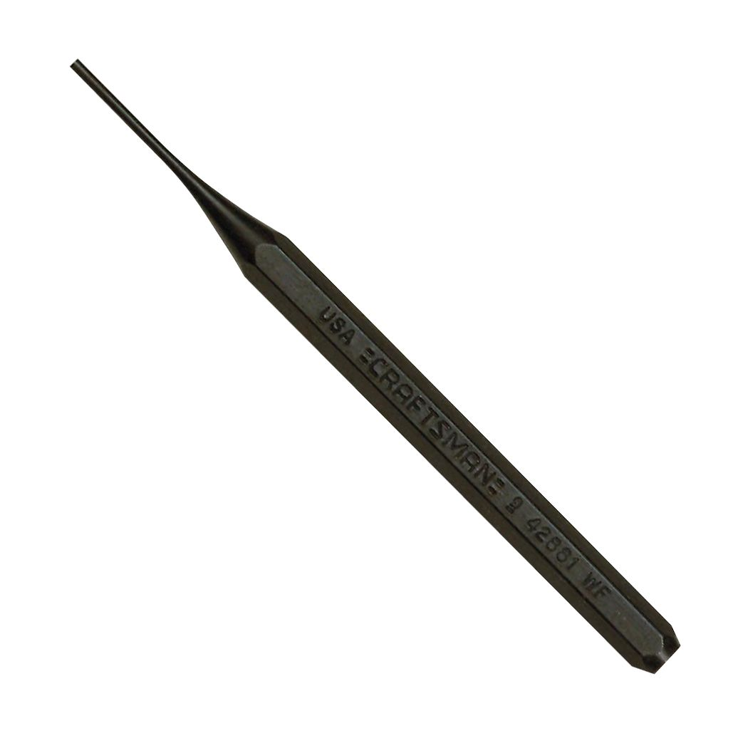
Pin Punch
This punch has a long, straight shank, the diameter of which designates the size. Used to remove bolts and pins.
Notes:
Common Tools-Punches Image: pin punch.jpg Height: 1036 Width: 1036

Slide 10
Drift Punch
The shank is tapered.
Notes:
Common Tools-Punches Image: DriftPunch.jpg Height: 14.88 Width: 240

Slide 11
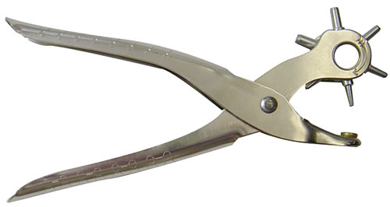
Leather Punch
The handles are similar to pliers. Used to punch holes in soft materials like leather and rubber.
Notes:
Common Tools-Punches Image: LeatherPunch.jpg Height: 159.6 Width: 300

Slide 12
Prick Punch
The punch should be sharp and ground to 30 degrees.
Notes:
Common Tools-Punches Image: PrickPunch.jpg Height: 29.28 Width: 240

Slide 13
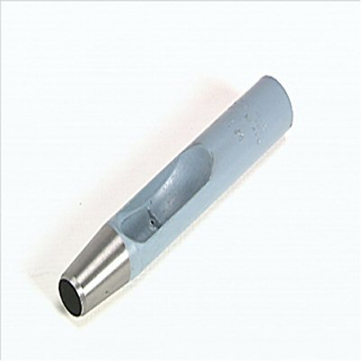
Hole Punch
These punches are used to make holes in gaskets and other materials. Also called a belt punch.
Notes:
Common Tools-Punches Image: BeltPunch.jpg Height: 96 Width: 96

Slide 14
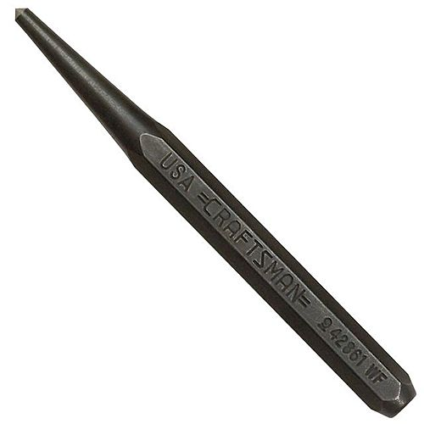
Center Punch
It is manufactured in various sizes and lengths.
Notes:
Common Tools-Punches Image: CenterPunch.jpg Height: 500 Width: 500

Slide 15
Torx Head Screwdriver
Also used on appliances, lawn and garden, and electronic equipment.
Notes:
Common Tools-Screwdrivers Image: Torx Screwdriver.jpg Height: 67.2 Width: 240

Slide 16
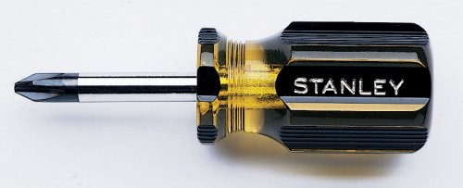
Stubby Screwdriver
It comes in slotted and Phillips, and has a blade length of 1 1/4 to 1 1/2 inches long.
Notes:
Common Tools-Screwdrivers Image: Phillips 2.jpg Height: 97.44 Width: 240

Slide 17
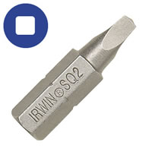
Square Recess Screwdriver
Each screwdriver is color coded for easy size identification.
Notes:
Common Tools-Screwdrivers Image: SqyareRecessedDrive.jpg Height: 200 Width: 200

Slide 18
Slotted Screwdriver
Used mostly in woodworking applications.
Notes:
Common Tools-Screwdrivers Image: Standard Screwdriver 1.jpg Height: 59.04 Width: 240

Slide 19
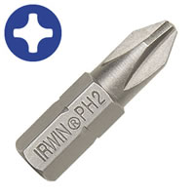
Screwdriver Bit
Available in slotted, Phillips, square, and torx drives for power screwdrivers. Shank is hexagonal.
Notes:
Common Tools-Screwdrivers Image: DriverBit.jpg Height: 200 Width: 200

Slide 20
Phillips Screwdriver
Always select the correct size for the correct application.
Notes:
Common Tools-Screwdrivers Image: Phillips1.jpg Height: 375 Width: 115.5

Slide 21
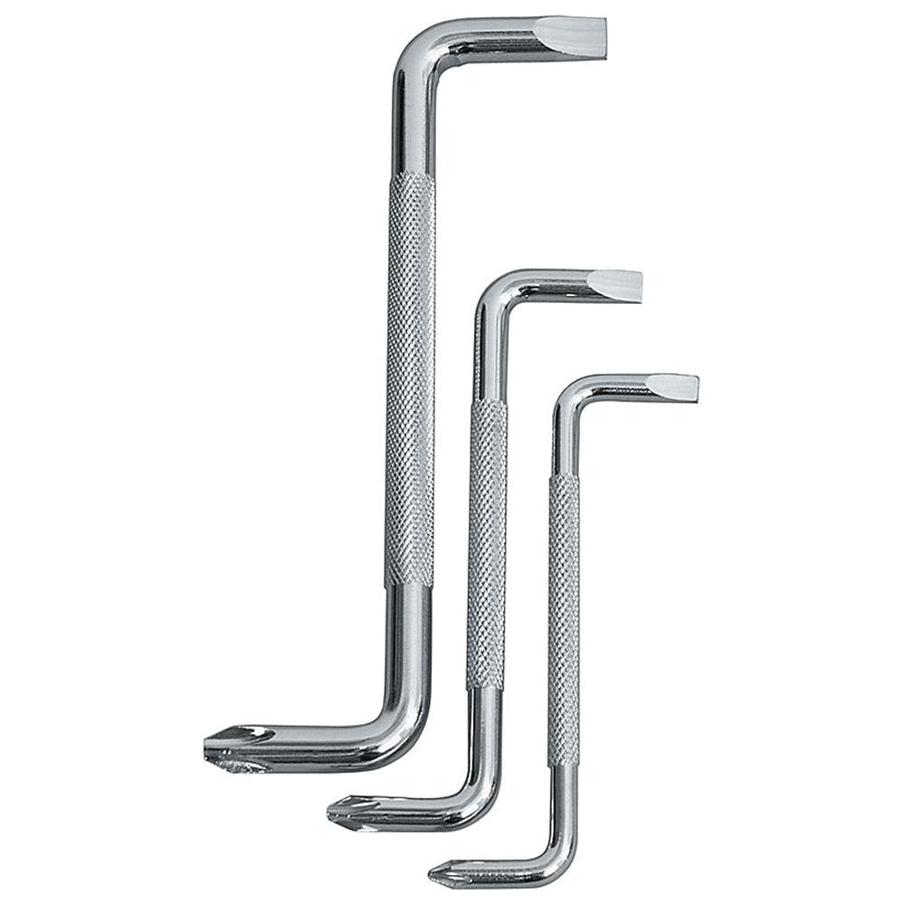
Offset Screwdriver
Used where it is difficult to reach the screw head with a common or standard screwdriver.
Notes:
Common Tools-Screwdrivers Image: OffsetScrewdriver.jpg Height: 750 Width: 750

Slide 22
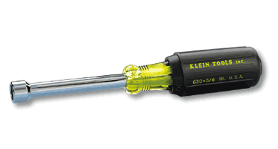
Nut Driver
This is a very popular tool in the electrical and sheet metal industry.
Notes:
Common Tools-Screwdrivers Image: NutDriver.gif Height: 126 Width: 235.2

Slide 23
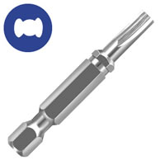
Clutch Driver
This is a specialty drive that fits screws used in mobile homes, boats, recreational vehicles, and electric motors.
Notes:
Common Tools-Screwdrivers Image: ClutchDrive.jpg Height: 200 Width: 200

Slide 24
Combination End Wrench
The reason for the popularity of this wrench is that it has the advantage of having both open and box ends.
Notes:
Common Tools-Wrenches Image: 6ptCombo.jpg Height: 50.4 Width: 240

Slide 25
Tubing Wrench
The box at each end of the wrench is 6 point only. Also called a flare nut wrench.
Notes:
Common Tools-Wrenches Image: FlareNutWrench.jpg Height: 453 Width: 1900

Slide 26
Open End Wrench
Both ends of the wrench are open but are of different sizes.
Notes:
Common Tools-Wrenches Image: OpenEndWrench.jpg Height: 52.8 Width: 240

Slide 27
Box End Wrench
Wrench is available in 12 and 6 point ends.
Notes:
Common Tools-Wrenches Image: BoxWrench.jpg Height: 35.52 Width: 240

Slide 28
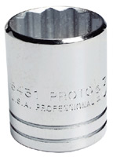
Twelve Point Socket
The socket has thin walls to fit in tight places.
Notes:
Common Tools-Wrenches Image: 12ptSocket.jpg Height: 120 Width: 86.4

Slide 29
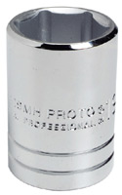
Six Point Socket
The socket has 6 points inside to fit over hexagonal nuts.
Notes:
Common Tools-Wrenches Image: 6ptSocket.jpg Height: 120 Width: 75

Slide 30
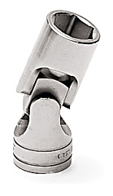
Flex Socket
This permits working at various angles.
Notes:
Common Tools-Wrenches Image: flexScocket.jpg Height: 172.8 Width: 100.08

Slide 31
Deep Socket
The deep socket is made in standard, thin, and extra thin walls, with 6 or 12 point openings and with 3/8, 1/2 or ¾ inch drive.
Notes:
Common Tools-Wrenches Image: 12PtDeepSocket.jpg Height: 120 Width: 49.2

Slide 32
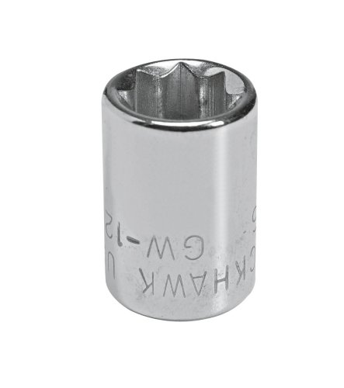
Eight Point Socket
Has 8 points and is used on square nuts found on farm machinery.
Notes:
Common Tools-Wrenches Image: 8PointSocket.jpg Height: 240 Width: 212.64

Slide 33
Speed Handle
Used to rapidly remove a nut or bolt. Common drive sizes 1-4”-3/4”.
Notes:
Common Tools-Wrenches Image: SpeedHandle.jpg Height: 64.32 Width: 240

Slide 34
Slide Bar Handle
Used as a "T” or “L” handle and is normally used with the extension.
Notes:
Common Tools-Wrenches Image: SlidingThandle.jpg Height: 45.6 Width: 240

Slide 35
Extension Bar
Used to connect, the socket wrench to the ratchet handle to give working clearance, and are 3 to 20 inches long.
Notes:
Common Tools-Wrenches Image: Extension.jpg Height: 35.04 Width: 240

Slide 36
Ratchet Handle
The ratchet speeds up the work. Common drive sizes 1-4”-3/4”.
Notes:
Common Tools-Wrenches Image: Ratchet.jpg Height: 56.64 Width: 240

Slide 37
Flex Handle
The end that fits into the socket is swivel hinged, and the other end has a hole with a sliding cross bar to permit use of the wrench at an angle.
Notes:
Common Tools-Wrenches Image: FlexHandle.jpg Height: 53.28 Width: 240

Slide 38
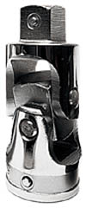
Universal Joint
It makes work possible in restricted places where the wrench cannot be aligned with the bolt.
Notes:
Common Tools-Wrenches Image: UniversalJoint.jpg Height: 180 Width: 75

Slide 39
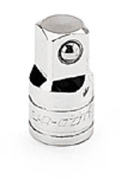
Socket Adaptor
Allows the use of larger drive sockets with smaller socket drives; i.e., 1/2 inch drive socket and 3/8 inch drive ratchet.
Notes:
Common Tools-Wrenches Image: SocketAdapter.jpg Height: 180 Width: 122.25

Slide 40
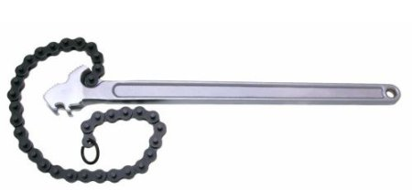
Chain Wrench
It is made in several sizes ranging from 13 ¾ to 87 inches long, and will handle pipe from 1/8 to 18 inches in diameter.
Notes:
Common Tools-Wrenches Image: ChainWrench.jpg Height: 208 Width: 450

Slide 41
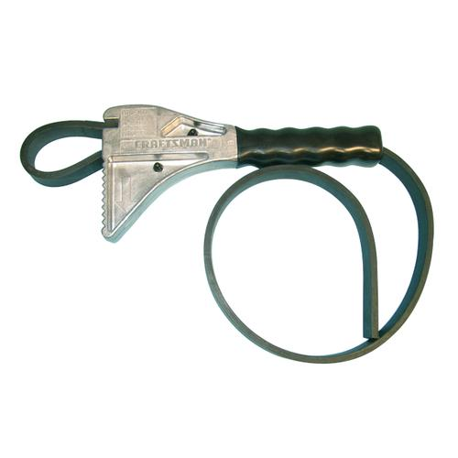
Strap Wrench
The adjustable strap is useful in rotating large diameter objects like filters.
Notes:
Common Tools-Wrenches Image: StrapWrench.jpg Height: 500 Width: 500

Slide 42
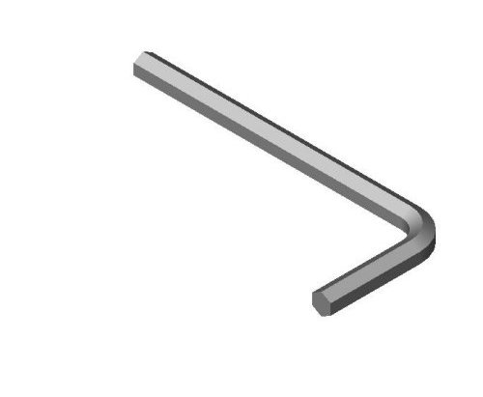
Hex Key
This wrench is made of hexagon stock with one end bent to a 90 degree angle.
Notes:
Common Tools-Wrenches Image: HexKeyWrench.jpg Height: 411 Width: 500

Slide 43
Adjustable Wrench
Size is designated by inches in length.
Notes:
Common Tools-Wrenches Image: AdjustableWrench.jpg Height: 67.2 Width: 240

Slide 44
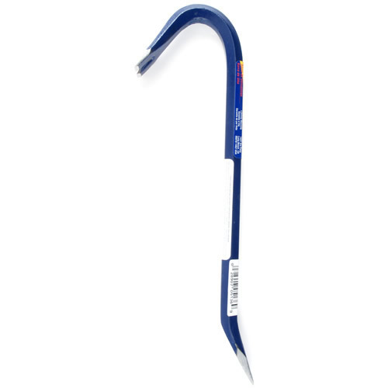
Ripping Bar
Usually it is of octagon tempered steel. Used for demolition and pulling large nails. Also called a Wrecking Bar.
Notes:
Common Tools-Bars Image: WreckingBar.jpg Height: 500 Width: 500

Slide 45
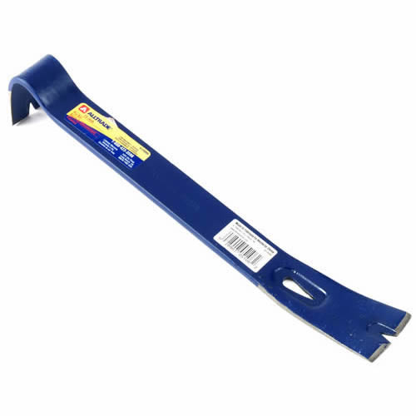
Flat Pry Bar
Contoured flat bar, with beveled nail slots at each end. Also called a Wonder Bar (Stanley brand name).
Notes:
Common Tools-Bars Image: FlatPryBar.jpg Height: 500 Width: 500

Slide 46
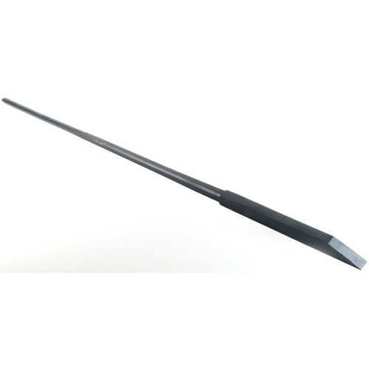
Crow Bar
It is normally four or five feet long with one end tapered round and the other end with a chisel point.
Notes:
Common Tools-Bars Image: CrowBar.jpg Height: 500 Width: 500

Slide 47
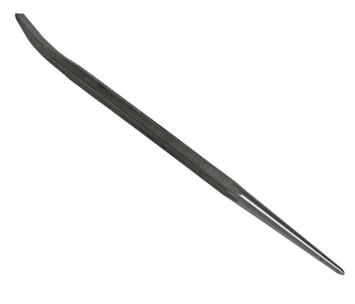
Pry or Fitting Bar
It has a long round taper at one end and a curved pry hook at the other.
Notes:
Common Tools-Bars Image: FittingBar.jpg Height: 205.44 Width: 240

Slide 48
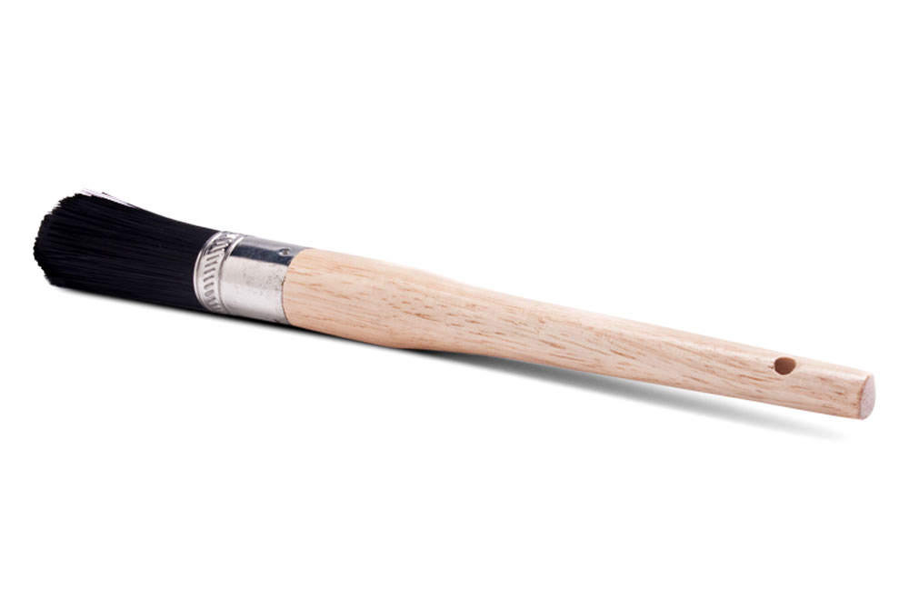
Parts Brush
Metal handle is usually sealed at both ends to enable brush to float in solvent to prevent losing brush in solvent tank.
Notes:
Common Tools-Brushes Image: PartsBrush.jpg Height: 670 Width: 1000

Slide 49
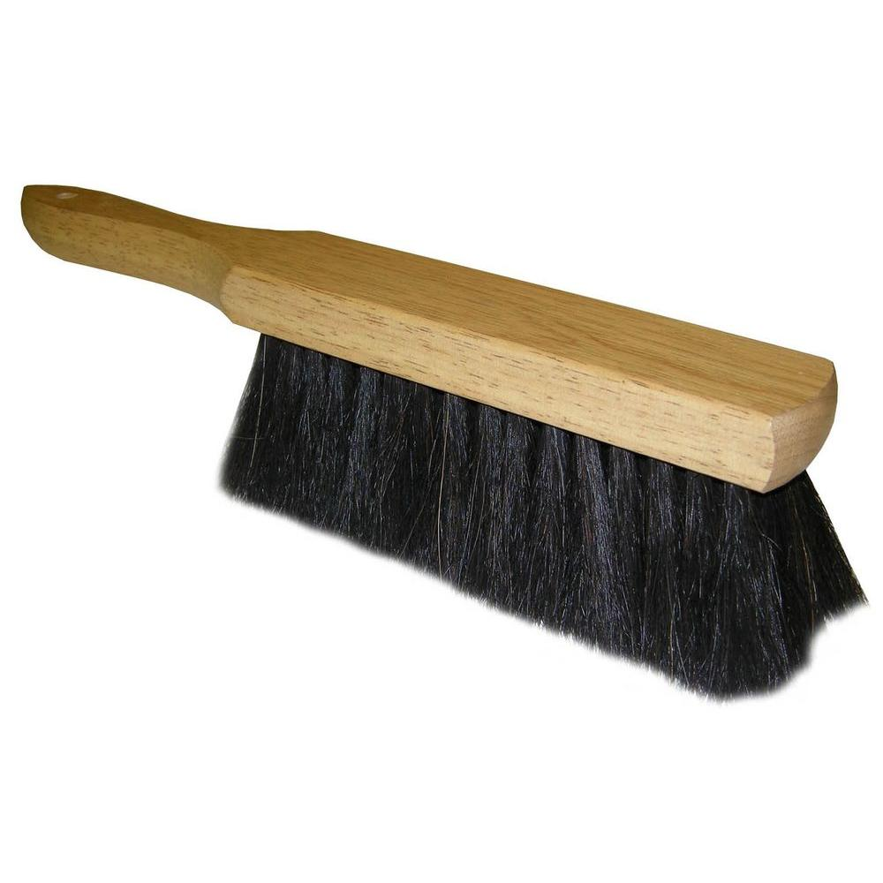
Bench Brush
The overall length is 16 inches.
Notes:
Common Tools-Brushes Image: BenchBrush.jpg Height: 1000 Width: 1000

Slide 50
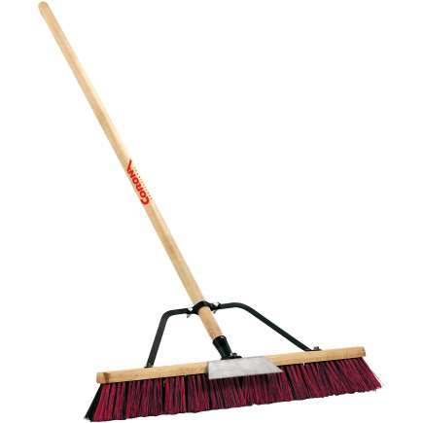
Push Broom
Handles are 7/8 inch in diameter 4 to 5 feet long and are threaded into broom body or bolted on.
Notes:
Common Tools-Brushes Image: PushBroom.jpg Height: 261 Width: 261

Slide 51
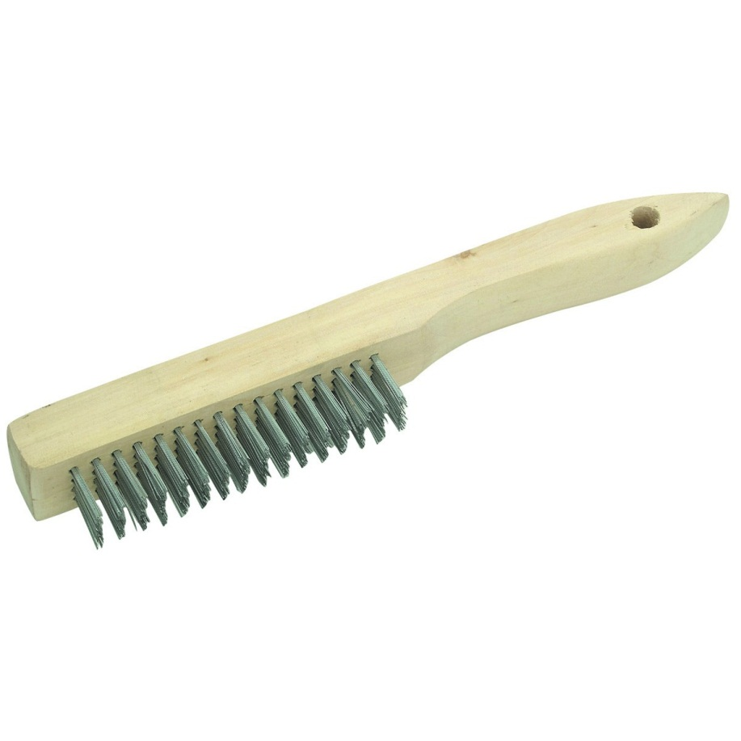
Wire Brush
Used for cleaning metal parts to be welding, cleaning machinery parts and removing slag and rust.
Notes:
Common Tools-Brushes Image: WireBrush.jpg Height: 720 Width: 720

Slide 52
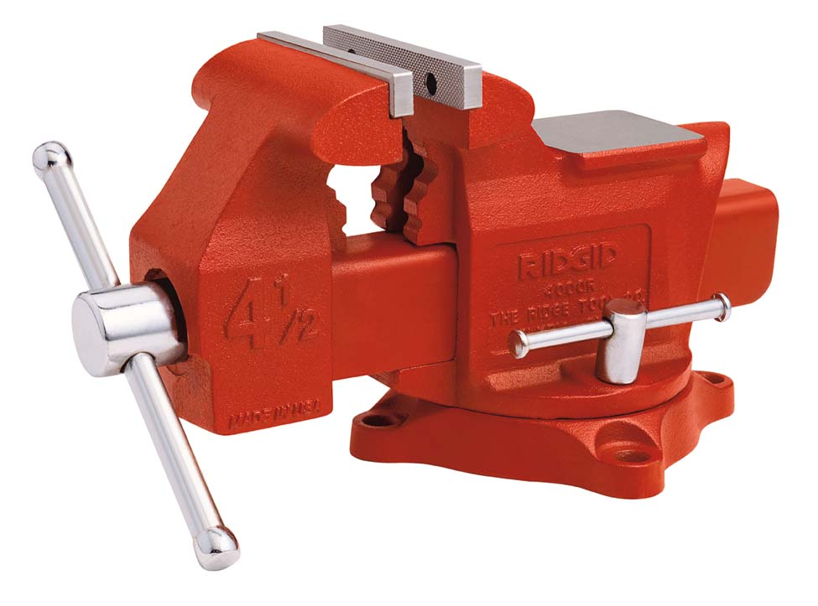
Machinist’s Vise
A bench mounted vise for metal with a swivel base and replaceable jaws. It should not be used for hammering or bending metal. Also called a Bench Vise.
Notes:
Common Tools-Vises Image: Machinists vise.jpg Height: 173.52 Width: 234

Slide 53
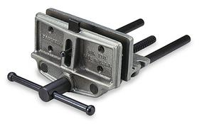
Woodworker’s Vise
The flat smooth jaws open up to 12 inches. Jaws may be lined with wood.
Notes:
Common Tools-Vises Image: WoodVise.jpg Height: 175 Width: 280

Slide 54
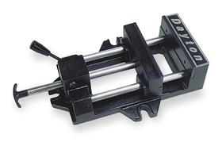
Drill Press Vise
Drilling is safe and more accurate when a vise is used, and fewer drill bits are broken.
Notes:
Common Tools-Vises Image: DrillPressVise.jpg Height: 179 Width: 280

Slide 55
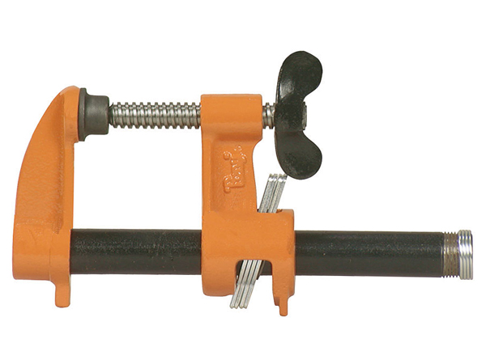
Pipe Clamp
A clamp made with a steel pipe.
Notes:
Common Tools-Clamps Image: clamp3.jpg Height: 270 Width: 360

Slide 56
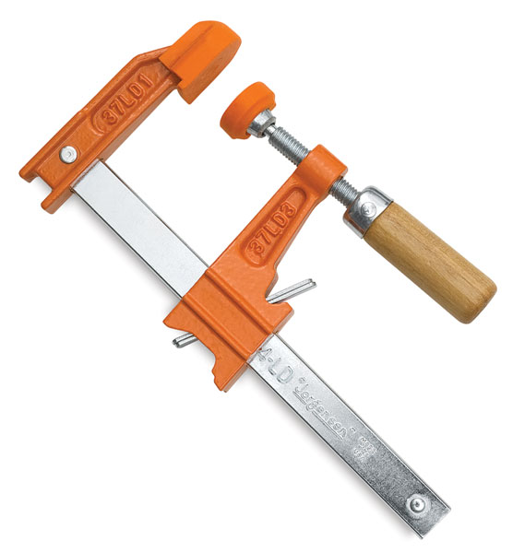
Bar Clamp
Bar type clamp has quick non­ slip adjustment to approximate size; then screws tight to apply pressure.
Notes:
Common Tools-Clamps Image: clamp2.jpg Height: 360 Width: 333.6

Slide 57
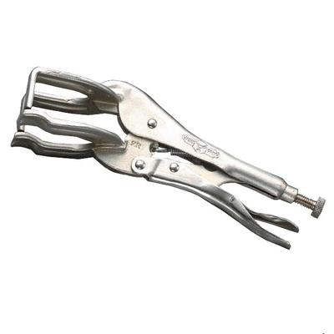
Locking Welding Clamp
Works well when clamping two pieces adjacent to each other or at 90 degree angles.
Notes:
Common Tools-Clamps Image: LockingWeldingClamp.jpg Height: 400 Width: 400

Slide 58
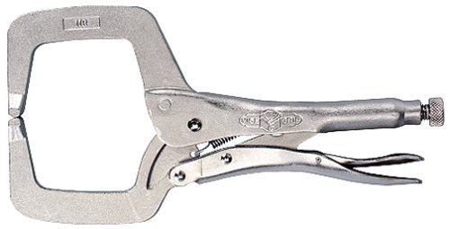
"C" Clamp Locking Pliers
Used for clamping irregular shapes quickly and firmly when welding or fastening.
Notes:
Common Tools-Clamps Image: LockingC-clamp.jpg Height: 153 Width: 300

Slide 59
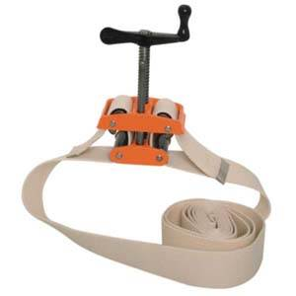
Strap Clamp
Uses a fabric strap that tightens around large or irregular projects.
Notes:
Common Tools-Clamps Image: BandClamp.jpg Height: 225 Width: 225

Slide 60
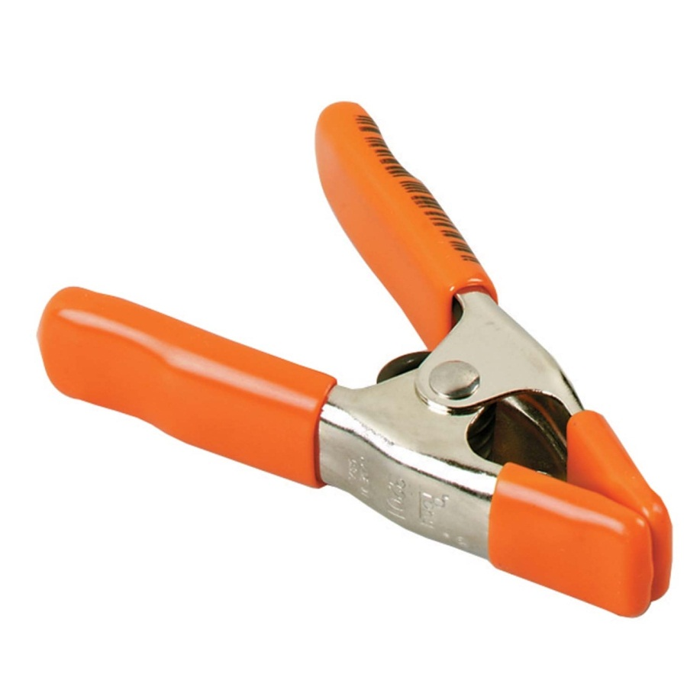
Spring Clamp
Jaws are specially formed to hold flat or round objects.
Notes:
Common Tools-Clamps Image: SpringClamp.jpg Height: 1305 Width: 1305

Slide 61
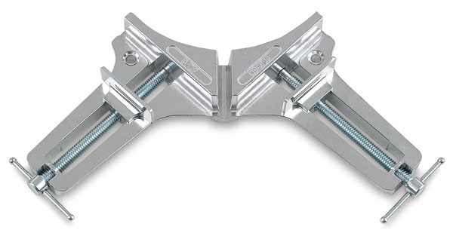
Corner Clamp
Jaws are at 90 degree angles. Used to clamp items like cabinet frames.
Notes:
Common Tools-Clamps Image: CornerClamp.jpg Height: 192.6 Width: 360

Slide 62
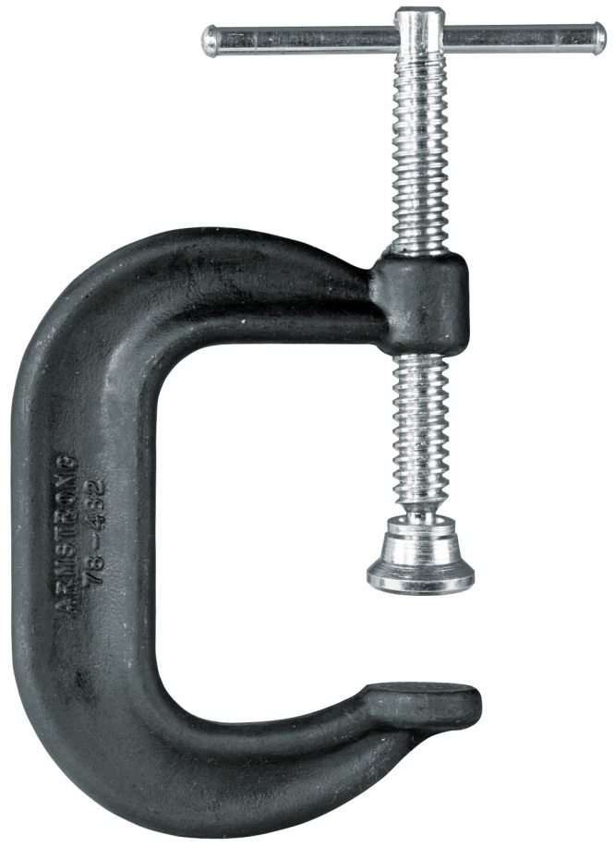
"C" Clamp
The screw has a sliding bar or a thumb screw at one end and usually a ball and socket pad at the other Sizes range from 2 to 12 inches.
Notes:
Common Tools-Clamps Image: C_Clamp.jpg Height: 900 Width: 654

Slide 63
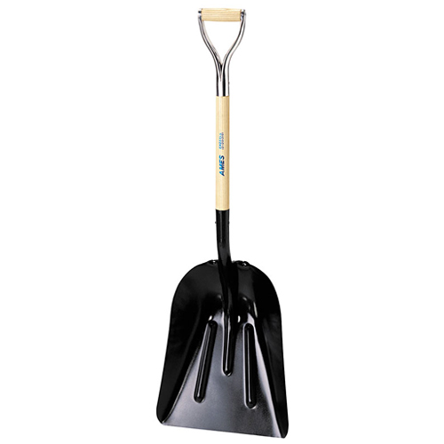
Scoop Shovel
The handle can be a short capped ferrule “0” type or 54 inch long handle.
Notes:
Common Tools-Shovels, Rakes, Picks, and Posthole Diggers Image: ScoopShovel.jpg Height: 300 Width: 300

Slide 64
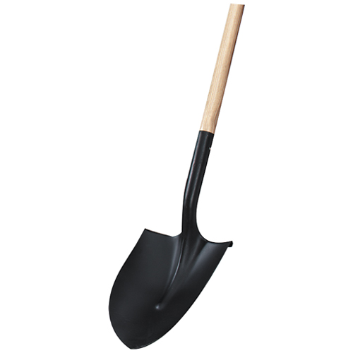
Round Point Shovel
A shovel used for digging. Typical handle length approximately 50 inches.
Notes:
Common Tools-Shovels, Rakes, Picks, and Posthole Diggers Image: RoundPointShovel.jpg Height: 300 Width: 300

Slide 65
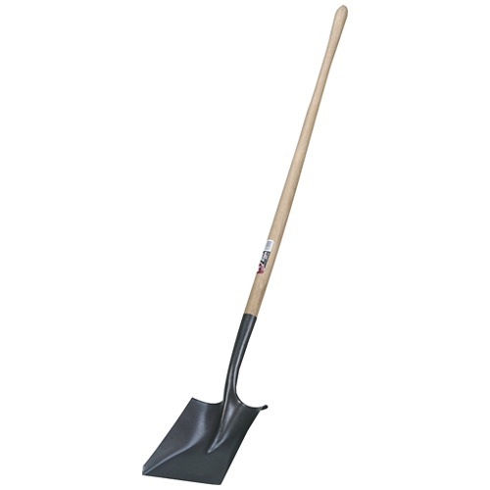
Square Point Shovel
Used for scooping materials such as sand and gravel. Typically the handle about 50 inches long.
Notes:
Common Tools-Shovels, Rakes, Picks, and Posthole Diggers Image: SqPtShovel.jpg Height: 300 Width: 300

Slide 66
Irrigating Shovel
The same as the round point except the blade is almost straight with the handle.
Notes:
Common Tools-Shovels, Rakes, Picks, and Posthole Diggers Image: IrrigShovel.jpg Height: 301.2 Width: 53.4

Slide 67
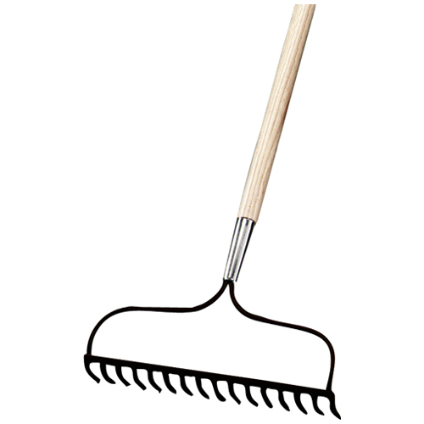
Bow Rake
Has 15, 2 1/2 inch pointed teeth attached at 90 degrees to a 5 foot ferruled handle.
Notes:
Common Tools-Shovels, Rakes, Picks, and Posthole Diggers Image: BowRake.jpg Height: 300 Width: 300

Slide 68
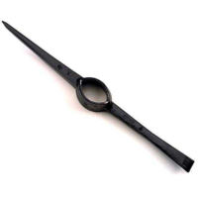
Clay Picks
The handles for all picks are 32 inches long and are larger at the head or blade end.
Notes:
Common Tools-Shovels, Rakes, Picks, and Posthole Diggers Image: ClayPick.bmp Height: 120 Width: 120

Slide 69
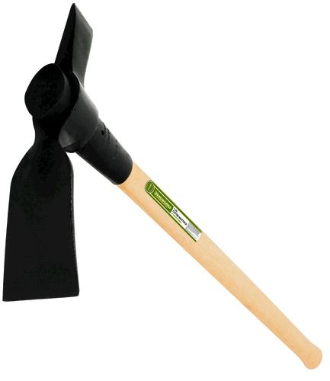
Cutter Mattocks
The blades ends are rotated 90 degrees and oval hole is in the center for the handle which is sold separate.
Notes:
Common Tools-Shovels, Rakes, Picks, and Posthole Diggers Image: CutterMattocks.jpg Height: 500 Width: 433

Slide 70
Pick Mattocks
Similar to the cutter mattocks except one end of the blade comes to a sharp point for breaking or digging in hardpan or very hard soil.
Notes:
Common Tools-Shovels, Rakes, Picks, and Posthole Diggers Image: PickMattocks.jpg Height: 346.8 Width: 405

Slide 71
Posthole Auger
It is operated by rotating the handle.
Notes:
Common Tools-Shovels, Rakes, Picks, and Posthole Diggers Image: PostHoleAugar.jpg Height: 500 Width: 500

Slide 72
Posthole Digger
It is operated by thrusting the points into the soil and spreading the handles to remove the soil. Also called a Clam Shell.
Notes:
Common Tools-Shovels, Rakes, Picks, and Posthole Diggers Image: PostHoleDigger.jpg Height: 300 Width: 300

Slide 73
Safety Goggles
Eye protection that covers eye glasses.
Notes:
Common Tools-Miscellaneous Image: SafetyGoggles.jpg Height: 462 Width: 708.6

Slide 74
Safety Glasses
Eye protection that covers eyes only. Safety glasses have side shields. The California State Educational Code states that all students, teachers, and visitors in a school shop must wear eye protection.
Notes:
Common Tools-Miscellaneous Image: SafetyGlasses.jpg Height: 189 Width: 252

Slide 75
Face Shield
Eye protection that covers the entire face. Often used with safety glasses when full protection of the face is required.
Notes:
Common Tools-Miscellaneous Image: FAceShield.jpg Height: 660 Width: 800

Slide 76
Chain Saw
Most chain saws are gasoline powered, but smaller pruning saws can be electric or hydraulically powered.
Notes:
Common Tools-Miscellaneous Image: ChainSaw.jpg Height: 172.8 Width: 439.92

Slide 77
Air Compressor
Used for supplying compressed air for spray painting and for operating air tools at low pressures (less than 100 psi).
Notes:
Common Tools-Miscellaneous Image: AirCompressor.jpg Height: 198 Width: 264

Slide 78
Rotary Hammer
Used for drilling holes in concrete and with chisel attachments. Special carbide tipped bits must be used with this unit.
Notes:
Common Tools-Common Power Tools Image: RotaryHammer.jpg Height: 300 Width: 300

Slide 79
Contractors Wheelbarrow
Used widely in the construction industry. Typical capacity 1/5 cubic yard. Wheel is pneumatic.
Notes:
Common Tools-Miscellaneous Image: wheelbarrow.jpg Height: 185 Width: 280

Slide 80
Hog Ringer
It is some what like a pair of pliers except the jaws of the ringer has special slots for holding the ring.
Notes:
Common Tools-Miscellaneous Image: HogRinger.jpg Height: 450 Width: 450

Slide 81
Bolt Cutter
The toggle and lever joints develop great mechanical advantage. Commonly used to cut bolts, chain, and reinforcing bar.
Notes:
Common Tools-Miscellaneous Image: BoltCutter.jpg Height: 318.6 Width: 480

Slide 82
Anvil
Sizes range in weight from 20 to 200 pounds. Used to shape cold and hot metal.
Notes:
Common Tools-Miscellaneous Image: anvil.jpg Height: 157.44 Width: 216

Slide 83
Electric Drill
Many models are variable speed.
Notes:
Common Tools-Common Power Tools Image: Portable Drill.jpg Height: 375 Width: 375

Slide 84
Hammer Drill
A power drill (corded or cordless) that creates a hammering action on the drill bit. Commonly used for concrete drilling with masonry bits.
Notes:
Common Tools-Common Power Tools Image: Hammer Drill.jpg Height: 900 Width: 900

Slide 85
Hammer Tacker
A stapler that operates like a hammer. Used to install insulation, builder's paper, roofing felt, etc.
Notes:
Common Tools-Miscellaneous Image: hammer tacker.jpg Height: 266 Width: 459

Slide 86
Power Screwdriver
Comes in many shapes and sizes. These power tools are battery or AC powered, reversible, and variable speed. They are commonly used for dry wall or decking installation. Many models also have a high speed range for drilling.
Notes:
Common Tools-Common Power Tools Image: Cordless Drill.jpg Height: 375 Width: 339

Slide 87
Staple Gun
Heavy duty and light utility models are available driving 3/16 to 1/2 inch staples.
Notes:
Common Tools-Miscellaneous Image: stapler2.jpg Height: 180.96 Width: 240

