Slide 1
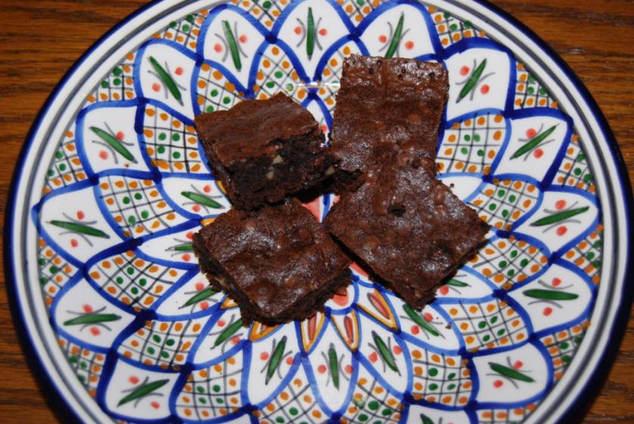
Brownies 101

Slide 2
How do you build a brownie?

Slide 3
You Need a Plan

Slide 4
You need materials

Slide 5
You need tools

Slide 6
However you might consider

Slide 7
And Alternate Materials

Slide 8
So lets start over….
What are the student learning outcomes (SLO) we desire?
Plan reading
Materials selection
How to measure
Proper selection and use of tools
And of course the brownies….

Slide 9
Dig a bit deeper, some additional SLO's
How can different materials be used and substituted
Different mixing techniques
Adjusting the plan

Slide 10
So what do you need to teach brownie building?
Confidence to show someone else how to do it.
The tools, but there are options

Slide 11
Can you use this?

Slide 12
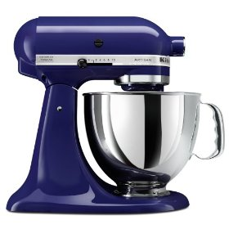
How about this?

Slide 13
How will using different materials and tools effect the SLO's?

Slide 14
Is this any different from teaching shop?

Slide 15
Standards and the BIG Picture
How do the SLO's support the course SLO's and standards?
How does this project fit with others to:
Introduce,
Reinforce,
and master skills
Where should this project fit in a sequence?

Slide 16
So you need to ask why build brownies?
Obviously because they are delicious!

