Slide 1
Basic Wiring Rules
June 2023

Slide 2
Actual Wiring Requires
Understanding of the circuit – how the devices must be connected
Understanding of the physical layout of the devices and source of power
Understanding of the wiring system (NM vs. Conduit)
Understanding of the rules (Code)

Slide 3
Color
Wire colors are standardized
Green or bare wire is ground
White is neutral
Any other color is “hot”
Wires may be marked with colored tape
Screws
Brass is hot
Silver is neutral
Green is ground

Slide 4
Screw terminals
Wire is wound clockwise so it tightens as screw is tightened
Bare wire goes ¾ of the way around the screw
Wire never overlaps
Bare wire does not protrude past the device
1 wire per screw

Slide 5
Eye Demo – You can do this!

Slide 6
Wire Nuts
Nut is properly sized for the number of wires (see box)
Nuts are tight on all wires (pull test)
Bare wire does not extend past the “skirt” of the wire nut.
Wires must always be connected in a box
This ensures that a bad connection cannot start a fire

Slide 7
Conductor Length
6” of conductor should extend from the box
This allows re-wiring in the future
The most common problem students have is short wires

Slide 8
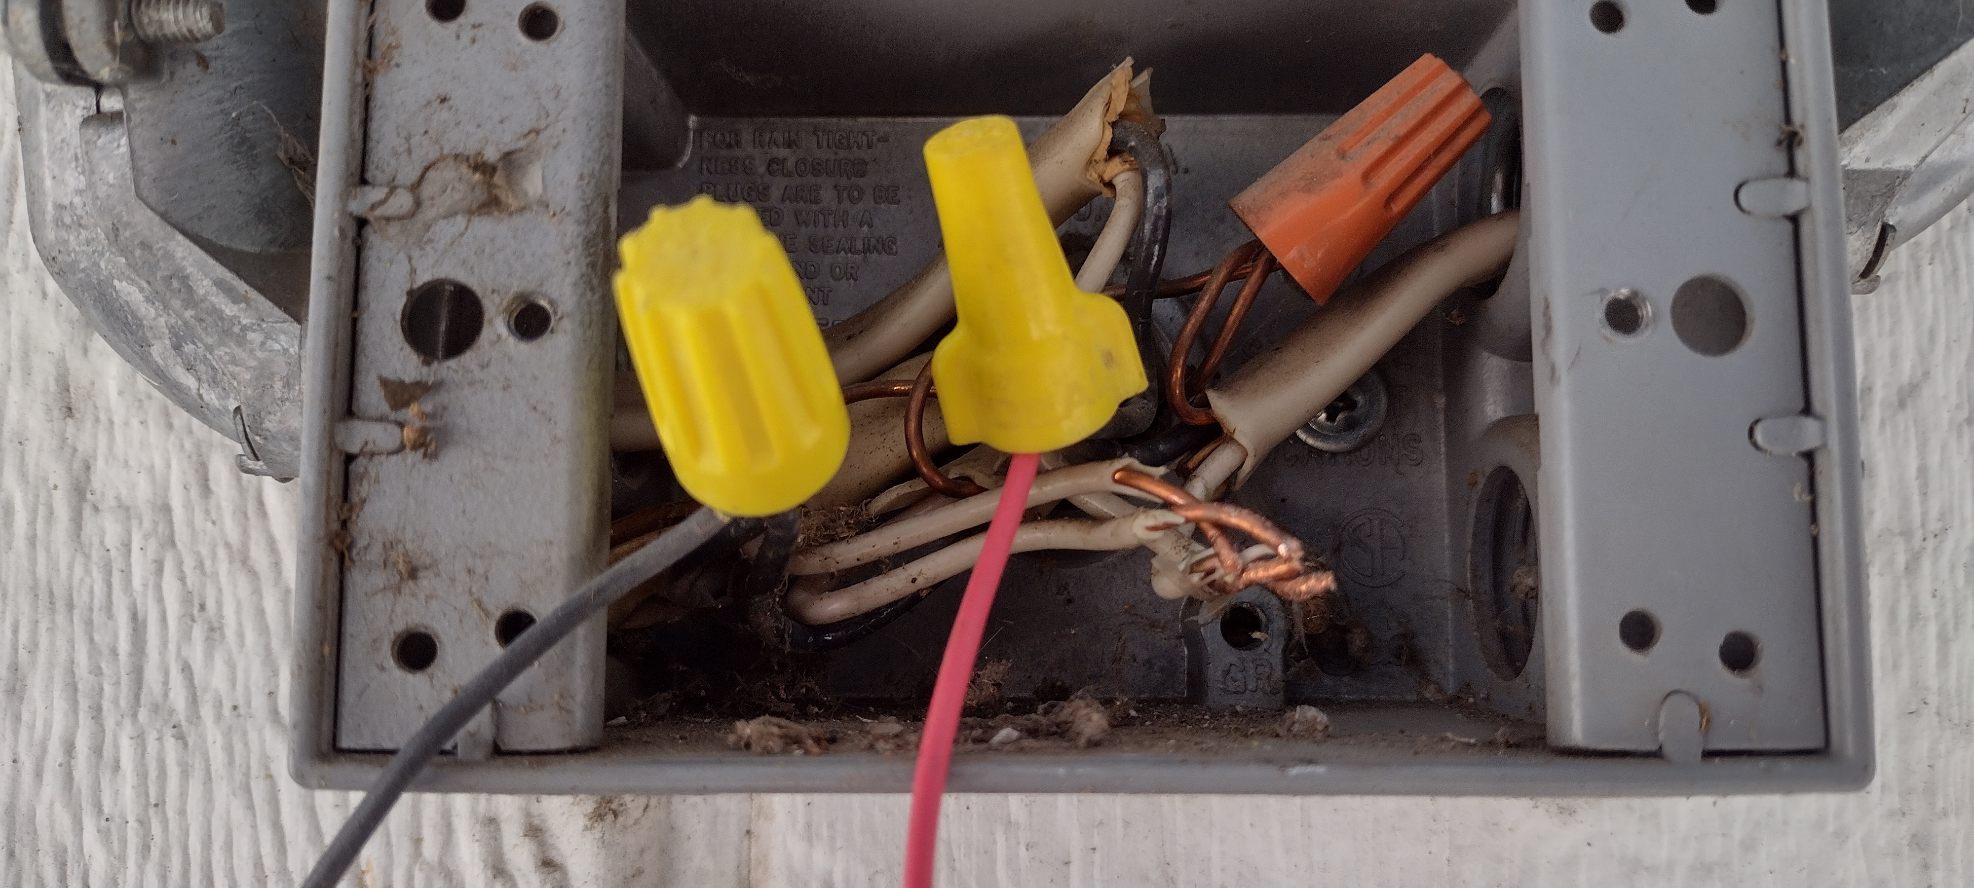
This is a problem…

Slide 9
Wire Size
Wires are protected by current overload devices (breakers)
Minimum wire sizes
15A Breaker – 14 gauge wire
20A Breaker – 12 gauge wire
30A Breaker – 10 gauge wire
Larger wire may be used to minimize voltage loss

Slide 10
Grounding
Ground wire must be continuous back to the source (SEP)
Metal boxes must be grounded
EMT and Rigid conduit serve as a ground wire
Receptacles must be grounded
Usually switches in residential applications do not require grounding. If in doubt ground.
Directly connected loads (ex. lights, tools) are grounded

Slide 11
NM Cable vs. Conduit

Slide 12
Non-Metallic (NM) Cable
Used in residential wiring
Conductors are covered with a plastic sheath
Available in 2 and 3 conductors with a ground
Ex. 14/2 w/g = 14 gauge, 2 conductors, with ground
Ex. 12/3 w/g = 12 gauge, 3 conductors, with ground
Wire colors are fixed
B/W or B/R/W
NM Cable cannot be exposed to people
Protected in a wall
NM Cable is fastened with staples
Solid wire
Direct Burial (UF) cable can be used underground

Slide 13
Wiring with NM Cable
Wiring options are limited when compared to wiring with conduit and single conductors.
Ground wire is required to connect grounded boxes and devices
Plastic boxes cannot be grounded, but ground wires are connected in the box.
Notes:
Students should be able to diagram their wiring practicum before completing their actual wiring assignments.
Use the following slides to show the students how to diagram. The slides show a variety of wiring scenarios (feel free to create additional scenarios for students to practice).
Tip: When diagraming, draw and show the connections for the hot wires first, then neutral wires, and lastly, ground wires. This will help students begin to understand the path that electricity takes in a circuit.
When diagraming, show the following:
Where the wires go into each box
How the wires stick up out of each box
Where to connect wires together with wire nuts
Where to connect wires directly to a device or box.
Use color codes to identify conductors.

Slide 14
Conduit wiring
Types:
PVC (waterproof, requires ground)
Electrical Metallic Tubing (EMT)
Rigid steel conduit (can be waterproof)
Flexible Conduit (requires ground)
Flexible waterproof conduit (requires ground)
Uses single conductor wire
Colors can be selected
Size is determined by the number/size of conductors (fill)

Slide 15
Typical Uses
PVC – Underground
EMT Shops – indoor surface wiring
Rigid – underground, explosion hazards (like feed mills and grain elevators), service entrance
Flex – commercial buildings in walls
Waterproof flex – pump connections

Slide 16
Metal Boxes
Used with conduit (or NM cable with clamps)
4” square is most common
Must be used with a plaster ring or cover to mount a device
2”x4” ‘handy box’ is commonly used for surface mounting
½” or ¾” knockouts (KO) are most common.
Waterproof boxes are used outside

Slide 17
Wire in Conduit
Solid wire is preferred for most applications
Cheaper
Easier to connect to devices
Stranded wire is more flexible and will pull through conduit easier
Stranded wire is commonly used to connect motors

Slide 18
NEC / Local Codes / Conventions
The National Electric Code is the standard
Counties usually follow the NEC, but may not have adopted the current Code
Electricians often have different “styles” of wiring. More than one style can meet code.
For example an electrician may say a switched wire must be red, but really any “hot” color may be used.

Slide 19
Teaching Tips
Strip NM cable back to the clamp, but no conductor outside the box.
Install ground first and put in the back of the box
Fold wires neatly into the box when installing devices
Panels
Install grounds, neutrals, then hot last
Bend wires to route neatly

