Slide 1
Panel Wiring
June 2023

Slide 2
Types Panels
Service Entrance Panel (SEP)
100 A +
Ground and Neutral and bonded
Panel is grounded to “earth ground”
Sub Panels
Serviced from another panel
Typically 60A +
Neutral and Ground are separate
Shutoff / Disconnect
Single circuit (ex A/C or Pump)

Slide 3
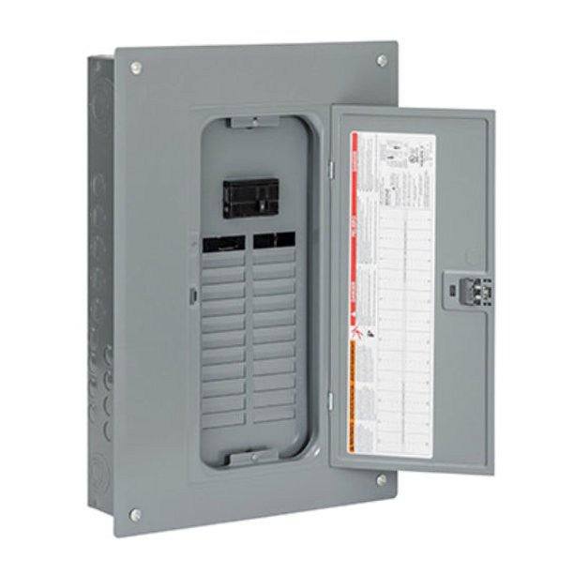
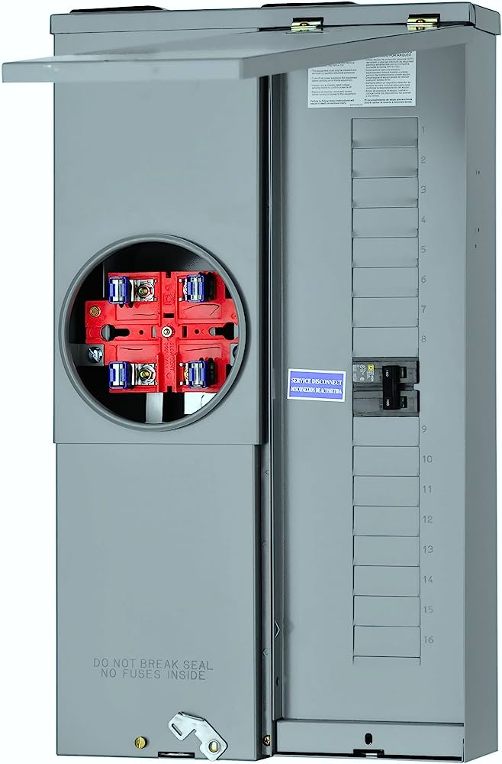
SEP

Slide 4
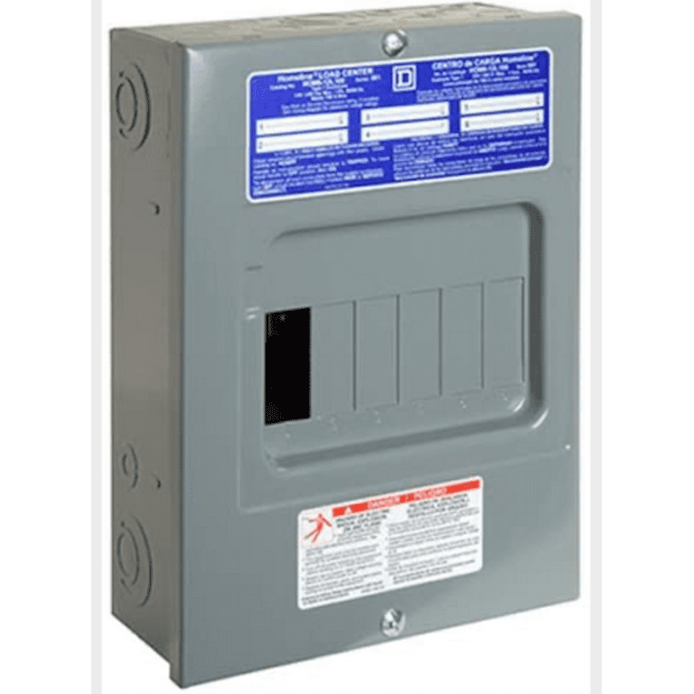
Sub Panel

Slide 5
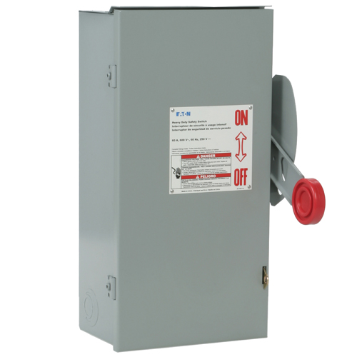
Disconnect

Slide 6
Distribution / Branch Circuits
Panels provide distribution of power
Some basic residential circuit requirements
Kitchens – Two 20A
Single serving: dishwasher, microwave, washing machine
“lighting” circuits commonly serve lights and receptacles in an area like a bedroom or living room

Slide 7
Overload Protection
Panels protect the wiring from overheating in the event of a short or overload.

Slide 8
Breaker Types
Single Pole (120V) are attached to one “leg” of the service
Double Pole (240V) are attached to both “legs” of the service. Must be tied together.
“thin” breakers are two breakers attached to a single leg
Arc Fault Circuit Interrupters (AFCI) - Used in living areas. Detects arcing in the circuit which could cause a fire

Slide 9
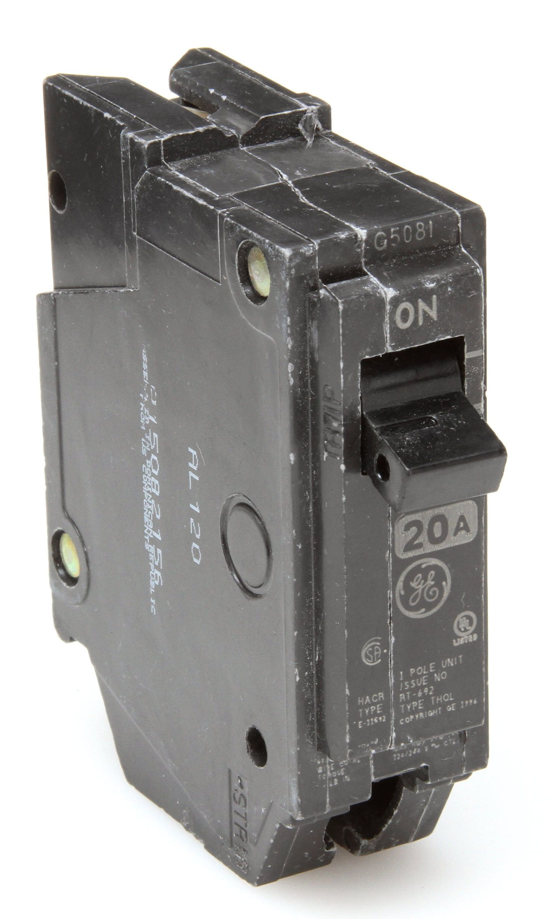
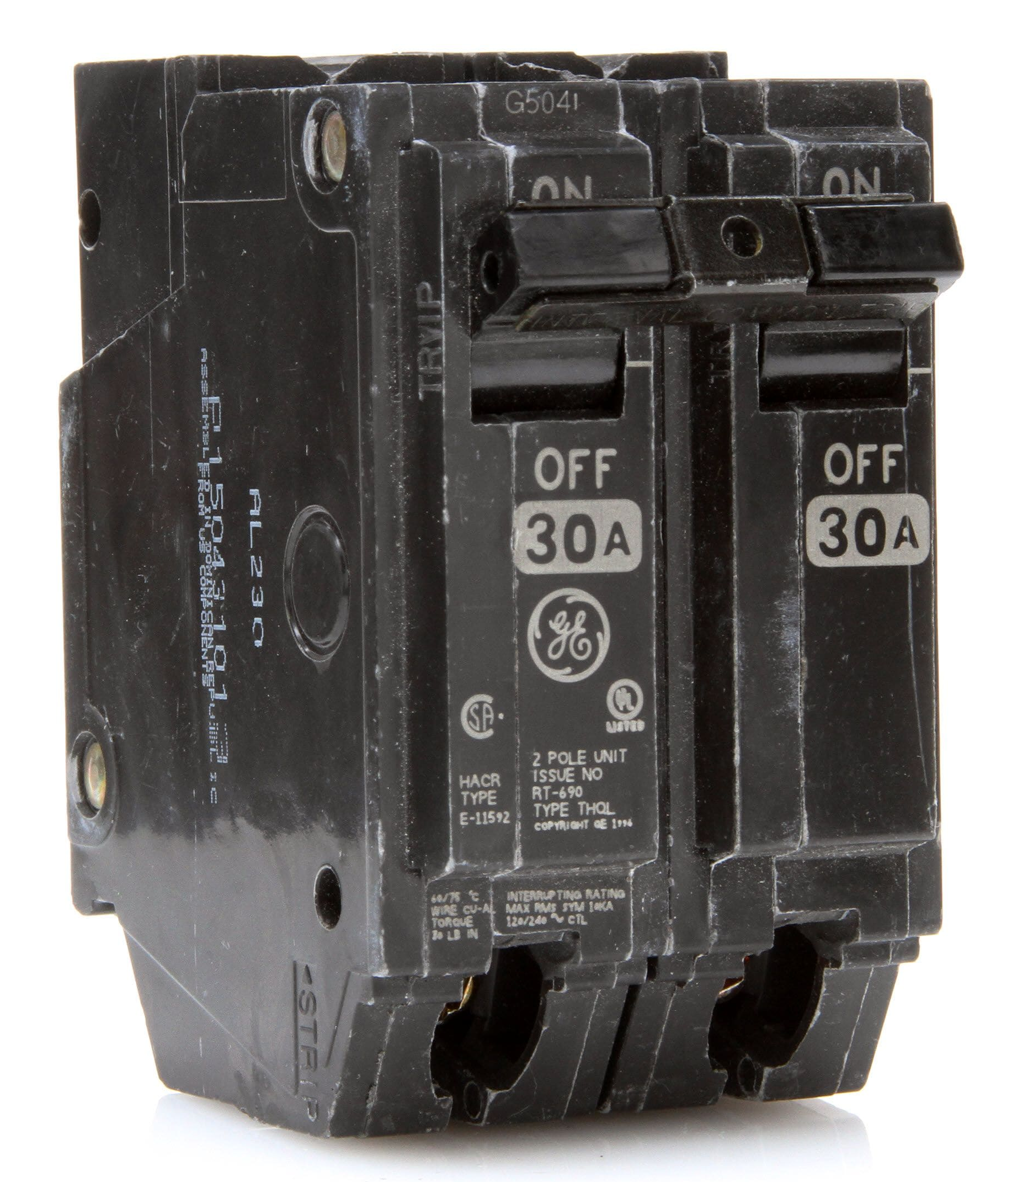
Circuit Breakers

