Slide 1
Electrical Circuits
June 2023

Slide 2
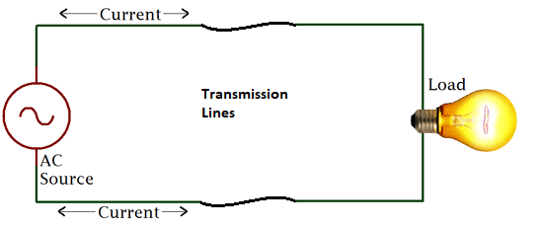
Look for the “Loop”
For current to flow there must be a complete path between the power source (hot), the load, and ground (neutral) or between two hot legs (240V) and the load.

Slide 4
Find the loop
Hot
Duplex
Receptacle
Neutral

Slide 5
Find the loop
Hot
Switch
Lamp
Neutral

Slide 6
Find the loop
Hot
Switch
Lamp
Neutral
What does the switch do?

Slide 7
Three Common Circuits
Unswitched receptacles
  DRs (15A / 20A)
  Dryers (30A)
  Stationary Equipment
Simple Toggle Switch (lights, fans)
3 & 4 way switches (lights)

Slide 8
Combining Circuits
Typically simple circuits are combined
  Kitchen with multiple DRs
  A lighting circuit with one or more DR
  A bathroom with separate switched fan and light
Switch
Lamp
Duplex
Receptacle

Slide 9
Circuit to Actual Wiring
Once the circuit is determined then you must determine how to run the actual wire
Consider the placement of boxes
Consider NM cable vs Conduit
Determine wire size

Slide 10
NM Cable Examples
(from FFA Curriculum)

Slide 11
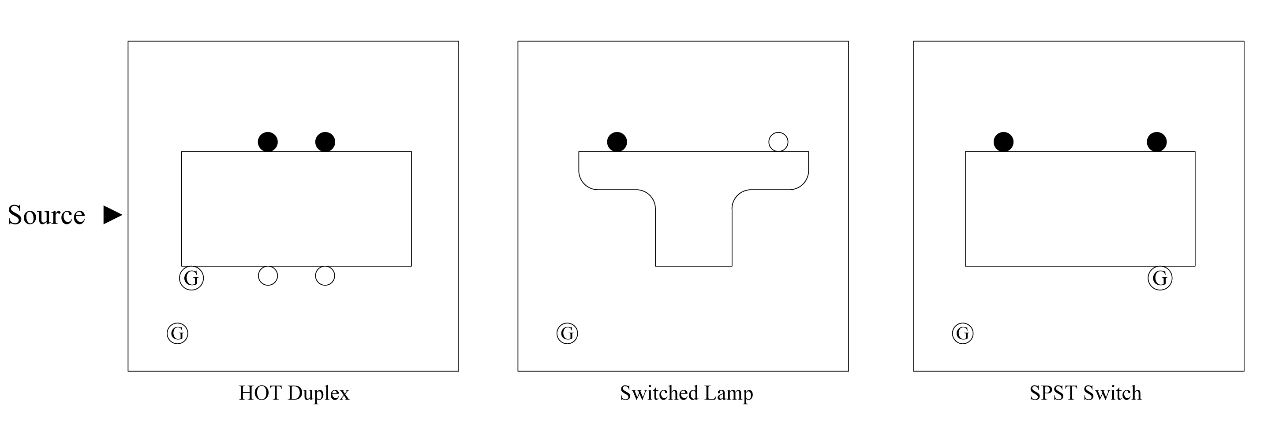

Switched Lamp (source at switch)
Box A
Box B
Source (14-2 w/g)
14-2 w/g
Between boxes
Screw Key:
Silver Screw
Gold/Brass Screw
Grounding Screw
Color Key:
Black = Hot
Blue = Neutral (White)
Green = Ground
Notes:
In this example:
Connect the source hot wire (black) to one of the gold or brass colored screws on the switch in box B.
From the second gold/brass screw on the switch, run a hot wire (black) to box A and connect to the gold/brass screw on the lamp base.
Pigtail off the source neutral wire (white) and run a neutral wire (white) to box A and connect to the silver screw on the lamp base.
Pigtail off the ground wire (green/bare) using green or bare wires and connect to all of the grounding screws in both boxes.
Use appropriate wire nuts to connect wires together.

Slide 12
Switched Lamp (Source at lamp)
Black Electrical Tape
Box A
Box B
Source
14-2 w/g
14-2 w/g
Between boxes
Screw Key:
Silver Screw
Gold/Brass Screw
Grounding Screw
Color Key:
Black = Hot
Blue = Neutral (White)
Green = Ground
Notes:
In this example:
Pigtail off the source hot wire (black) and run a hot wire (black) to box B and connect to one of the gold or brass colored screws on the switch.
Use the available neutral wire as a hot wire (tape both ends of this wire with black tape to indicate that it is a hot wire now) and connect it to the second gold/brass screw on the switch in box B and in box A, connect it to the gold/brass screw on the lamp base.
Connect the source neutral wire (white) to the silver screw on the lamp base in box A.
Pigtail off the ground wire (green/bare) using green or bare wires and connect to all of the grounding screws in both boxes.
Use appropriate wire nuts to connect wires together.

Slide 13
Switched Lamp, Hot Duplex
(Source at Switch)
Box A
Box B
Box C
Source
14-2 w/g
Between boxes
Color Key:
Black = Hot
Red = Hot
Blue = Neutral (White)
Green = Ground
Screw Key:
Silver Screw
Gold/Brass Screw
Grounding Screw
14-3 w/g
Between boxes
Notes:
In this example:
Hot wires
In box C, connect a pigtail (hot/black) to one of the gold/brass screws on the switch. Connect this pigtail, the source hot wire (black), and the hot wire from box B together with a wire nut.
In box B, connect the hot wire (black) to the hot wire (black) from box A using a wire nut.
In box A, connect the hot wire (black) from box B to a gold/brass screw on the duplex.
In box C, connect the hot wire (red) from box B to the second gold/brass screw on the switch in box C.
In box B, connect the hot wire (red) to the gold/brass screw on the lamp base.
Neutral wires
In box C, connect the source neutral wire (white) to the neutral wire (white) from box B with a wire nut.
In box B, make a pigtail out of neutral wire (white) and connect it to the silver screw on the lamp base. Connect this pigtail with the neutral wires (white) from box C and box A together with a wire nut.
In box A, connect the neutral wire (white) from box B to one of the silver screws on the duplex.
Ground wires
Pigtail off the ground wire (green/bare) using green or bare wires and connect to all of the grounding screws in all boxes.
Use appropriate wire nuts to connect all ground wires together.

Slide 14
Wiring Board Circuits
A simple 3 box board can be used for many different wiring problems
Simply changing the location of the power source or the location of the devices presents different challenges

