Slide 1
Introduction to Ag Mechanics Curriculum
Mike Spiess

Slide 2
Agenda
Introductions
Units
Unit Plans
Hours
Methods
Teacher Prep
Where to get it!

Slide 3
Who you are?
Teaching < 5 years?
Teaching Ag Mechanics currently?
Train an Ag Mechanics CDE Team?
Who came the farthest?

Slide 4
Who We Are
Dick Piersma – Ag Mechanics Hilmar HS
  Secondary Teacher
  Coach State and National Ag Mechanics Teams
  Coach Farm Power Team
  Cooperating Teacher
John Williams – Ag Mechanics, Fresno State
  Secondary Teacher (Madera High School)
  Teacher Educator
  CDE host (Farm Power)

Slide 5
Who We Are
Tommy Henderson – Ag Engineering Technology, Chico State
  Secondary Teacher (Sanger HS)
  Teacher Educator
  CDE Host (Ag Mechanics)
Mike Spiess – Ag Engineering Technology, Chico State
  Secondary Teacher (Biggs & Sierra HS)
  Coach Ag Mechanics Team
  CDE host (ag mechanics, farm power, small engines)
  National Ag Mechanics CDE committee
  Teacher Educator
We are all shop teachers!

Slide 6
So Let’s Talk Shop!

Slide 7
Units
Surveying
Electrical
Machinery
All are quite different and require different approaches in methods and organization
All cover safety
All have an identification component
Look for ways to tie lessons to your local community. Ex. building construction, or hay harvesting.

Slide 8
Surveying
The focus is on common (and practical) ag and building construction skills
Subject requires higher order thinking skills similar to project layout
Oh no some math is required!

Slide 9
Electrical
Covers AC wiring skills
Fits into most “Intro” shop skills classes
Includes a lesson on DC wiring (trailers, machinery)
Wiring is “Rules” based
Projects are easily fixable and don’t require precise cutting/fitting
Circuits are easily varied by switching devices and source locations
Note: See local building codes/inspectors

Slide 10
Machinery
Covers Tractors and Common Machinery
Choose machinery common to your area. Lessons are broken out.
How machines work is interesting and highly variable. Challenge students to figure it out!
Calibration (sprayers and planters) introduces math
Manual reading is a skill that can be introduced with each machine. Both for specifications and operation
“Studies” can be tailored to locally available equipment.

Slide 11
Content
PowerPoints
  Contains the lesson outline
  Teacher Notes
Guided Notes for Students - Optional
Activities
Assessments
Other Resources
Videos (under development)

Slide 12
Unit Plans – Start Here
Introduction
Teacher Preparation
  Print Materials
  Web Sites
  Other Videos
Teacher Notes
Teaching Methods
Required Equipment (tools)
Math

Slide 13
Unit Plans (continued)
Student Learning Outcomes
Unit Plan (list of lessons)
  Time
  What materials are provided
List of resources provided
Standards and Skills Addressed
  Oregon ANFR
  Oregon Ag Mechanics CDE
  National FFA Ag Mechanics CDE

Slide 14
File Organization
Separated into folders by type of content
  PPT – PowerPoint slides
  Guided Notes – Guided Notes that are aligned with the lessons (word)
  Activities – Activities aligned with lessons (word)
  Assessments – Assessments for the units (word)
  Resources – Additional resources (various formats). These are generally not formatted as they come from various sources. Some are for teacher reference, and some are suitable for student handouts.
File Naming Convention – Unit/Lesson/Topic
  Electrical 06 Panel Wiring Activity.docx
  Survey 04 Right Angle Layout.pptx

Slide 15
Lesson Hours and Order
Use our estimate as a guide only
Your teaching style and experience can cause this to vary greatly.
Class schedules (ex. block vs. daily)
Lesson order is some cases can be varied to suit your needs

Slide 16
Teaching Methods
Ag Mechanics is a hands-on subject. We encourage you to use actual tools/equipment for demonstrations.
Different areas require different management
  Electrical – Need to order materials, but each student can do their own project
  Machinery – You may have only one tractor or planter. Determine how to manage the class. Consider rotations in small groups to perform different tasks.
  Survey – Consider small groups doing different activities such as leveling, pacing, 3-4-5 triangle layout.
Guide Notes can be used. Consider having students keep a notebook.

Slide 17
An Example:
Tool ID

Slide 18
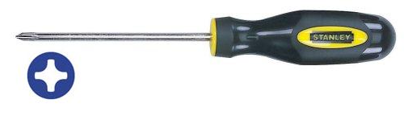
Screwdrivers
Notes:
Both flat and Phillips head screws are used for electrical devices

Slide 19
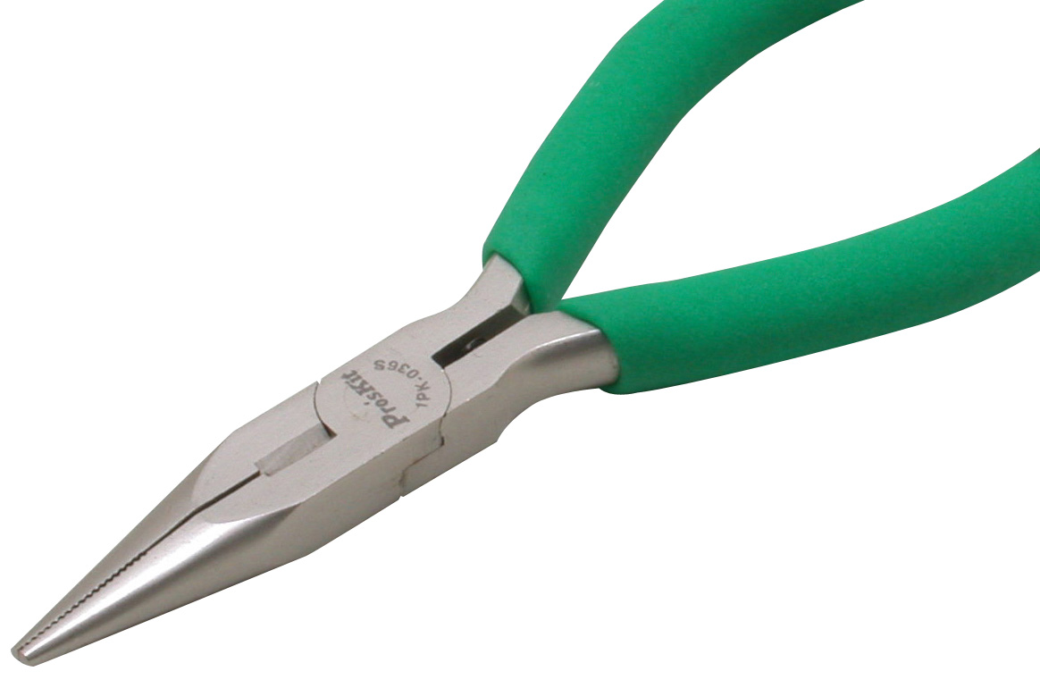
Needle nose pliers
Notes:
Commonly used to bend wire. Electrical tool has a wire cutter.

Slide 20
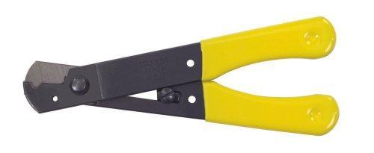
Wire Strippers
Notes:
Wire strippers are used to remove insulation from conductors.

Slide 21
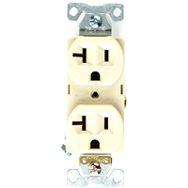
Duplex Receptacle
Notes:
Common 120v outlet

Slide 22
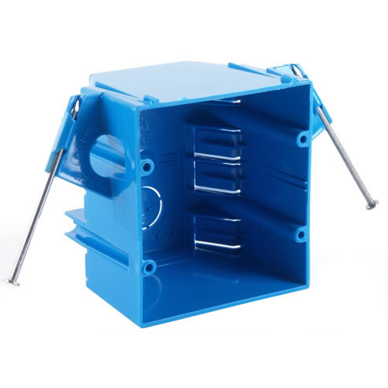
Nail on plastic box
Notes:
Commonly used for home construction with NM Cable

Slide 23
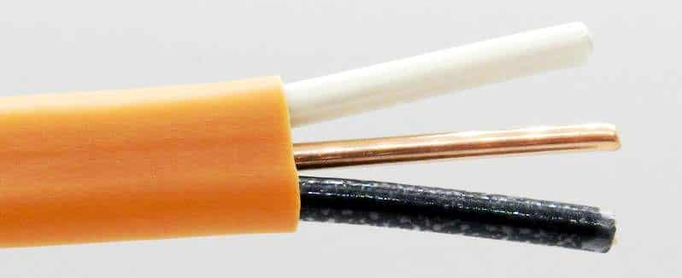
Non-Metallic (NM) Cable
Notes:
Used in homes. Designated by size and number of conductors (ex. 12/2, 14/3)

Slide 24
Live Tools/Materials

Slide 25
An Example:
Instrument Setup

Slide 26
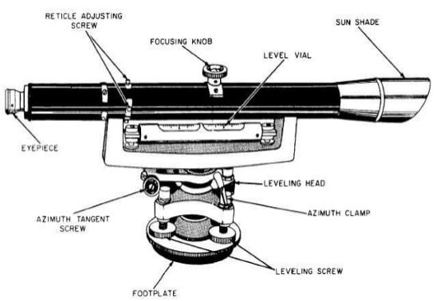
4 Screw Levels (Dumpy Levels)

Slide 27
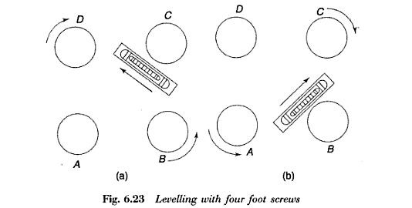
Adjusting 4 Screw Levels
Mount the instrument on the tripod and line up the telescope in line with two opposite screws (a).
Adjust the screws that are aligned to the telescope. Grasp screws the two screws so that both thumbs are moving in opposite directions, either toward each other or away from each other.
Note that the bubble moves in the same direction as your left thumb. Adjust until the bubble is centered.
Rotate the telescope 90 degrees so it aligns with the other two screws (b). Repeat steps 2 and 3.
Rotate the telescope back to the original position and adjust as necessary.
Check to see that the instrument is level by rotating to random positions. The level bubble should remain centered. If not repeat the procedure.

Slide 28
The Video
4 Screw Level.mp4

Slide 29
Live Demo

Slide 30
Teacher Preparation
Review the materials
  Many PPT slides contain notes
Practice the activities
Many additional resources are provided for background
Determine how the materials will fit into existing curriculum

Slide 31
Slice and Dice!
Choose the lessons that make sense for your program.
Add additional lessons over time.
Choose from a variety of activities as time and tooling permits.
Materials are in editable formats.
  PowerPoint: Hide slides, reorder, add your own slides
  Activities: customize for your school

Slide 32

Download
http://www.agedweb.org/ORAgMechanics
Content in a single zip file
Videos individually downloaded (large)
  Videos under development….

Slide 33
What Additional Questions Can I Answer?
Feel free to contact me: mspiess@csuchico.edu

