Slide 1
Part #3 – Weather
Types of Drones and
Aircraft Performance

Slide 2
Overview
Weather
Types of Drones
Drone Sensors (Cameras)
Aircraft Performance

Slide 3
Weather
Wind
Visibility
FAA Test…

Slide 4
Sources of Weather Information
Services like WeatherUnderground and Acuweather
Aviation products. Mostly clouds and winds.
  https://www.aviationweather.gov/
  METAR (hourly reports from airports)
  TAF (Forecasts)
  Automated weather stations -- AWOS or ASOS.

Slide 5
METAR
  KCIC 192347Z 30013KT 80SM FEW070 26/05 A3003
  METAR for: KCIC (Chico Muni, CA, US)
  Text: KCIC 192347Z 30013KT 80SM FEW070 26/05 A3003
  Temperature: 26.0°C ( 79°F)
  Dewpoint: 5.0°C ( 41°F) [RH = 26%]
  Pressure (altimeter): 30.03 inches Hg (1017.0 mb)
  Winds: from the WNW (300 degrees) at 15 MPH (13 knots; 6.7 m/s)
  Visibility: 80 sm (129 km)
  Ceiling: at least 12,000 feet AGL
  Clouds: few clouds at 7000 feet AGL

Slide 6
TAF
KSMF 192335Z 2000/2024 36009KT P6SM FEW250 FM201500 34012KT P6SM SKC
TAF for: KSMF (Sacramento Intl, CA, US) issued at 2335 UTC 19 Sep 2021
Text: KSMF 192335Z 2000/2024 36009KT P6SM FEW250
Forecast period:0000 to 1500 UTC 20 September 2021
Forecast type: FROM: standard forecast or significant change
Winds: from the N (360 degrees) at 10 MPH (9 knots; 4.6 m/s)
Visibility: 6 or more sm (10+ km)
Ceiling: at least 12,000 feet AGL
Clouds: few clouds at 25000 feet AGL
Text: FM201500 34012KT P6SM SKC
Forecast period:1500 UTC 20 September 2021 to 0000 UTC 21 September 2021
Forecast type: FROM: standard forecast or significant change
Winds: from the NNW (340 degrees) at 14 MPH (12 knots; 6.2 m/s)
Visibility: 6 or more sm (10+ km)
Ceiling: at least 12,000 feet AGL
Clouds: clear skies

Slide 7
Automated Weather
Airport systems
Automated Surface Observing System (ASOS) hourly.
Automated Weather Observing System (AWOS) every minute.
Accessible by radio.
Often accessible by phone.
See A/FD.

Slide 8
Why care about weather?
Winds can present considerable issues with ground speed and battery life.
Clouds will skew remote sensing data
VLOS cannot not be maintained with clouds, smoke, or fog
Movement of frontal systems will cause shifting winds and perhaps severe weather.

Slide 9
Types of Drones
Weight (review)
  < .55 pounds (250 g)
  .55 – 55 pounds (250 g to 25 kg) Most ag drones will fall into this range.
Rotor vs. Fixed Wing
  Take off and landing space (Rotor is vertical)
  Ground speed (Fixed Wing is faster)
Control systems
  Level of Automation
Mission Planning
  Requires ability to program the drone

Slide 10

Propellor Airfoils
Propellor and Rotors are rotating airfoils. (Not a fan.)
Air moving over the airfoil creates an area of low pressure on the “top” of the airfoil. This creates thrust. Note that sailboats use this same method in their sails.
The amount of force created varies by the speed of rotation.

Slide 11
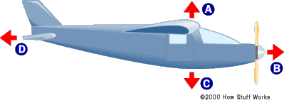
Forces Acting on Airplanes
Lift
Thrust
Weight
Drag

Slide 12
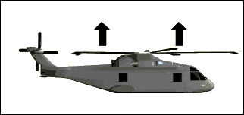
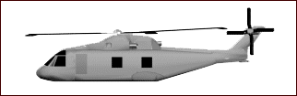
How Helicopters Fly
The rotor(s) create lift. In a conventional helicopter the rotor is tilted to create thrust.
Notes:
Helicopters fly by creating lift with a rotary wing. The helicopter gets its forward movement by tilting its rotor. In order to compensate for the torque created by the main rotor, helicopters use a tail rotor to provide directional stability.

Slide 13
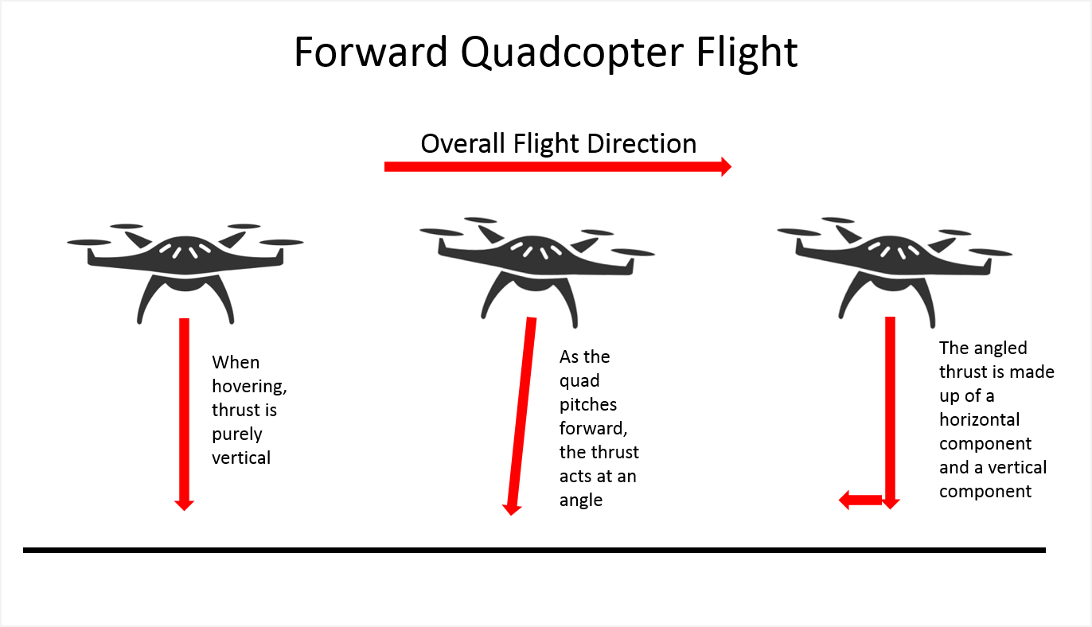

Slide 14
Propeller/Rotor Torque
Torque (twisting force) is created by the engine driving a prop or rotor.
In aircraft this is counter acted by the rudder
In helicopters this is counter acted by the tail rotor
In quadcopters rotors turn in the opposite direction (cancelling the torque).
Turning in quadcopters is accomplished by changing the speed of some of the rotors.

Slide 15
Software
Controller – Typically a phone or tablet interface
Manufacturers control software (ex. DJI Fly)
3rd Party mission planning and control
  Used by ag to fly a field
  Mission is planned. Area to Fly, Height, and Overlap
  DroneDeploy – May have educational discount.
  Dronelink
“Stitching” software
  Required to combine many small images
  Drone Deploy
  Web ODM

Slide 16
Sensors
Video and Still Photos
RGB (Red, Green, Blue)
  Color camera
  Analysis:
    Visual
    VARI (red/green ratio)
Near IR (Infra-red)
  NDVI – Normalized Difference Vegetation Index
  Sensitive to Chlorophyll levels.
Using with your drone
  Drones typically come with RGB, but some may be ordered with other sensors
  Replacement sensors are designed to replace the OEM camera.
  External sensors may be attached to the drone (alters the flight charactistics)
  Altering the drone may void the warranty.
  The speed of image capture affect the maximum ground speed

Slide 17
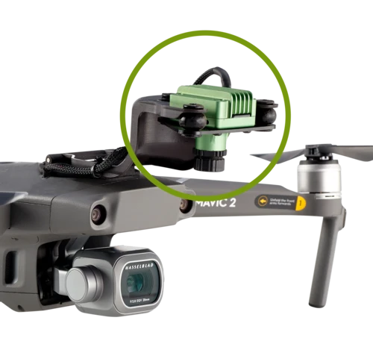
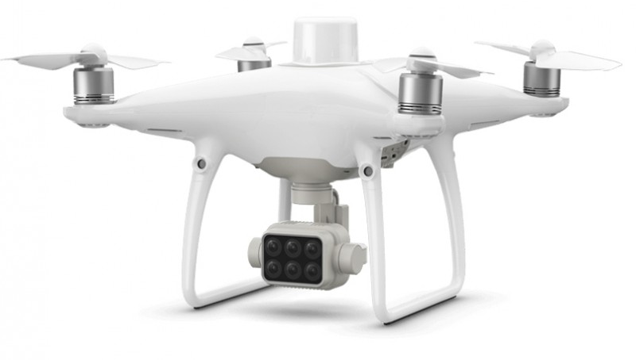
Sensor Configurations

Slide 18
Image Area
Affected by:
  Focal Length (angle)
  Height
  Sensor size (Megapixels)
Distortion
  Longer focal lengths reduce distortion
Few images are easier to stitch
Larger images

Slide 19
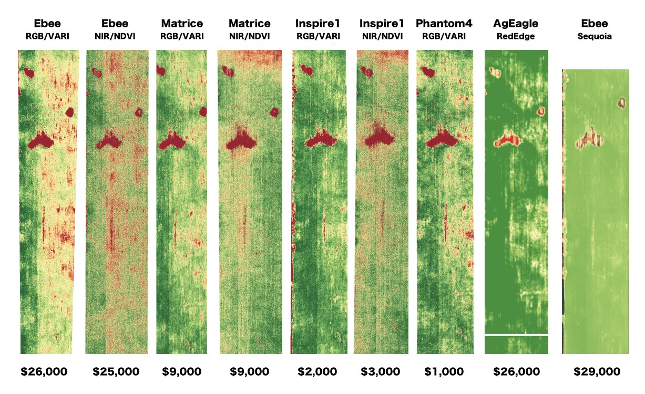
Comparison
Images courtesy of DroneDeploy

Slide 20
Camera Basics
Images should be taken straight down.
Images are distorted away from the center. (Think parallax)
Camera sensor is fixed size (pixels)
Height (AGL) determines the area covered by the camera.
  Higher = More area, less resolution (area/pixel). Few images for a given area.
  Lower = Less area, higher resolution. More images for a given area.
Uneven terrain can cause problems.
  AGL will change if flight is level.
  Following terrain can be a challenge.

Slide 21
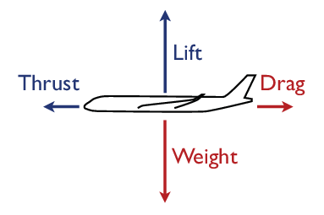
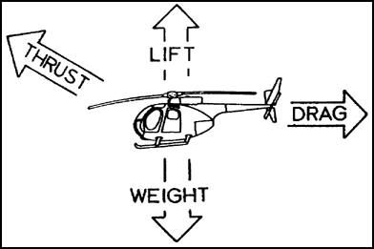
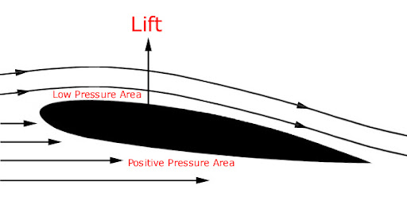
Aircraft Performance
Forces acting on an aircraft.
  Gravity: weight is generally fixed (down)
  Lift: rotors or wings (up)
  Thrust: prop or rotors (forward)
  Drag: Increases exponentially with speed (backwards)
When the aircraft is stationary in the air the forces are equal.
Props are an airfoil not a fan!
High, Hot, Humid all limit performance
Internal combustion engine power is limited by air density.

Slide 22
Aircraft Performance
Electric Power
  Battery life can be affected by temperature
  Prop performance is affected by air density – More power is used to gain the same performance.
Why do we care?
A mission (distance and speed) to fly a field at sea level uses less power than at Lake Tahoe. Available battery power may not be enough to complete the mission. The same is true of a cool day vs. a hot day. Plan for it!
So how does a quadcopter move laterally?

Slide 23
Resources
Aviation Weather: https://www.aviationweather.gov/
ASOS/AWOS (in A/FD). https://www.faa.gov/air_traffic/flight_info/aeronav/digital_products/dafd/search/advanced/
Mission Planning (some examples):
  DroneDeploy: https://www.dronedeploy.com/
  Dronelink: https://www.dronelink.com/
  Precision Hawk: https://www.precisionhawk.com/precisionanalytics-agriculture
  Botlink: https://botlink.com/
Stitching:
  DroneDeploy: https://www.dronedeploy.com/
  Web ODM: https://www.opendronemap.org/webodm/

