Slide 1
Part #2 – Airspace and Charts

Slide 2
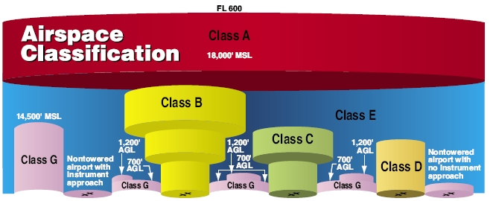
Airspace
A – Above 18,000’
B – Large Airports (SF, LA, SD)
C – Regional Airports (Fresno)
D – Part time tower (Modesto)
E – “everywhere” (most uncontrolled airports)
  Surface, 700’, 1400’ ceilings
G – “good” unrestricted

Slide 3
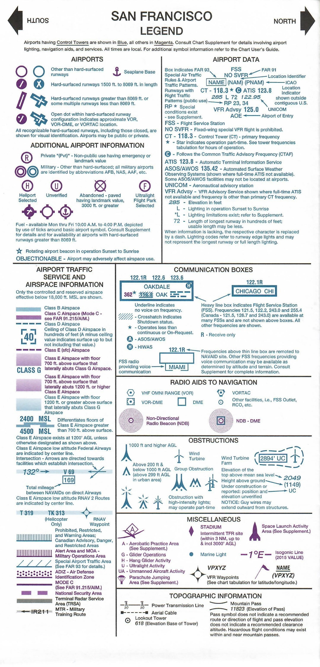

Sectional Maps

Slide 4
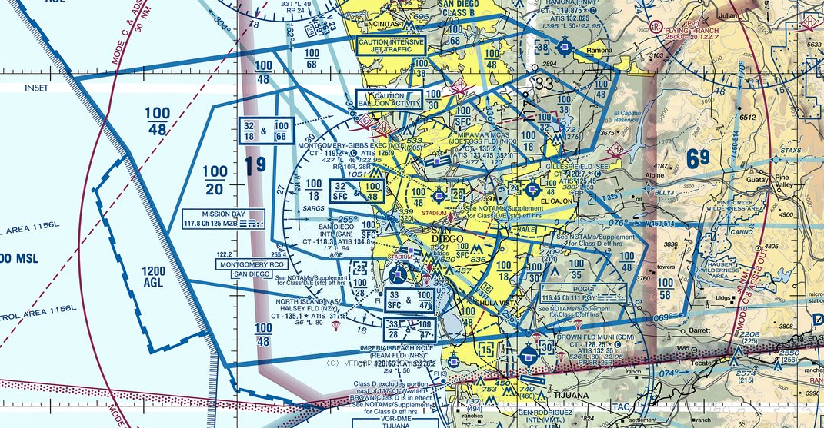
Class B

Slide 5
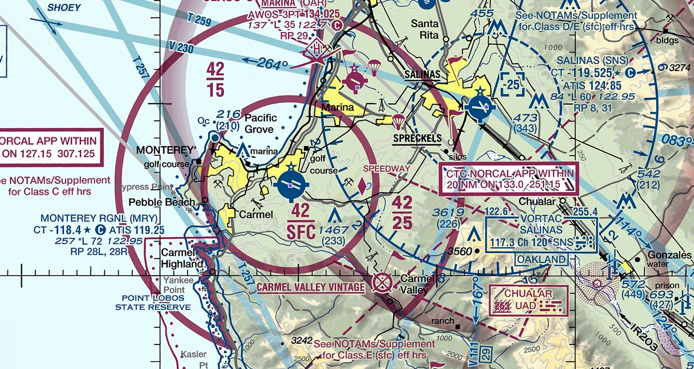
Class C

Slide 6
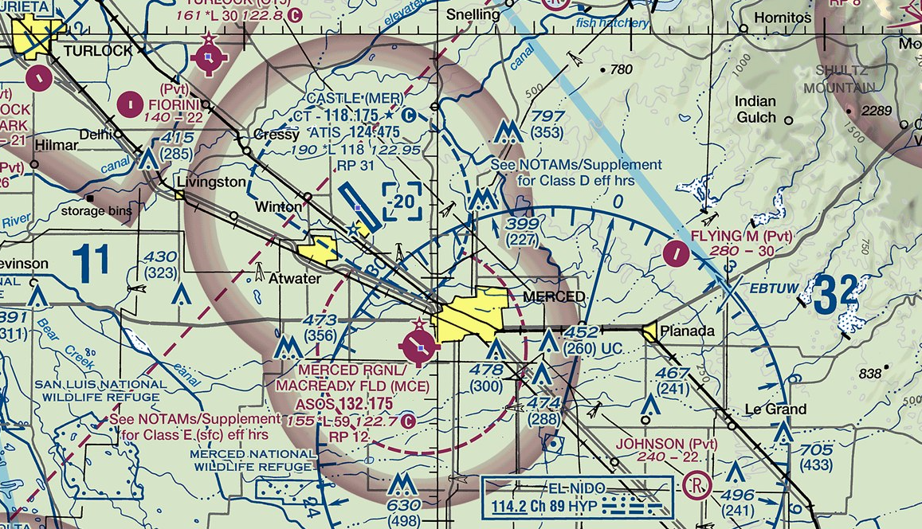
Class D

Slide 7
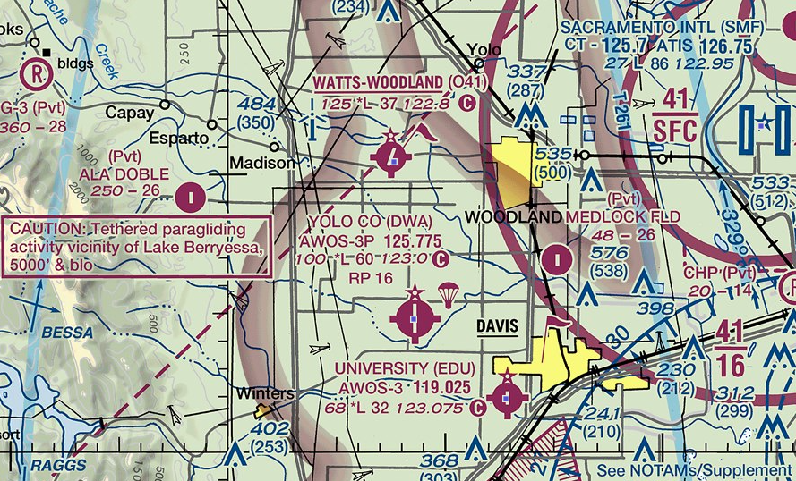
Uncontrolled

Slide 8
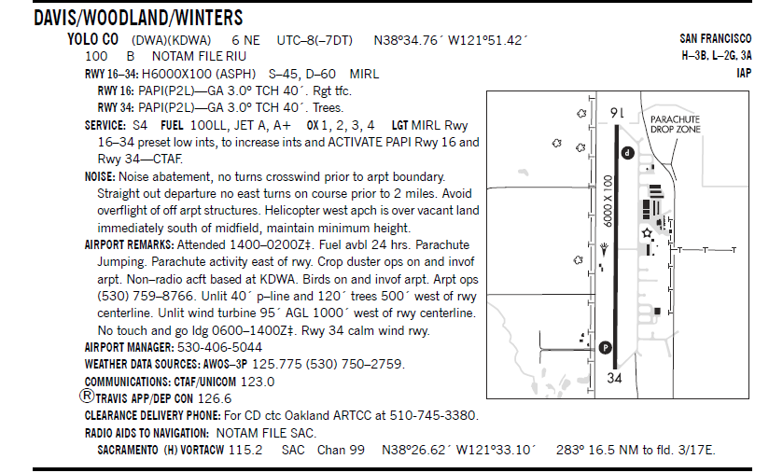
Airport /Facilities Directory (AFD)

Slide 9
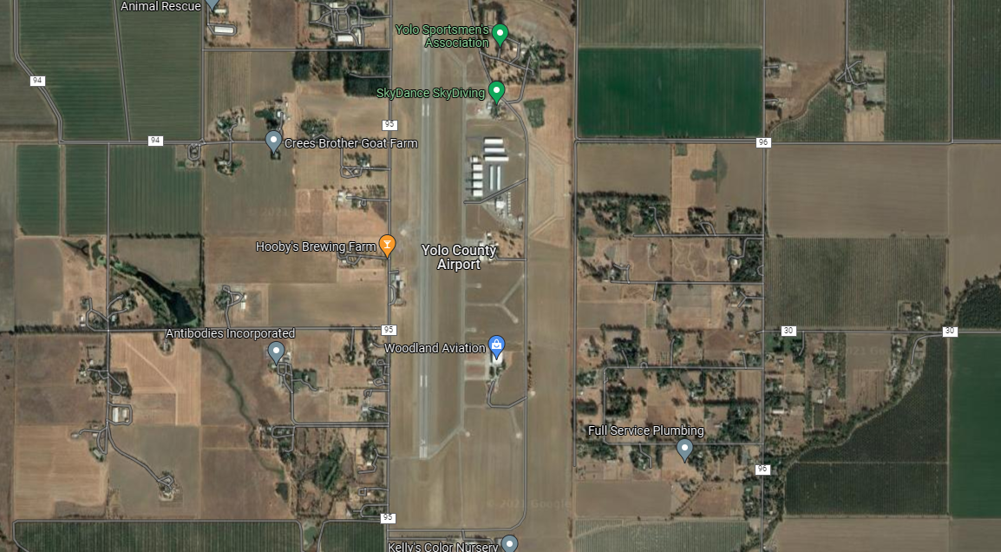
Google Map

Slide 10
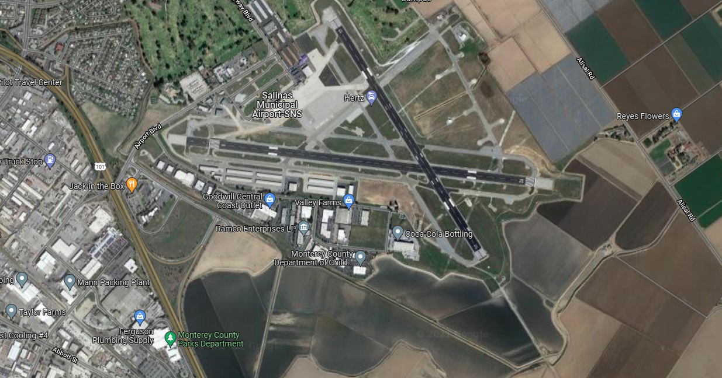
Class D Example

Slide 11
Class D Example

Slide 12
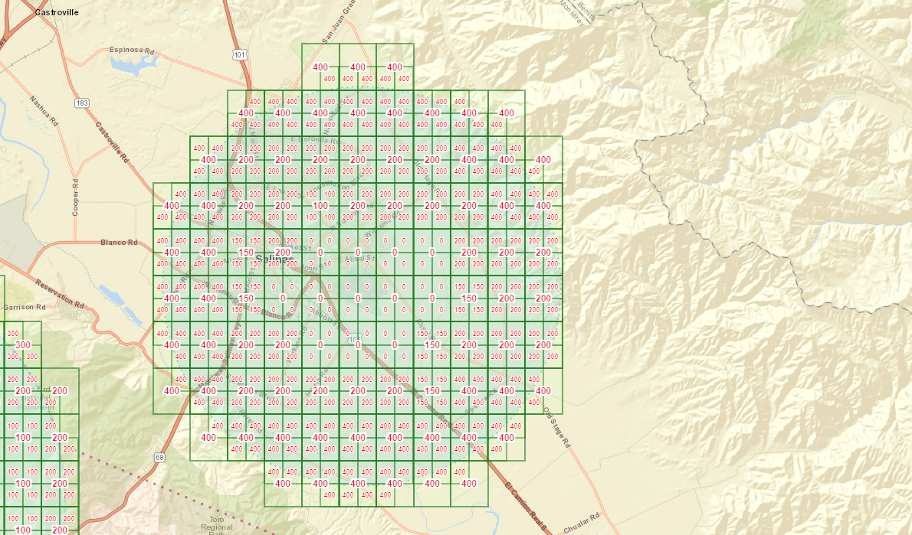
Class D Ceilings

Slide 13
Special Airspace
Military Operations Areas (MOA)
  Typically, over unpopulated areas for military use.
  See published altitudes on charts
Temporary Flight Restrictions (TFR)
  Fires
  Special Events (Superbowl)
  Presidential Visits
  Not on Charts, See B4Ufly

Slide 14
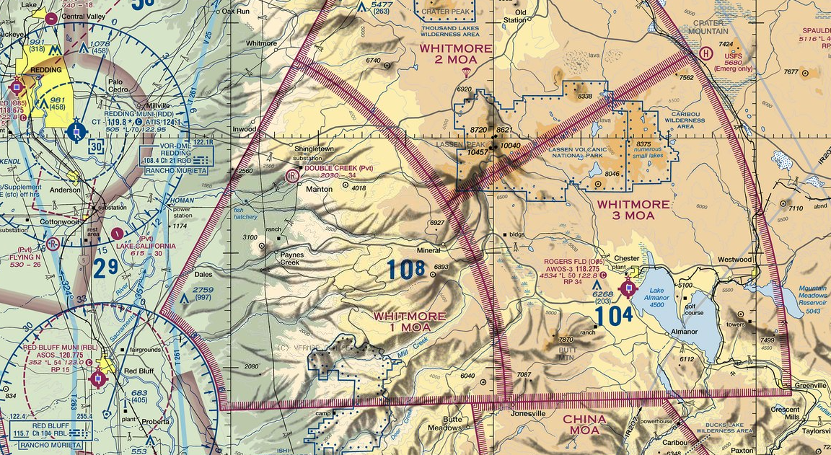
MOA

Slide 15
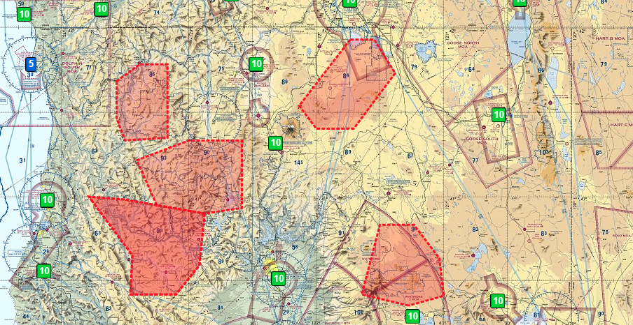
TFR

Slide 16
NOTAMS (notice to airmen)
NOTAM : 1/0412
FDC 1/0412 ZLA CA..AIRSPACE TULE INDIAN RESERVATION..TEMPORARY FLIGHT RESTRICTIONS WI AN AREA DEFINED AS 360857N1184604W (TTE025018.8) TO 360231N1184823W (TTE038013.0) TO 355400N1184626W (TTE078012.1) TO 355407N1182806W (TTE075026.9) TO 360028N1182642W (TTE063028.6) TO 360920N1182818W (TTE045030.4) TO POINT OF ORIGIN SFC-13000FT. TO PROVIDE A SAFE ENVIRONMENT FOR FIRE FIGHTING AVIATION OPS. PURSUANT TO 14 CFR SECTION 91.137(A)(2) TEMPORARY FLIGHT RESTRICTIONS ARE IN EFFECT. SEQUOIA NATIONAL FOREST TEL 559-781-5780 OR FREQ 119.0750/WINDY FIRE IS IN CHARGE OF THE OPS. LOS ANGELES /ZLA/ ARTCC TEL 661-265-8205 IS THE FAA CDN FACILITY. EFFECTIVE 2109181700 UTC UNTIL 2110310900 UTC. 2109181700-2110310900EST

Slide 17
Practical Lessons
Be aware of where manned aircraft fly
  Airports (private too)
  Traffic patterns
  Hospitals (helipads)
Sky divers (ex. Lodi, Brentwood, Woodland, Lincoln)
Crop Dusters!
Don’t fly in Class B, C, D surface area without authorization.
Use tools
  VFR Charts
  Google Maps
  Be4UFly
  TFR

Slide 18
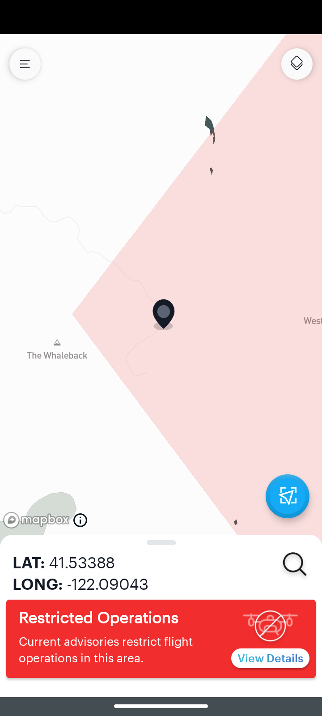
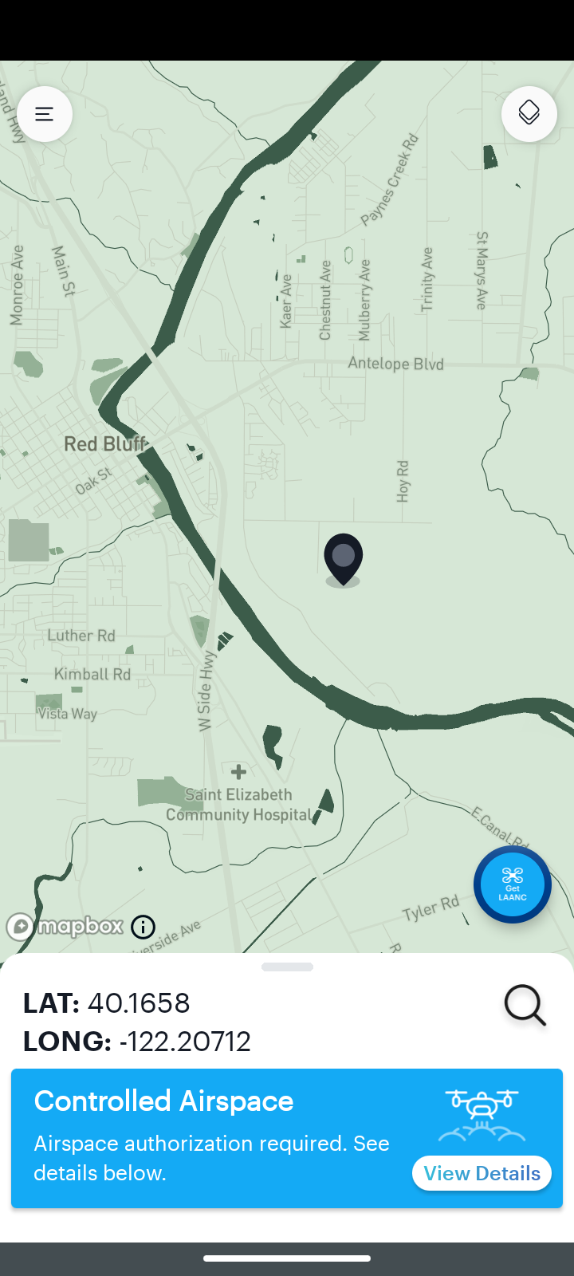
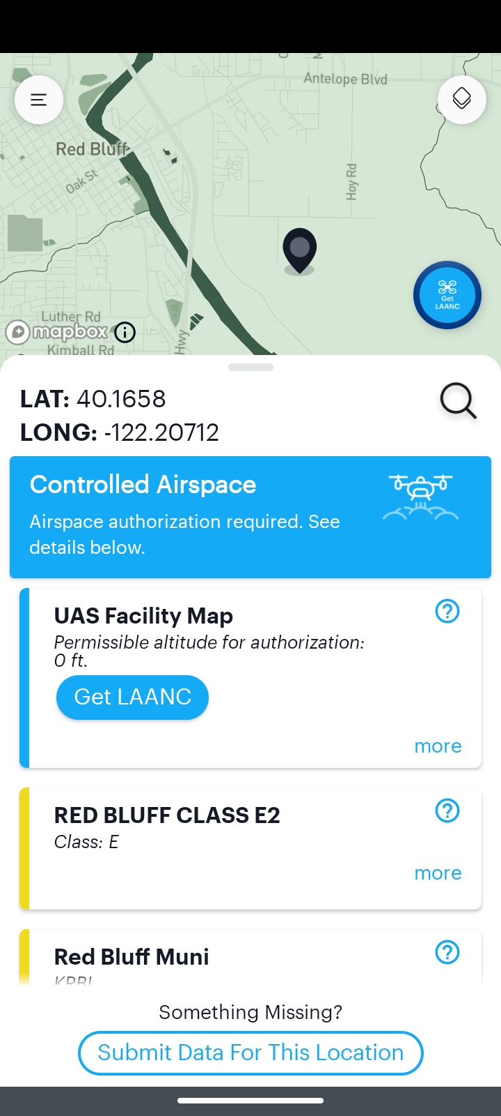
B4UFly

Slide 19

No Drone Zone Areas
Restricted Airspace: The FAA prohibits drone flight over certain areas of airspace.
Local Restrictions:
  In some locations, drone takeoffs and landings are restricted by state, local, territorial, or tribal government agencies. The FAA has provided No Drone Zone signage that can be used by these governments to identify areas where there are local flight restrictions.
  It is important to note, these No Drone Zones only restrict taking off or landing and do not restrict flight in the airspace above the identified area.
The FAA may use the term "No Drone Zone" to identify an area where there is a TFR. Examples include, major sporting events, presidential movements, or in security sensitive areas designated by federal agencies.

Slide 20
Drone Sightings
Wallace, R. J., Vance, S. M., Loffi, J. M., Jacob, J., Dunlap, J. C., Mitchell, T. A., Thomas, R., & Whyte, S. R. (2019). Cleared to Land: Pilot Visual Detection of Small Unmanned Aircraft During Final Approach. International Journal of Aviation, Aeronautics, and Aerospace, 6(5). https://doi.org/10.15394/ijaaa.2019.1421

Slide 21
Drone Sightings
2018 Pilot sighting near airports (final approach)
Wallace, R. J., Vance, S. M., Loffi, J. M., Jacob, J., Dunlap, J. C., Mitchell, T. A., Thomas, R., & Whyte, S. R. (2019). Cleared to Land: Pilot Visual Detection of Small Unmanned Aircraft During Final Approach. International Journal of Aviation, Aeronautics, and Aerospace, 6(5). https://doi.org/10.15394/ijaaa.2019.1421

Slide 22
Resources
VFR Charts: https://vfrmap.com/
B4Ufly: https://www.faa.gov/uas/recreational_fliers/where_can_i_fly/b4ufly/
TFR: https://tfr.faa.gov/tfr_map_ims/html/
Notams: https://www.notams.faa.gov/dinsQueryWeb/
Airspace Authorization: https://www.faa.gov/uas/programs_partnerships/data_exchange/
  UAS Facility Maps: https://faa.maps.arcgis.com/apps/webappviewer/index.html?id=9c2e4406710048e19806ebf6a06754ad
Airnav (Airport info): http://www.airnav.com
A/FD: https://www.faa.gov/air_traffic/flight_info/aeronav/digital_products/dafd/search/advanced/
Pilot’s Handbook of Aeronautical Knowledge (Chapter 15): https://www.faa.gov/regulations_policies/handbooks_manuals/aviation/phak/media/pilot_handbook.pdf

