Slide 1
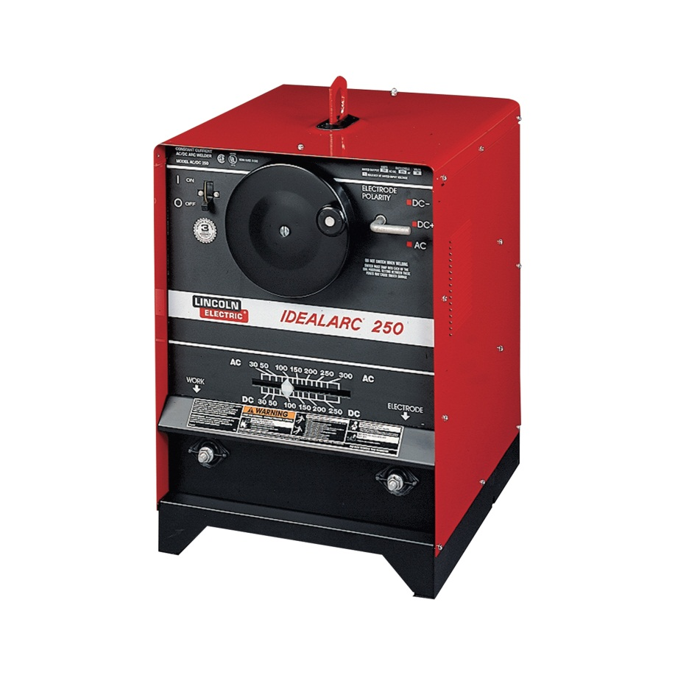
Arc Welder Power Supply
Converts AC power to welding current. SMAW and GTAW processes use constant current power supplies and GMAW processes use constant voltage power supplies.
Notes:
Welding-Arc Welding Tools Image: ArcWelder.jpg Height: 1200 Width: 1200

Slide 2
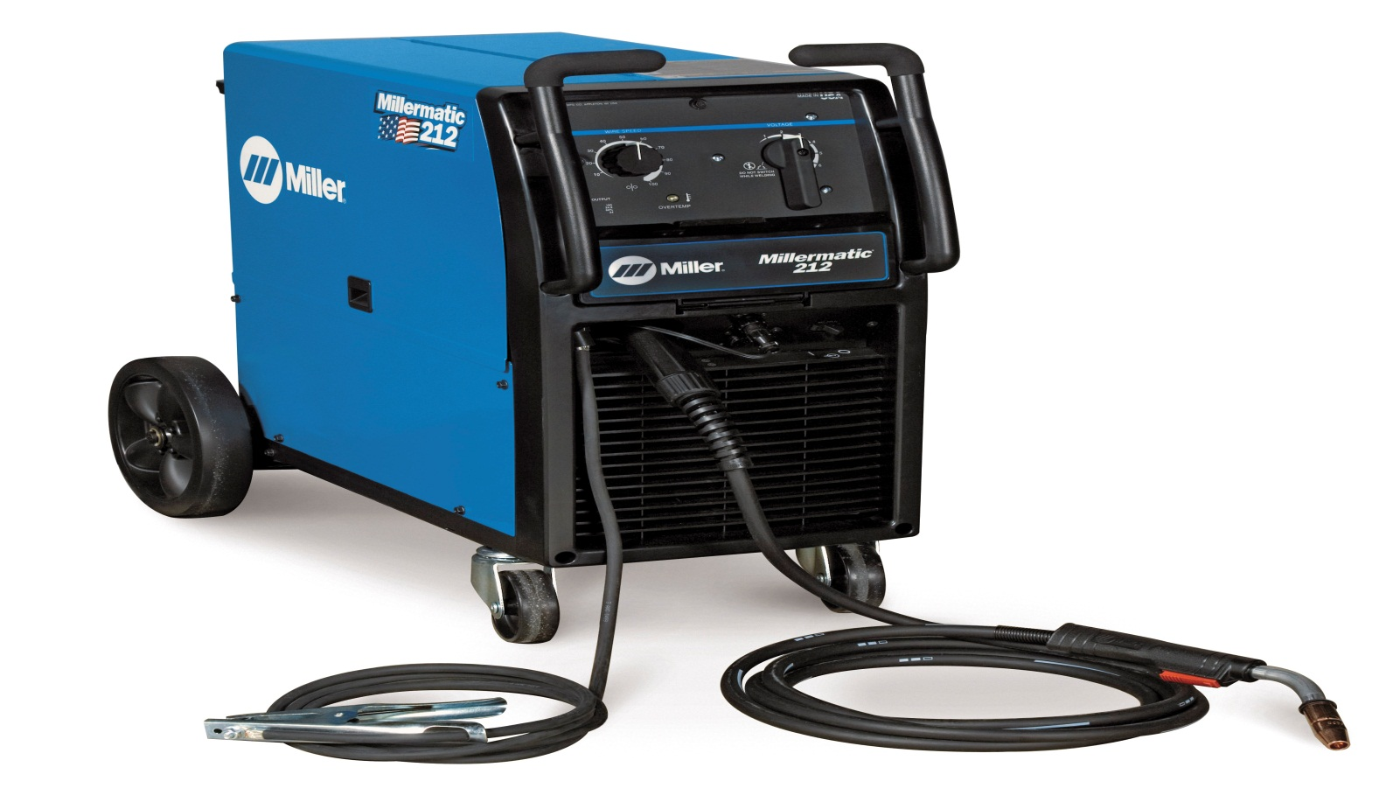
GMAW Welder
A constant voltage power supply with a wire electrode feed. May be used with solid or flux core wire. Commonly used with a shielding gas (required for solid wire electrode). Common shielding gasses are carbon dioxcide and argon.
Notes:
Welding-Arc Welding Tools Image: GMAW Welder.jpg Height: 399.9272 Width: 699.3818

Slide 3
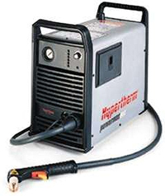
Plasma Cutter
Uses an arc and compressed gas to create a plasma stream for cutting and gouging of ferrous and non-ferrous metals.
Notes:
Welding-Arc Welding Tools Image: plasma-cutter.jpg Height: 142.8 Width: 120

Slide 4
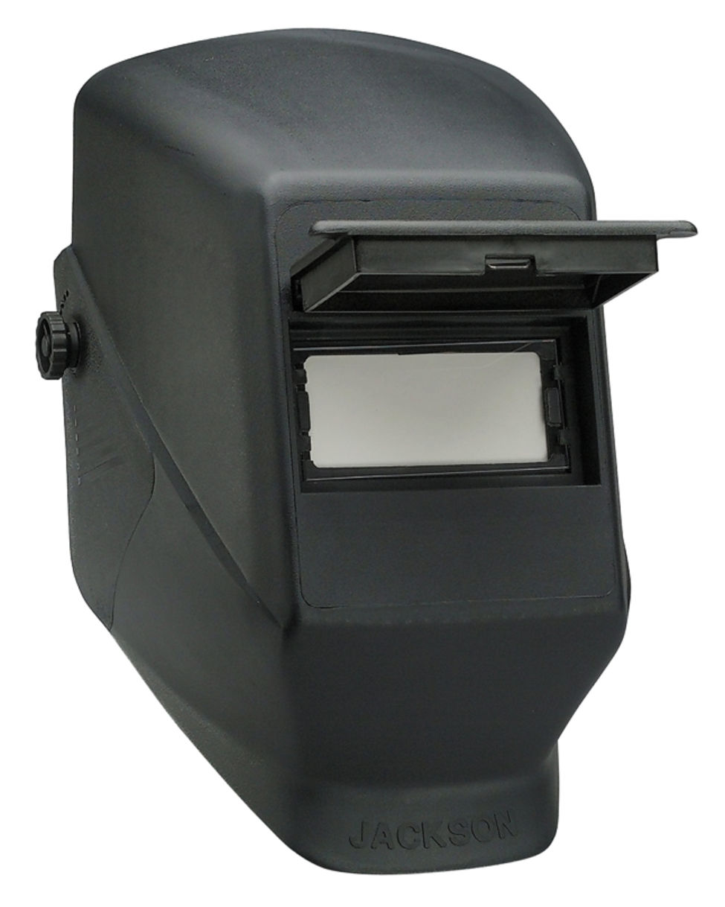
Welding Helmet
A colored lens filters out harmful light rays. Lens shades typically 10-12
Notes:
Welding-Arc Welding Tools Image: welding7.jpg Height: 287.5279 Width: 230.1639

Slide 5
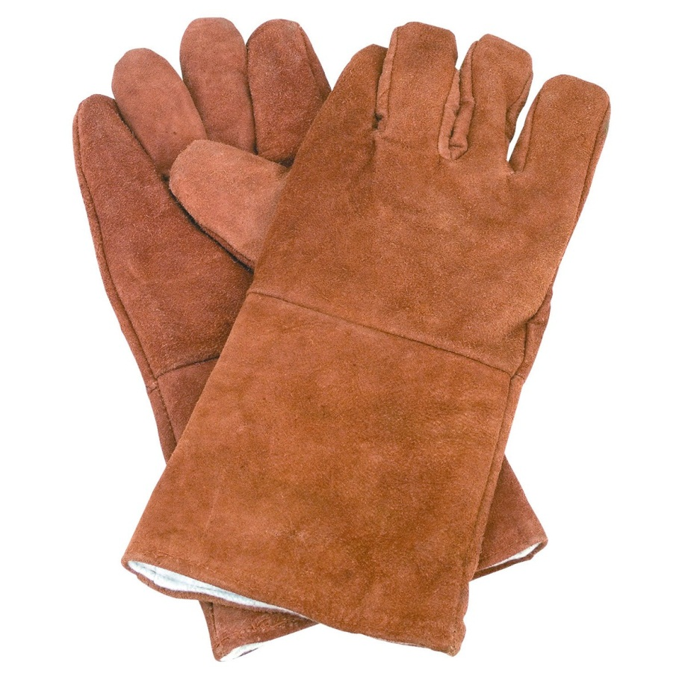
Leather Gloves
Gauntlet style gloves are recommended.
Notes:
Welding-Arc Welding Tools Image: welding9.jpg Height: 720 Width: 720

Slide 6
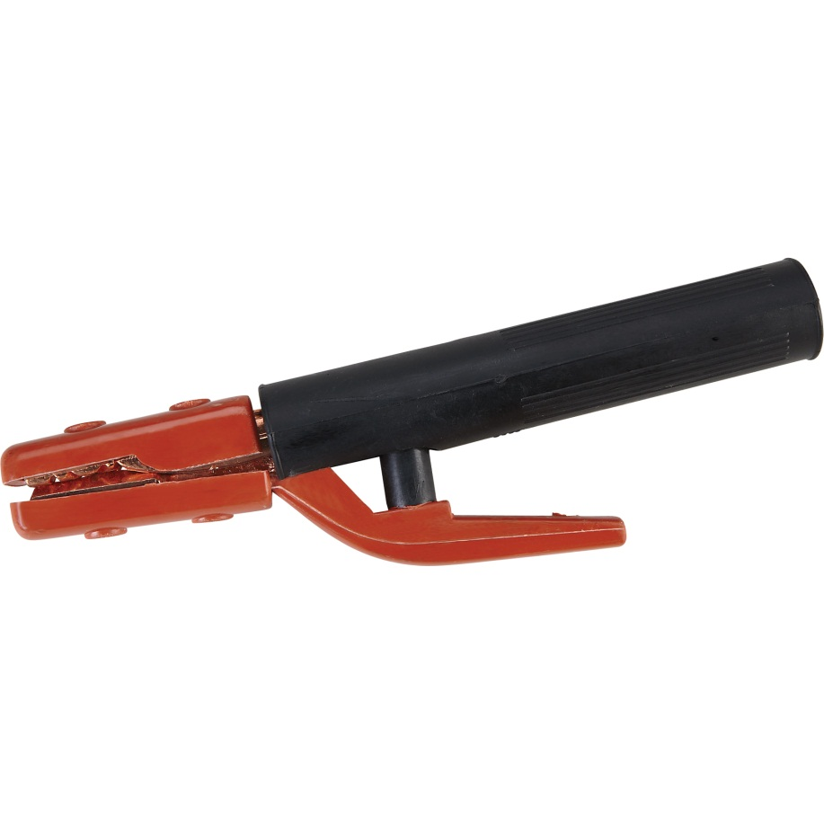
Electrode Holder
Connected to the welding cable and holds the electrode for SMAW process welding.
Notes:
Welding-Arc Welding Tools Image: welding12.jpg Height: 480 Width: 480

Slide 7
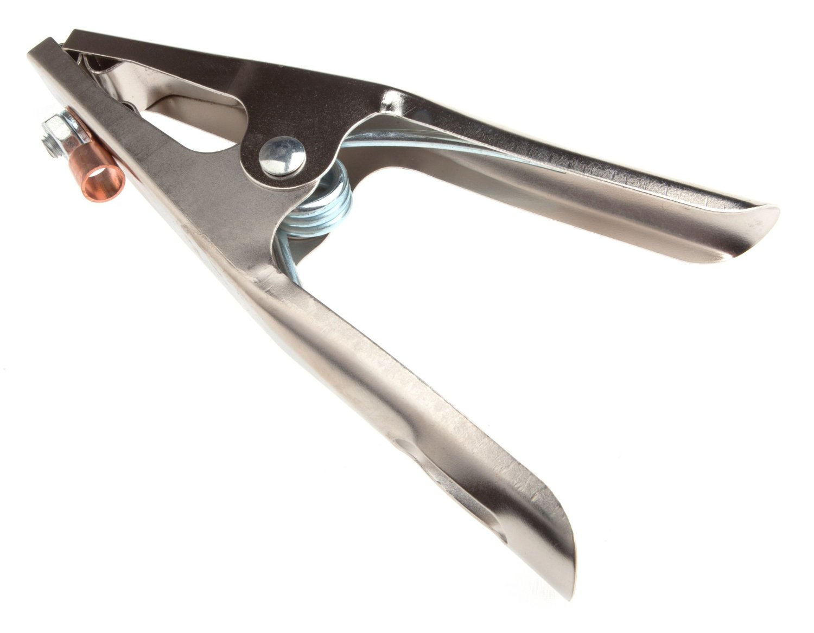
Ground Clamp
Used to connect one of the cable leads from the welding machine to the welding table or the material being welded so as to make a complete circuit.
Notes:
Welding-Arc Welding Tools Image: welding11.jpg Height: 700.2 Width: 900

Slide 8
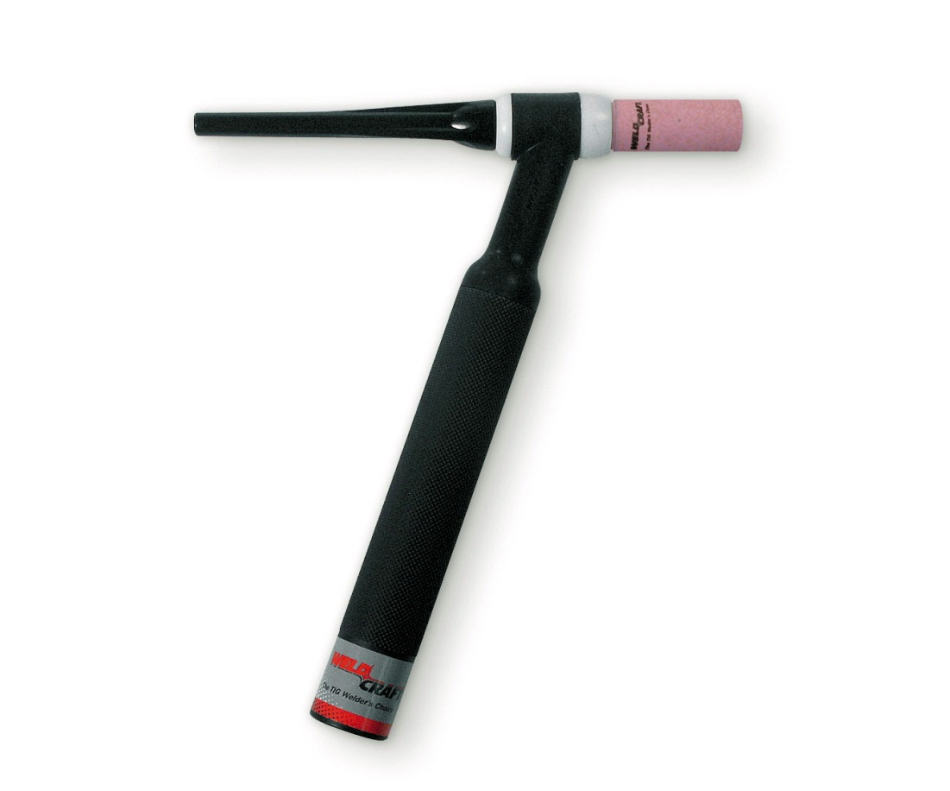
GTAW Torch
Holds a non-consumable electrode and directs shielding gas to the weld.
Notes:
Welding-Arc Welding Tools Image: TigTorch.jpg Height: 266.88 Width: 320.64

Slide 9
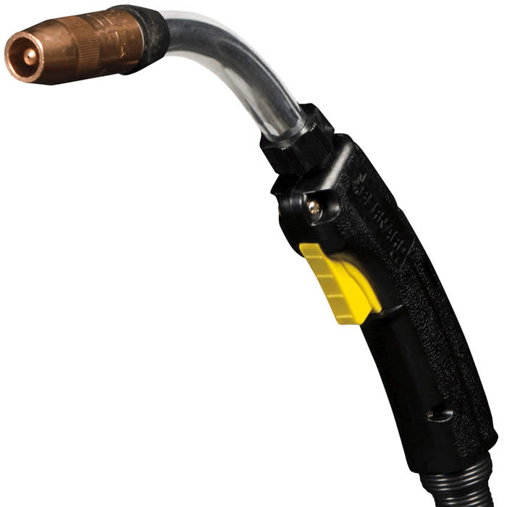
MIG Gun
Used with a constant voltage power supply and a gas source (e.g. carbon dioxide, argon) for GMAW process.
Notes:
Welding-Arc Welding Tools Image: MIG_Gun.jpg Height: 700 Width: 700

Slide 10
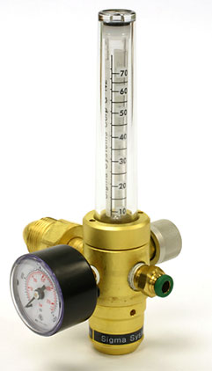
Gas Flow Regulator
Used with GMAW and GTAW to control the flow of shielding gas.
Notes:
Welding-Arc Welding Tools Image: gasRegulator.jpg Height: 253.2 Width: 144.6

Slide 11
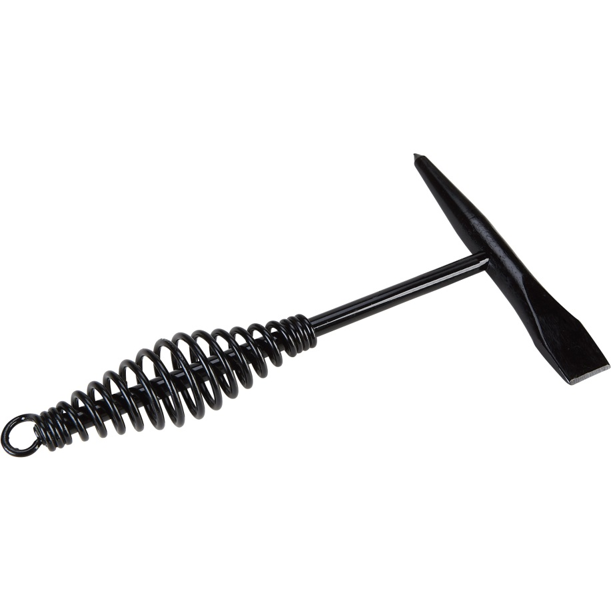
Chipping Hammer
One end of the head is shaped with a blunt point, and the other end is shaped like a cold chisel. Also called Slag hammer,
Notes:
Welding-Arc Welding Tools Image: welding10.jpg Height: 480 Width: 480

Slide 12
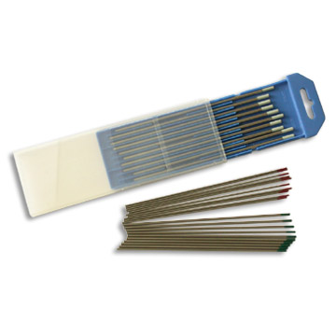
Tungsten Electrode
Non-consumable electrode used for GTAW process welding.
Notes:
Welding-Arc Welding Electrodes Image: TungElectrode.jpg Height: 216 Width: 216

Slide 13
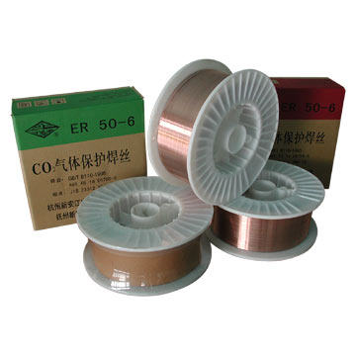
Tubular Wire Electrode
Tubular electrode (e.g. E-70T-L) is flux cored., and the last number is position and usability capabilities, as no gas is required for tubular flux cored rod. See Solid Welding Wire Electrode. Also called innershield wire since the shielding flux is "inside".
Notes:
Welding-Arc Welding Electrodes Image: GMAWElectrode.jpg Height: 216 Width: 216

Slide 14
Solid Welding Wire Electrode
Identified in a similar manner as SMAW rod . For example ER-70S-4. Solid wire is classified in a ER means it is an electrode, 70 is tensile strength, S means it is solid wire, 4 is type of shielding gas. Shield Gases: 2. C02A-O,A-C02, 3. C02A-O,A-C02, 4. CO2, 5. CO2, 6. C02A-O, 7. C02A-O,A-C02 and C02=Carbon Dioxide, C02A-O=Carbon Dioxide, Argon and Oxygen, A-CO2 = Argon and CO2
Notes:
Welding-Arc Welding Electrodes Image: GMAWElectrode.jpg Height: 216 Width: 216

Slide 15
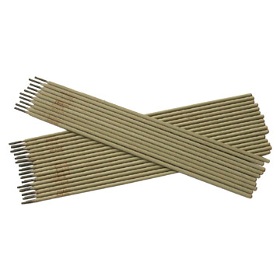
SMAW Electrode
Electrode used in the SMAW process for example E-6010. E meaning it is an electrode, 60 means it has a tensile strength of 60,000 PSI, 1 indicates welding in all positions, 0 indicates the coating to be cellulose sodium and the welding current is DCEP or direct current electrode positive
Notes:
Welding-Arc Welding Electrodes Image: SMAWelectrode.jpg Height: 216 Width: 216

Slide 16
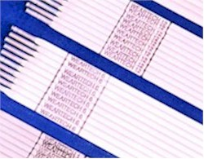
Hard Facing Electrode
Hard facing rod is not classified by a numbering system. Each manufacturer has their own nomenclature for their particular rod.
Notes:
Welding-Arc Welding Electrodes Image: HardFacingElectrode.jpg Height: 117 Width: 150

Slide 17
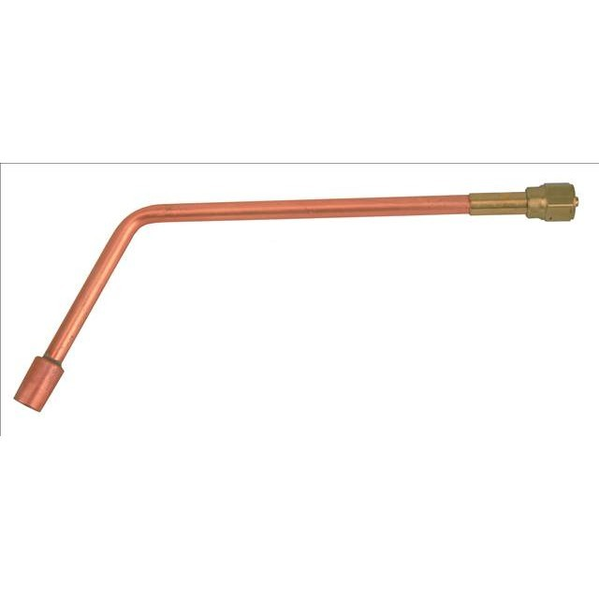
Heating Tip
A tip with multiple orifices used to for heating metal usually for bending. Also called a rosebud.
Notes:
Welding-Oxyacetylene Welding Tools Image: rosebud.jpg Height: 384 Width: 384

Slide 18
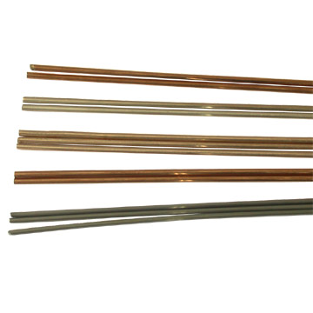
Copper Coated Mild Steel
Available in 1/16 to 3/16 inch diameter and 36 inches long.
Notes:
Welding-Oxyacetylene Welding Tools Image: CopperClad.jpg Height: 216 Width: 216

Slide 19
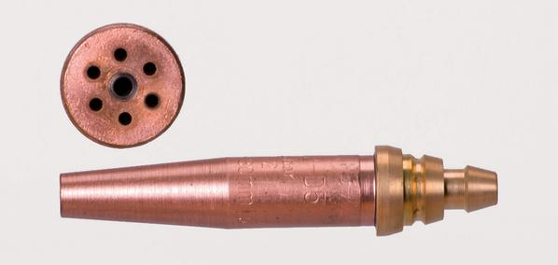
Cutting Tip
The larger center hole is for pure oxygen to oxidize or cut the metal.
Notes:
Welding-Oxyacetylene Welding Tools Image: CuttingTip.jpg Height: 85.2 Width: 179.4

Slide 20
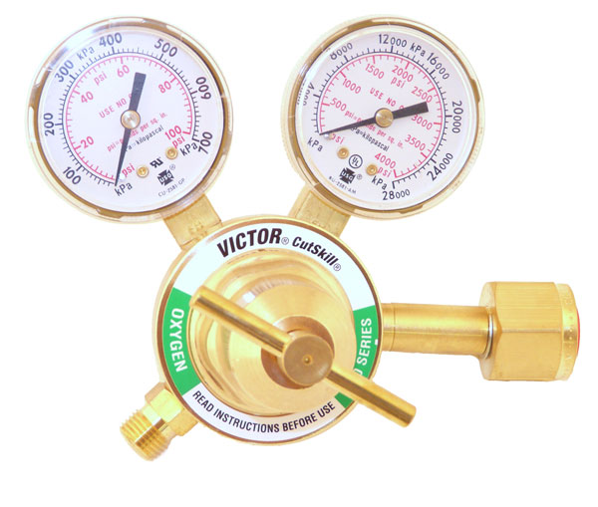
Oxygen Regulator
The threads on the hose connector are right hand. Commonly a two stage regulator.
Notes:
Welding-Oxyacetylene Welding Tools Image: OxyReg.jpg Height: 305.4 Width: 360

Slide 21
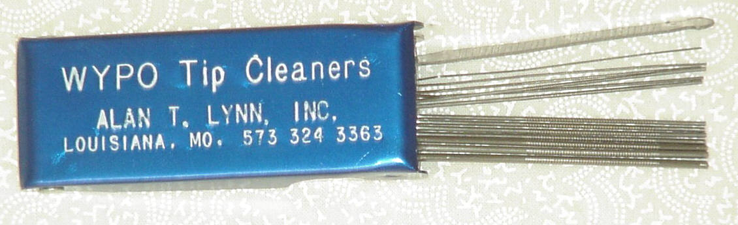
Tip Cleaner
It consists of several needle-like round files of different sizes.
Notes:
Welding-Oxyacetylene Welding Tools Image: TipCleaner.jpg Height: 82.8 Width: 271.2

Slide 22
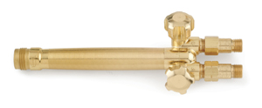
Torch Handle
Quite often called a torch butt.
Notes:
Welding-Oxyacetylene Welding Tools Image: GasTorchHandle.jpg Height: 74.4 Width: 180

Slide 23
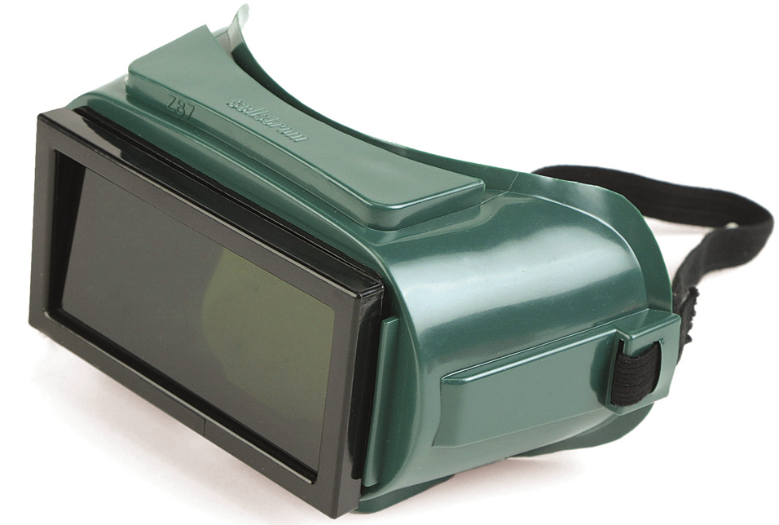
Welding Goggles
Used to protect the eyes from harmful rays and from spatter when using the welding torch.
Notes:
Welding-Oxyacetylene Welding Tools Image: welding8.jpg Height: 154.56 Width: 229.44

Slide 24
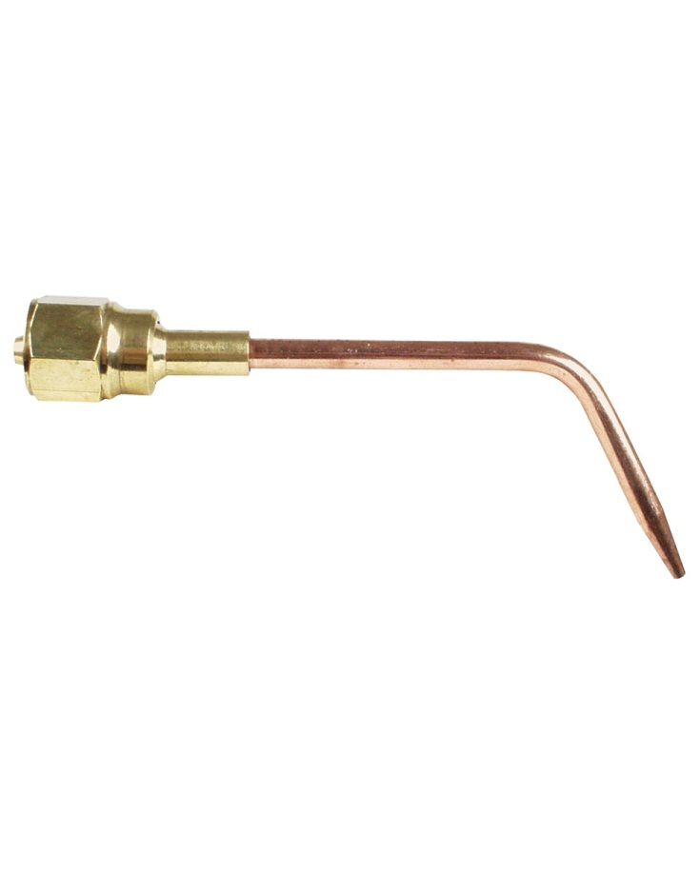
Welding Tip
The tips come in various sizes.
Notes:
Welding-Oxyacetylene Welding Tools Image: WeldingTip.jpg Height: 730.8 Width: 585

Slide 25
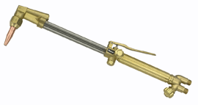
Cutting Torch
It consists of valves for mixing oxygen and acetylene, and a valve lever attached to the torch handle to release oxygen which does the cutting.
Notes:
Welding-Oxyacetylene Welding Tools Image: CuttingTorch.gif Height: 85.8 Width: 162

Slide 26
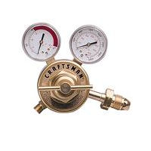
Acetylene Regulator
The threads on the hose connector are left hand.
Notes:
Welding-Oxyacetylene Welding Tools Image: AcetReg.bmp Height: 120 Width: 120

Slide 27
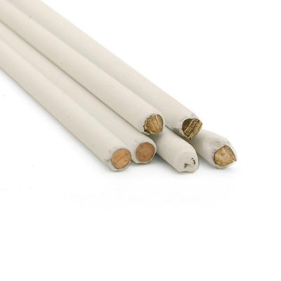
Flux Coated Brazing Rod
Generally available in 1/8 inch diameter rod.
Notes:
Welding-Oxyacetylene Welding Tools Image: BrazingRod.jpg Height: 400 Width: 400

Slide 28
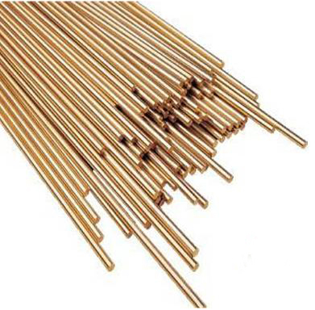
Brazing Rod
Available in1/16 to 3/16 inch diameter and 36 inches long.
Notes:
Welding-Oxyacetylene Welding Tools Image: BrazingRod2.jpg Height: 288 Width: 293.25

Slide 29
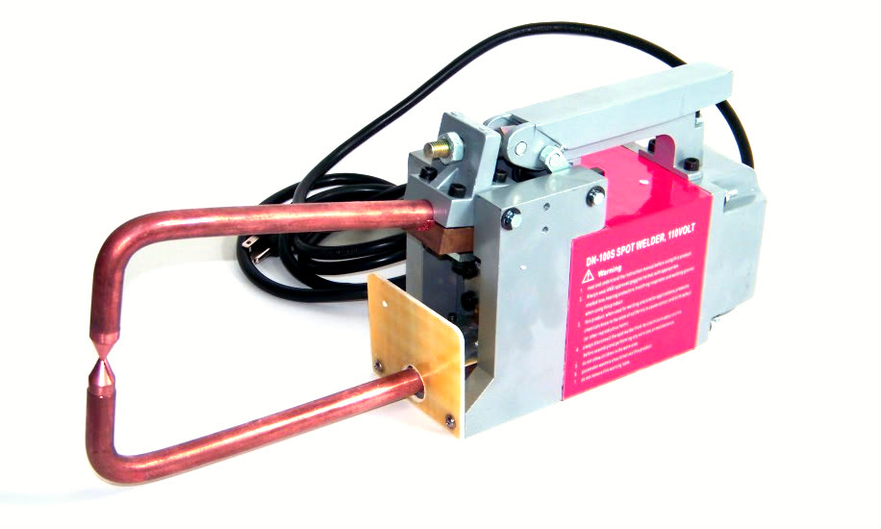
Spot Welder
Used for welding sheet metal.
Notes:
Welding-Other Welding Equipment Image: SpotWelder.jpg Height: 330 Width: 549.6

