Slide 1
Bronze
An alloy of copper and tin. It is less malleable than brass. It is sold by the piece or by the pound.
Notes:
Metal Working-Metals Image: Brass.jpg Height: 90 Width: 252.75

Slide 2
Copper
It is sold by the piece, running foot or pound.
Notes:
Metal Working-Metals Image: Copper.jpg Height: 88.5 Width: 240.75

Slide 3
Brass
An alloy of copper and zinc. It is sold by the piece or by the pound.
Notes:
Metal Working-Metals Image: Brass.jpg Height: 90 Width: 252.75

Slide 4
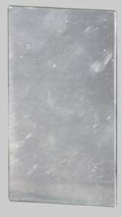
Aluminum
It is sold by the square foot, by the piece or by the pound.
Notes:
Metal Working-Metals Image: aluminum.jpg Height: 180 Width: 100.8

Slide 5
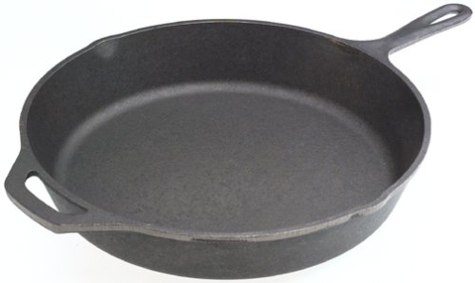
Cast Iron
Used to make castings for cylinder blocks, plow bottoms, housings for tractor differentials, transmission cases, sprockets wheels, pulleys, pipe fittings and gears.
Notes:
Metal Working-Metals Image: CastIron.jpg Height: 178.8 Width: 300

Slide 6
Galvanized Steel
The coating varies from 0.0002 inch for the lightest coating to 0.002 inch for water pipe.
Notes:
Metal Working-Metals Image: Galvanized_Steel.jpg Height: 132 Width: 331

Slide 7
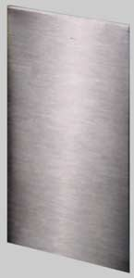
Stainless Steel
An alloy steel that resists oxidation. Commonly a chrome or nickel alloy of iron.
Notes:
Metal Working-Metals Image: Stainless.jpg Height: 180 Width: 87

Slide 8
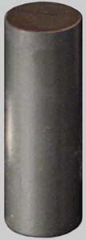
Hot Rolled Steel
Available in many shapes. Formed hot the finish is rough and dark.
Notes:
Metal Working-Metals Image: HotRolled.jpg Height: 180 Width: 64.8

Slide 9
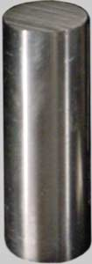
Cold Rolled Steel
It is commonly used for making bolts and shafting. Shaped cold the metal is bright and shiny.
Notes:
Metal Working-Metals Image: ColdRolled.jpg Height: 180 Width: 63

Slide 10
Sheet Metal
Sizes thinner than 1/8". Commonly hot rolled steel in 2',3', and 4' widths and 8', 10', and 12' lengths. Steel may be plain or galvanized. Thickness in wire gauge sizes.
Notes:
Metal Working-Metals Image: sheet metal.jpg Height: 126 Width: 180

Slide 11
Tool Steel
It can be tempered to various degrees of hardness.
Notes:
Metal Working-Metals Image: hexagon.jpg Height: 54.6 Width: 120

Slide 12
Angle Iron
It is sold by the pound. Sized by the length of the legs and thickness. Ex. 2”x2”x1/4”.
Notes:
Metal Working-Metals Image: struct_equal_angle.jpg Height: 125 Width: 110

Slide 13
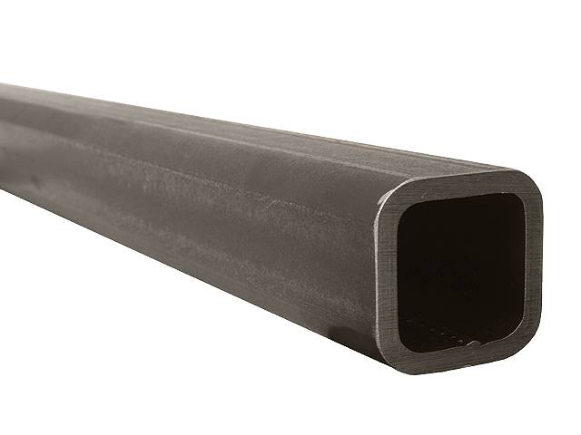
Square Tubing
Wall thickness varies from very light ( ex. .080") to thick in larger sizes (ex. 1/2"). Heavier wall tubing is excellent for cultivator tool bars because of its smooth exterior finish and ability to with stand heavy loads.
Notes:
Metal Working-Metals Image: square_tube.jpg Height: 288 Width: 384

Slide 14
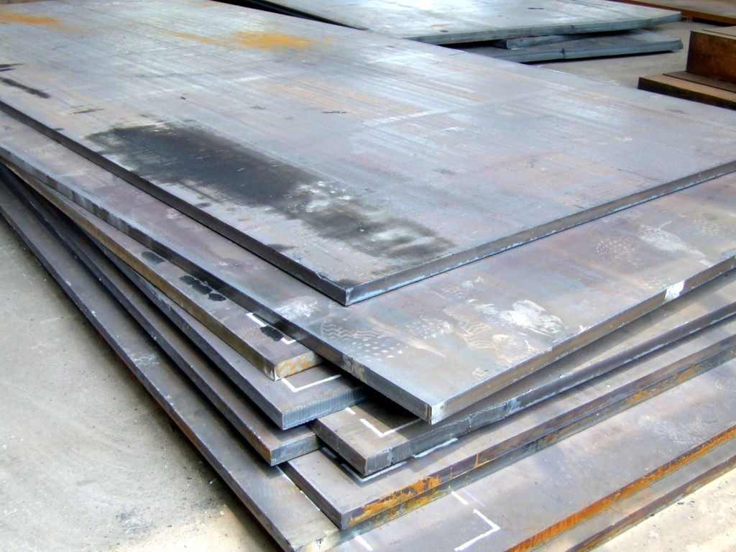
Plate
Sizes thicker than 1/8". Commonly hot rolled in 4'x8' sheets.
Notes:
Metal Working-Metals Image: Plate.jpg Height: 576 Width: 768

Slide 15
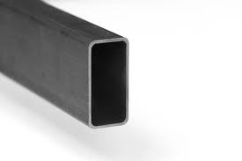
Rectangular Tubing
Unequal dimensions (ex. 2"x4") steel tubing. Wall thickness varies from very light ( ex. .080") to thick in larger sizes (ex. 1/2"). Also see square tubing.
Notes:
Metal Working-Metals Image: RectTubing.jpg Height: 109.8 Width: 165

Slide 16
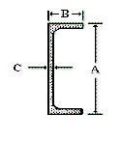
Channel Iron
The common sizes range from 1/2” X 1 inch to 4 X 12 inches.
Notes:
Metal Working-Metals Image: channelfig.gif Height: 87.6 Width: 75

Slide 17
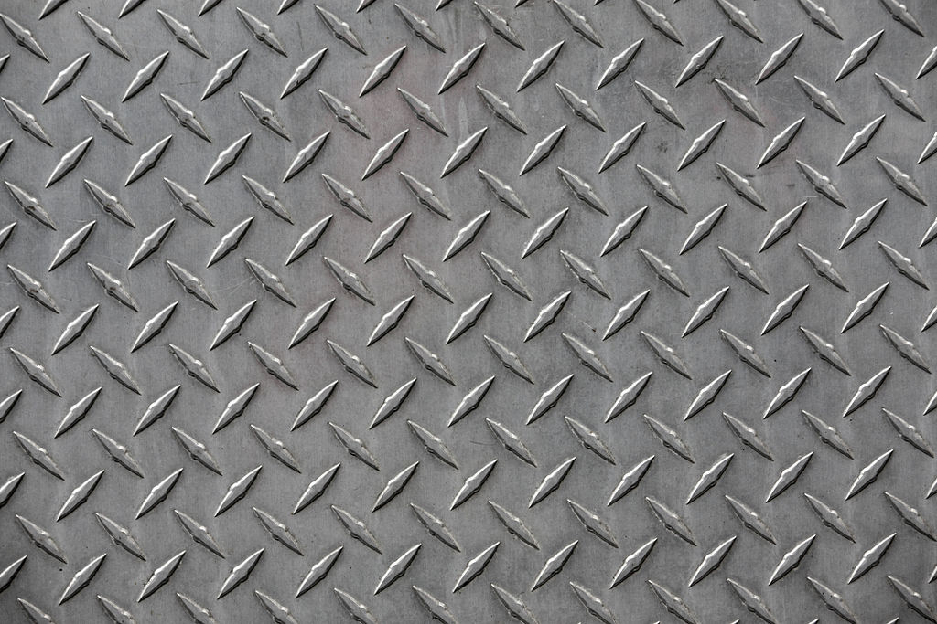
Diamond Plate
Sizes range from 1/8 to 1/4 inch thick, 4 to 5 feet in width and 8 to 12 feet in length.
Notes:
Metal Working-Metals Image: DiamondPlate.jpg Height: 683 Width: 1024

Slide 18
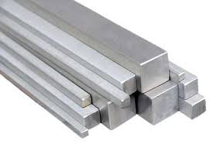
Square Bar
Ranges in size from 1/8 inch and greater.
Notes:
Metal Working-Metals Image: square_bar.jpg Height: 111.6 Width: 162.6

Slide 19
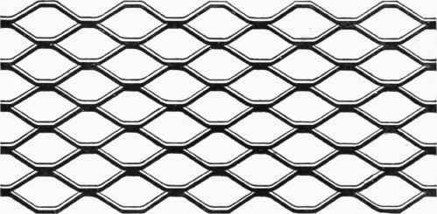
Expanded Metal
Come in gauge thickness and usually 4 to 5 foot width and 8 to 12 foot lengths.
Notes:
Metal Working-Metals Image: expanded.jpg Height: 183.75 Width: 374.25

Slide 20
Flat Bar
Size is 3/16 inch thick and greater and comes in a variety of widths.
Notes:
Metal Working-Metals Image: HRFlat.jpg Height: 180 Width: 55.2

Slide 21
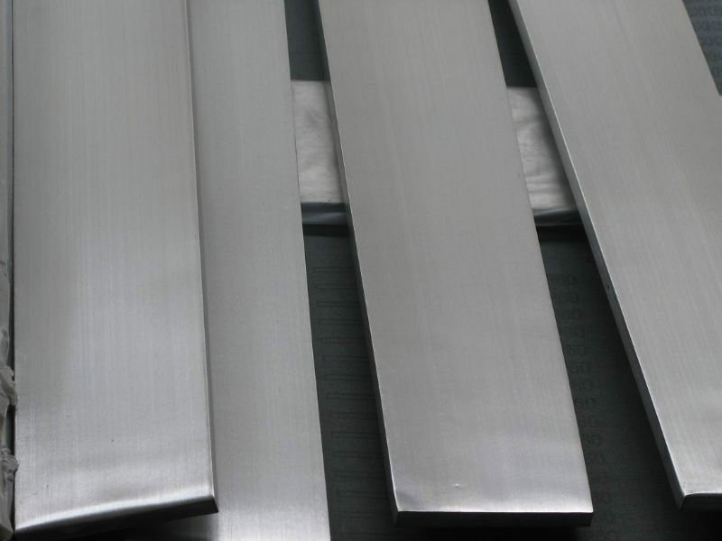
Strip Iron
It is 1/8 inch or less in thickness and comes in various widths.
Notes:
Metal Working-Metals Image: strip.jpg Height: 360 Width: 480

Slide 22
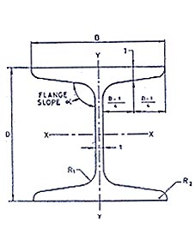
H Beam
A 4 inch H beam is 4 inches wide and 4 inches high.
Notes:
Metal Working-Metals Image: h-beam.jpg Height: 176.4 Width: 136.2

Slide 23
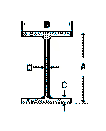
I Beam
Used to support structures (placed horizontally). Typical lengths 20-40 feet.
Notes:
Metal Working-Metals Image: beamfig.gif Height: 99.6 Width: 80.4

Slide 24
Straight Shank Twist Drill
If used on hard steel and at high speeds, it should be made of high speed steel.
Notes:
Metal Working-Boring Tools (Metal) Image: St_Shank_Drill.jpg Height: 177.7399 Width: 540.115

Slide 25
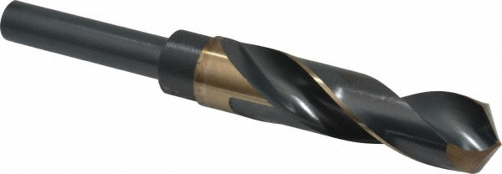
Reduced Shank Drills
The shank of the drill comes in three sizes, 1/4, 1/2, and ¾ inch.
Notes:
Metal Working-Boring Tools (Metal) Image: Reduced_Shank_Drill.jpg Height: 208 Width: 600

Slide 26
Tapered Shank Twist Drill
It should never be used in a chuck.
Notes:
Metal Working-Boring Tools (Metal) Image: TaperShankDrill.jpg Height: 122 Width: 747

Slide 27
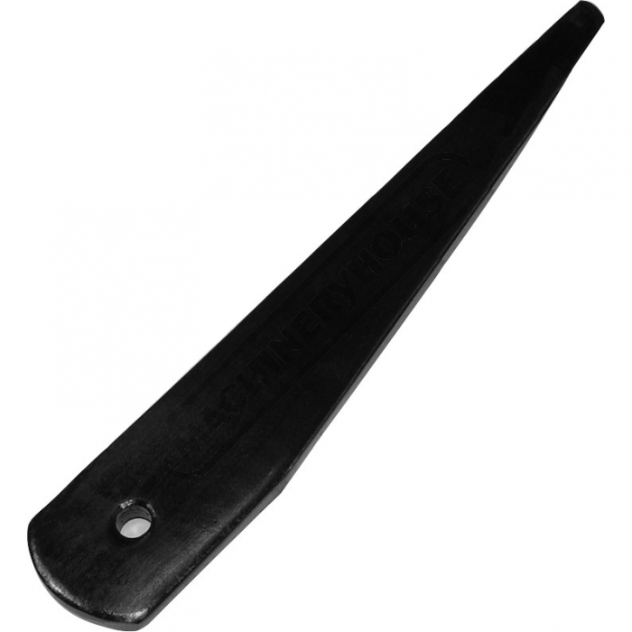
Drill Drift
Used for removing Morse taper sleeves and tapered shank twist drills from a drill press. Also called a Center Key.
Notes:
Metal Working-Boring Tools (Metal) Image: DrillDrift.jpg Height: 420 Width: 420

Slide 28
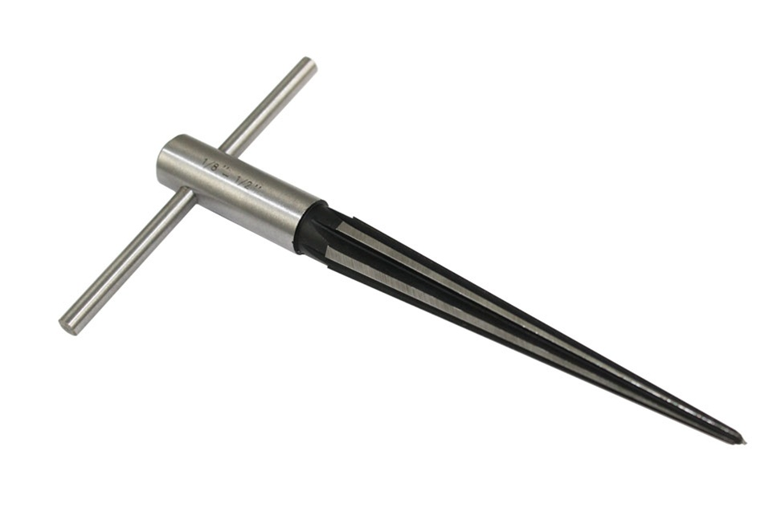
Taper Reamer
Used to ream holes for tapered pins used on farm machinery and equipment.
Notes:
Metal Working-Boring Tools (Metal) Image: TaperReamer.jpg Height: 486 Width: 729

Slide 29
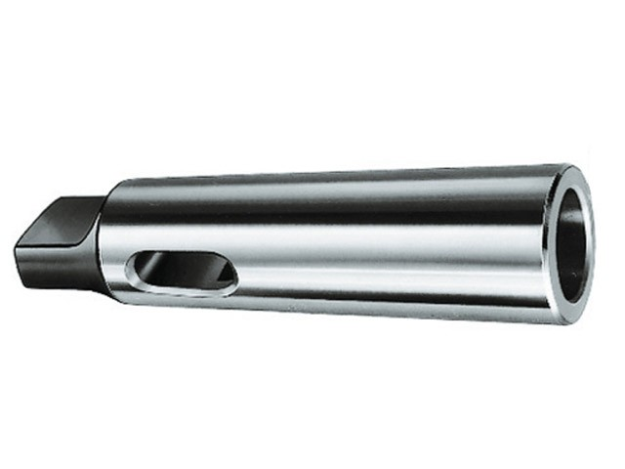
Morse Taper Sleeve
Used as an adaptor to insert different number taper shank twist drills into the drill press.
Notes:
Metal Working-Boring Tools (Metal) Image: MorseTaperSleeve.jpg Height: 288 Width: 384

Slide 30
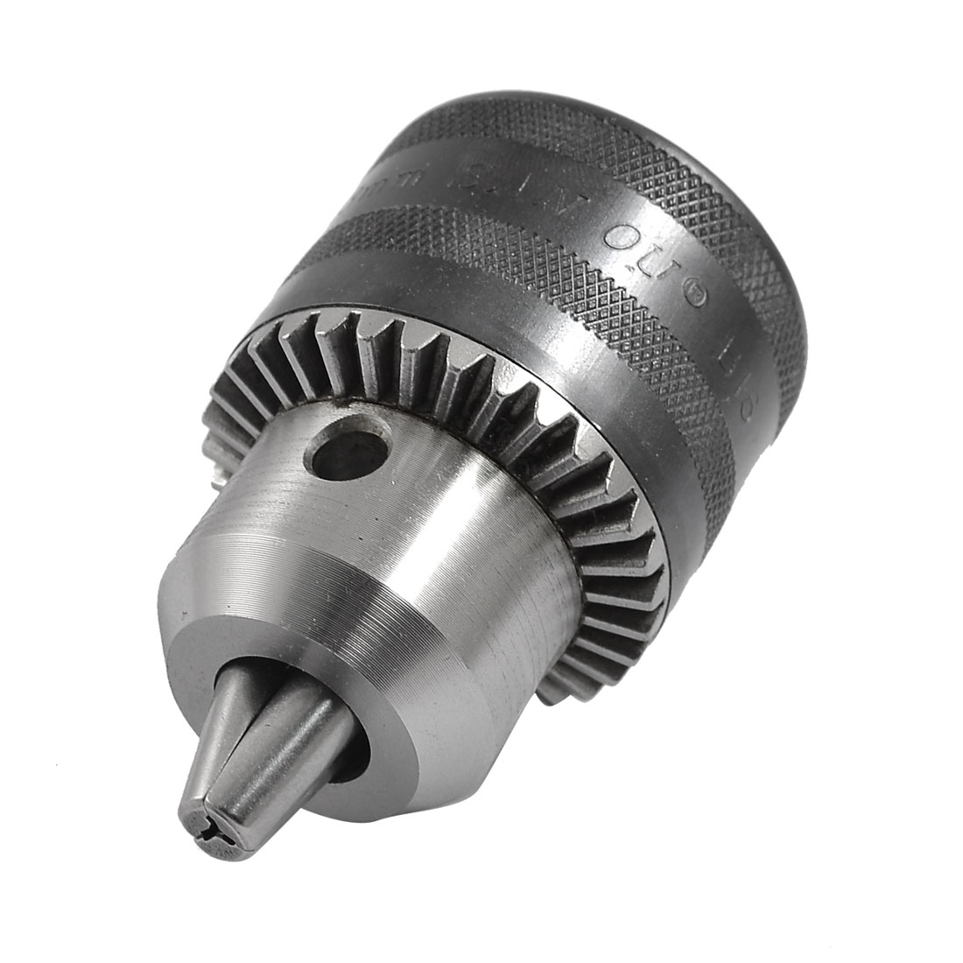
Chuck
Used to hold a drill in a drill press or drill motor. May portable drill motors are using keyless chucks that are tightened by hand.
Notes:
Metal Working-Boring Tools (Metal) Image: Chuck.jpg Height: 660 Width: 660

Slide 31
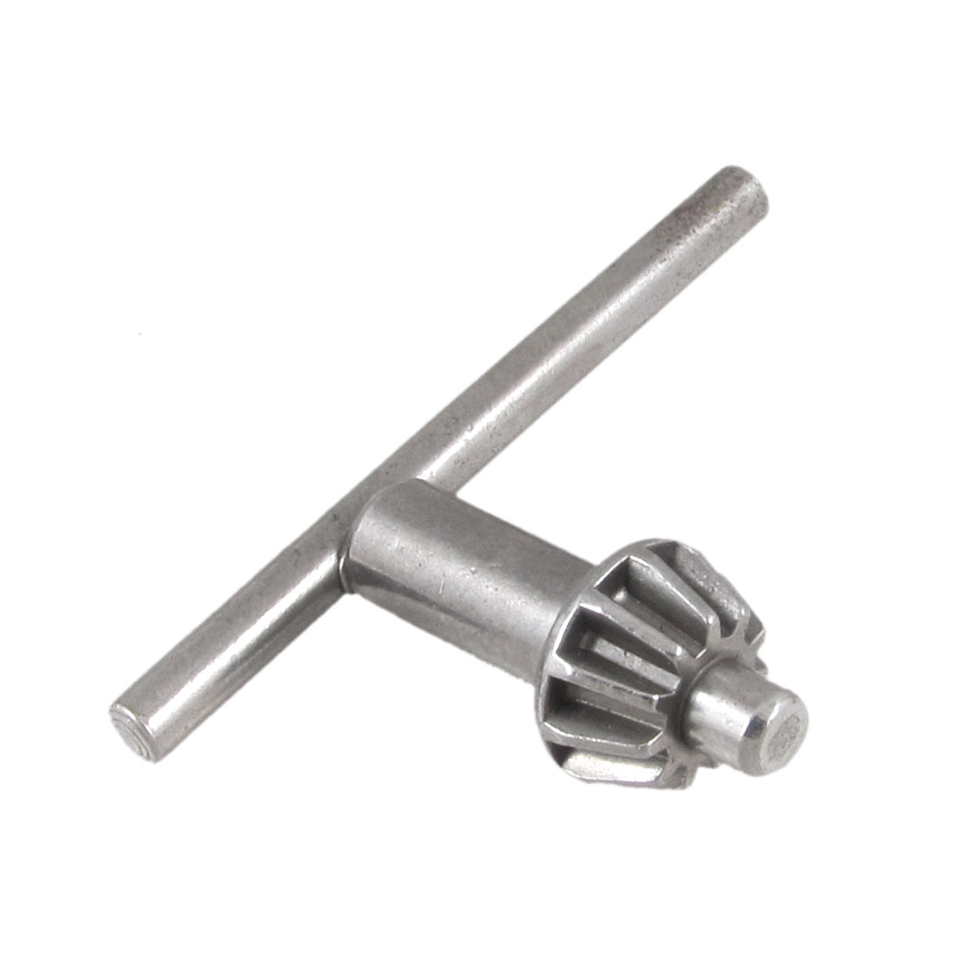
Chuck Key
Used in keyed chuck to tighten or loosen the chuck
Notes:
Metal Working-Boring Tools (Metal) Image: ChuckKey.jpg Height: 660 Width: 660

Slide 32
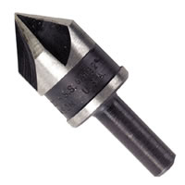
Countersink
The shank is 1/4 inch in diameter and can be used in hand or power drills.
Notes:
Metal Working-Boring Tools (Metal) Image: CounterSink.jpg Height: 200 Width: 200

Slide 33
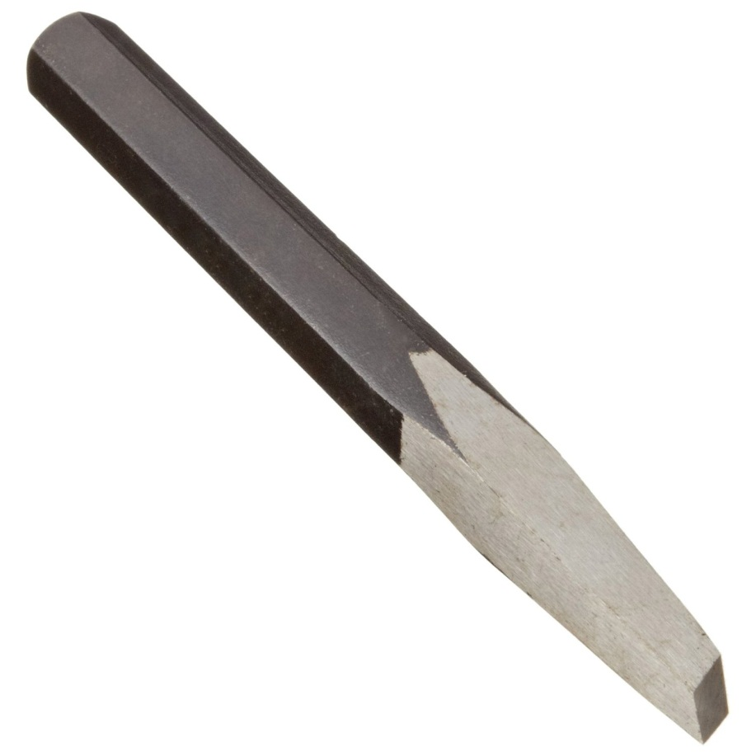
Diamond Chisel
Use for cutting keyways and groves. Useful for tight places where a cold chisel is too large. Sized by the width of the cutting edge.
Notes:
Metal Working-Chisels Image: DiamondPtChisel.jpg Height: 900 Width: 900

Slide 34
Cape Chisel
Use for cutting keyways and groves. Useful for tight places where a cold chisel is too large. Sized by the width of the cutting edge.
Notes:
Metal Working-Chisels Image: CapeChisel.jpg Height: 171 Width: 863.25

Slide 35
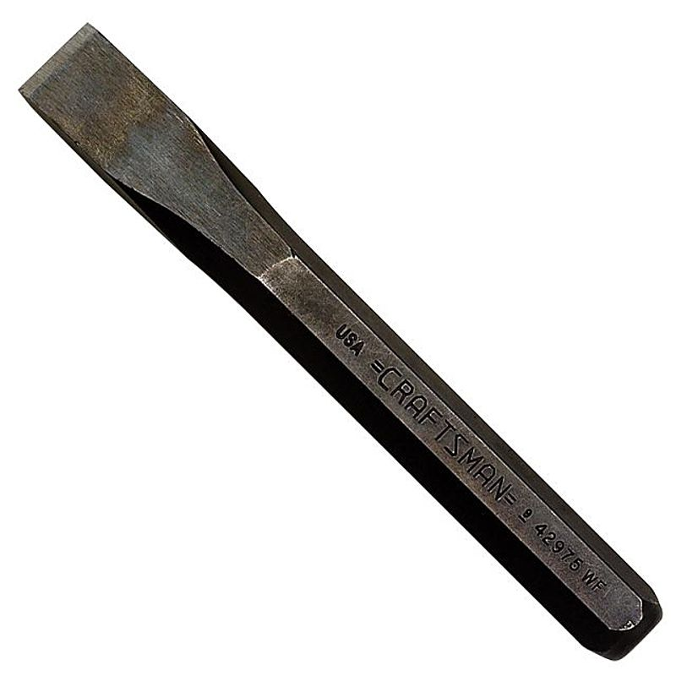
Cold Chisel
Size is determined by the width of the cutting edge.
Notes:
Metal Working-Chisels Image: ColdChisel.jpg Height: 800 Width: 800

Slide 36
Round Nose Chisel
The sides of the shank are flattened and the width at the cutting edge determines the size.
Notes:
Metal Working-Chisels Image: RoundNoseChisel.jpg Height: 120.6 Width: 900

Slide 37
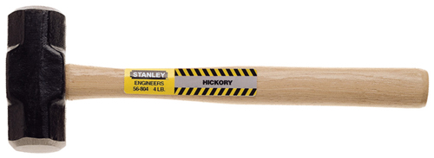
Engineer’s Hammer
Sizes are form 2 1/2 to 4 pound with handle length of 16 inches.
Notes:
Metal Working-Hammers (Metal) Image: Engineer hammer.jpg Height: 87.84 Width: 240

Slide 38
Ball Peen Hammer
This hammer is constructed with a ball at one end and a round crowned hammering face at the other. Also called a Machinist’s Hammer
Notes:
Metal Working-Hammers (Metal) Image: Ball pein hammer.jpg Height: 75.36 Width: 240

Slide 39
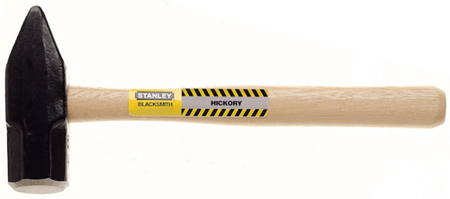
Blacksmith’s Hammer
The hammering surface is crowned. Designed for use in forming hot metal.
Notes:
Metal Working-Hammers (Metal) Image: Blacksmith Hammer.jpg Height: 106.08 Width: 240

Slide 40
Dead Blow Hammer
It does not absorb liquids or produce sparks when striking steel objects. Some models are weighted with lead shot.
Notes:
Metal Working-Hammers (Metal) Image: DeadBlowHammer.jpg Height: 59.04 Width: 180

Slide 41
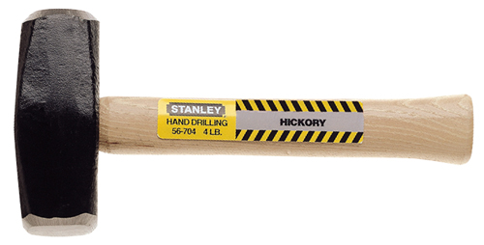
Hand Drilling Hammer
The head is made in three different sizes, 2, 3, and 4 pound. It has a short handle and can be used in tight places to drive punches and chisels.
Notes:
Metal Working-Hammers (Metal) Image: DrillingHammer.jpg Height: 121.92 Width: 240

Slide 42
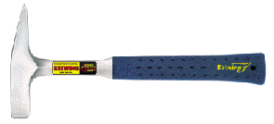
Tinner’s Hammer
The hammer head is beveled on one end and has a square face on the other.
Notes:
Metal Working-Hammers (Metal) Image: TinnersHammer.gif Height: 80.4 Width: 177

Slide 43
Sledge Hammer
Looks like engineers hammer but much larger. 6-12 pounds in weight.
Notes:
Metal Working-Hammers (Metal) Image: SledgeHammer.jpg Height: 52.8 Width: 240

Slide 44
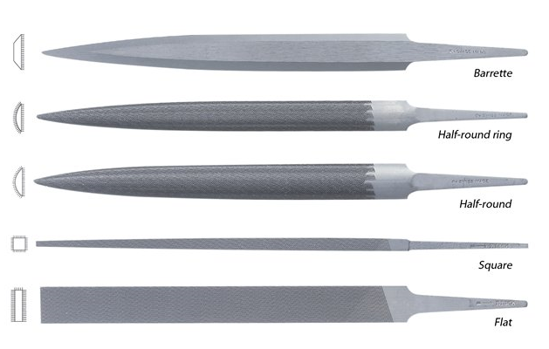
Metal File
Common Shapes: flat, mill, square, half round, round and three square (triangular). Common Coarseness Cuts (rough to smooth): bastard, second cut, smooth. Kinds of Teeth: Single Cut and Double Cut.
Notes:
Metal Working-Files, Threading, and Cutting Tools Image: Files1.jpg Height: 299.9625 Width: 471.6911

Slide 45
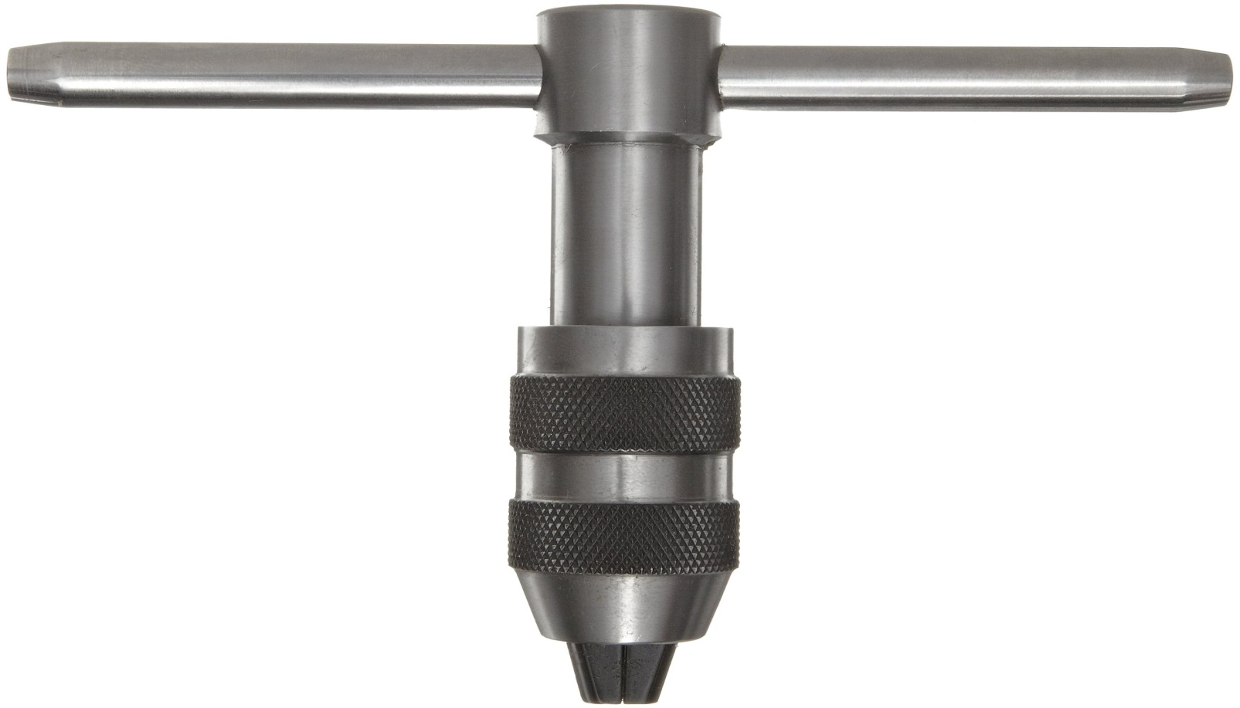
"T" Tap Wrench
"T" type tap wrenches have an adjustable chuck.
Notes:
Metal Working-Files, Threading, and Cutting Tools Image: TapWrench.jpg Height: 399.9272 Width: 700.6909

Slide 46
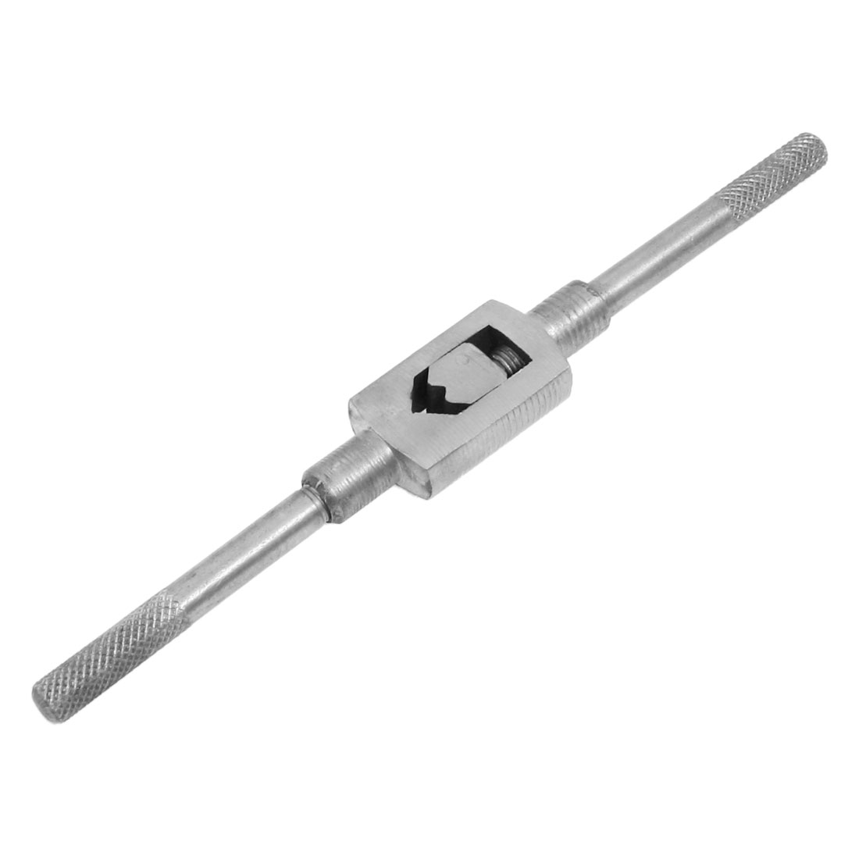
Tap Wrench
Used to hold the tap when threading.
Notes:
Metal Working-Files, Threading, and Cutting Tools Image: TapHandle.jpg Height: 660 Width: 660

Slide 47
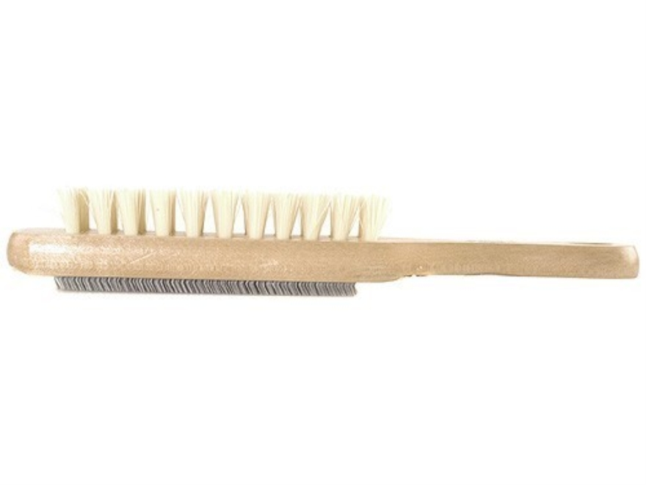
File Card
The card is a small fine wire brush.
Notes:
Metal Working-Files, Threading, and Cutting Tools Image: FileCard.jpg Height: 396 Width: 528

Slide 48
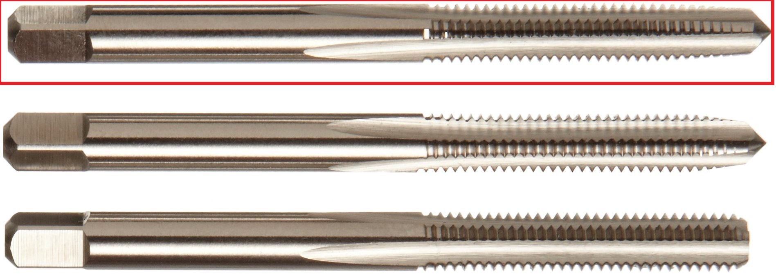
SAE Tap
Used to cut Society of Automotive Engineers or National Fine threads in bored holes and nuts.
Notes:
Metal Working-Files, Threading, and Cutting Tools Image: TaperTap.jpg Height: 507 Width: 1422.75

Slide 49
USS Tap
Used to cut United States Standard or National Coarse threads in drilled holes or nuts.
Notes:
Metal Working-Files, Threading, and Cutting Tools Image: USSTap.jpg Height: 132.75 Width: 1422

Slide 50
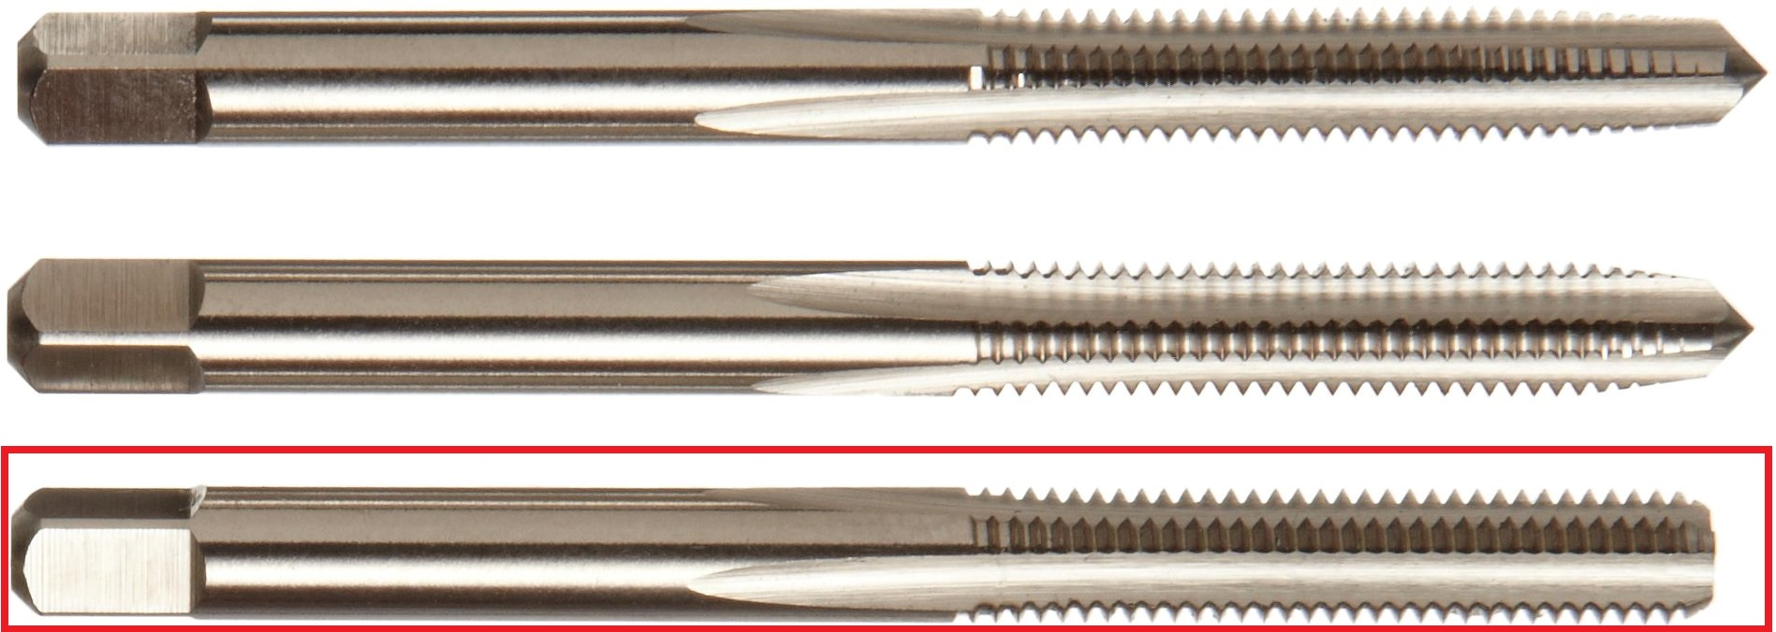
Bottoming Tap
Widely used in machine operations to complete a thread in a bottom of a hole.
Notes:
Metal Working-Files, Threading, and Cutting Tools Image: BottomTap.jpg Height: 507 Width: 1422.75

Slide 51
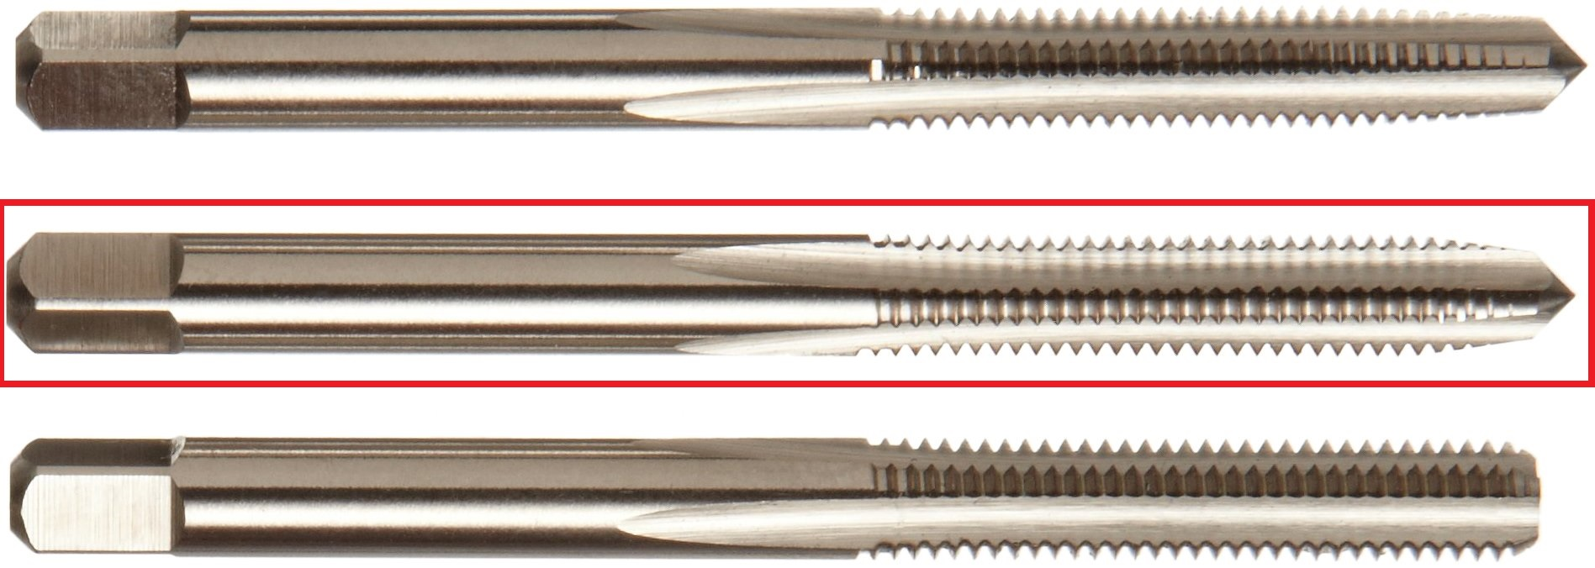
Plug Tap
Used to cut threads in machine operations.
Notes:
Metal Working-Files, Threading, and Cutting Tools Image: PlugTap.jpg Height: 507 Width: 1422.75

Slide 52
Taper Tap
Also used to start threads in a blind hole.
Notes:
Metal Working-Files, Threading, and Cutting Tools Image: TaperTap.jpg Height: 507 Width: 1422.75

Slide 53
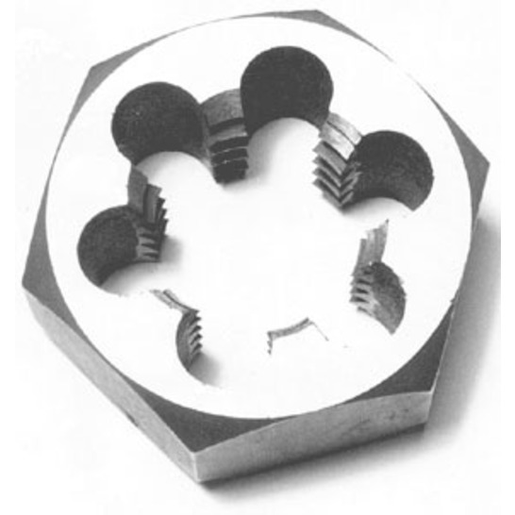
SAE Dies
Used to cut Society of Automotive Engineers of National Fine (NF) Threads on bolts.
Notes:
Metal Working-Files, Threading, and Cutting Tools Image: SAEDie.jpg Height: 147.7894 Width: 147.7894

Slide 54
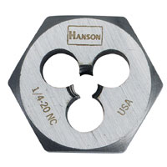
USS Die
The die cuts the male thread of a bolt or rod. USS also called National Course (NC) thread.
Notes:
Metal Working-Files, Threading, and Cutting Tools Image: USSDie.jpg Height: 120 Width: 120

Slide 55
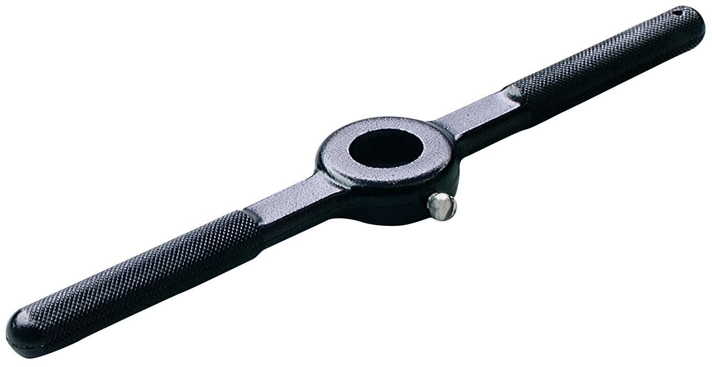
Die Stock
Used as a handle for dies.
Notes:
Metal Working-Files, Threading, and Cutting Tools Image: DieStock.jpg Height: 513 Width: 994.5

Slide 56
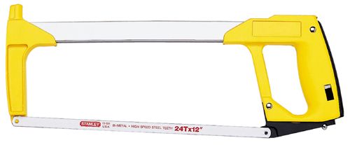
Hack Saw
The handle normally has a pistol type grip.
Notes:
Metal Working-Files, Threading, and Cutting Tools Image: hacksaw.jpg Height: 99.36 Width: 240

Slide 57
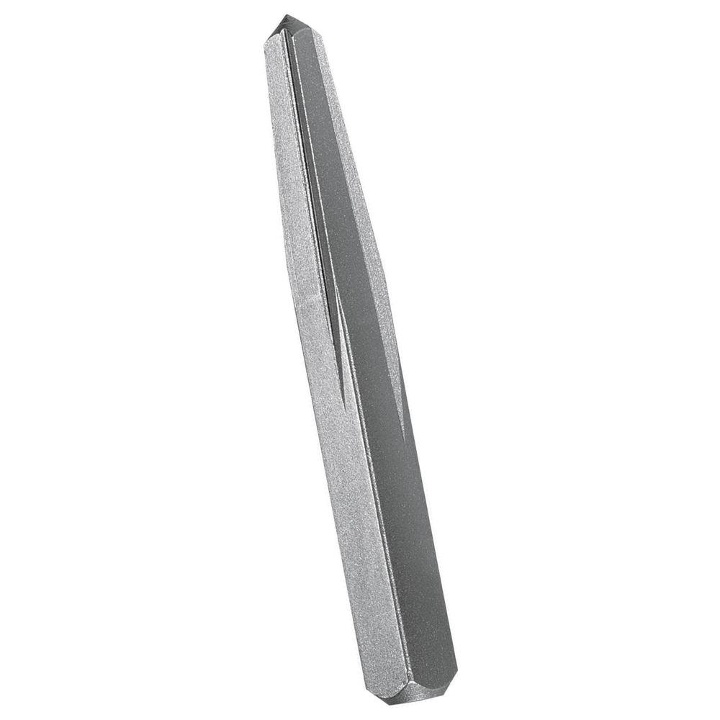
Screw Extractor
A hole is drilled in the center of the broken stud, and the extractor screwed into the hole in a counter clockwise direction. Also called an easy out.
Notes:
Metal Working-Files, Threading, and Cutting Tools Image: ScrewExtractor.jpg Height: 750 Width: 750

Slide 58
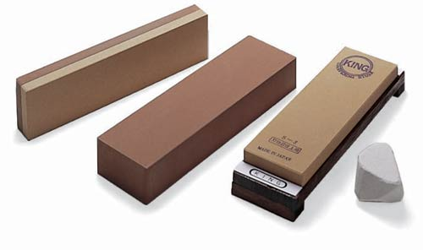
Whet Stone
Used for sharpening tools such as wood chisels and other tools to a fine edge.
Notes:
Metal Working-Files, Threading, and Cutting Tools Image: Shapening Stone.jpg Height: 177.6 Width: 300

Slide 59
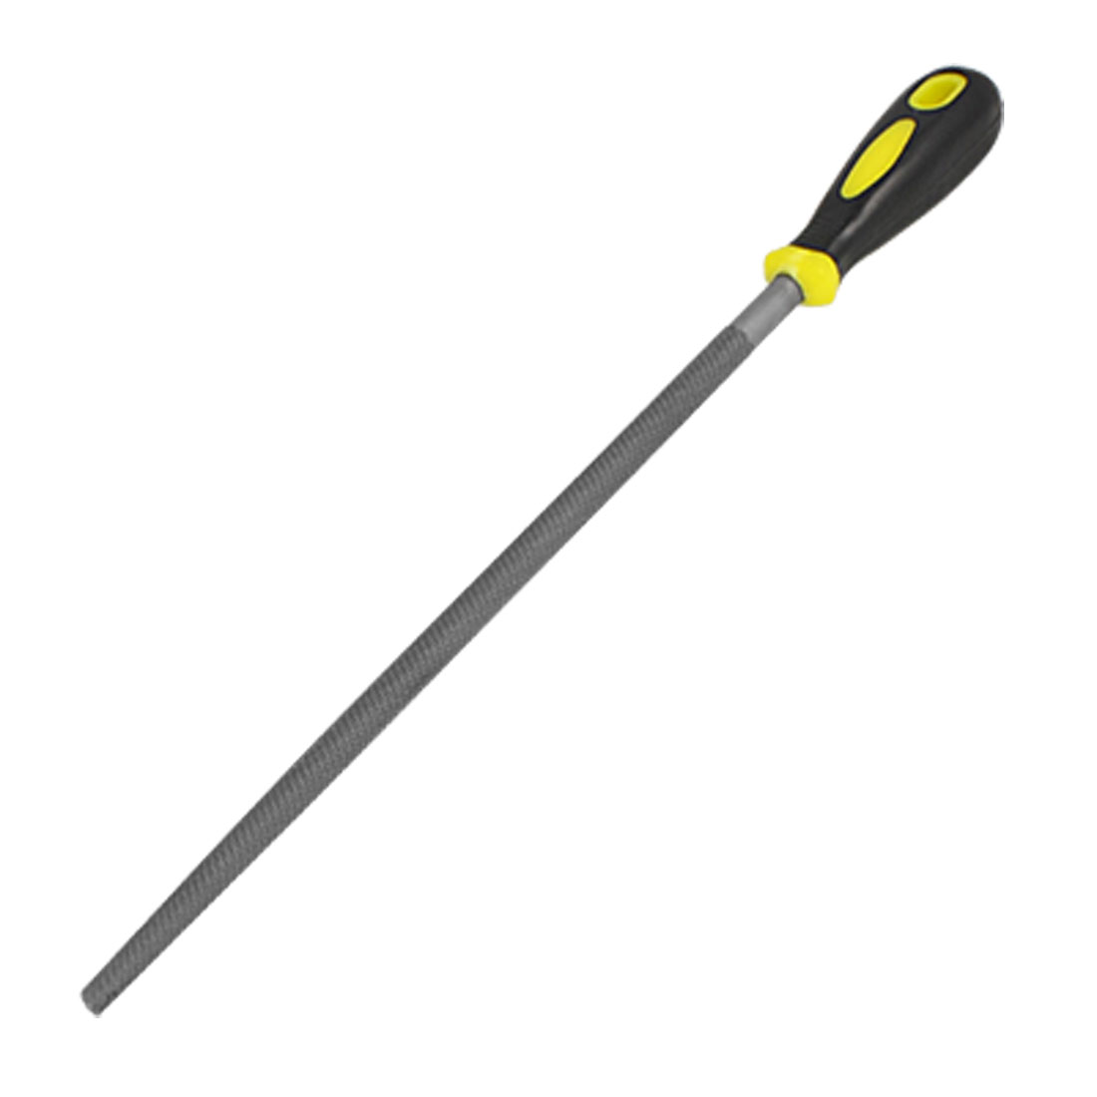
Round File
It is available 4 to 16 inches long and 3/16 to ¾ inches in diameter.
Notes:
Metal Working-Files, Threading, and Cutting Tools Image: RoundFile.jpg Height: 660 Width: 660

Slide 60
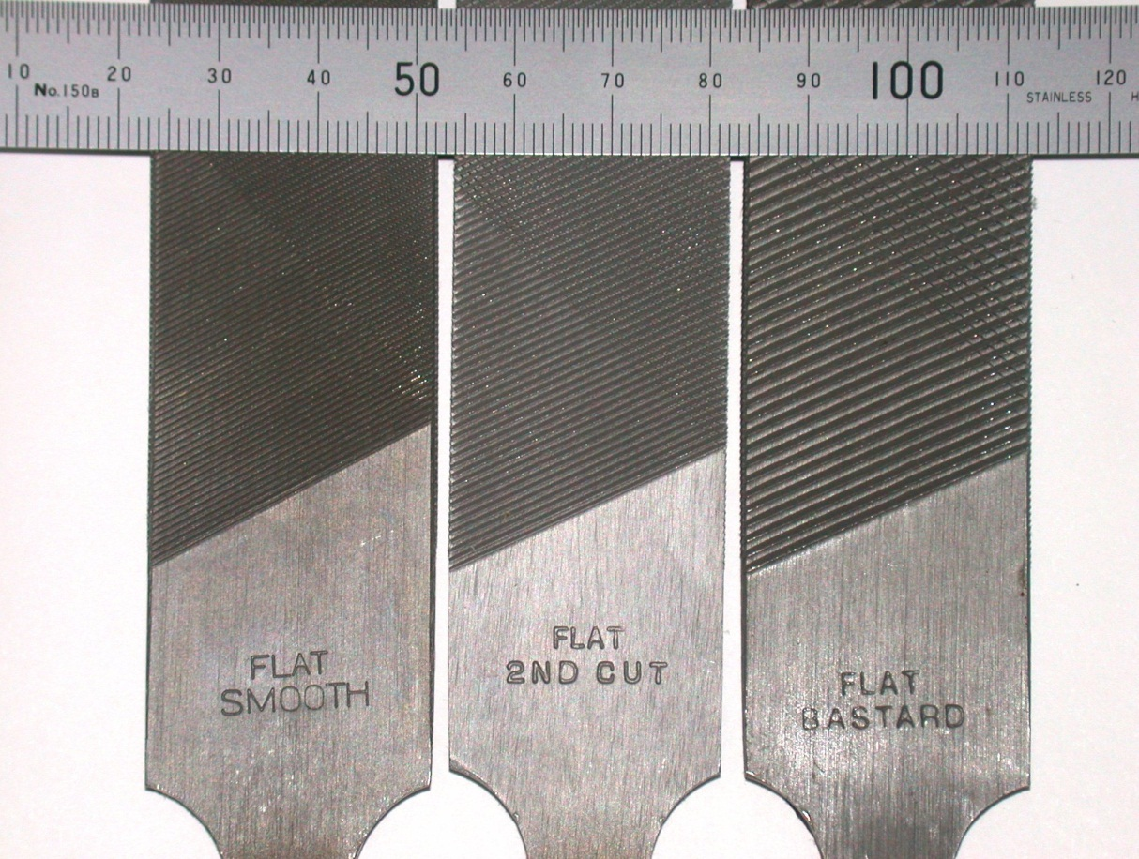
Single Cut File
It has a single series of teeth and is made in bastard cut, second cut and smooth type teeth.
Notes:
Metal Working-Files, Threading, and Cutting Tools Image: singleCutFile.jpg Height: 1533 Width: 2030

Slide 61
Flat Leg Pattern Dividers
Used For Precision Transferring Of Segments From Pattern To Pattern.
Notes:
Metal Working-Sheet Metal Tools Image: PatternDividers.jpg Height: 394.5 Width: 126

Slide 62
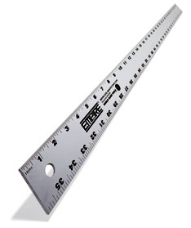
Sheet Metal Layout Rule
It also has circumference measurements on the back side.
Notes:
Metal Working-Sheet Metal Tools Image: SheetMetalRule.bmp Height: 167.4 Width: 140.4

Slide 63
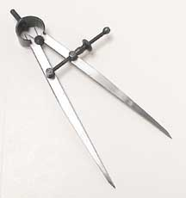
Wing Dividers
Divider Tips Are Adjustable By Loosening A Set Screw And Spreading The Tips Apart.
Notes:
Metal Working-Sheet Metal Tools Image: WingDivider.jpg Height: 230 Width: 216

Slide 64
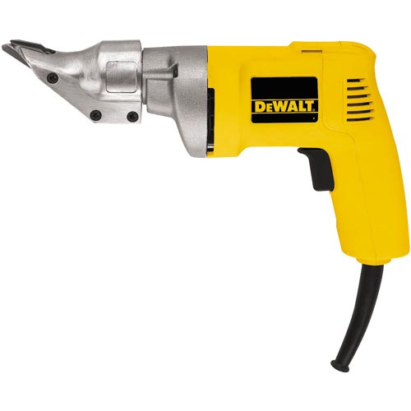
Shear
A powered hand tool used for cutting sheet metal up to 12 gauge.
Notes:
Metal Working-Sheet Metal Tools Image: Shear.jpg Height: 300 Width: 300

Slide 65
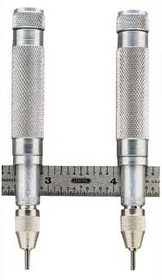
Adjustable Trammel Points
The trammel points can be adjusted to any point on the bar.
Notes:
Metal Working-Sheet Metal Tools Image: TrammelPoints.jpg Height: 207.6 Width: 120

Slide 66
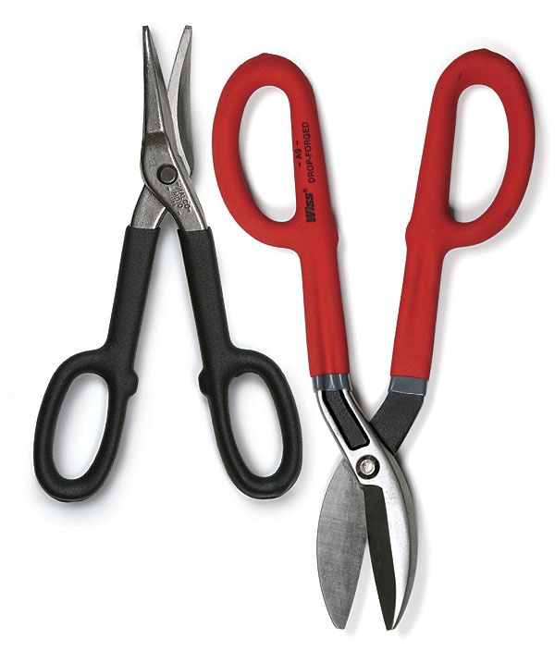
Tin Snip
There are four types available; regular straight snip, curved (left and right) snip, and duckbill snip.
Notes:
Metal Working-Sheet Metal Tools Image: snips.jpg Height: 528 Width: 450

Slide 67
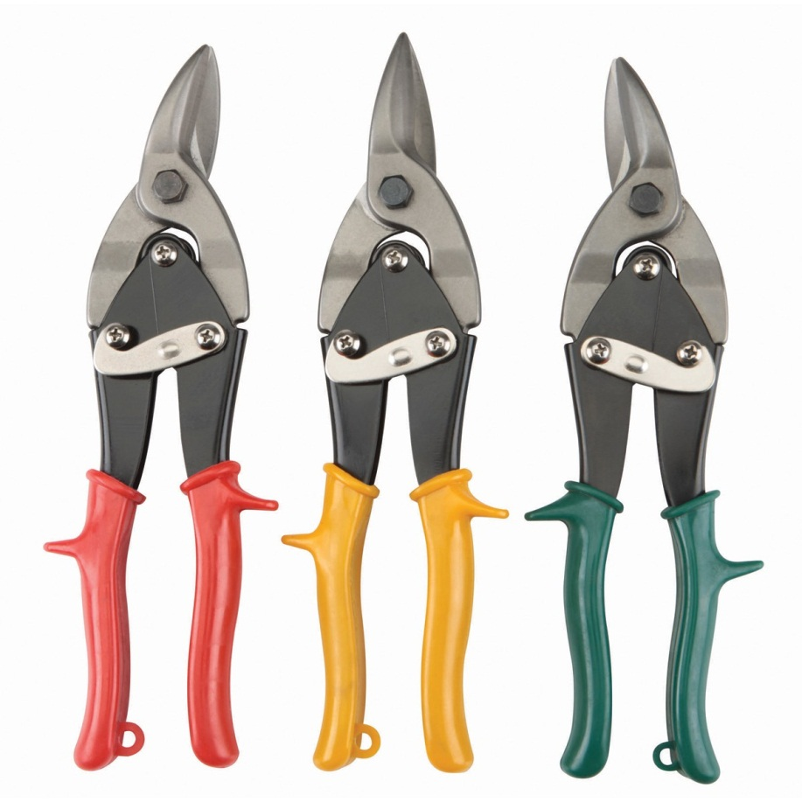
Aviation Snips
Available in straight, left, or right. Compound action makes cutting easier and the jaws are usually serrated. Also called Compound snips.
Notes:
Metal Working-Sheet Metal Tools Image: aviationSnip.jpg Height: 720 Width: 720

Slide 68
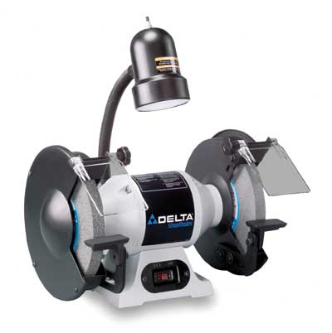
Bench Grinder
Used for sharpening and removing material. Stones are classified by diameter, width, and coarseness (i.e. 1" x 6" 80 grit).
Notes:
Metal Working-Power and Stationary Tools Image: grinder.jpg Height: 241.2 Width: 240

Slide 69
Hydraulic Shear
Powered by a hydraulic pump and cylinder these shears commonly can cut flat stock, angle iron, and punch holes.
Notes:
Metal Working-Power and Stationary Tools Image: HydShear.jpg Height: 313.8 Width: 202.8

Slide 70
Sheet Metal Shear
Foot operated shear
Notes:
Metal Working-Power and Stationary Tools Image: foot shear.jpg Height: 261 Width: 350

Slide 71
Brake
Used for bending sheet metal.
Notes:
Metal Working-Power and Stationary Tools Image: box brake.jpg Height: 253 Width: 350

Slide 72
Angle Grinder
Available in sizes from 2 to 9 inch. May be used with a grinding, sanding, or wire brush wheel.
Notes:
Metal Working-Power and Stationary Tools Image: AngleGrinder.jpg Height: 300 Width: 300

Slide 73
Cut Off Saw
Cutting wheels may be disposable or with teeth. Used for cutting steel bar and pipe.
Notes:
Metal Working-Power and Stationary Tools Image: CutoffSaw.jpg Height: 400 Width: 400

