Slide 1
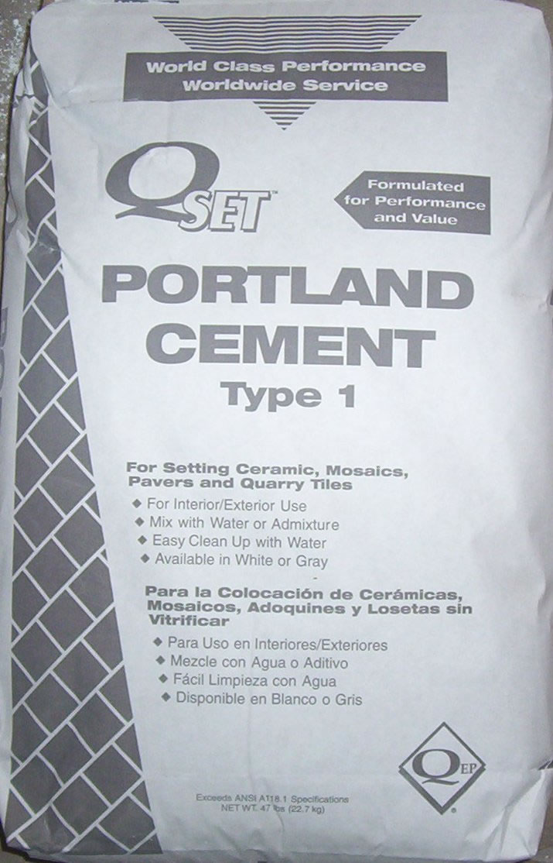
Portland Cement
Fine power made from limestone. Used to make concrete and mortar. Commonly sold in 94 lb. bags (1 cubic foot).
Notes:
Concrete-Concrete Tools And Supplies Image: Portland cement.jpg Height: 348.7305 Width: 223.8261

Slide 2
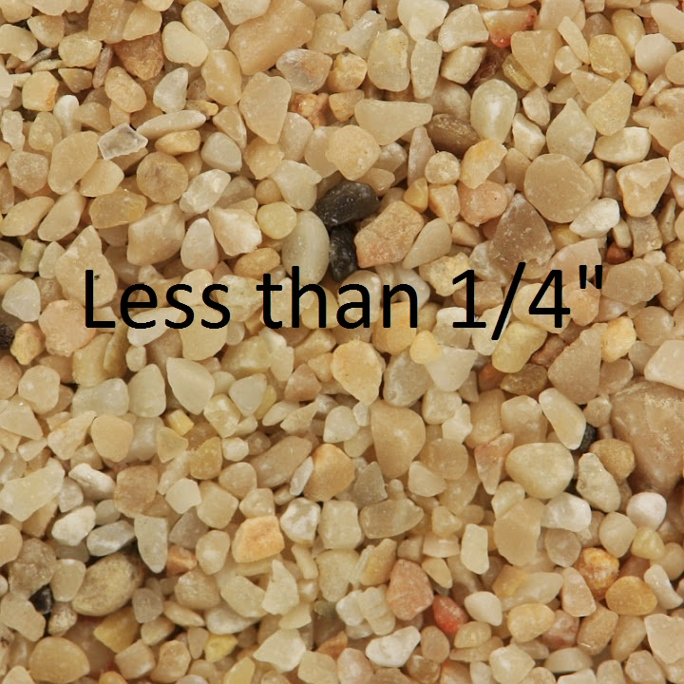
Sand
Fine aggragate less than 1/4" in size.
Notes:
Concrete-Concrete Tools And Supplies Image: sand.jpg Height: 540 Width: 540

Slide 3
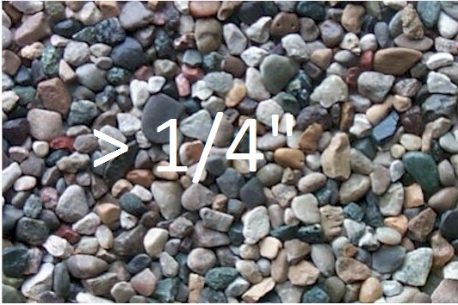
Gravel
Course Aggregrate greater than 1/4" and commonly less than 1 1/2" in size.
Notes:
Concrete-Concrete Tools And Supplies Image: Gravel.jpg Height: 265.5 Width: 399

Slide 4
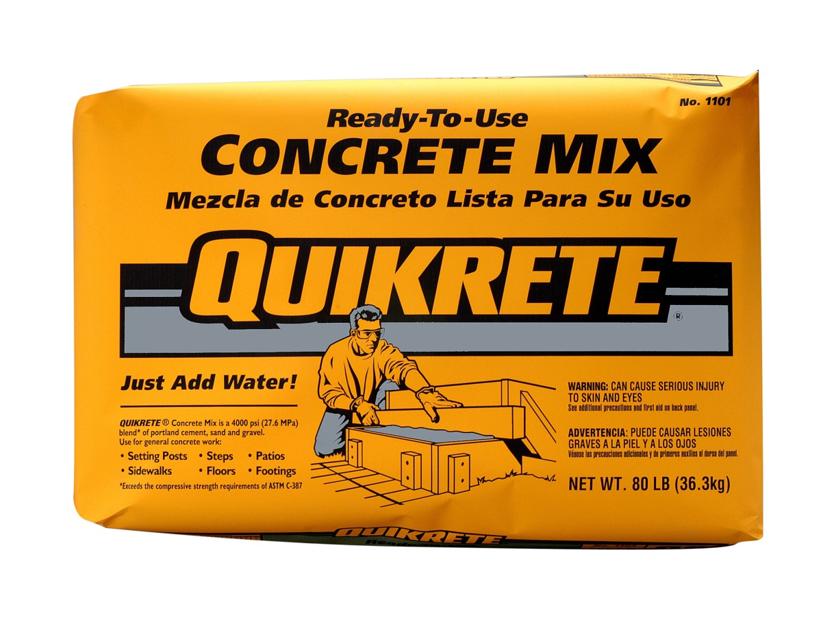
Concrete
A mix of cement, sand, and gravel. Typically in a ratio of 1:2:3 or 1:2:4. Used for building pads, sidewalks, and equipment pads.
Notes:
Concrete-Concrete Tools And Supplies Image: Concrete Mix.jpg Height: 916.2 Width: 1200

Slide 5
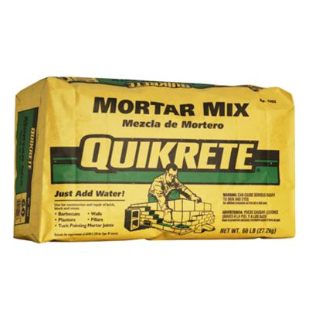
Mortar
A mix of cement, lime, and sand used to lay bricks or concrete blocks.
Notes:
Concrete-Concrete Tools And Supplies Image: Mortar.jpg Height: 240 Width: 240

Slide 6
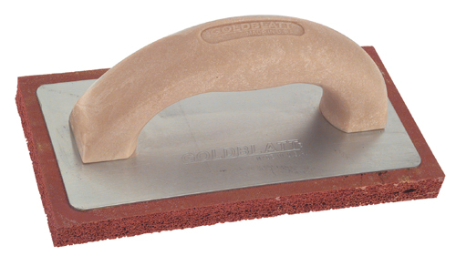
Sponge Rubber Float
Must be dipped continuously in water when working plaster to keep the plaster from adhering to the rubber.
Notes:
Concrete-Concrete Tools And Supplies Image: rubberFloat.jpg Height: 134.88 Width: 240

Slide 7
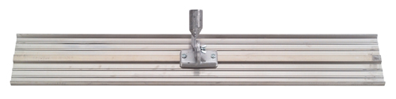
Bull Float
A large float with a long detachable handle. Made from wood or magnesium. Common sizes are 8 inches wide by 36 or 48 inches long.
Notes:
Concrete-Concrete Tools And Supplies Image: Bull Float.jpg Height: 60.48 Width: 240

Slide 8
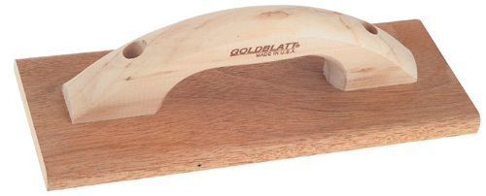
Hand Float
It is 4 to 5 inches wide and 13 inches long. Floats are used for rough finishing.
Notes:
Concrete-Concrete Tools And Supplies Image: Float.jpg Height: 96.96 Width: 240

Slide 9
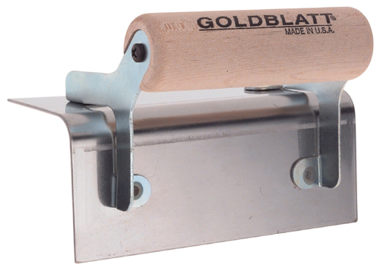
Corner Trowel
Size is 2 1/2 by 2 1/2 wide and 6 inches long. Used to finish corner in curbs, steps, etc. The handle placement determines if the trowel is outside or inside. Outside corner trowel is also called a step trowel.
Notes:
Concrete-Concrete Tools And Supplies Image: OutsideCorner.jpg Height: 169.44 Width: 240

Slide 10
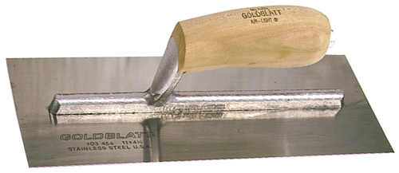
Finishing Trowel
The finishing trowel is made of steel and is 4 inches wide by 14 inches long.
Notes:
Concrete-Concrete Tools And Supplies Image: Finish Trowel.jpg Height: 104.16 Width: 240

Slide 11
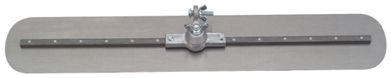
Fresno Trowel
This large finish trowel also has a long detachable handle.
Notes:
Concrete-Concrete Tools And Supplies Image: Fresno Trowel.jpg Height: 48 Width: 240

Slide 12
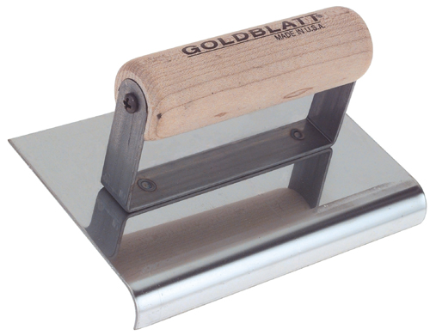
Concrete Edger
The ends may be curved up slightly. Used to finish the edges of concrete.
Notes:
Concrete-Concrete Tools And Supplies Image: Edge Trowel.jpg Height: 187.2 Width: 240

Slide 13
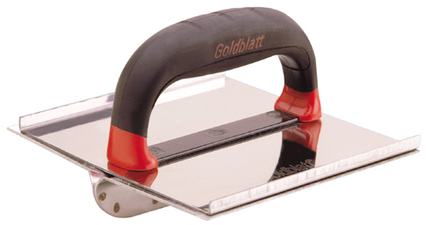
Groover
It is 2 7/8 inches wide and 6 inches long with the ridge being 1/2 inch deep and 1/2 inch wide. Use to place groves in concrete slabs.
Notes:
Concrete-Concrete Tools And Supplies Image: Grover.jpg Height: 126.72 Width: 240

Slide 14
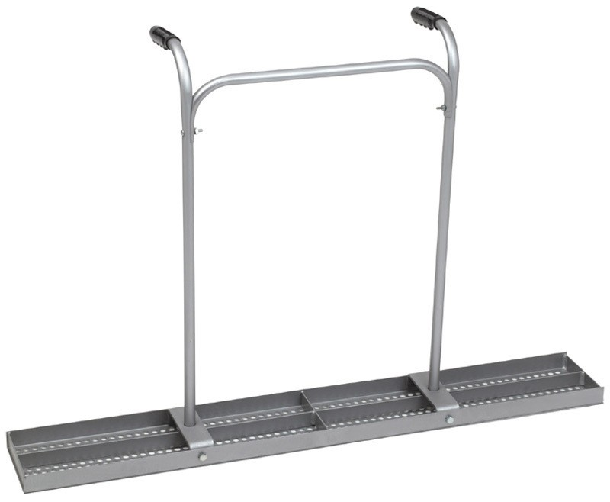
Concrete Tamper
A tubular steel frame handle is attached to the top which allows a person to operate the tamper while walking in the concrete. Also called a Jitterbug.
Notes:
Concrete-Concrete Tools And Supplies Image: marshalltown_tamper.jpg Height: 157.92 Width: 192

Slide 15
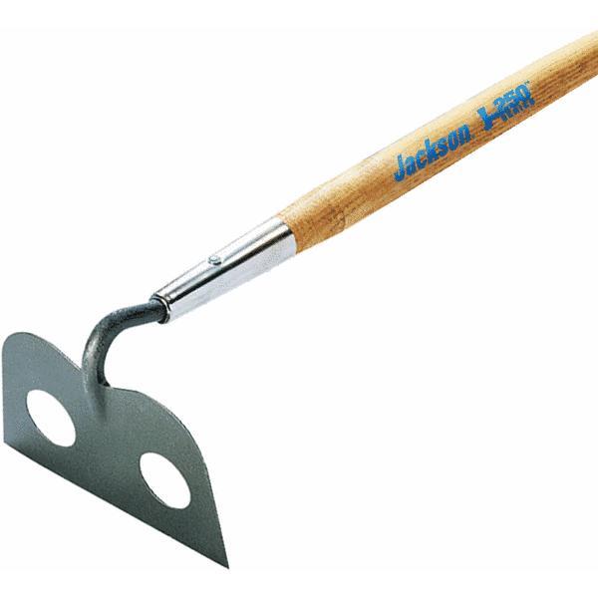
Mortar Hoe
It also has a 5 1/2 foot handle and holes in the hoe to aid mixing.
Notes:
Concrete-Concrete Tools And Supplies Image: MortarHoe2.jpg Height: 450 Width: 450

Slide 16
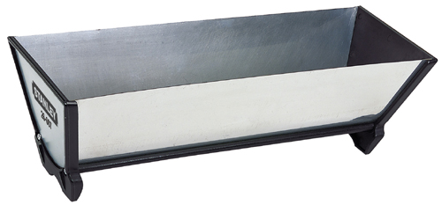
Mud Pan
Used mostly with small trowels or putty knifes.
Notes:
Concrete-Concrete Tools And Supplies Image: MudPan.jpg Height: 111.84 Width: 240

Slide 17
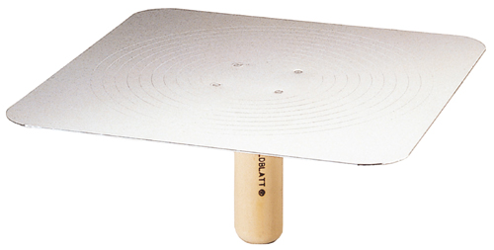
Hawks
The size is 13 x 13 inches square. Use to carry mortar.
Notes:
Concrete-Concrete Tools And Supplies Image: hawk.jpg Height: 121.44 Width: 240

Slide 18

Star Drill
It is operated by striking with a hammer while rotating by hand.
Notes:
Concrete-Concrete Tools And Supplies Image: StarDrill.jpg Height: 47.25 Width: 375

Slide 19
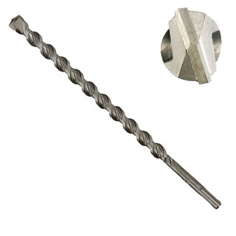
Masonry Bit
Used to drill in brick, block, and concrete. The tip is treated with tungsten carbide to resist heat and wear.
Notes:
Concrete-Concrete Tools And Supplies Image: MasonaryBit.jpg Height: 320 Width: 320

Slide 20
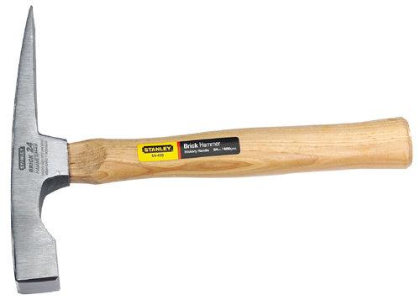
Brick Layer’s Hammer
The wedge shaped end is for scoring and cutting brick, and the other end is for tapping bricks into place when leveling.
Notes:
Concrete-Concrete Tools And Supplies Image: Brick hammer.jpg Height: 171.36 Width: 240

Slide 21
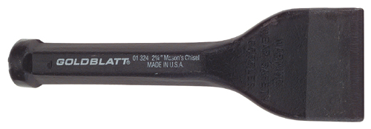
Brick Chisel
Blade is 3 1/2 inches wide, overall length is 7 inches.
Notes:
Concrete-Concrete Tools And Supplies Image: Brick Chisel.jpg Height: 83.52 Width: 240

Slide 22
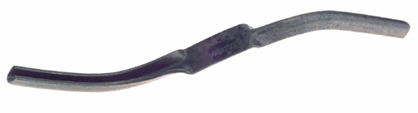
Brick Jointer
The jointer is bent at each end at about 20 degrees to allow the mason to use one end as a handle and the other as a jointer. The tool is used to finish the joints between bricks.
Notes:
Concrete-Concrete Tools And Supplies Image: Brick jointer.jpg Height: 65.28 Width: 240

Slide 23
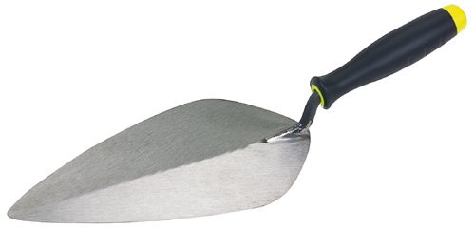
Brick Trowel
It is pointed and measures 4 ¾ inches by 11 inches.
Notes:
Concrete-Concrete Tools And Supplies Image: Brick Trowel.jpg Height: 115.68 Width: 240

Slide 24
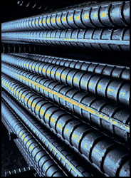
Reinforcing Bar
Available in 20, 30, and 40 foot lengths. Common sizes (diameter) of 3/8" to 1" are use in small construction projects.
Notes:
Concrete-Concrete Tools And Supplies Image: Rebar.jpg Height: 250 Width: 184

