Slide 1
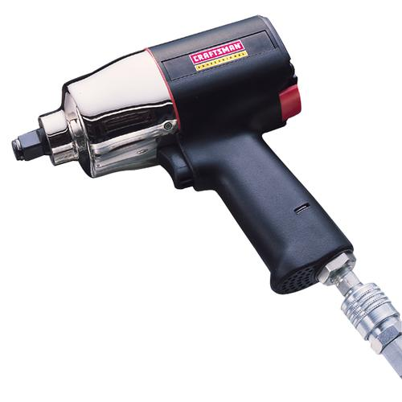
Impact Wrenches
Available in 3/8, 1/2 and ¾ inch drive.
Notes:
Power Mechanics-Power Mechanics Tools Image: ImpactWrench.jpg Height: 500 Width: 500

Slide 2
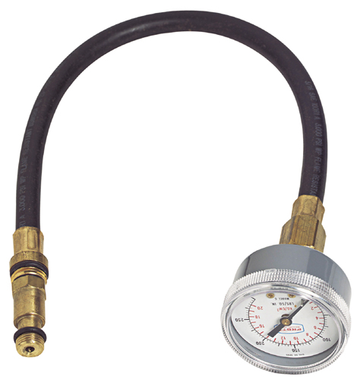
Compression Gauge
Ranges from 0 to 300 pounds.
Notes:
Power Mechanics-Power Mechanics Tools Image: CompressionGauge.jpg Height: 240 Width: 227.52

Slide 3
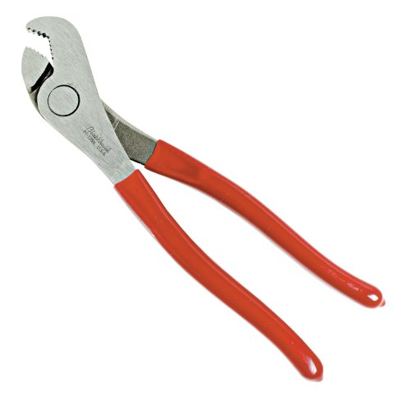
Battery Pliers
Used for removing battery terminals. The end clearance prevents cell-cover damage.
Notes:
Power Mechanics-Power Mechanics Tools Image: BatteryPliers.jpg Height: 240 Width: 235.2

Slide 4
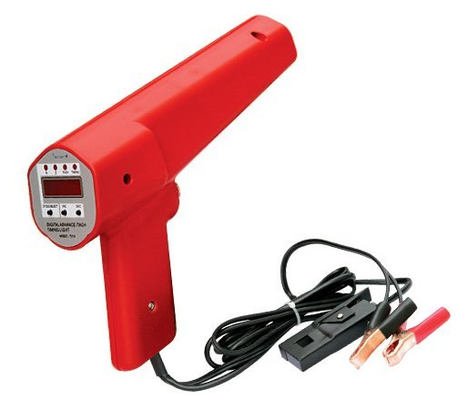
Power Timing Light
Operates on 6 or 12 volt DC producing a blue-white flash for reading of timing mark.
Notes:
Power Mechanics-Power Mechanics Tools Image: TimingLight.jpg Height: 439 Width: 503

Slide 5
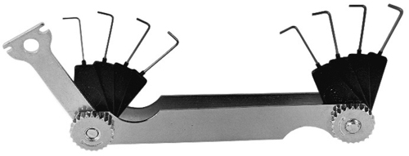
Spark Plug Gauge Set
Usually ranges from .020 to .040 thick wire sizes.
Notes:
Power Mechanics-Power Mechanics Tools Image: SparkGauge.jpg Height: 91.68 Width: 240

Slide 6
Torque Wrench
Comes in 1/4, 3/8, 1/2, and ¾ inch drives.
Notes:
Power Mechanics-Power Mechanics Tools Image: TorqueWrench.jpg Height: 75.36 Width: 240

Slide 7
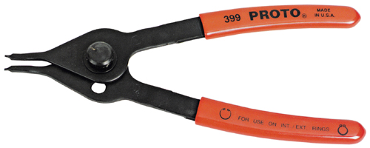
Retaining Ring Pliers
User for remove and install internal and external retaining (snap) rings.
Notes:
Power Mechanics-Power Mechanics Tools Image: RetainingRingPliers.jpg Height: 96 Width: 240

Slide 8
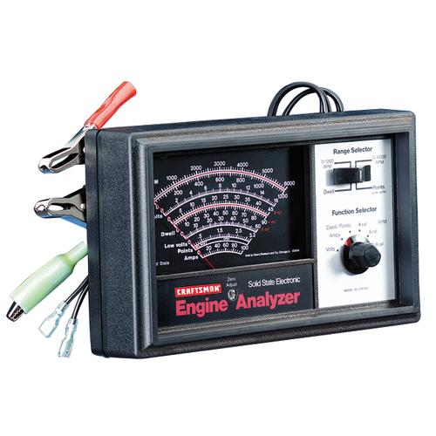
Tachometer
Useful for checking speed on tools, machines, and engines.
Notes:
Power Mechanics-Power Mechanics Tools Image: Tach.jpg Height: 500 Width: 500

Slide 9
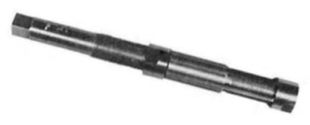
Expansion or Adjustable Reamer
Used for reaming piston pin holes, king pin holes, holes for water pump bushings, valve stem guides and other precision reaming jobs.
Notes:
Power Mechanics-Power Mechanics Tools Image: ExpReamer.jpg Height: 84 Width: 207.36

Slide 10
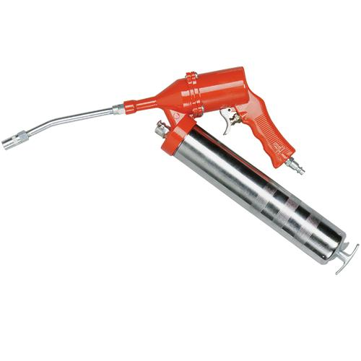
Air Pressure Type Grease Gun
It is portable but must be attached to an air line.
Notes:
Power Mechanics-Grease Guns And Fittings Image: PneumaticGreaseGun.jpg Height: 500 Width: 500

Slide 11
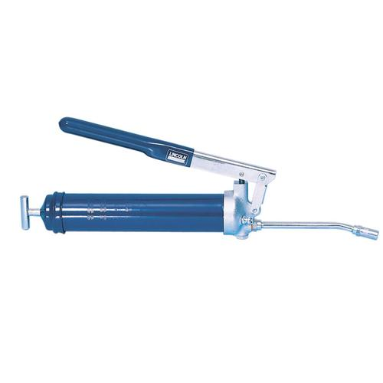
Lever Type Grease Gun
It is filled by hand, cartridge, or from an air pressure gun.
Notes:
Power Mechanics-Grease Guns And Fittings Image: LeverGreaseGun.jpg Height: 500 Width: 500

Slide 12
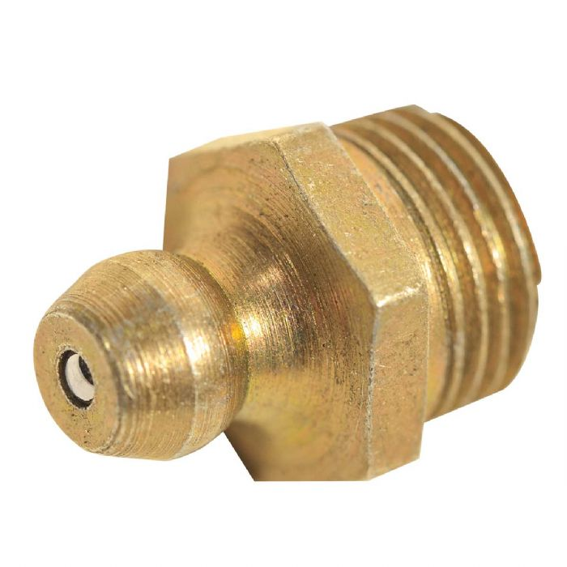
Zerk Grease Fitting
This fitting will withstand high pressure. The grease gun "snaps on" to the fitting.
Notes:
Power Mechanics-Grease Guns And Fittings Image: Zerk.jpg Height: 420 Width: 420

